Slide 1
Guidelines and template for A vital statistics report
Vibeke Oestreich Nielsen
Head of Division for Development Cooperation
Statistics Norway
von@ssb.no

Slide 2
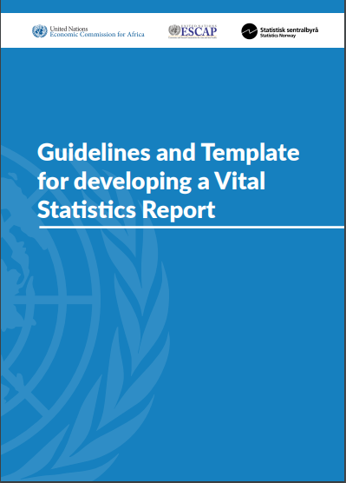
Purpose
To serve as a practical guidance tool for producing vital statistics reports (VSR) based on data from civil registration systems.
http://apai-crvs.org/resources/publications.
Notes:
Countries requested for a practical tool
ECA and ESCAP asked Statistics Norway to develop
Feedback received from countries, ECA/ESCAP as well as international partners

Slide 3
Background
Countries requested for a practical tool
ECA and ESCAP asked Statistics Norway to develop
Feedback received from countries, ECA/ESCAP as well as international partners

Slide 4
Considerations/focus
Aimed at countries with limited prior experience in publishing statistics based on CR
Focus on system description and data quality
Most on births and deaths

Slide 5
Report set-up
Guideline
Template
Boxes
Boxes
Notes:
Template-for countries to use directly if they want (will also be available in word format)
Guidelines: About the template and how to use it – and info boxes
An attempt to make a generic VS report which the user can use to fill in text, charts and numbers about his/her own country

Slide 6
Part 1: Guidelines
I. Purpose
II. Rationale
III. Target audience and important considerations
IV. Link with other activities
V. Initial focus on key vital events
VI. Reasons for publishing a Vital Statistics Report
VII. How to use this document
As well as guidance boxes throughout

Slide 7
Boxes
(a few examples)
Confidentiality of data
Civil registration and population registers
General and country examples of incentives and disincentives for civil registration
Coverage and completeness
Presentation of data
Key birth registration variables
Calculating birth indicators
Expected population size
Civil registration and vital statistics organization
Sub-counties and civil registration office overview for Kenya
Timeliness of birth registration
Examples of graphs and maps showing completeness of birth registration
Country examples of birth registration tables and graphs
Examples of tables and figures on marriages and divorces

Slide 8
Part 2: Template outline
Chapter 1. Introduction and Background
Chapter 2. Civil Registration System of the Country
Chapter 3. Data Quality, Completeness and Definitions
Chapter 4. Births
Chapter 5. Deaths
Chapter 6. Causes of death
Chapter 7. Marriages and Divorces
Chapter 8. Summary Tables

Slide 9
Chapter 2:
Civil Registration system of the country
2.1 History
2.2 Legal and administrative issues
2.3 Organizational structure, registration process and information flows
2.4 Incentives and disincentives for registration
Length and content will depend on availability of previous descriptions and demand by users.
Possible to use comprehensive assessments as source
Notes:
Describe the CR system, including history, legal background, administrative structure, local and regional systems, data flows, relationship between the CRVS authorities and agencies, incentives and disincentives for civil registration, and plans for further improvement of CRVS.
The length of this chapter would depend on previous descriptions of the system and the capacity of the office.

Slide 10
Chapter 3:
Data quality, completeness and definitions
3.1 Quality of data
3.2 Completeness
3.2.1. Completeness by group
3.2.2. Completeness rates over time
3.3 Definitions and specifications

Slide 11
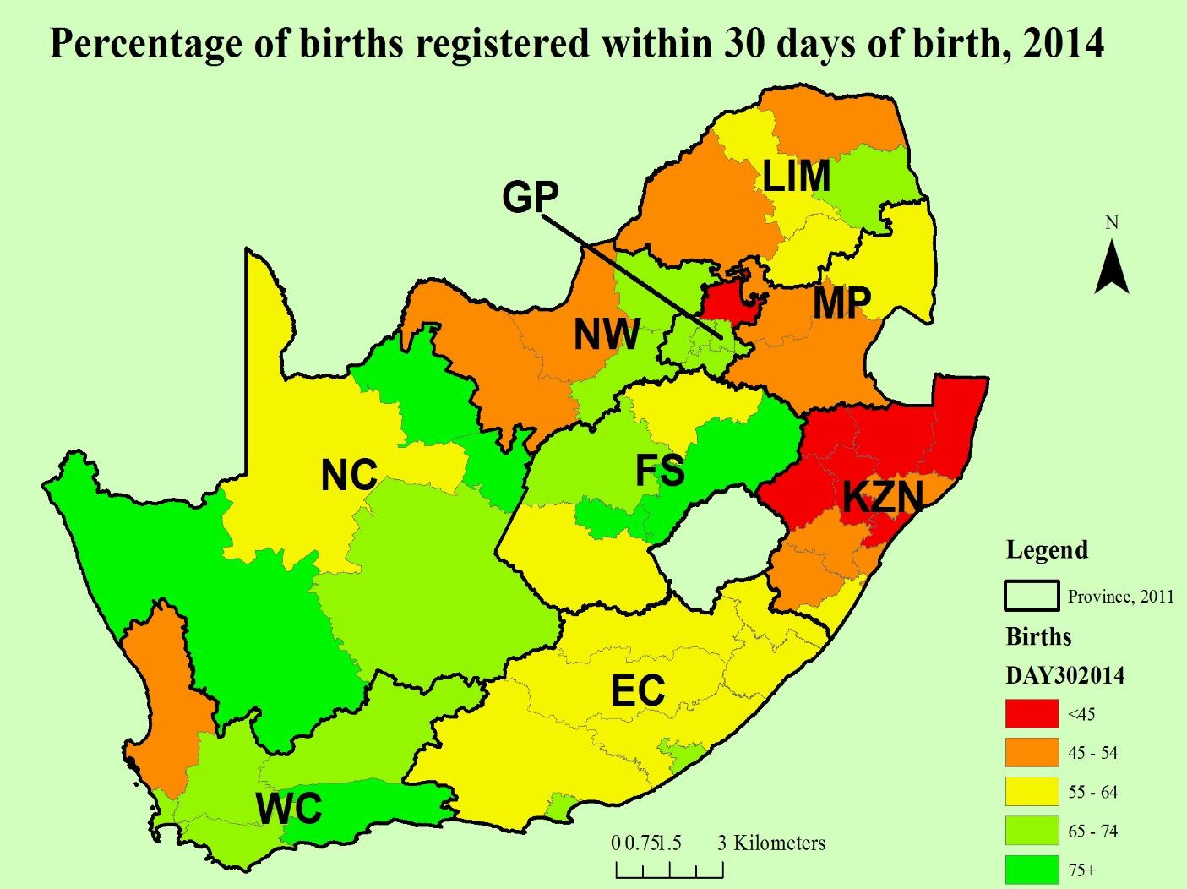
Birth registration completeness
South Africa 2015
Source: Statistics South Africa (2015a).

Slide 12
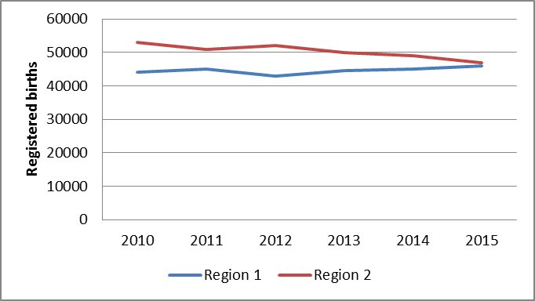
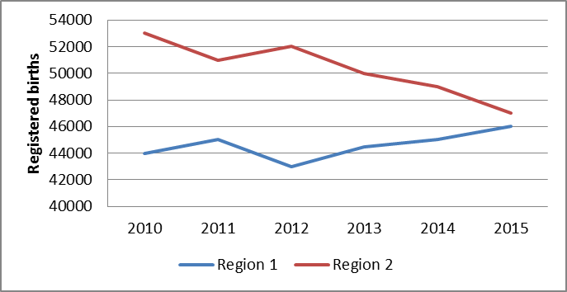
Box 14: Presenting data
The data are the same
Why do the figures look different?
Which would you use?

Slide 13
Chapters 4 to 7: Vital Statistics
Key registration variables
Key indicators and calculation
Template tables
Selected examples

Slide 14
Template table: Registered live births by place of occurrence, 20xx– 201x
 | Total | Health facility | At home | Other
:
2012
2013
2014

Slide 15
Table 5.1 Registered deaths by age and gender, 201x
 | Total | Male | Female
0
1-4
5-9
10-14
15-19
20-24
…
…
95-99
100+
Not known
Total

Slide 16
Annexes
List of civil registration variables
List of tabulations
Notification and/or registration forms for births and deaths
Other relevant CRVS forms and documents, including forms for sending aggregate numbers to the NSI

Slide 17
Availability of variables
Birth registration variables
Number | Topic | Available from civil registration of birth | Available from other sources | Not available | Year(s) available
(i) | Characteristic of the event
a | Date of occurrence | Yes |  |  | 2007-2015
b | Date of registration | Yes |  |  | 2010-2015
c | Place of occurrence |  | Yes
d | Locality of occurrence |  |  | X
e | Urban/rural occurrence
f | Place of registration
g | Type of birth (i.e., single, twin, triplet, quadruplet or higher multiple delivery)
h | Attendant at birth
i | Type of place of occurrence (hospital, home, etc.)

Slide 18
Tabulation plan
Table num­ber | Num­ber in the UN P&R | Table content | Pos­­sible: Yes/ No | Possible if civil registration data are com­­bined with data from other sources | Year(s)
 |  | First priority tables
4.1 | IB-1 | Total number of live births by sex, incl. sex ratio at birth and site of deliveryª
4.2 | ST-3 | Live births by place of residence¹ and urban–rural residence of the motherª
4.3 | LB-9 | Live births by age of mother (15-19, 20-24 … 45-49)
4.4 | LB-1 | Live births by place of occurrence and sex of childª
4.5 | LB-2 | Live births by place of occurrence and place of usual residence of mother

