Slide 1
Republic of Sudan
Ministry of interior
police forces headquarter General administration of the civil rolls

Slide 2
Sudan Overview
30 Million Population (More than 60% of the Population is under 24 Years of age)
(35%) Urban Population
A Federal System with (18) States.
A gate way between North, East and Central Africa.
NORTHERN ESTATE
RED SEA
NORTHERN DARFUR
NAHR ELNIL STATE
NORTH KORDOFAN
KHARTOUM
KASSALA
WEST DARFUR
ELGEZIERA
WHITE NILE
EL GEDARIF
WEST KORDOFAN
SENNAR
SOUTH DARFUR
SOUTH KORDOFAN
BLUE NILE

Slide 3
Sudan Overview
Sudan is a vast country, it is the third largest country in Africa, after Algeria and DR Congo, The length of Sudan's borders is 6,751 kilometers. surrounded by 7 different countries. Border countries are:
Central African Republic (175 km),Chad (1,360 km), Egypt (1,275 km),Eritrea (605 km),Ethiopia (769 km), Libya (383 km) South Sudan (2,184 km).
It is definitely a very unique situation, with this:
Almost all the inhabitances near the stretching borders are nomadic tribes, who truly have no motivations towards the politically drawn borders
Also we find a lot of Refugees and asylum seekers originate from the neighboring countries, due many different reasons
3

Slide 4
The Strategy
With all above in mind, the Sudan since 1998 planned a very strict strategy to insure the Sudanese Nationality, and to highly secure the National Identification methods of the citizens and inhabitants.
The Vision was to adopt the latest IT technologies available to fulfill and produce the most modern Citizen Identification documents, by:
Registration of citizens and theirs vital events.
Registration of foreigners and Refugees (with vital events).
Granting a Unique National Id Number .
Hence :
4

Slide 5
The Strategy
Build of the required infrastructure
Issuance of the National Identity Cards
Issuance of vital events certificates
The most important aspects of the message of the strategy were, compliance with the latest International standards and regulations, putting in mind the impact on:
Environmental constrains
Security issues
Social, Economical and Political prevailing situations
Modernization of the services offered to our citizens
Improvement of life style and standards
5

Slide 6
The Strategy
The Ministry of Interior of the Republic of the Sudan confronted these difficult aspects, in order to pave the paths towards stricter national security and a better e-governance services.
6

Slide 7
The Civil Registration System

Slide 8
CRS is the Heart of the e-Government Systems
Other Applications and Systems
Automated Border Control System (ABCS)
National Identity Card System (NIDS)
Automated Fingerprint Identification System
(AFIS)
National ID No.
E-Passport
System
Outside world Web based
CRS
E-Government
National ID No.
Other MoI Applications and Services
Communication Network CNS
Data Backup, Warehousing & DRC Solutions

Slide 9
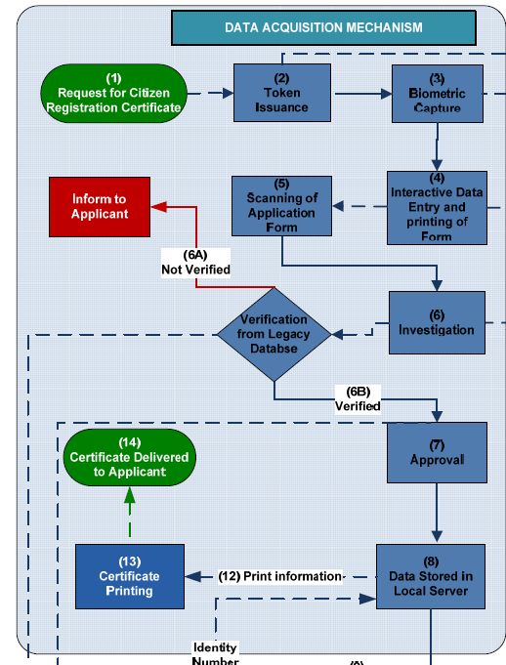
The Civil Registration System
9

Slide 10
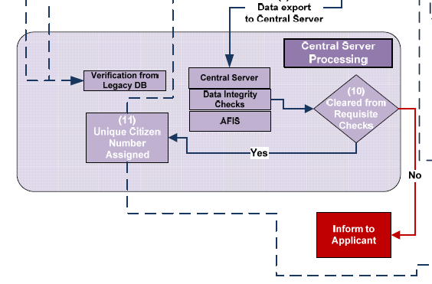
The Civil Registration System
10

Slide 11
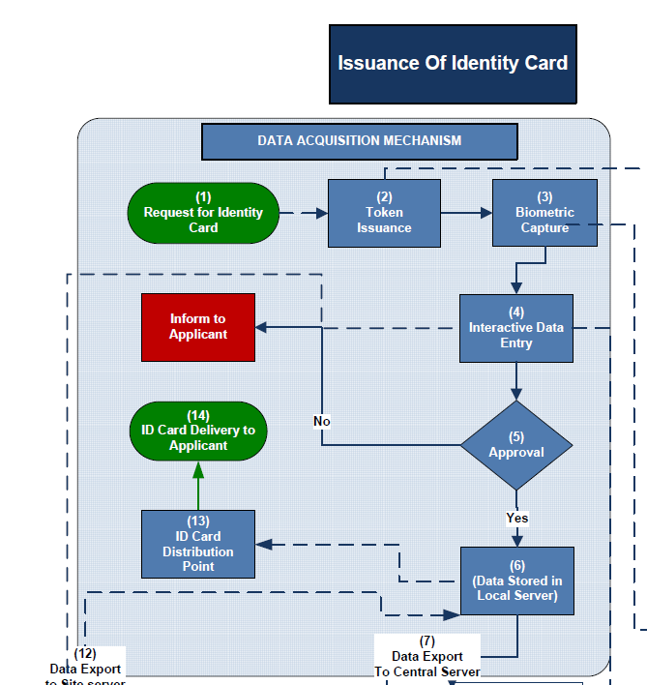
The ID System
11

Slide 12
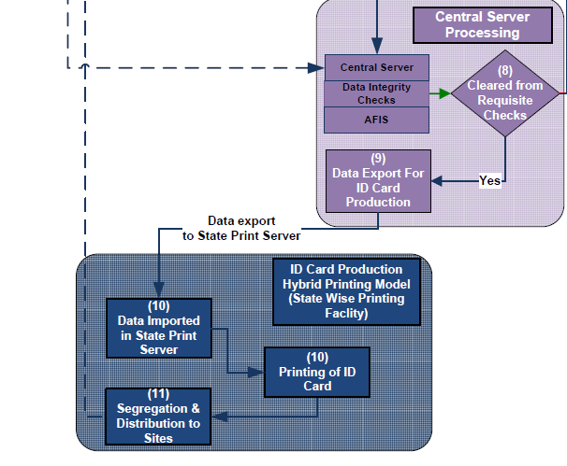
The ID System
12

Slide 14
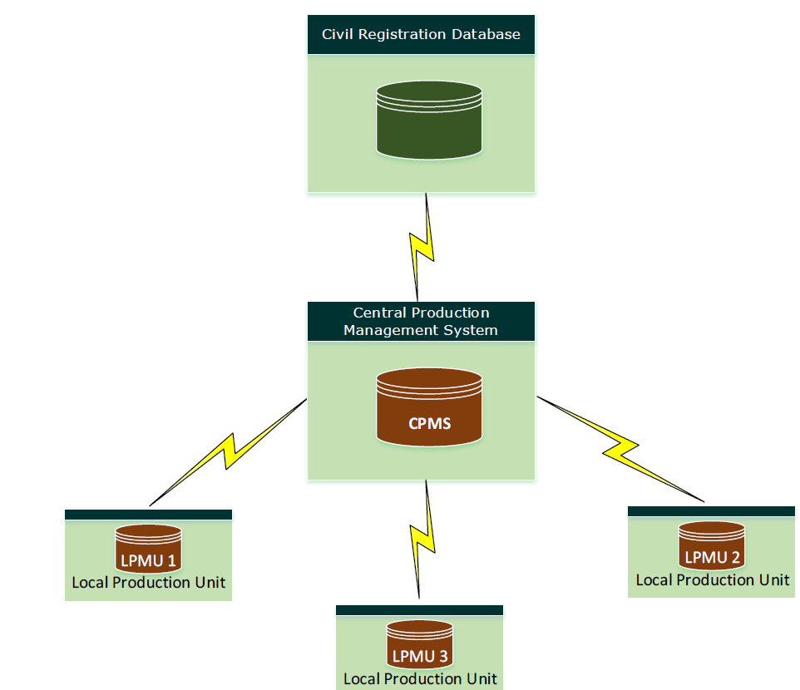

Slide 15
Civil rolls project
The aim of the Civil Registry Department is to register all individuals present on the territory of Sudan in a central national database. The Civil Registry also intends to keep the central database updated with four events: births, deaths, marriages and divorces. The events will be recorded through continuous registration which will take place at government institutions dealing with the particular events as well as Civil Registry offices across the country.

Slide 16
Civil rolls project
The registration of Sudanese nationals and the issuance of the national number were commenced in Khartoum in May 2011. The procedure has since rolled out to most of the states in Sudan through the establishment of permanent Civil Registration Centres in each state capital. Teams using mobile registration units have been deployed outside the state capitals to reach populations in remote areas.

Slide 17
The objectives
Protecting and adjusting the Sudanese identity.
Establishing central database for the population.
To proof the familial origins, families connections and setting the inheritance.
To continuously register, update and analyze the information.
Issuing the identification documents and protecting them against counterfeiting and forgery.
Coordinating with the other relevant bodies.
The civil rolls is considered as a referential record that helps in preparing the lists for the political participations and in the other citizens rights that need it.

Slide 18
The social importance of the civil rolls project
Realizing the social justice by providing the basic services continuously.
Developing the services and providing it through advanced means to save the citizen time and efforts.
Organizing the familial and social relationships.
To be able to determine the genealogy and the familial origins.
To be able to determine the inheritance’s relationships.
The advanced social planning for social development purposes.
Better educational and health planning as the civil rolls provides statistical indicators of the population with high potentials that help in combating the negative phenomena as fast as possible.
Enable the state to develop the luxurious expenditure and provide services and aids to the different sectors of the population.

Slide 20
Networks and communications
A communication network has been built to meet the requirements of the working operating system.
The most important features of the network:
- to cover the whole Khartoum state via wireless communication network with high and advanced technical standards with a large transmission capacity and a good insurance means. It also provides a backup network that uses SHEDSL techniques presented by the Sudanese telecom.
- to complete connecting the civil rolls offices in the northern states via wired network using the frame relay or SHDSL techniques as available.
- using the fiber optics to connect all the civil rolls links together with the center.

Slide 21
Data center
The data center has been well prepared with standards corresponding with the real needs of the civil rolls project particularly in the following:
- the large total storage capacity of the data center.
- the huge rapidity of data processing centrally.
- securing the data through the encryption, the backups and disaster recovery center, etc.
- supporting and reinforcing the center with a qualified technical cadre who has high qualifications and long and excellent experience in order to settle the technology.

Slide 22
AFIS
The international system AFIS ( Automated Fingerprints Identification System) has been used to link the operations of the passports, civil rolls, the criminal fingerprints and the other systems used in the interior ministry.
The Automated Fingerprint Identification System (AFIS) is a biometric identification (ID) methodology that uses digital imaging technology to obtain, store, and analyze fingerprint data.

Slide 23
The national number
A model of the Sudanese's national number has been developed and promoted. It consists of 11 numbers distributed as follows:
* three digits for the registration office.
* seven random digits connected with the registration office.
* one check digit.
1 1 | 1 0 | 9 | 8 | 7 | 6 | 5 | 4 | 3 | 2 | 1
n¹¹ | n¹⁰ | n⁹ | n⁸ | n⁷ | n⁶ | n⁵ | n⁴ | n³ | n² | n¹
Registration office
A single random digit
Check digit

Slide 24
National card production center
The center is equipped with 18 machines that produce the national cards and receives the requests for the accredited cards through the data center, and perform the following jobs:
- produce the national identification cards.
- carry out the quality tests operations.
- sending the cards to the registration centers automatically.

Slide 25
Registration centers
The registration center is the main front., through which civil rolls is performing his jobs in:
* the basic registration.
* registering the civil status chronicles.
* issuing the national identification cards.
* delivering the produced cards and the civil registration certificates.
the registration centers divided into:
Movable centers ( a well prepared car working as movable center).
Fixed centers ( buildings).

Slide 27
Thank You
Dr : Haj hamed Abd almalik

