Slide 1
GCC Stat Initiatives on Civil Registration and Vital Statistics in GCC Countries
2018م

Slide 2
Outline
Background
Priority Statistical Fields
Importance of Vital statistics in GCC Countries
Collecting data of Vital Statistics
Harmonization
Capacity Building
Vital Statistics in 2020 Census
Dissemination
2018م

Slide 3
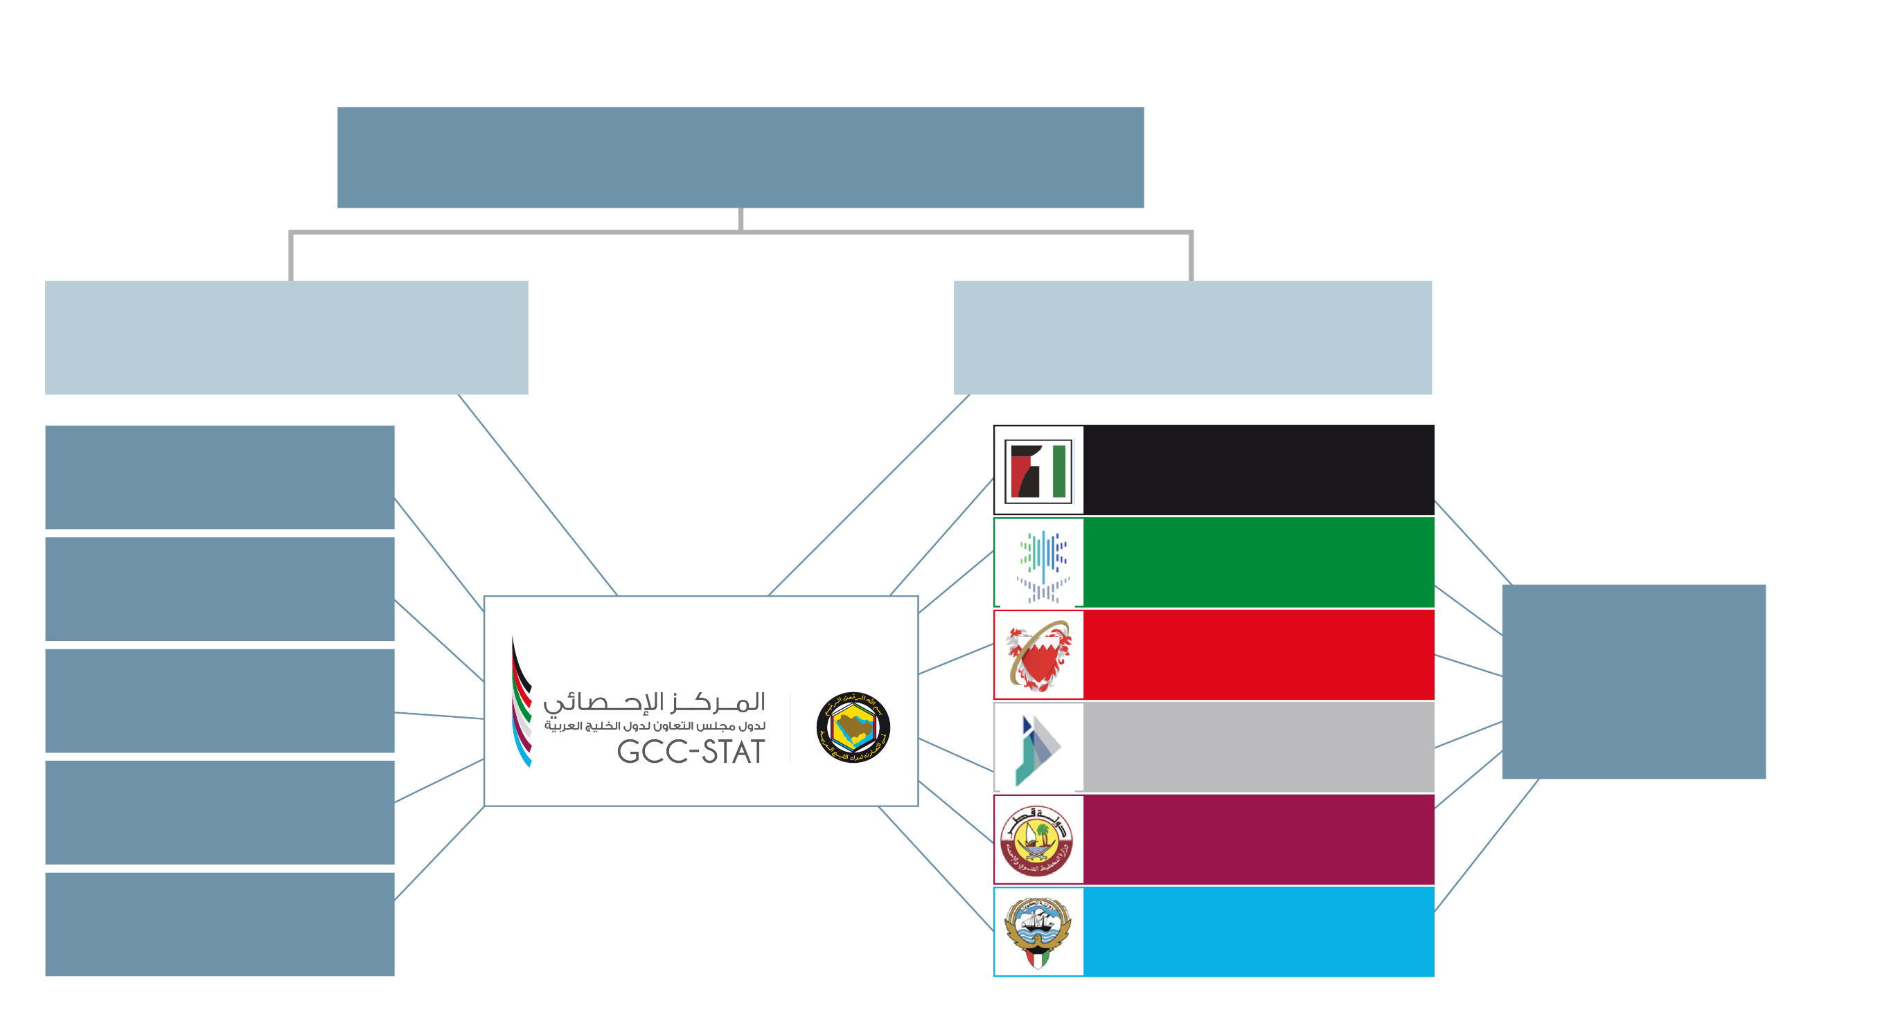
Background
Gulf Co-operation Council (GCC) Ministerial Council
GCC
Secretary-General
Standing Committee:
Heads of NSOs & DG/GCC-Stat
Standing Committee – Strategy, Planning
Federal Competitiveness & Statistics Authority
Standing Committee - Heads of IT
General Authority for Statistics
Partners
Information and e-Government Authority
Central Banks and Ministries
Standing Committee - SDGs Indicators
National Center for Statistics & Information
Standing Committee - Economic Statistics
Ministry of Development Planning & Statistics
Standing Committee – Pop. & Soc. Statistics
Central Statistics Bureau

Slide 4
The Priority Statistical Fields:
National Accounts
Monetary, Financial and Balance of Payments Statistics
Price Indices and Short-Term Indicators
Foreign Trade Statistics
Labour Statistics
Energy and Environment Statistics
Development, Progress and Sustainability Indicators
Harmonized 2020 Population Census
Enhanced Use of Administrative Data
Standards, Classifications, Methodology and Data Quality
Tourism statistics (subsequently agreed by the Board)
Other social statistics: Health, Education, Trade in Services

Slide 5
Vital Statistics:
Importance of Vital Statistics in GCC?
1
The three Factors that affected the population change in any country or 666region are Live births, deaths and migration (movement of people between 666countries).
2
Natural Increase is the main driven of Citizens Population in GCC Countries
3
Vital data give indicates of the Fertility of the society as well as the 555describe the health of the population
4
Strong interest to decision makers, researchers and others interested in the 666GCC. It is help to make strategic planes for the future.

Slide 6
Vital Statistics
Data Collection
Demand
1
SDGs
2
Team work
3
Most important thing is that the published statistical information should meet the demands of users such as other institution inside GCC countries and outside
When applying for data, consideration should be taken to the indicators that are important at the international level and what is related to Sustainable Development Goals
Explore the Views of health and vital statistical team work in regards of transmission tables related to Live births and deaths.

Slide 7
Harmonization
How?
Aggregate GCC Indicators
ensured that data were collected in all countries using the Same mechanism and method
Using harmonize way to calculate the vital Indicators according to international calcification and methodologies. (We have create Metadata Tables for each topic to be filled by countries).

Slide 8
Capacity Building
Workshops hosted by GCC STAT:
1- Workshop on harmonized of concepts, procedures and methodologies applied in the 33GCC countries for the produce of health and sustainable development (2016/2030) indicators.
3314-15 Feb. 2016, Muscat, Oman
Recommendations :
Developing statistical systems in national statistical centers to include expanding the health and vital database to serve statistical work.
Create team Work whose task it is to agree on a strategic plan and a timetable for the development of the statistical work in the field of health and vital statistics.
Continue providing GCC-Stat updated data and indicators of vital and health from the countries.
Meeting
1
Participants
Work program
3
2
The First Meeting held 18 may 2017
Each country had two participants one from the statistical center and the other from Ministry of Health
The team discussed the importance to provide linkage between ministries of health and national statistical centers to ease the flow of health and vital data.

Slide 9
Capacity Building
Workshops which was hosted by GCC:
2- Workshop on Principles and Recommendations for a Vital Statistics System, Revision 3 for 333Arabic-speaking countries
33314 – 17 November 2017, Muscat, Oman
The workshop was conducted by the United Nations Statistics Division in partnership with the Economic and Social Commission for Western Asia (ESCWA) and hosted by the Statistical Centre of the Gulf Cooperation Council (GCC Stat)
Recommendations :
Coordination at the national level among institutions responsible for civil registration, vital statistics and public health is a particularly sore point for many participating countries – yet, when functioning, clearly results in excellent quality and timeliness of vital and related health statistics
implementation of the international standards is recognized as a goal for all participating countries

Slide 10
Statistical Objectives of 2020 Harmonized Census project :
Vital Statistics is a Key role in 2020 Census project
1
Using administrative sources, conduct a harmonized population census in 2020 for the GCC region, in such a way that agreed datasets can be validly aggregated to the GCC level and consistent with the UN recommendations for the 2020 round of population censuses.
2
Develop technical capacity of the GCC statistical system in this work.
While mix of sources will be different between countries, the 2020 Census project will mean all GCC countries using some form of administrative data for the census.

Slide 11
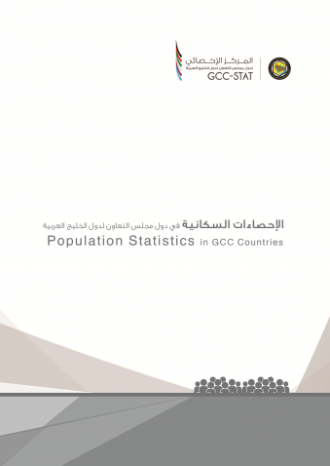
Dissemination
3
3
3
Data Portal
Statistical Releases
Data & Metadata Transmission Tables
Population and Vital Thematic Report
2010-2016 – in progress

Slide 12
Dissemination ( Data portal )
Gulf Co-operation Council (GCC) Ministerial Council
Population data Base
Marriage and Divorce data Base
Standing Committee - Economic Statistics
Standing Committee – Pop. & Soc. Statistics
Births and Deaths data Base

Slide 13
Challenges
Lack
Lack of vital information, especially for the disaggregation.
Variation
Insufficient coordination
weakness
Insufficient coordination of information systems at the local level.
The weakness of the civil registration system as a primary source of continuous data.

Slide 14
Thank you

