Slide 1
Management Information System
and other Tools for
Management of field enumeration
DEPARTMENT OF CENSUS AND STATISTICS
SRI LANKA

Slide 2
FIELD OPERATION:
Department of Census and Statistics has dedicated division for field operation.
Major role of the division are Progress monitoring, Communication with District Heads, Staff and Statistical Officers who work in the field

Slide 3
FIELD OPERATION …
It produce timely reports on field situation to the management
Communication media were Telephone, letters and email.

Slide 4
CENSUS OPERATION
Traditional Management System
Control forms
Master Registry of Census Blocks
Progress Monitoring
Material Distribution
Results
Online monitoring
Census 2021

Slide 5
Census of Population and Housing - 2011
Forms & Schedules used for Enumeration level
No. | Label | Name of Form/ Schedule
1 | A2 | Form of Oath or Affairmation of Census Officers
2 | A8 | List of Census Circles & Supervisors
3 | A9 | List of Enumerators
4 | A9.1 | List of Special Enumerators
5 | A10 | Act of Appointments of Supervisor's (Census Enumeration)
6 | A11 | Act of Appointments of Enumerators ( Census Enumeration)
7 | A12 | Training Programme for Enumerators
8 | A12.1 | Report of Enumerators Training Classes
9 | A13 | Post Cards for Enumerators to inform Training Classes
10 | F1 | Pre-Listing Form for Listing
11 | F3 | Population & Housing Schedule
12 | F4 | Population Schedule for Roofless Persons
13 | IP2 | Enumerator's Manual
14 | IP3 | Instructions for Enumerator's for Enumeration of Roofless Persons
15 | IP4 | Instructions to Census Supervisors
16 | IP5 | Instructions to Enumerators of Special Institutions(
17 | IP7 | Instructions for Deputy Census Commissioners on Census enumeration
18 | R1.C | Census Results for Census Circle
19 | R1.I | Census Results for Special enumeration unit
20 | R1.DC | Notification of the Census Results (First Round/ Revision Round)from Deputy Commissioner of Census to the Commissioner of Census
21 | R1.CC | Notification of the Census Results (First Round/ Revision Round) by the Commissioner
22 | R2E.P | Enumerator's Abstract for population Information
23 | R2S.P | Supervisor Abstract for Census Circle on Population Information
24 | R2DC.P | Abstract on GA/AGA division for Population Information
25 | R2C.P | Abstract for District on Population Information
26 | R2E.H | Enumerator's Abstract for Housing Information
27 | R2S.H | Supervisor Abstract for Census Circle on Housing Information
28 | R2DC.H | Abstract on GA/AGA division for Housing Information
29 | R2C.H | Abstract for District on Housing Information
30 | EP/ G | Supervisor's list of Census Blocks & Enumerators Paysheet
31 | EP/ I | Paysheet for Special Institution Enumerators
32 | E | Enumeration Pass
33 | CID | Census Identity card
Control forms

Slide 6
Master Registry of Census Blocks

Slide 7
Master Registry of Census Blocks

Slide 8
Progress Monitoring

Slide 9
Material Distribution

Slide 10
Results

Slide 11
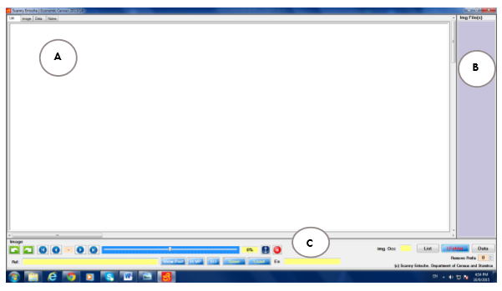
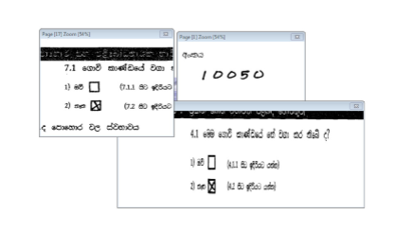
SCANNY ENTSHE - DSS
Features: Multiple view port in a single screen, Visualize edit checks,
edit checks define Window

Slide 12
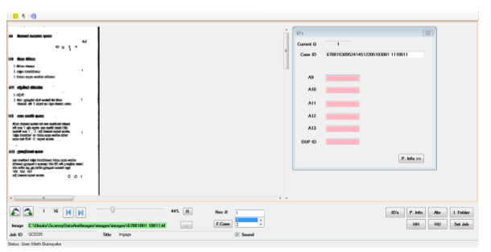
SCANNY QC
Quality check against the scanned data, 2012

Slide 13
CHANGED WITH TECHNOLOGY
Department introduced online real-time monitoring and information system with the use of Information and communication technologies.

Slide 14
DHS
DHS CAPI SW developed by ICF, DCS done Server maintaining and Data Communication module
DCS Developed online portal for users to Monitor the progress for following levels
Enumerators
Supervisors
Administrative Staff

Slide 15
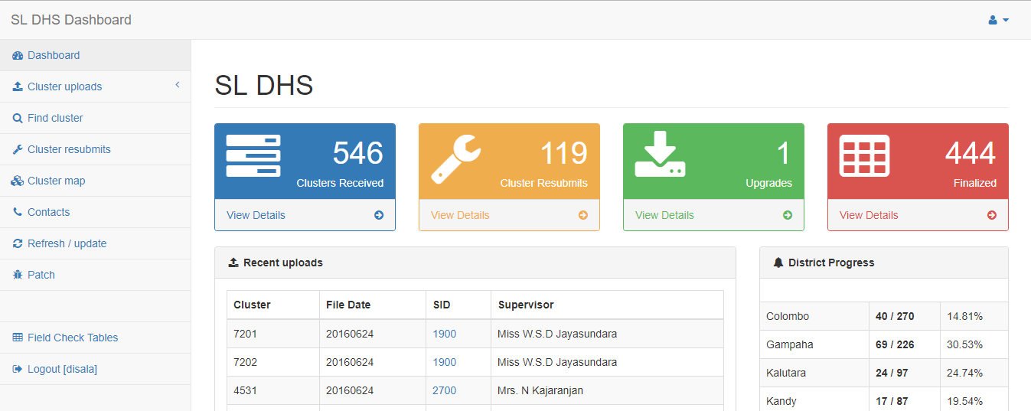
DHS Dashboard
Features: Real time, Reports, Summaries, Progress Monitoring, updates/patches, timestamps

Slide 16
DHS Dashboard ….
Activity Monitoring

Slide 17
PRODUCER’S PRICE SYSTEM
Collect 222 Items under 9 categories form 331 DS divisions which divided to 3 virtual centres
System converted to CAPI Data collection method very recently

Slide 18
PRODUCER’S PRICE SYSTEM
New system sends data directly to DCS Server
Monitoring and Information distributed in built module to the enumerators tablets and separate program to District supervisors and Head office staff

Slide 19
PRODUCER’S PRICE SYSTEM DASHBOARD
Features:
Real Time, Reports, summaries, Lists, online table generation, Decision support, Per person monitoring, Device Monitoring

Slide 20
PRODUCER’S PRICE SYSTEM DASHBOARD …
Features:
Real Time software installation monitoring, Device detection,
Device Monitoring,
Activity Monitoring

Slide 21
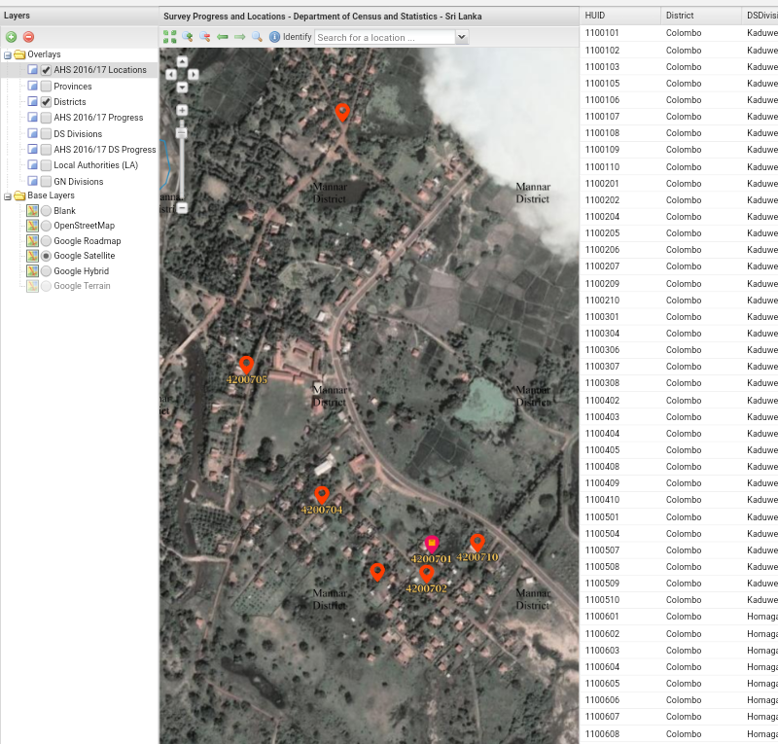
Geo spatial technology for survey (On going AHS survey)
Features:
Real Time

Slide 22
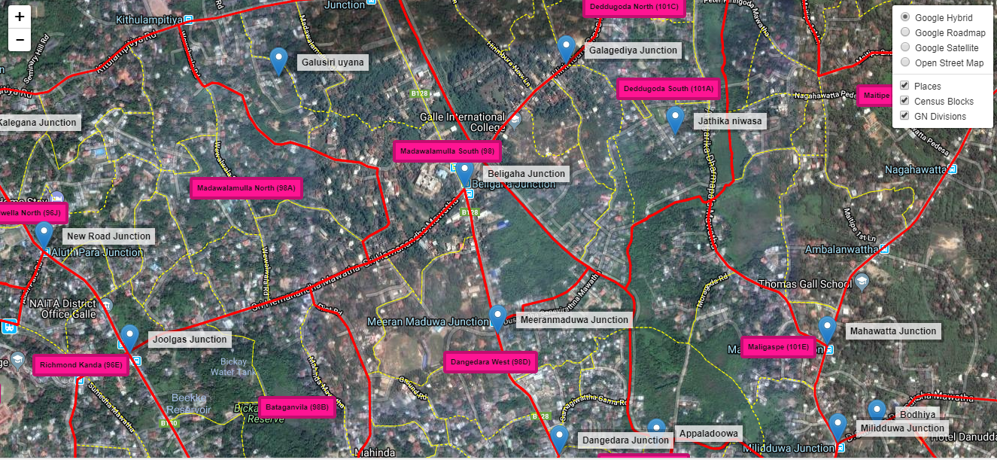
MRCB – Online
Online database for Master Registry of Census blocks for 2021 Census (Development Stage)

Slide 23
Thanks

