Slide 1
United Nations Regional Workshop on the 2020 World Programme on Population and Housing Censuses: International Standards and Contemporary Technologies, Colombo, Sri Lanka, 8-11 May 2018
Session 13
Management and Monitoring Systems
Meryem Demirci
United Nations Statistics Division

Slide 2
Management and Monitoring Systems
Establish a centralized system for an effective management, monitoring and controlling operational activities;
On-site monitoring and tracking the risks and making right decisions
Integrated systems with field operations and should be available to different level of field staff/managers

Slide 3
Management and Monitoring Systems
Whatever census methodology/technology used in conducting censuses:
Management and monitoring of field enumeration should be maintained by information systems and support mechanisms
Careful planning is required for determining:
what information will be collected,
who will be users
What will be responsibilities/duties of users
how the system will be integrated with data collection

Slide 4
Management and Information Systems
Management and Information Systems should focus on aspects of the operation that matter most, in particular:
understanding the status of recruitment of field staff;
understanding the status of logistical issues
understanding the status of the progress of the field enumeration, ensuring that the field operation proceeds according to schedule
identifying levels of non-response or under-coverage;
status of data transfer
identifying trouble spots;

Slide 5
Management and Information Systems
A number of software solutions can be developed for management and monitoring which can be classified into three groups:
1. Management of recruitment of field staff, logistical and financial issues
2. Data collection management
3. Management and information system (MIS) for operational control

Slide 6
Management of recruitment of field staff, logistical and financial issues
Registration of field staff, their personal information, payments, contract status, etc.
Identification of hierarchy between field staff
Distribution of electronic devices and materials –linking with users of devices
Information for electronic devices –type of device, broken, stolen, etc.
Information for Data Collection Stations, Regional Offices (address, phone number, etc.)

Slide 7
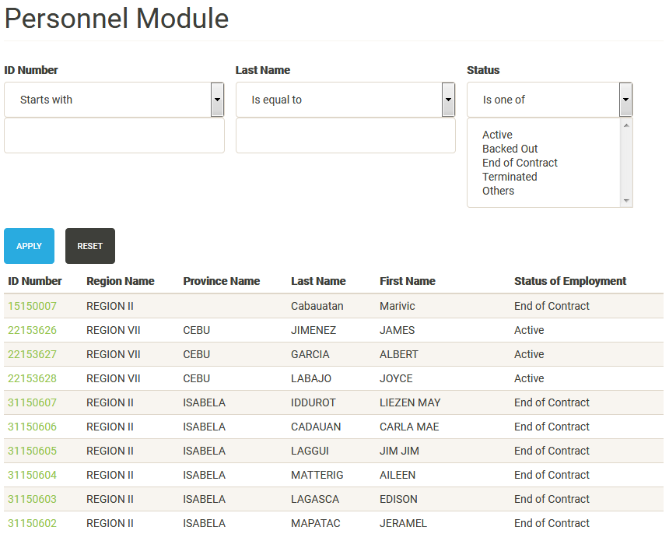
Personnel Module

Slide 8
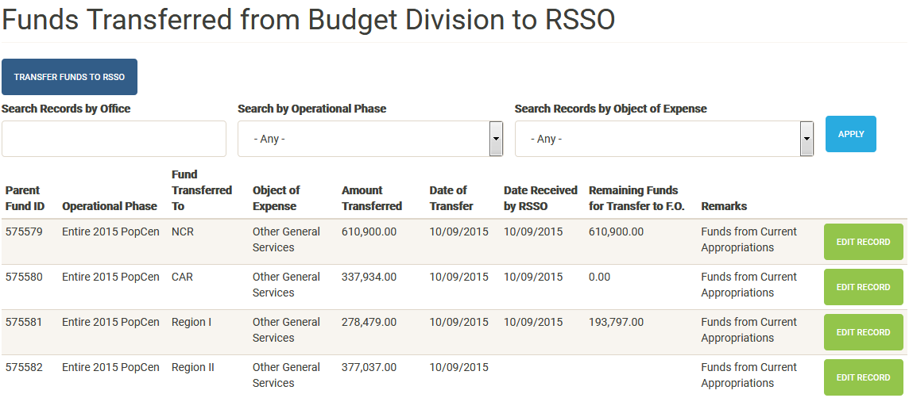
Financial Module

Slide 9
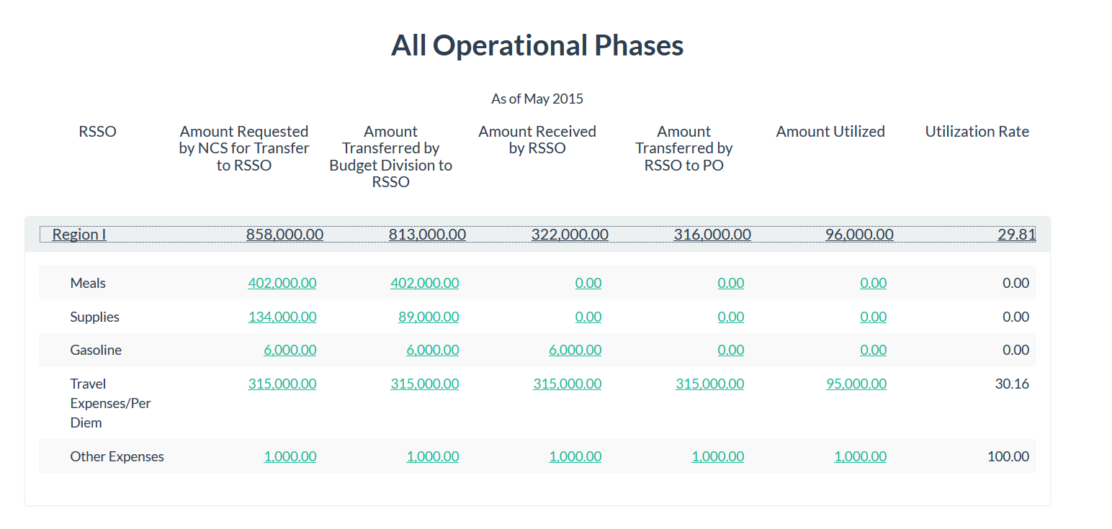
Financial Module
Financial Monitoring Report

Slide 10
1. Data collection management
Number of applications can be developed for field staff
Fieldwork management systems for the field staff
Regional coordinator
IT Support team
Supervisors
Enumerators
…

Slide 11
Data collection management and monitoring modules for field staff
Number of modules for each level of field staff can be developed
Field staff management: through which the regional coordinator can identify enumerators and their immediate supervisors according to hierarchical structure. It should also provide information on the handheld devices - type and features - used by each member of the field staff
Tasks distribution: through which the work is assigned from the regional coordinator to the local supervisors and then to the enumerators according to the various tasks assigned to them

Slide 12
Data collection management and monitoring modules for field staff
Number of modules for each level of field staff can be developed
Data transmission: through this module, the authorized staff (usually coordinators and supervisors) can view data transmission between the handheld devices and the central database
Work approval and review: this module is used to review and approve the work submitted by the enumerators. If the supervisor refuses to approve the work, then the work is returned to the enumerator to make any appropriate changes
GPS tracking: this module allows the supervisors to monitor each enumerator’s progress in his/her area, tracking their daily movement

Slide 13
A view of filling the questionnaire out of the EA, Brazil

Slide 14
Data collection management and monitoring modules for field staff
Regional coordinator`s module
Assigning the enumeration areas to the field supervisors and to ensure all EAs are covered by the field staff;
Monitoring daily progress of the enumeration based on operational performance indicators and reports generated by the system;
Monitoring the changes in the number of the enumerators and supervisors and electronic devices to ensure there are no problems that may affect the performance;
Good communication with headquarters and field staff on urgent issues;
Ensuring timely payments of the field staff;

Slide 15
Data collection management and monitoring modules for field staff
IT support team module
Providing handheld devices to field staff and follow up problems related to devices (broken, stolen, etc.) ;
Monitor technical problems and provide the first line support in the field for resolving technical problems encountered by the enumerators/supervisors;
Monitoring operational difficulties related to data transmission
Communications with the headquarters and regional commissions in case of emergency

Slide 16
Data collection management and monitoring modules for field staff
Supervisor`s module
Assigning the EAs to the enumerators and ensure complete coverage with no overlapping or omission;
Monitoring the daily progress of the enumeration in terms of the number of housing units visited and each enumerator`s assignments and their status;
Approving or rejecting the completed questionnaires submitted by enumerators;
Following-up non-response and refusals;
Providing information for specific cases or situations or possible risks;
Communicating with enumerators, other supervisors and coordinators at the local and central level;
Displaying the entered data at aggregate and individual levels for checking purposes;
Controlling/performing data transmission to headquarters

Slide 17
Data collection management and monitoring modules for field staff
Enumerator`s module
Data transmission (?)
Approved and rejected enumeration (and reason for rejection)
Results of enumeration for each unit in EA
Completed,
Refused,
No contact,
Interview rescheduled (including information on reason and appointment time/date),
Vacant dwelling,
Addresses/buildings not used for residential purposes
Other explanation

Slide 18
Management Information System for operation control (MIS)
This system is fundamental for identifying problems and taking appropriate actions
Tools for operation control
Performance indicators
Alerts for identifying potential risks
Geospatial information for monitoring
Geo-tracking tool

Slide 19
Management Information System for operation control (MIS)
Performance indicators
Key indicators
Status of enumeration –Completed, Refused, Interview re-scheduled, No contact, Non-residential, Vacant, etc.
Enumerated population by sex, age
Average number of population/housing unit per day
Number of data transmissions per day by geographical area
Number and percentage of devices that have to be renewed (CAPI)
Counts of submitted completed questionnaire/incomplete questionnaires
Comparisons between actual return and planned returns
Housing units enumerated by mode of data collection for timely monitoring non-response

Slide 20
Management Information System for operation control (MIS)
Alerts for identifying potential risks
Other information that can be potentially useful in monitoring the field enumeration is what might be termed ‘supervision alerts’, created from a comparison of data actually collected during the enumeration with what might be expected, such as:
Population count below/above expected
Male population proportion below/above expected
Proportion of population under X years and above Y below/above expected
Housing units count below/above expected

Slide 21
Management Information System for operation control (MIS)
Geospatial information for monitoring
It is suggested that advantage should be taken of GIS tools for presenting data collected for monitoring the field enumeration. In particular, the data on performance indicators and alerts can be integrated with GIS that make it easier to recognise problematic geographic areas and to get a better view of regional performance.
Geo-tracking tool
The MIS could make use of geo-referenced information on the location where the enumerator has started an interview (captured by the device’s GPS), thus identifying possible enumerator fraud attempts

Slide 22
Management Information System for operation control (MIS)
Centrally managed sub-systems for operational control
Field Management and Control System: This system enables the fieldwork administration and the headquarters administration to review the data at both levels (individual and aggregate)
It provides reports on productivity and performance indicators through tables, charts and electronic maps. This system may also provide interactive reports to keep regional coordinators/supervisors and headquarters informed about problematic areas.
Call Center System: This system can be used for monitoring data quality control by re-calling a sample of households whose data were collected during the census to verify the validity of the data entered, and can be used also to collect the incomplete data for some households

Slide 23
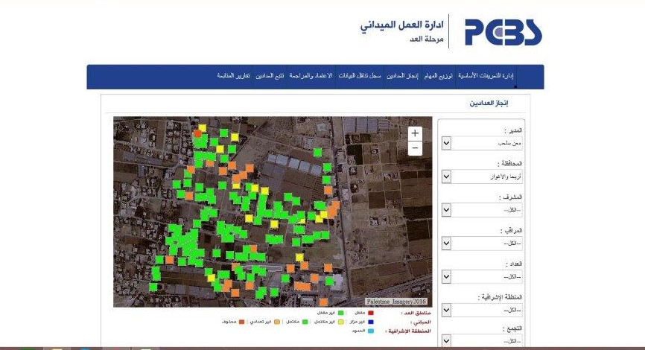
2017 Census of Palestine
Snapshot screen explains achievement follow up per enumeration area per building through different colors:
Blue: not visited;
Gree: completed;
Red: deleted buildings;
Orange :non-census building; and,
Yellow: incomplete

Slide 24
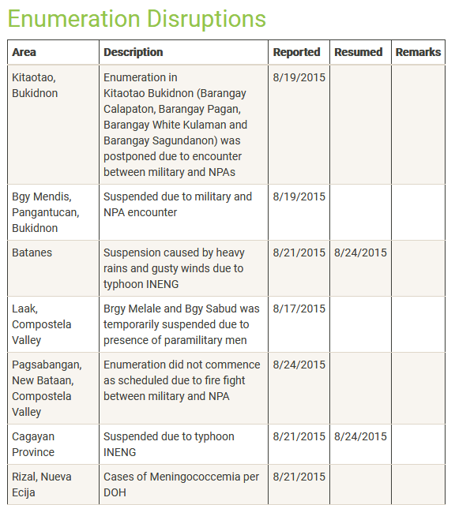
Incident Report Module
Gave a snapshot of areas where enumeration was disrupted for reasons such as peace and order problem, calamity or other reasons

Slide 25
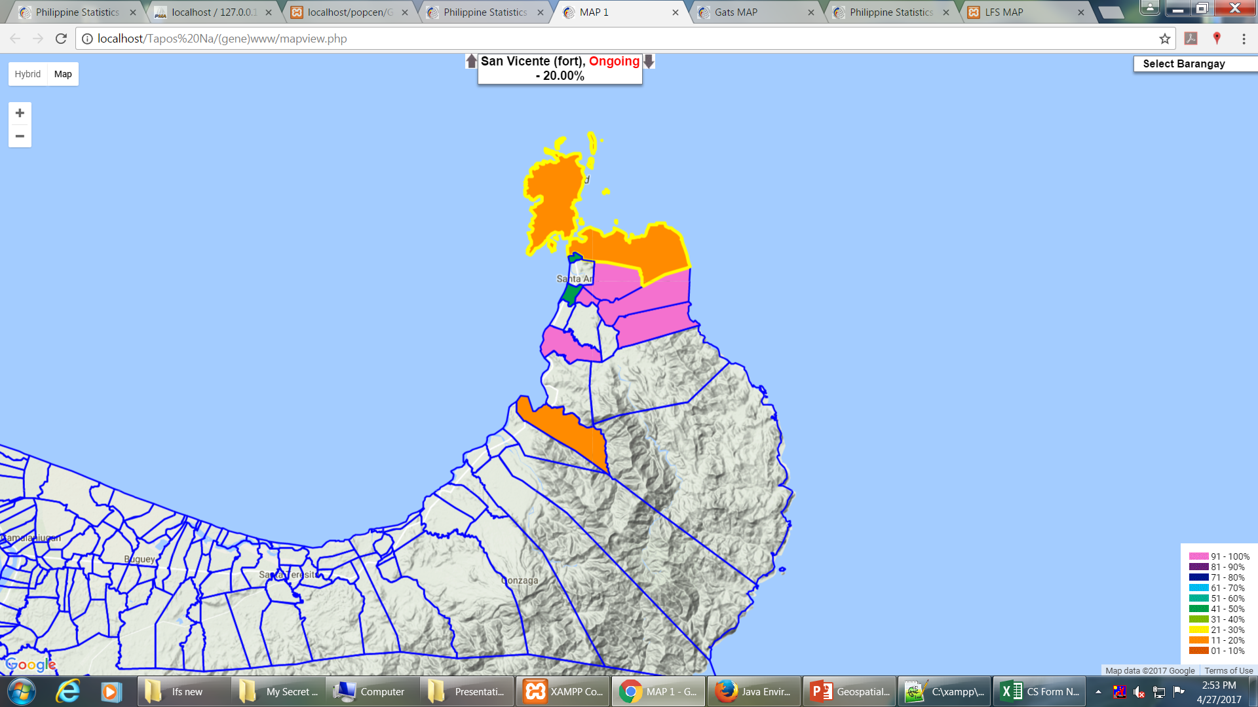
Status of Enumeration (on-going/completed, percent completed)
Status of field operation (percent completed) in each barangay.

Slide 26
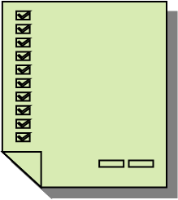
Main Functions of Call Center
Confirming the identity of the census enumerator
Interviewing
Arranging visits for census enumerators
Review and validation of data
Hotline (Census helpline)
Support for respondents and enumerators

Slide 27
Main Functions of Call Center
Support for respondents -Internet
Provide a support for completing census questionnaire
Provide technical support to access online questionnaire
Provide information about census methodology and operation
Provide information about the field staff , especially for identification of enumerators and supervisors who have direct contact with households

Slide 28
Main Functions of Call Center
Technical support to field staff
provide logistical support for field staff in the local and regional offices;
help enumerators and supervisors in the field for organizing the field work
provide IT technical support for field staff in the local and regional offices
provide clarification on those methodological issues (such as definitions and response categories) and the duties of field staff
resolve IT problems remotely by direct dialogue with handheld devices
IT technicians may be able to resolve problems by connecting to the devices remotely while speaking to the enumerators

Slide 29
Main Functions of Call Center
Quality control and Validation
Call center can also be used for reviewing and verification of data for:
Incomplete questionnaires
Missing values
Inconsistency in data
Double counting

Slide 30
2015 Census of Jordan

Slide 31
THANK YOU…

