Slide 1
Planning and Implementing a Census Geospatial Programme
JANARDAN YADAV Additional Registrar General, India
Office of the Registrar General, India Ministry of Home Affairs
Government of India.
United Nations Regional Workshop on the 2020 World Programme on Population and Housing Censuses:
International Standards and Contemporary Technologies
Colombo, Sri Lanka
8-11 May 2018

Slide 2
Indian Census is “largest administrative exercise” in the world.
India has the second largest population in the world.
India has 2.4% of Worlds Surface Area of the world
The enumerators number is more than the population of many countries of the world..
India is multiethnic, multilingual and multicultural society.
In India, census is much more than mere head count of the population. It gives a snap shot of economic, social and cultural profile of the country.

Slide 3
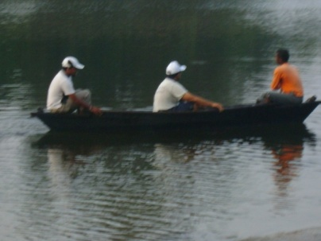
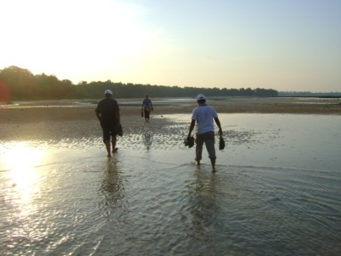
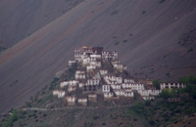
Challenges – Vast & Diverse
Provinces/States - 35
Districts - 640
Sub-districts - 5,924
Towns/Cities - 7,933
Villages - 640,930
Enumeration Areas (In million) - 2.47
Households (in million) – 249
Population (in million) – 1,211
Enumerators & Supervisors (in million) – 2.7
Ethnic groups - 4,635
Mother tongues – 6,661

Slide 4
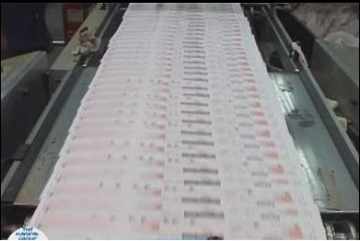
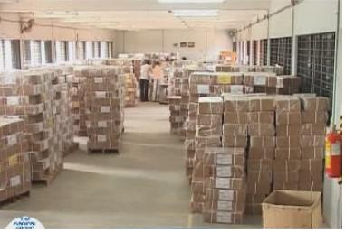
Challenges – Vast & diverse (contd.)
5.4 Million Instruction Manuals printed in 18 languages
340 Million Census Schedules printed in 16 languages
Materials moved to and from about 17,500 addresses across India

Slide 5
Methodology adopted during Census 2011
Preparation of unambiguous list of Administrative Units : Freezing of administrative boundaries.
Finalization of Rural Urban Frame
Assigning of location codes to various Administrative Units
Carving Out the Enumeration Blocks(EBs)
Data Users Conference
Constitution of Technical Advisory Committee(TAC)
for Finalization of Questionnaires
Contd….

Slide 6
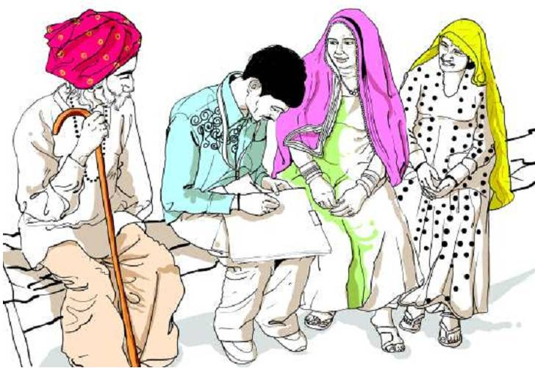
Census of India 2011
1st Phase:
Houselisting & Housing Census (30 days)
Population Register (15 days)
2nd Phase:
Population Enumeration (20 days)
(From 9th to 28th February 2011)
Face to Face or Canvasser method
Paper Questionnaire
During April to September 2010

Slide 7
The socio-cultural, demographic and economic profile can be disseminated by way of data products.
The purpose is to understand the indicators and their national distribution using thematic maps.
This kind of thematic presentation is very helpful for the planning and implementation of various government programme initiatives.
Some of the social indicators which were collected during the Census 2011 are presented here.

Slide 8
SOURCE OF DRINKING WATER
Sources | Number of Households (in crore) | Percentage
1. Tap: | 10.74 | 43.5
(a) From treated sources | 7.89 | 32.0
(b) From un-treated sources | 2.85 | 11.6
2. Well | 2.72 | 11.0
(a) Covered well | 0.38 | 1.6
(b) Un-covered well | 2.33 | 9.4
3. Hand pump | 8.25 | 33.5
4. Tube well / Borehole | 2.09 | 8.5
5.All others | 0.86 | 3.5
Notes:
87% of households using Tap, Tube well, Hand pump and Covered well as source of drinking water
32% households using Tap water from treated sources
47% of households have source of water within the premises (R – 35%; U – 71%)
36% of households have to fetch water from a source located within 500 m in rural areas/100 m in urban areas
18% still fetch drinking water from a source located more than 500 m away in rural areas or 100 m in urban areas

Slide 9
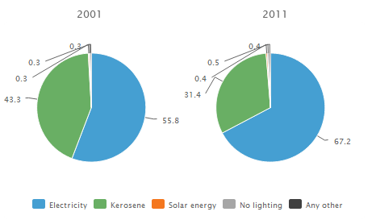
Main source of lighting
TOTAL
Source of lighting | Households (in crore) | Percentage
Electricity | 16.58 | 67.3
Kerosene | 7.75 | 31.4
Solar energy | 0.11 | 0.4
Other Oil | 0.05 | 0.2
Any Other | 0.05 | 0.2
No lighting | 0.11 | 0.5

Slide 10
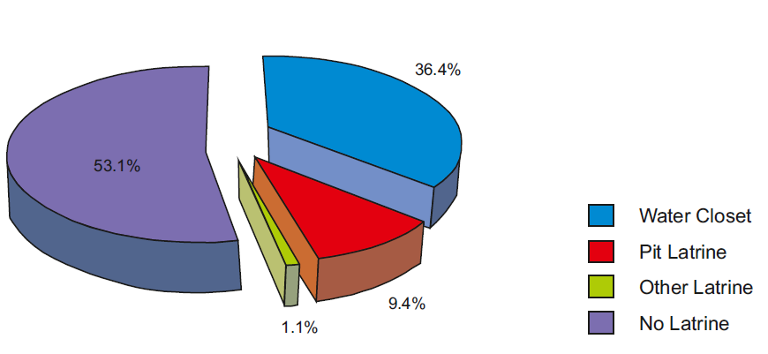
Latrine within premises
Sources | Number of Households (in crore) | HHs having latrine facility within premises (%)
Have latrine facility | 11.57 | 100.0
a. Flush/ pour flush connected to | 8.99 | 77.6
b. Pit latrine | 2.33 | 20.0
c. Night soil disposed into open drain | 0.13 | 1.1
d. Service latrine | 0.13 | 1.1

Slide 11
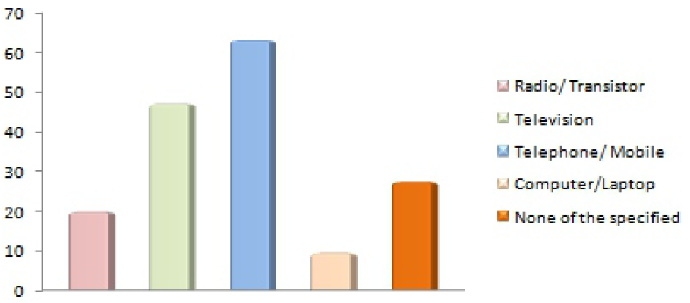
Households Possessing computer/laptop
Mode of Communication
Assets | Total | Rural | Urban
Computer: | 9.5 | 5.2 | 18.7
Computer/Laptop - With Internet | 3.1 | 0.7 | 8.3
Computer/Laptop - Without Internet | 6.4 | 4.5 | 10.4

Slide 12
Census of India 2021: Way Forward
Canvasser method to continue
National Population Database to be used:
As frame for Census 2021
To pre-populate the questionnaire to minimize workload
Possibilities for using digital devices during data collection
Mobile/Internet penetration
Geo-referenced maps for data collection in cities:
Vertical growth
Horizontal growth

Slide 13
Thank you …..
For more information please visit:
censusindia.gov.in
Our Census, Our Future

