Slide 1
Population and Housing Topics (Bhutan)

Slide 2
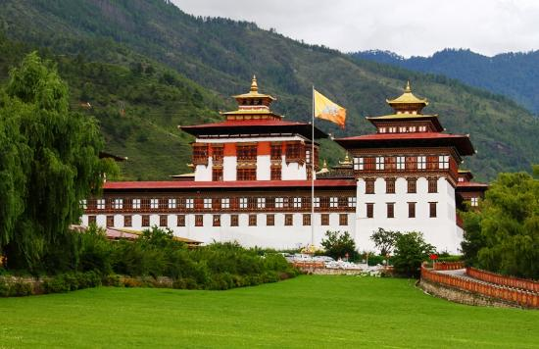
BACKGROUND
The first census conducted from 1744-1763
Equivalent to the civil registration in Bhutan, was
Was conducted annually for the
Headcount of citizens
Basis for taxation and
Mobilization of labour force for the government.

Slide 3
BACKGROUND
Ministry of Home and Culture Affairs (MoHCA) carried out annual civil registration starting early 1990s
Counted the vital events
In 2005, the first ever-United Nations Standard Population and Housing Census of Bhutan (PHCB) was conducted ( May 30th – 31st )

Slide 4
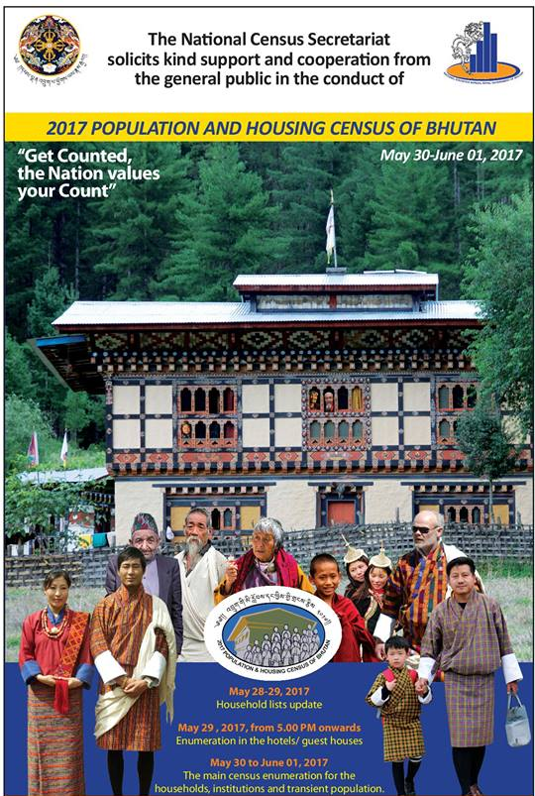
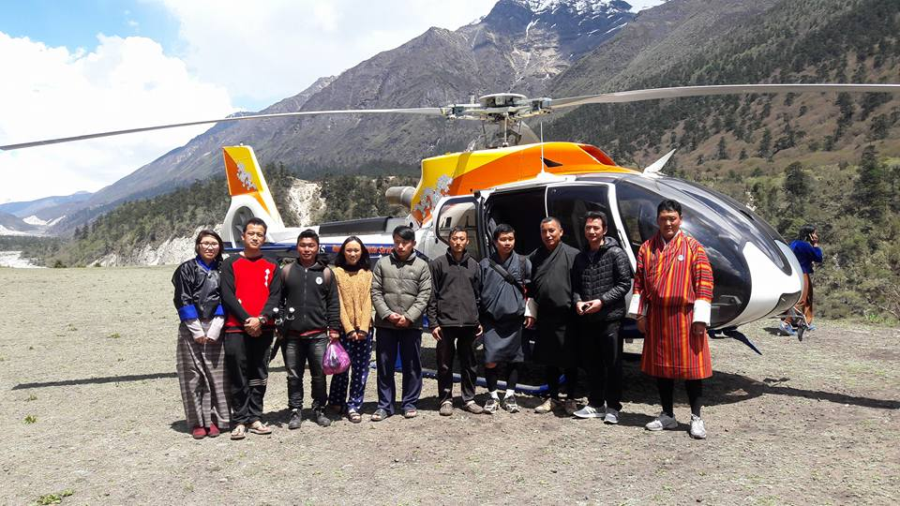
BACKGROUND
The Second international standard Population and Housing Census conducted in 2017( May 30th – 31st & 1st June )

Slide 5
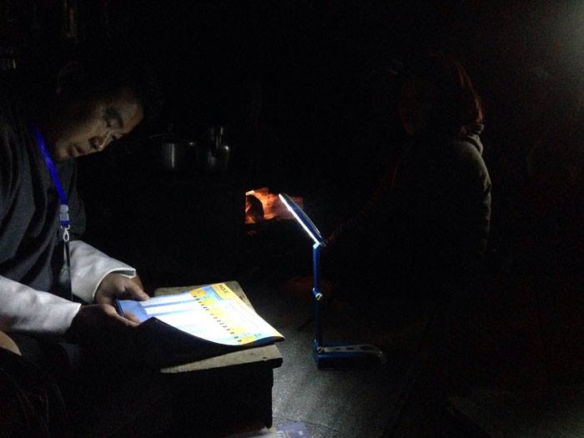
2017 PHCB
CENSUS PROCESS
Legal basis
Design of census tools
House Listing and Mapping
HR Management
Publicity and Advocacy
Field Enumeration
Data Processing
Data Tabulation/report writing /Analysis

Slide 6
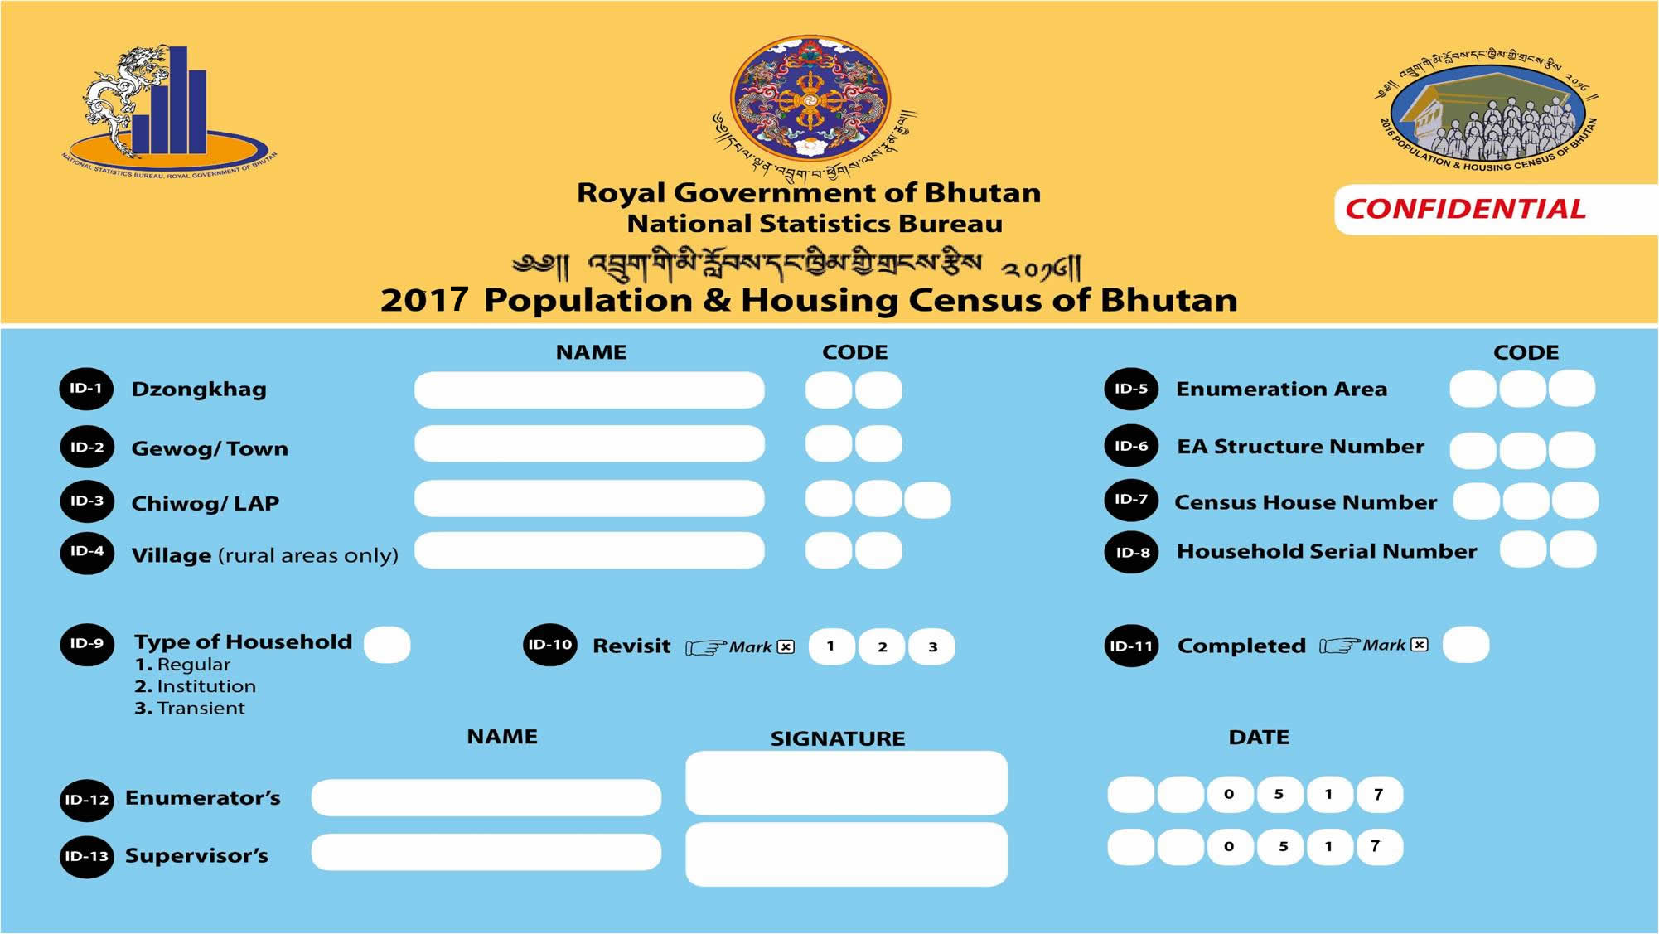
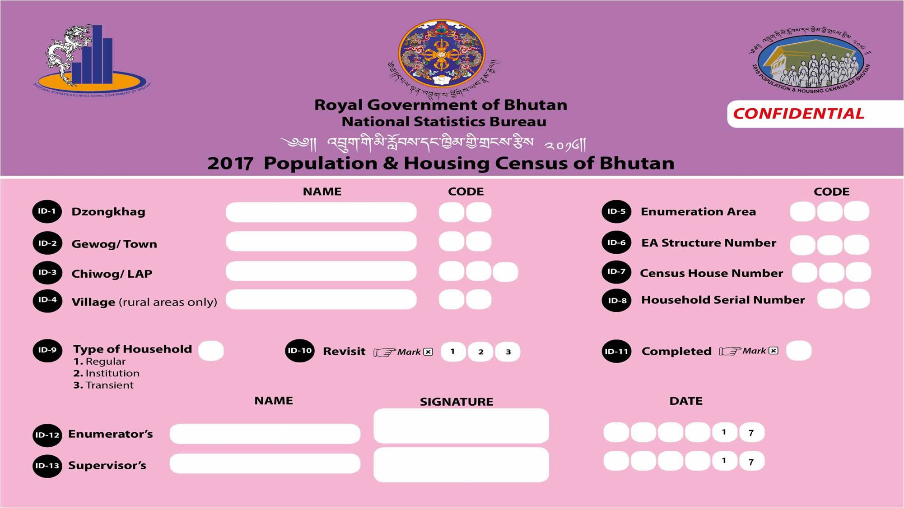
2017 PHCB
CENSUS PROCESS

Slide 7
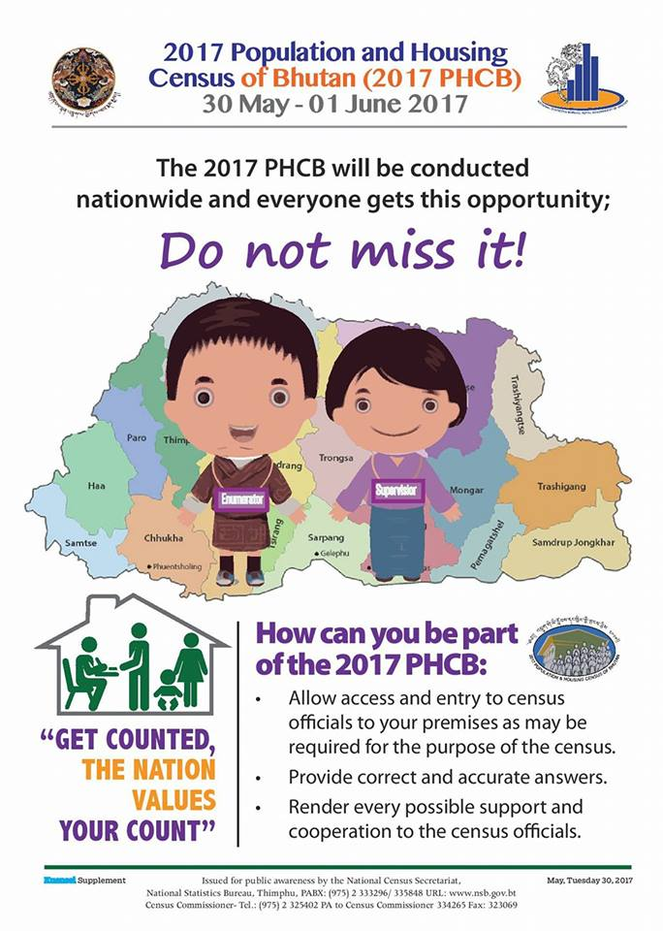
2017 PHCB
Population and Housing Topics
Demographic
Education & Employment
Fertility
Mortality
Disability
Housing information
Income and debt
Land, poultry, livestock and fruit tree ownership
Psychological wellbeing

Slide 8
2017 PHCB
Demographic
Relationship To the Household head Social
Sex
Age
Member Status
Duration Absent
Marital Status
Place of Birth (within and outside )
Place of Previous Residence (within and outside )
Usual Residence
Place of Residence 5 Years ago
Duration of Stay in Current Location
Reason for Migration

Slide 9
2017 PHCB
Education & Employment
Literacy
Highest Grade
Traditional Learning
Main Activity at Present and Products produced
Work in the last one week
Status of employment
Industries
Occupation

Slide 10
2017 PHCB
Fertility
Ever Delivered
Age at First Birth
Children Ever Born By Sex
Children Dead and Living
Delivery in the past 12 Months

Slide 11
2017 PHCB
Housing Condition and Facilities
Approach Road
Wall Material/Roof Material/Floor Material
House Occupancy Status
Number Of Rooms
Lighting/Cooking Fuel/Toilet Facility
Drinking Water Source
Drinking Water Reliability
Visit To Health Facility
Communication Media Facilities
Ownership/ Asset- Household
Food Sufficiency
Access To Drinking Water

Slide 12
2017 PHCB
Mortality
Death In The Past 12 Months In The Household
Sex Of Deceased
Age At Death
Causes Of Death
For Women 15-49 Years Who Died
Pregnant
Giving Birth
Within 6 Weeks Of The End Of A Pregnancy Or Child Birth

Slide 13
2017 PHCB
Disability
The information on disability for the census is based on the Washington Group (WG) short set of questions on disability.
Difficulty performing basic universal activities walking, seeing, hearing, cognition, self-care and communication
Cause of Disability

Slide 14
2017 PHCB
Land, poultry, livestock and fruit tree ownership
Land ownership of the household
Type of land owned
Uncultivated and Fallow
Reason for leaving the land fallow
Fruit Tree ownership of the household
Livestock Ownership of the household

Slide 15
2017 PHCB
Income & Debt
Loan availed by Household
Household income

Slide 16
2017 PHCB
Psychological Wellbeing
Happiness rated at a scale of 1-10
Source of Happiness
Physical Health
Mental Health
Enmity in the community
Rating on Positive and negative moods
Social Isolation

Slide 17
2017 PHCB
Challenges
Providing quality training
Confusion with some of the definition
Respondent not aware of income and debt details of the other members

Slide 18
2017 PHCB
Thank you

