Slide 2
QUALITY ASSURANCE IN POPULATION AND HOUSING CENSUS
UN REGIONAL WORKSHOP ON THE 2020 WORLD PROGRAMME ON POPULATION AND HOUSING CENSUS
By
Syed Hassan Raza
Chief Statistical Officer
Pakistan Bureau of Statistics
Muhammad Riaz
Deputy Census Commissioner
Pakistan Bureau of Statistics
8
Colombo, Sri Lanka, 8 -11 May 2018

Slide 3
SEQUENCE OF PRESENTATION
Population Censuses in Pakistan
Census process / Methodology 2017
Quality Assurance in Census 2017
Quality Assurance of Questionnaire
Quality Assurance of interview
Quality Assurance of content
Quality Assurance of coverage

Slide 4
Population Censuses in Pakistan
Pakistan Bureau of Statistics (PBS) is the responsible agency to conduct Population and Housing (PH)Census in the Country.
In Pakistan six censuses have been undertaken so far and the last census was conducted in 2017.
Census No. | Year | Population (Million)
First | 1951 | 33.7
Second | 1961 | 42.8
Third | 1972 | 72
Fourth | 1981 | 83.78
Fifth | 1998 | 134.7
Sixth | 2017 | 207.7

Slide 5
INSTITUTIONAL ARRANGEMENTS
KPK
PUNJAB
SINDH
BALOCHSITAN
FATA
G-B
A J & K
DIVISIONS
DIVISIONS
ADMIN DISTRICTS
DISTRICT / AGENCY / CANTONMENTS / CENSUS DISTRICTS
TEHSIL / TALUKA / SUB-DIV / CANTTS. CENSUS DISTRICTS
CENSUS CHARGES
CENSUS CHARGES
CENSUS CIRCLES
CENSUS CIRCLES
CENSUS BLOCKS
CENSUS BLOCKS

Slide 6
ADMINISTRATIVE ARRANGEMENTS
For complete coverage and effective field supervision, the country has been delimited on four tier system.
SET UP | COMPRISING OF
Census District | District / Tehsils/ Taluka / Cantonments / Agencies
Census Charge | Qanungo Halqa / Part of Urban Area / Cantonment 5 To 7 Circles in Charge
Census Circle | Patwar Circle/ Part of Urban Area / Cantonment. 5 To 7 Blocks in a Circle 1500 houses on an average
Census Block | 200 To 250 Houses

Slide 7
ADMINISTRATIVE ARRANGEMENTS
Deputy Commissioner / Assistant Commissioner / Cant. Executive Officer/Political Agent as
Census District Officer
Charge Superintendent
Circle Supervisor
Circle Supervisor
Enumerators
Enumerators

Slide 8
CENSUS METHODOLOGY
Enumeration Method: Information will be collected and recorded on questionnaires by the Enumerator through door to door visit.
Population Count: Population to be counted at usual place of residence (De-jure method). All persons residing in the country except diplomats and refugees living in camps will be counted in the census process.
Field Operation: House Listing and Population & Housing Census will be conducted in one go i.e. 1st three days for house listing followed by 10 days for census operation and one day for homeless population.
Census in phases: Census will be conducted in two phases. Operation will start simultaneously in all the provinces.

Slide 9
METHODOLOGY FOR FIELD OPERATION
Each Block was completed in Fourteen Days.
First 3 days for House numbering
Followed by 10 days for filling up of Form-2 and
The last day i.e. 14th day for enumeration of homeless population.
Two blocks were assigned to one Enumerator.
Each phase was completed over a period of 30 days.
Second phase was started with a gap of 10 days.

Slide 10
PROPOSED FIELD OPERATION PLAN
Note:-
Field operation was carried out in two phases
Two blocks were covered by one enumerator in each phase
PHASE-1
Field Enumeration for 1st Block | From | To
House Listing Operation @ 3 days per block | 15th March, 2017 | 17th March, 2017
Filling up of Form-2 @ 10 days per block | 18th March, 2017 | 27th March, 2017
Enumeration of homeless population @ 1 day per block | 28th March, 2017 | -
Retrieval of Filled in documents and issuance of Census material for 2nd Block | 29th March, 2017 | 30th March, 2017

Slide 11
PROPOSED FIELD OPERATION PLAN
Note:-
2nd phase was started with a gap of 10 days
PHASE-2
Field Enumeration for 1st Block | From | To
House Listing Operation @ 3 days per block | 25th April, 2017 | 27thApril, 2017
Filling up of Form-2 @ 10 days per block | 28thApril, 2017 | 7th May, 2017
Enumeration of homeless population @ 1 day per block | 8th May, 2017 | -
Retrieval of Filled in documents and issuance of Census material for 2nd Block | 9th May, 2017 | 10th May, 2017

Slide 12
PROPOSED FIELD OPERATION PLAN
Note:-
2nd phase was started with a gap of 10 days
PHASE-2
Field Enumeration for 2nd Block | From | To
House Listing Operation @ 3 days per block | 11th May, 2017 | 13th May, 2017
Filling up Form-2 @ 10 days per block | 14th May, 2017 | 23rd May, 2017
Enumeration of homeless population @ 1 day per block | 24th May, 2017 | -
Retrieval of Filled in documents | 25th May, 2017

Slide 13
Methodology Contd.
Information recorded on machine readable, Intelligent Character Recognition (ICR)questionnaires by the Enumerators through canvasser method i.e, Door to Door Visit.
Initially three forms have been designed for 6th Population and Housing Census
Form-1 Household listing operation
Form-2 Individual information on core questions and housing characteristics
Form 2-A Sample questionnaire having detail questions on education, migration, economic activity and disability etc been dropped and will now be conducted after the finalization of the census results

Slide 14
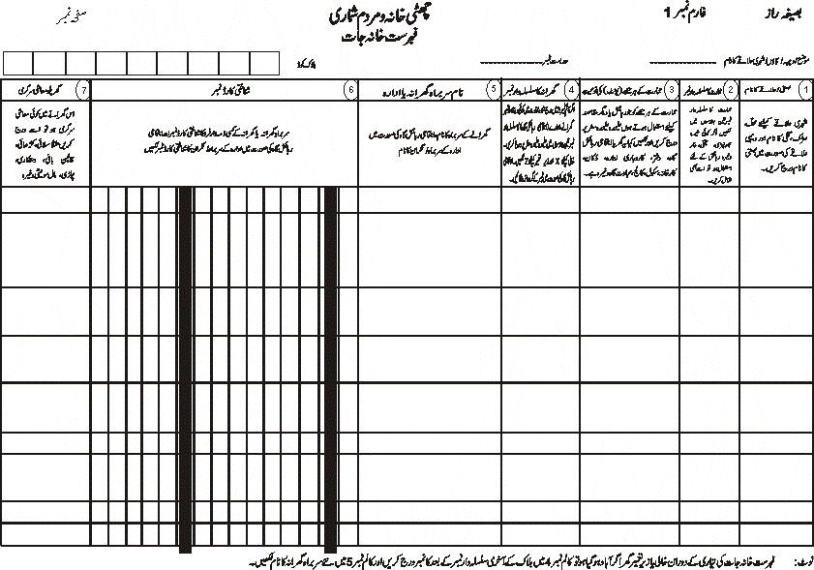

Slide 15
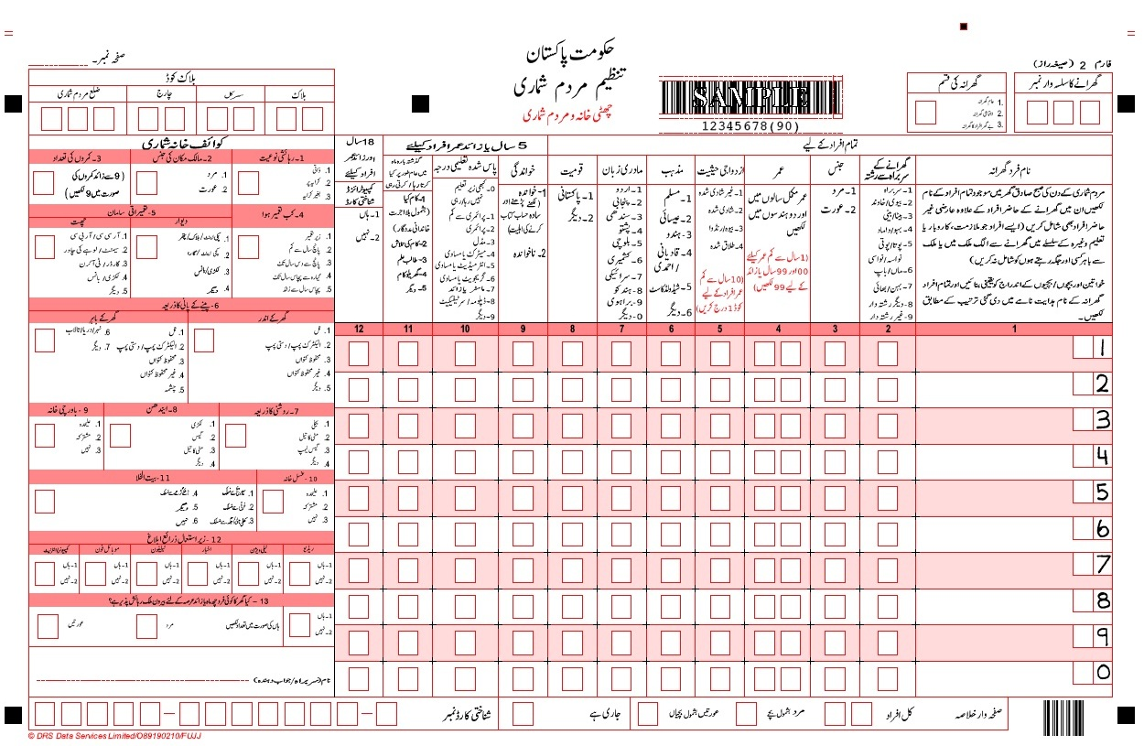

Slide 17
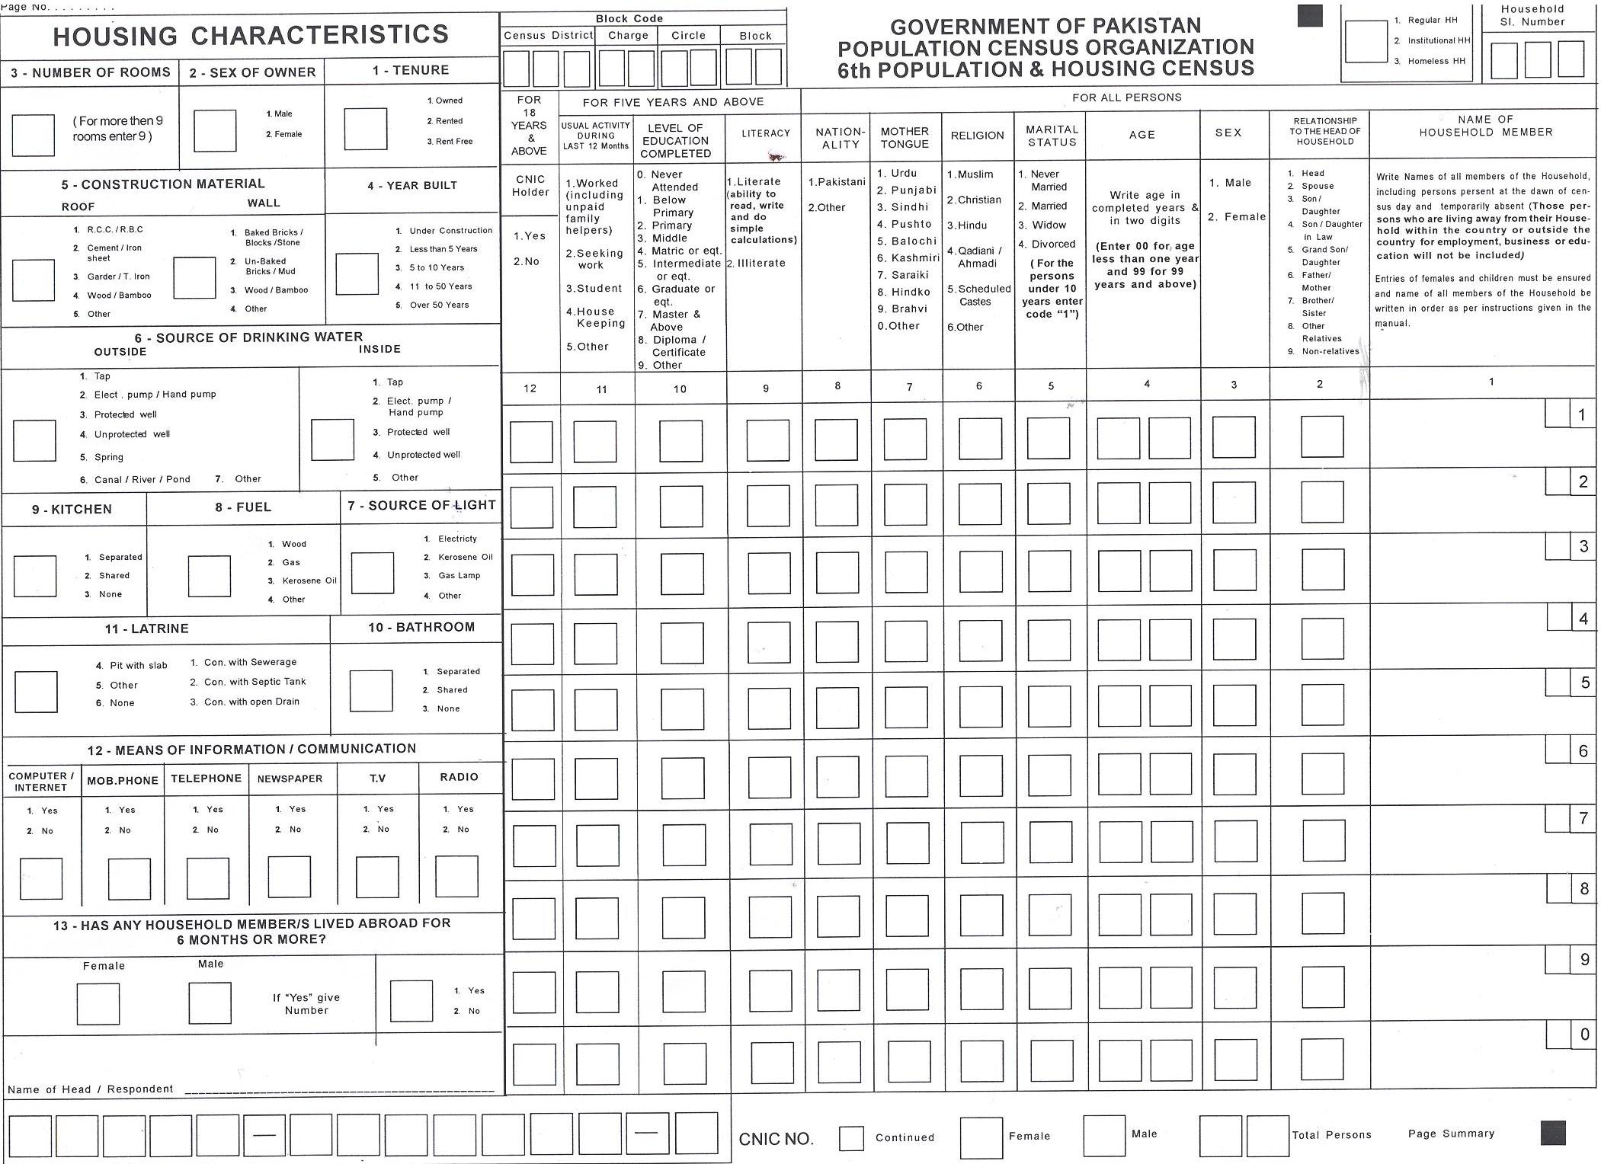

Slide 18
QUALITY ASSURANCE IN THE DESIGNING OF QUESTIONNAIRE
The questionnaires for Census 2017 were designed by PBS with advice from Local experts.
The highest care was taken to ensure that questions were well understood and were clear to both enumerator and respondent.
A Pre testing of the questionnaire was carried out.
The census questionnaires were improved in the light of analysis of pretesting.

Slide 19
QUALITY ASSURANCE OF INTERVIEW, CENSUS 2017
Ensured that all the persons in the exercise clearly understand the whole operation, i.e Objectives, concepts and contents in the questionnaire and field operations.
Field operation Plan and a comprehensive Manuals were prepared for enumerator and supervisory staff.
Circle Supervisor accompanied each enumerator at the beginning of the enumeration .
Mistakes including both asking the questions incorrectly and errors in recording the questions were highlighted to the enumerator and Mistakes were corrected at the spot.
The supervisor were directed to fill at least 5 Field Quality Control Forms

Slide 20
QUALITY ASSURANCE OF CONTENT
During enumeration, completed questionnaires were checked for completeness and consistency at random.
After the enumeration exercise all completed questionnaires were checked and edited
A check list for quality control of completed questionnaires was produced for checking internal inconsistency
If any inconsistencies arose during field operation checking both supervisor and the enumerator had to go back to the household for clarification
Measures taken to ensure quality data collection
Before the census took place, a set of measures have been developed and introduced by PBS in order to guarantee the quality of the most important phase of the census: gathering complete and trustful data of all Pakistani inhabitants.

Slide 21
QUALITY ASSURANCE OF COVERAGE
The census was undertaken on the basis of 100 % coverage of population and area.
Unit of Enumeration was a household(Normal household and Collective household)
Special instructions were issued for enumeration of the Diplomats and foreigners residing in Pakistan.
Each and every structure was numbered.
Digitized maps along with description of boundaries of EA was supplied to Enumerator as well as Supervisors.
Control Rooms were established from census district to PBS headquarter to cater the complainants regarding non enumeration and non coverage of the area, if any.
Organizational measures
The P & H Census in Pakistan followed the traditional Convor method (door to door visit) of universal direct enumeration based on field operations with completion of questionnaires by enumerators.
Due to the complexity of some questions and in order to achieve harmonized and coherent answers, allowing questionnaires being directly filled-in by the respondents would have increased the risk of incorrect responses and would have had as a consequence a loss of data quality.
PBS defined specific selection criteria for the enumerators, the controllers (CDOs) as well as for the supervisors (Circle Supervisors and Charge Suprentendents).
Selection Criteria was based on the education level, experience, knowledge of local context etc.
It was understood that the performance of field work and the quality of data collection was depending from the quality and care provided to the whole training procedures Trainings and training modules were given particular importance.
Trainings were conducted all over Pakistan and were all done with the same training materials, instruments and methodology.
Although it was proposed in the instruction manuals that the enumerators make frequent trials to get in contact with the inhabitants of a household, in case of absence.
Also, before the census start, each enumerator visited its enumeration area to get acquainted with its geographical limits of the census blocks (enumiration artea) and to update the existing building and dwellings existing. During this preliminary visit the enumerators informed the residents of EA on census Process.
During the census, if a dwelling was found empty, the enumerators were instructed to try to contact the nabours and inform the inhabitant of empty house about the timing for the interview.

Slide 22
QUALITY ASSURANCE OF COVERAGE
PREPRATION OF MAPS
Maps of each Census District, Charges, Circles and Blocks have been prepared/updated.
Maps of Urban and Rural areas have been verified through satellite image (Google Earth).
Maps showing physical landmarks in the census Blocks were provided to the Enumerators and Supervisors.
Digitized maps of urban areas and ammonia print maps of rural areas were provided.

Slide 23
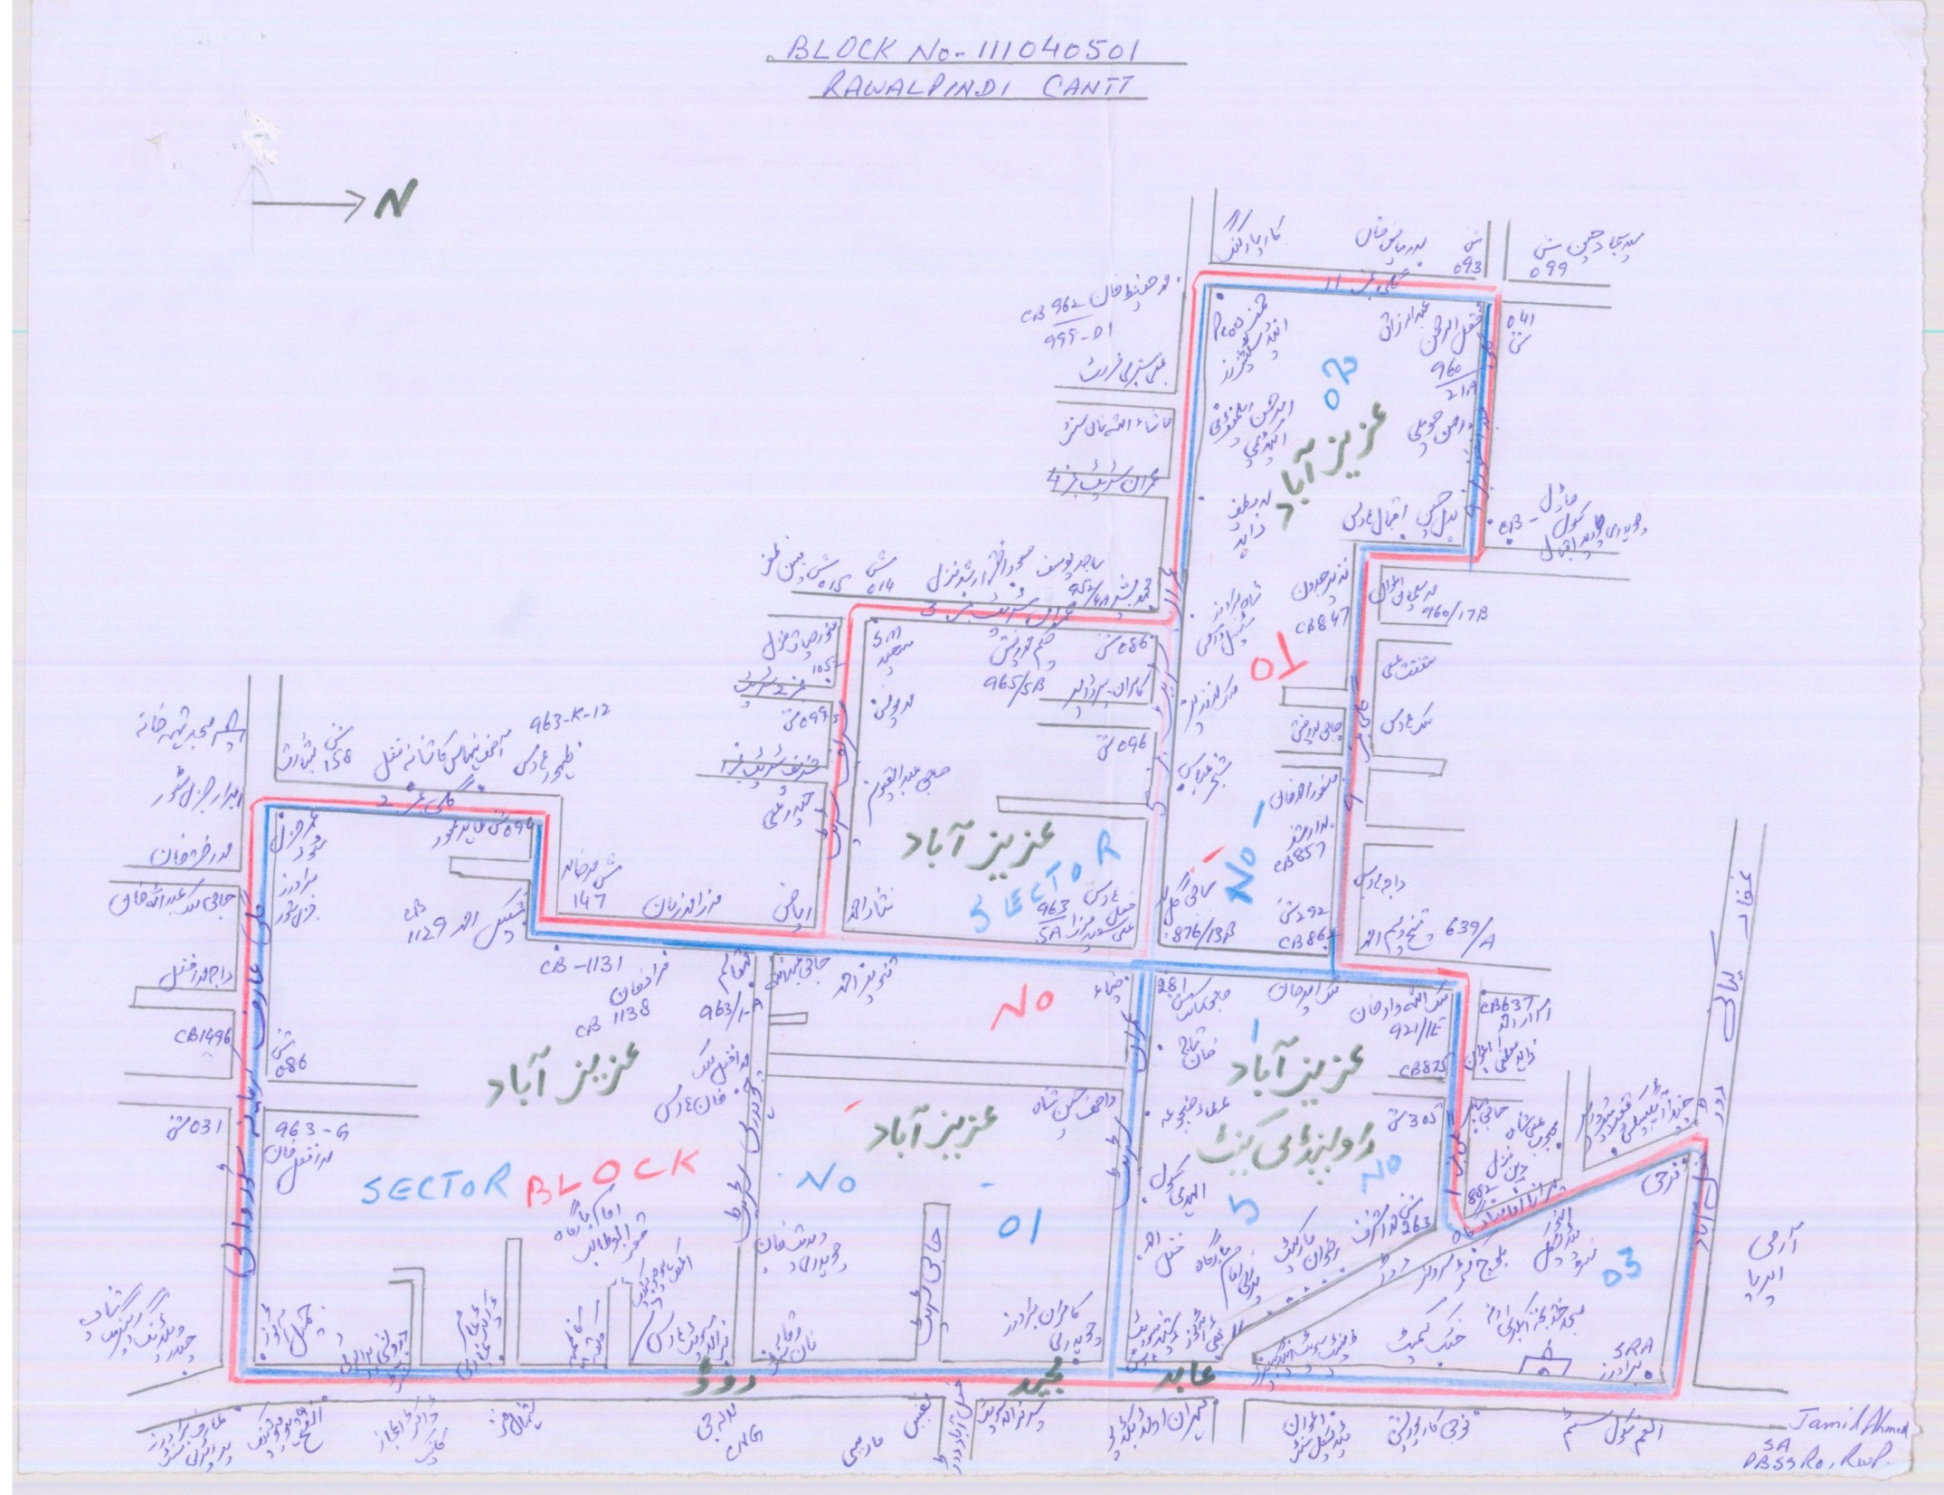

Slide 24
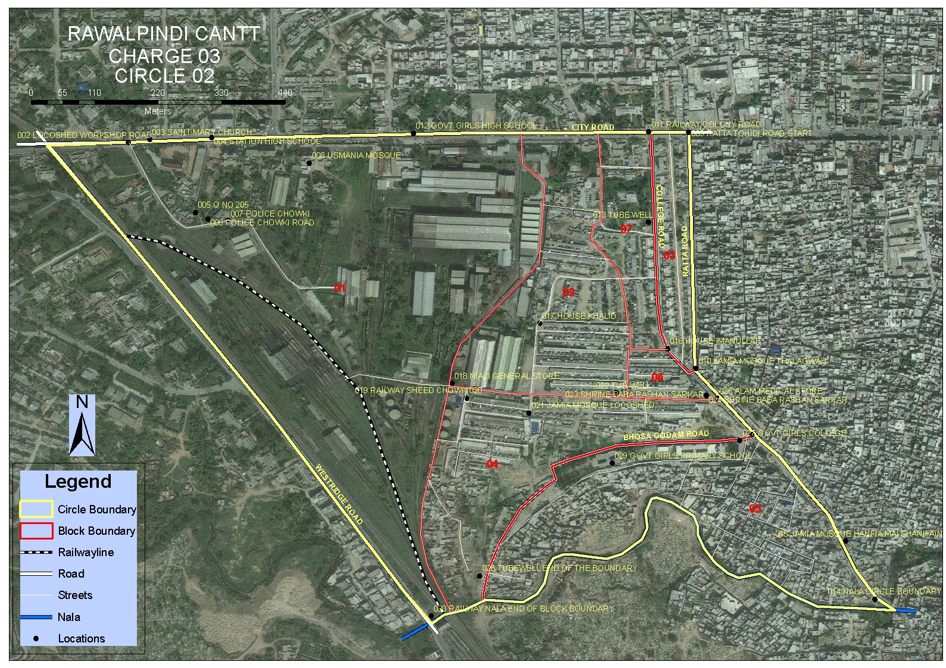

Slide 25
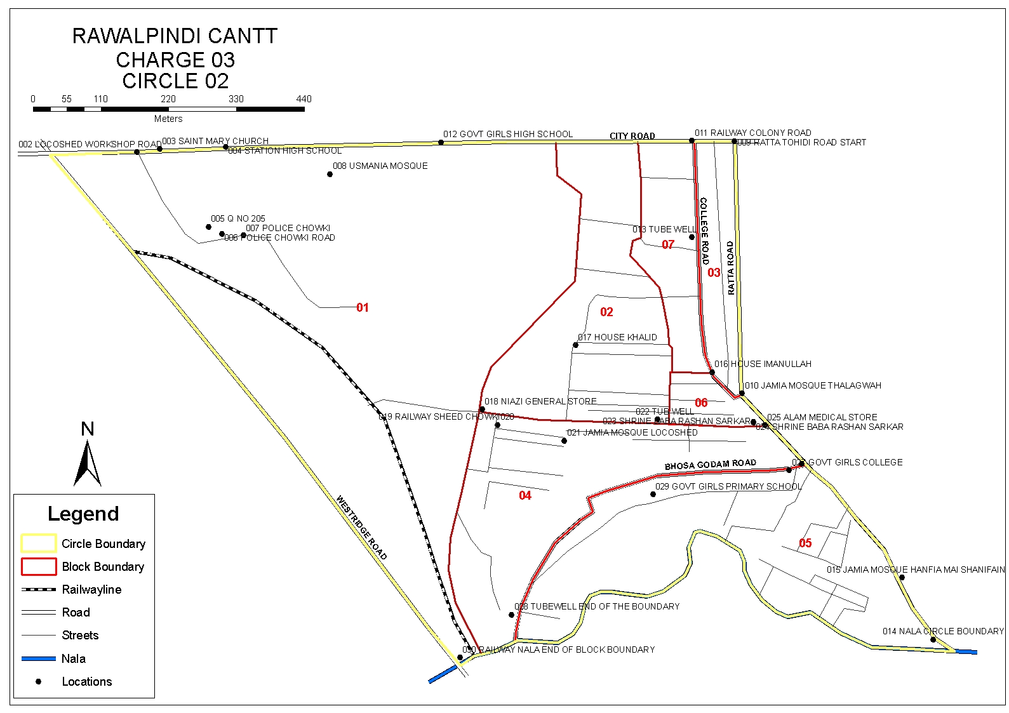

Slide 26
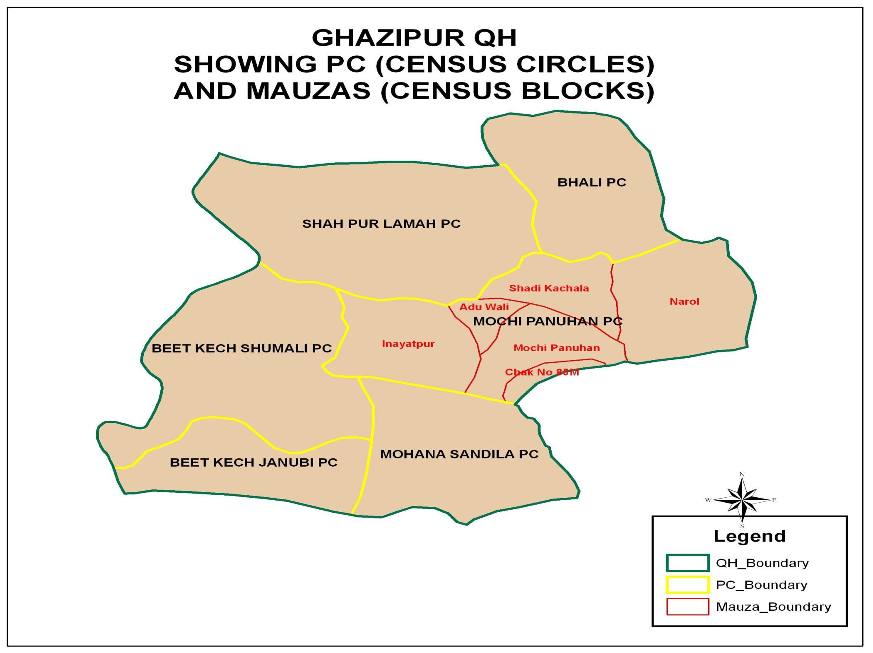

Slide 28
QUALITY ASSURANCE IN DATA PROCESSING
Efforts have been made for the Quality Assurance in the following steps of Data Processing:
Manual Editing
Scanning of ICR Forms
ICR Verification/Editing
Software Development
Data Processing/Tabulation
Table Verification

Slide 29
PREPARATION OF PROVISIONAL RESULTS
Provisional results were based on the summary Forms (REN-2) of each block
The summary forms REN-2 of 168943 blocks received separately from all over country
Data of the REN-2 is manually entered
Entered Data is verified/ checked on 100 percent basis with the received REN-2 Form after manual entry.

Slide 30
MANUAL EDITING
Checklist of Manual Editing
Checking of Block code on every form along with household number
Checking that characters are legible or not.
Checking the inconsistencies in data.
Every column must be checked for out of range values
Checking for Missing entries, which resulted from the failure of enumerator to record the required information.
Correction / Continuation of serial numbers/ Block numbers in case of sub created blocks

Slide 31
SCANNING OF ICR FORMS
CHECKLIST OF SCANNING/VERFICATION
Form-2 received from manual Editing Coding Section
Cutting Form-2 booklets
Sorting of Form-2
Scanning of Form-2
Data Verification
Preparation of CSV file of Admin District
Admin District sent for Processing/ Tabulation
Receiving of Form-2 booklets Envelops from Store
Separate the title and blank pages from filled in forms
Arrange the sorted block envelops in specified order i.e. circle wise
Send the sorted forms for scanning

Slide 32
SCANNING OF ICR FORMS
CHECKLIST OF SCANNING/VERFICATION
Receiving of work from ACC/ SO Incharge
Preparation of batch before initiating the scanning
Cross checking of block ID with frame list
Initiate scanning and ensure that all forms in the batch have been scanned correctly
Registration of batch by assigning block ID.
After successful scanning pack all the forms in relevant envelops.
Send all scanned batches to verification and also send a copy to server for backup.

Slide 33
DATA PROCESSING/TABULATION
Checklist Data Processing / Tabulation
Data Processing/Tabulation
Imputation Pre-processing Phase
Data Cleaning Phase
Tabulation Phase
Database Backup
CSV Files Processing
Tabulation Activity

Slide 34
DATA PROCESSING/TABULATION
Imputation Pre-processing Phase.
Data Analysis Phase.
Tabulation Phase
Data Cleaning Phase

Slide 35
TABLE VERFICATION
Checklist for Table Verification:-
To Check the consistency of Data in all Tables regarding Population & Housing characteristics
To Compare the Area / Population with the previous Census 1998

Slide 36
TABLE VERFICATION
ISSUES RAISED/OBSERVED DURING TABLE VERIFICATION
Area figures and their adjusted population can not compare with the previous census data 1998 of newly created Admin. Units (Districts, Tehsils/Talukas.
CNIC obtained population not match with the 18 & above.
Literacy Ratio, Growth Rate, in Adjusted Areas.

Slide 37
THANK YOU

