Slide 2
UN Regional Workshop on the 2020 World Programme on Population and Housing Censuses:
International standards and Contemporary Technologies
Bureau of Statistics Lesotho
Mr. Pelesana Moerane

Slide 3
OUTLINE
Background
Objective
Census Planning
Selection and Acquisition of Handheld Devises
Data Collection Application
Synchronization of Data
Current Status

Slide 4
Background:
Lesotho undertook a digital Population and Housing Census in April 2016. According to record, Lesotho is the first country to go digital in the SADC region.
The decision was driven by the increasing data demand in support of the African Agenda 2063, Sustainable Development Goals as well as the SADC Regional Indicative strategic development plan and the National Strategic Development Plan.
Lesotho Bureau of Statistics first used CSPro application during the 2006 population and Housing Census following regional training conducted by UN Census Bureau.
That year a scanning technology was applied in data processing.
Furthermore this was the time when the urge to migrate from manual census operations to technology emerged.

Slide 5
2016 population and Housing Census - - Objective
Having had adequate experience in using technology not only in census data processing but also in GIS in 2006, it became imperative to move on to even much more advanced technology in the form of Hand Held devises.
Some of the considerations in going this route included but not limited to timeliness in the release and publication of census results, data quality assured, coverage adequately addressed and above all, minimum time spent in administering a questionnaire in a household.

Slide 6
Census Planning:
The Bureau of Statistics, with TA from UNFPA prepared a census project document outlining the objectives, work plan, strategy and the budget.
The TA composed of expert in design of the project document and an expert in Information Technology from NSO Dakar Senegal.
The outcome of the two TA missions was a comprehensive document with a well-defined and costed IT architecture.
The choice of Senegal NSO was based on that country's experience in digital census and therefore Lesotho was able to get first-hand information relating to challenges and success stories in this regard.

Slide 7
Motivation
The decision to go digital was made despite known challenges of Lesotho in terms of poor infrastructure access roads ,electricity connectivity , limited network coverage and unfavorable topography including the threat of severe weather conditions.
Despite this the Senegalese experience strengthened our determination and commitment to beat the odds.

Slide 8
Development of Census Instruments
Three (3) types of questionnaires designed and were ready for pretests by May 2015
Household Questionnaire
Institutional and
Cattle posts
There was need therefore for training on Data Collection Application
First Training was in July 2015.
Training Guides, Controls and edit specs and Code lists were made as the application was developed.
Enumerators and Supervisors' manuals were developed by June.
And then pilot in August the same year.

Slide 9
Capacity building:
The first training was held in July 2015 for three weeks. It was delivered by US Census Bureau and tailor made for Lesotho. Participants were IT personnel as well as members of the census technical team.
The benefit of that kind of arrangement was that a good number of participants took part in the training, secondly, the fact that it was tailor made and also using Lesotho questionnaire it became more relevant and realistic.
The second intervention from US Census Bureau was November 2015 soon after the pilot census. This helped a great deal because we were able to attend to technical challenges experienced during the pilot.

Slide 10
Staff Deployment and Trainings
There were 3 types of deployed staff during data collection:
BOS employees (both technical and support staff).
Other government employees (technical and or drivers)
All Temporarily staff.
Trainings started end of February and went on until the first week od April
Reference night was the 9th April 2016

Slide 11
Staff Deployment
Supervision was intensified such that there were several layers as follows:
District Coordinators –13
Constituency Supervisors—179
Assistant Supervisors -- 1465 at a Ratio of 1:4
Enumerators –5689 including those enumerating cattle posts and institutions using paper questionnaires
IT Support Staff—57

Slide 12
Number of Tablets
The demarcated Enumeration Areas were 4685 which translated to deployment of a similar number of Enumerators.
However, the purchased number of tablets was 4770 and we already had 80 tablets that were acquired with the help of UNFPA and 10 tablets that were procured locally.
Therefore, the overall number of tablets was 4860.

Slide 13
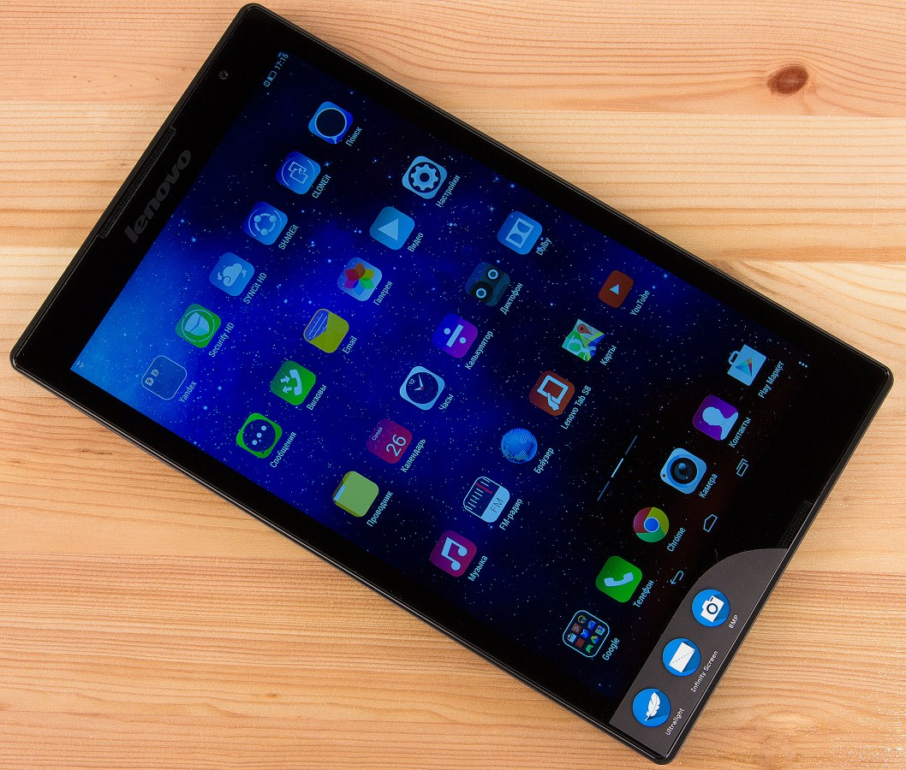
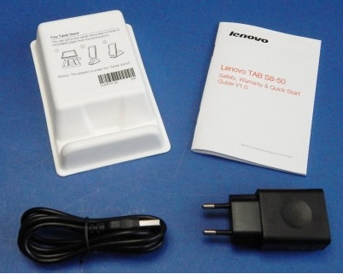
Tabs Used - Lenovo

Slide 14
Interviewer App
This is the application that was used every time by almost everyone who was engaged in the Census Project.
It was the key to all interviews done by the enumerator.

Slide 15
WPS Office
To read documents loaded on the tablet (i.e. Manuals, Statistics Act, etc)

Slide 16
Power Bank
Is an external battery in a sealed case with special circuit to control power flow
They allowed one to store electrical energy for later use it to charge up mobile device
Make sure that your Power Bank is fully charged at all times

Slide 17
Navigation buttons:
Next
Back
These buttons are used to move to the next screen or to the previous screen
If you are authenticated user enter your User Code into the textbox and tap next.
But if not consult IT Support to authorize you

Slide 18
If the code you entered is for enumerators, the application will display Enumerator menu with Username and given options. Make sure the name that appears is yours
The options are:
1. Data Entry
2. Sync with Supervisor
3. Logout
Data Entry: this option will take you to census questionnaire
Sync with Supervisor: this option is used when synchronizing with your supervisor. You synchronize with supervisor when submitting your work or when you get new updates for the application
Logout: You click this option when you want to leave the application

Slide 19
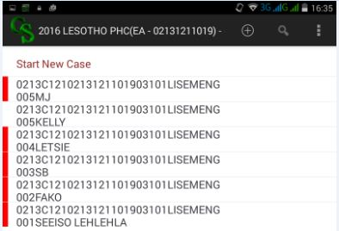
When you click on data entry in the previous screen the following screen will be shown.
A screen to enter a new case will appear. By new case we mean a new questionnaire for a household.
Click the ‘Start New Case’
A screen to enter a new case will appear. By new case we mean a new questionnaire for a household.
Click the ‘Start New Case’

Slide 20
Here you are asked to select appropriate Ward from the list.
NOTE: the Wards for this district appear on the list. Then click next
NOTE: On the left pane/frame, there are identification variables already filled in. these are District, Constituency, Community Council, Zone, Settlement and Enumeration Area. They are prefilled to easy your work.

Slide 21
If the code you entered is for assistant supervisors, the application will display Assistant Supervisor menu with Username and given options. Make sure the name that appears is yours
The options are:
1. Postcheck Households
2. Household Status
3. Approve Cases
4. Logout
Postcheck households: Used to open application for post checking
Household Status: either view all households enumerated or view by Date households enumerated in that particular day.
Approve Cases: whereby the enumerator has partially saved cases as to enable him/herr to complete those cases.
Logout: As in the previous slide
Notes: all of these functions will indicate that data is not available till enumerator has enumerated.

Slide 22
If the code you entered is for constituency supervisors, the application will display Constituency Supervisor menu with Username and given options
View Data: It takes you to Summary report menu
Sex Ratio: view males and females by EA or All the EAs assigned and synchronized
Population Pyramid: view population distribution by age for a selected EA or All EAs assigned and synchronized
Household Status: as in the previous slide
Sync with Enum: Synchronize with enumerator to get work completed or give him/her new updates to the application
Sync with HQ: Send work completed to the server at BOS head quarters
NOTE: These reports are for quality checks. You are expected to run them before you could send data to the server

Slide 23
Technical Architecture

Slide 24
Challenges – Delayed Procurement Processes let to;
Failure to acquire the services of a local ISP internet service provider
Wi-Fi from District Offices was used for synchronizing data to the servers in Head Quarters.
Failure to acquire devise brand preferred (those being either Mecer or Lenovo or Samsung).
Among the preferred devises, we only got Lenovo. The other two devises caused us a lot of problems such as, batteries which did not last long even when fully charged, their incapability in capturing the GPS and they would sometimes exit the application without saving the case.

Slide 25
Challenges – Delayed Procurement Processes let to;
Delayed arrival of the devises. The last bunch arrived a 2 weeks before the census night. So setting up of such devises was a hustle as they arrived almost at the same time.
Inadequate number of solar Chargers and Power Banks.
The supervisors had to take the tablets, charge them overnight and then return them to enumerators the following morning.

Slide 26
Challenges – Missing Cases
In the initial stages, the main technical problem observed was the cases that disappeared after the enumerator has completed enumeration.
The main reason for this was that the identification fields were too long and this caused the application to hide all completed cases.
Some Enumerators panicked and therefore remunerated the households.
This had let to duplicates in our data.
With the help of US Census Bureau, our data processing team was able to rectify that and improve the application.

Slide 27
Challenges – Getting Updates
To get these updates therefore, Constituency Supervisors had to synchronize with the server and then go and synchronize with the enumerators.
However, there was a delay in other enumerators getting such updates, especially those who were in the remote area hence, their supervisors were reluctant to either sync with the server to get the updates or go to the enumerators to update their applications.

Slide 28
Challenges – Broken Tabs
Broken tablets – some fell down and were broken, while others just went off
The supplier was able to power them up and the data was then retrieved from those tabs.

Slide 29
Challenges – Devise management
Lack of mobile devise management. This was caused by a delay in the purchasing of such devise, as a result, there were no preparations made for receiving, managing and tracking of such.
Traditional way of signing for taken equipment was deployed.
Luckily all of them except one were returned. That one was reported stolen and the case is still with police.

Slide 30
Challenges – Swapped EAs
After deployment, some Enumerators Swapped or exchanged the Enumeration Areas maps, and enumerated the EA that was not allocated to them initially.
This led to some difficulty in structural cleaning of the data
We recommend that during deployment, enumerators be given the tabs with everything pre-installed in them (applications, manuals, EA maps etc)

Slide 31
Recommendation
We took a risk of applying this new method in a project of this magnitude. Though we have the positive results, we recommend that small scales survey would be a good way to start.

Slide 32
Benefits -- My Gratitude
Digital census saves a lot of time and saves on the budget. It cuts lot of processes such as data cleaning, data entry etc. as such there is no longer a need to recruit data entry clerks, coding clerks etc.
Time taken in a household is reduced drastically thus allowing for more coverage in a short space of time.
The design of the application makes it easier for an enumerator to edit the work as they go.
The cost of the tablets continues to go down therefore access will no longer be a hustle in the long run.
It is necessary to procure census materials on time and to the extend possible, go for the best brands.
Data revolution calls for improved technology in census.

Slide 33
The End

