Slide 1
Implementing technology in Census Data Management

Slide 2
NSA goes CAPI
It is better to prevent errors than to cure them later (Redman 2001)

Slide 3
Why NSA goes CAPI
Accuracy of data collection
Improved project completion time
Timeliness and availability of data
Flexibility of technology
Cost – effective ( especially for large and re- occurring surveys)
Notes:
Questionnaire logistics reduced, replaced manual processes e.g. post data capturing, recruitment of data entry clerks,
Improve data quality through..
Setting up type of data, and upper and lower boundaries
Automated routing (skips)
Direct consistency checks and data validation during fieldwork
Pre‐coded drop down menus or radio‐buttons
Provision to use visual aid and technical support
More accurate measurement..e.g... GPS coordinates
Dynamic question text
Dynamic and cascading value sets
Hard and soft edit checks
Other (Specify)
Date controls
Notes
Case tree
Validation and completeness of sections
Help text

Slide 4
NSA and CAPI Successful stories
Agriculture Census 2013/14
Used laptop Acer 15inch
Namibia Household Income Expenditure Survey 2015/16 – 10600 HHs
Namibia Inter-censual Survey 2016 - 12000HHs
Labour Force Survey (NIDS) 2016 - 12000HHs
NIDS and LFS 2016 took 3 months for data processing.
Notes:
Spent more time in system development, and less time in post data processing – Because data management applications ( data entry, data transmission, cleaning, recodes, edit) were all developed BEFORE fieldwork.
The environment was ready for processing by the time fieldwork ended.
The only programming done after fieldwork was specific edits and recodes.

Slide 5
Census 2021 Planning Data collection tools design Considerations

Slide 6
Considerations of technology
Software main features
Case management
In field automation sampling process
Advanced programming languages
Case tree (menu)
Selection of handheld device
GPS and mapping
Data synchronization and backups
Storage capacity
Device performance in terms of processing power
Compatibility with CSPro (Window & Android platform)
user friendliness in terms of weight and size

Slide 7
NSA & Census and Survey Processing System (CSPro)

Slide 8
CSPro and NSA
CSPro – Census and Survey Processing System
Developed by U.S. Census Bureau
CSEntry Android application, First release in 2014
Data entry, edits and imputations and tabulation
Main CSPro features
Support multiple languages
Sophisticated programming languages
Tightly controlled path
Data synchronization
Notes:
-Sophisticated programming languages that can be used to create highly customized applications
- Ability to create a dynamic application ( value sets )

Slide 9
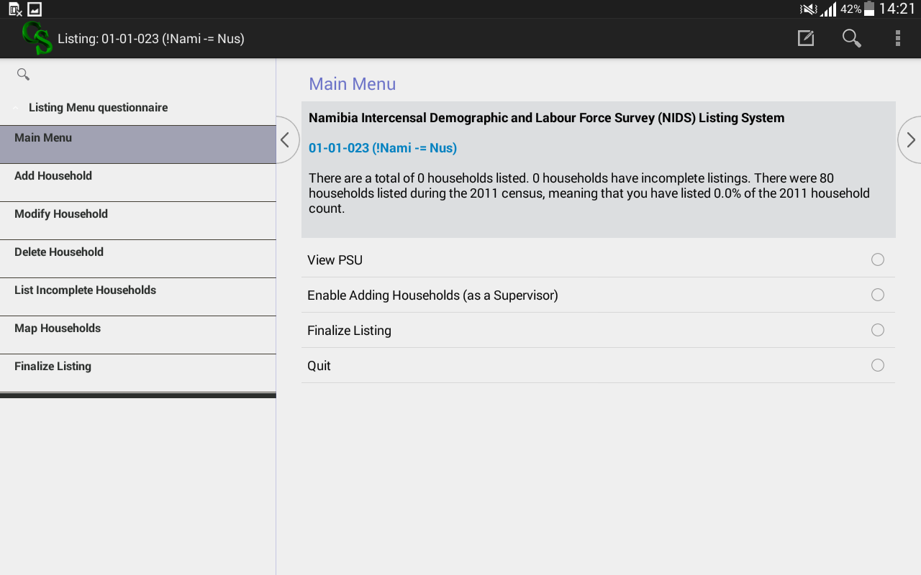
Why CSPro?
Case Management
Segregation of roles , HH assignment, completeness and accuracy controls
Interview assignments
Field supervisor can assign interviews
Field Supervisor overseen the completeness and quality of interviewer output
Transferring data to the central server

Slide 10
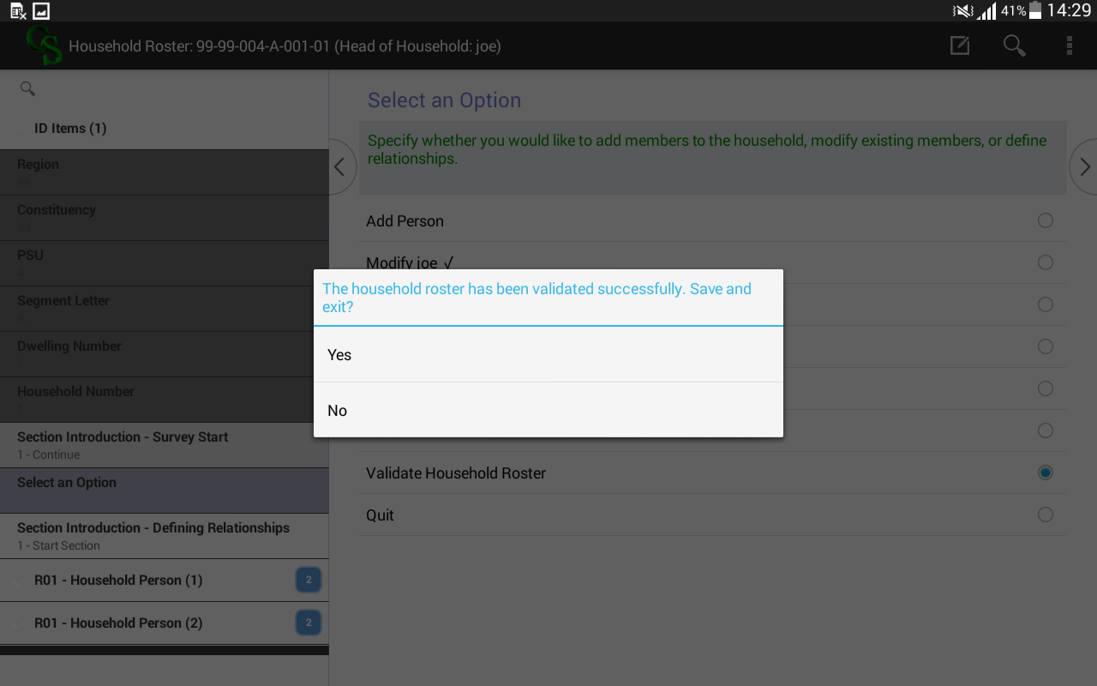
Why CSPro?
Improve data quality through..
Automated routing (skips patterns)
Direct consistency checks and data validation during fieldwork
Pre‐coded drop down menus or radio‐buttons
More accurate measurement..e.g... GPS coordinates
Notes:
Dynamic question text
Additional CAPI Elements
Dynamic and cascading value sets
Hard and soft edit checks
Other (Specify)
Date controls
Notes
Case tree
Validation and completeness of sections
Help text

Slide 11
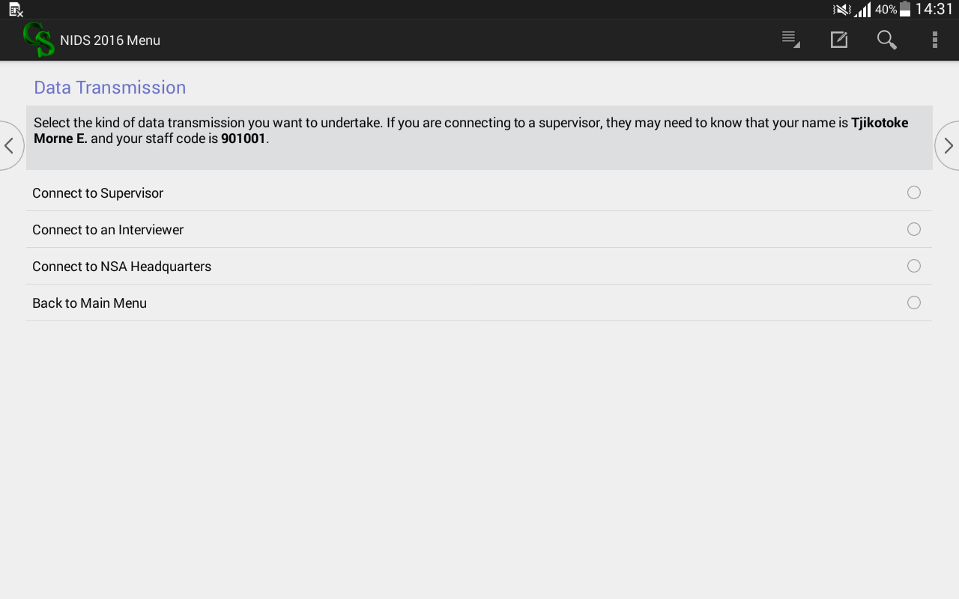
Why CSPro?
Data Transfer – Data is transmitted via FTP
including transfer protocols that encrypt and protect sensitive survey data

Slide 12
Why CSPro? Cont…
Case tree – makes navigation easier
Visibility of entered records on the same screen

Slide 13
Lessons learned from first implementation
CAPI
Notes:
Implemented measures – these are already in place

Slide 14
DP- Lessons learned
Planning Phase
New technology without proper methodology assessment done < resources , time & costs)
Advanced programming required (CSPro etc..) ,support from U.S. Census
New technology for a complex survey on very tight schedule/timeline
Lack of Process /Methodology change management < awareness & understanding>
Design Phase
Questionnaire & System specifications plan ( Business rules, edits rules, recodes, derived variables, Tabulation) needed earlier
Incomplete project process data flow leads to risky continual application updates during fieldwork
Not sufficient built –in buffer time in the project plan
Lack of project change control measures limited accountability
Notes:
Main survey processes and specification were not defined /developed before fieldwork
Post data processing requirements not defined and no plan after data collection
Tabulation plan
Data editing requirements ,
Derived variables requirements were only realized 5months into data collection process
Lack of specifications in a written and standardized format
Questionnaire development without defined Tabulation /Analysis plan
Project process & change management not implemented effectively
The whole survey process changes with the technology (e.g. edit rules samples, staff allocation, minmax, case management, monitoring etc.)

Slide 15
DP - Lessons learned
Build / Execution
Android CSEntry application was being upgraded and more features added during production
Insufficient testing plan and procedures < no test end-to-end >
Pilot study done partially
Supervisors & enumerators need basic IT skills
IT risks (loss, crash, fallback) support needed

Slide 16
CAPI and Process Change Management
ICT Infrastructures
Backup and Storage of data. Need to have access to internet or USB / External drives.
Data is kept on the tablets until completion of project data analysis
Power Availability. Computer batteries need to be recharged…. a bit difficult with remote areas with no electricity.
Availability of technological support ( timely availability of IT equipments, Networking and intenet access for transfering and updating of files )

Slide 17
CAPI and Process Change Management
Things must be done earlier than usual at least six month for a survey
Tabulation plan
Finalise questionnaire content
Define business process flow and field structure(e.g. sampling frame)
Data editing rules & specifications ( rules, upper /lower data range, derived variables and so on)
Subject Matter and Data Management must co-operate more closely
Invest more time on planning for all project KEY stakeholders
Ensure comprehensive system testing by both stakeholders
CAPI is (only) a tool - Project management & people stay essential
Notes:
Data processors, IT & SM staff more need time

Slide 18
Getting ready for Census 2021…
Notes:
Implemented measures – these are already in place

Slide 19
Implemented measures
Adopted a standard data processing tool - CSPro
Invested in capacity training to Key DP staff
Sponsors – UNFPA ,USAID, Ukaid
Instructor – U.S. Census Bureau
90% of the programmers are trained in Android CSPro programming Version.6.3
Improved process documentations supported by templates( specification requirements, change control, system testing procedures + sign off)
Notes:
Implemented measures – these are already in place

Slide 20
ICT – implemented mitigations
Secure file transmission server (sftp)
Centralized encryption for data and devices and remote device management
Assets inventory management
Backup plans, recovery plans, redundancy and high systems availability.
Internet provision for the field users, only until team supervisor level.
ICT support staff during fieldwork – ICT office for each region
Notes:
Centralised applications deployment system to deploy all applications and configurations onto the handhelds at the same time, to reduces the time needed to setup handhelds and removes the chances or errors caused during configuration or deployment.

Slide 21
Envisioned System Improvement
Planning
Start earlier with the planning and setting up project architectural for Census 2021
Questionnaire design ( indicators and edit rules) finalized earlier prior to system development – atleast a year before
Increase permanent data processing staff
Sharing resources ( skills and devices) with other African countries
Improve field quality assurance and control
Develop a web-based report tool – enable real time reporting at field level
Monitor the enumerator progress per EA as linked to the GIS-component
Timely correction and solving field problems as they occurs
Management daily monitoring and progress report
Notes:
In
crease permanent data processing staff – Senior database administrator , Senior system Analyst and 2 programmers

Slide 22
CAPI – Data flow

Slide 23
ICT Infrastructures

Slide 24
Thank you

