Slide 1
Census Planning and Management
United Nations Regional Workshop on the 2020 World Programme on Population and Housing Censuses: International Standards and Contemporary Technologies
Lusaka, Zambia, 20-23 March 2017
Central Statistical Office
Zambia

Slide 2
Outline
Census undertaking in Zambia
Census Organisation
Census Planning
Planning for Mapping
Enumeration Plan
Questionnaire Design
Pilot Census
Plans for Enumeration
Data Processing
Dissemination

Slide 3
Census Undertaking in Zambia
Five Censuses carried out so far
1969
1980
1990
2000
2010

Slide 4
Census Organisation
The census undertakings have been nationally organised with Government taking the lead (Committees from national to district levels)
Census supported by the census and statistics act
A number of committees are formed to oversee the census undertaking

Slide 5
Census Organisation Structure

Slide 6
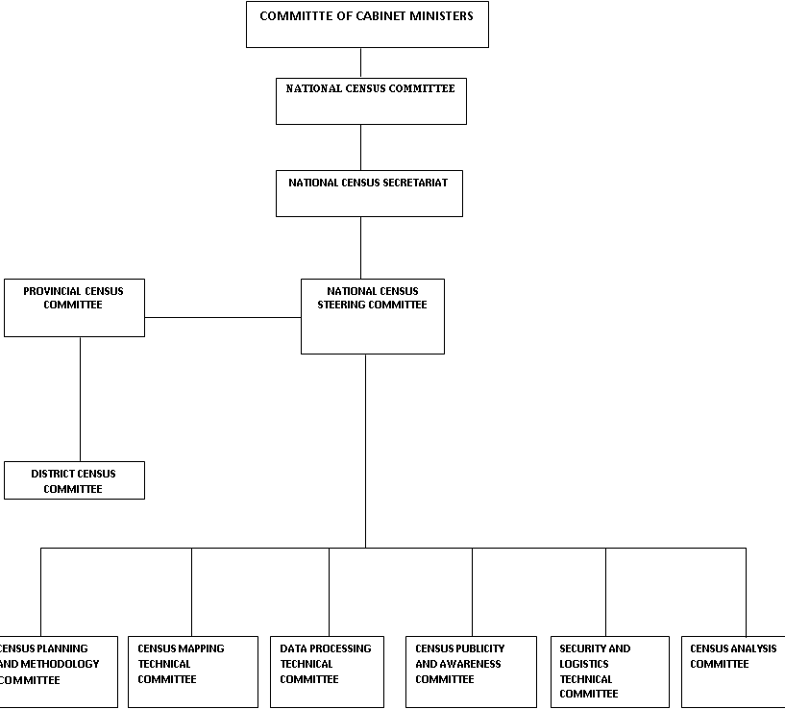

Slide 7
Census Planning
Forms an integral part of the census as it success depends on it
Production of the census project document
Resource mobilization
Activity Schedule
Plan for capacity building
Plan for all other stages of the census

Slide 8
Census Planning_Contd
Consultation with users
Identifying areas of need and organisations to offer the services
Census legislation/CAB memo
Production of the Cabinet memorandum

Slide 9
Census Planning_Contd
Organization of Committees
Formation of Committees:
Census secretariat.
National census committee.
Committee of cabinet ministers.
Census mapping technical committee.
Census steering committee.
Provincial census committees.
District census committees.
Design and methodology technical committee.
Census data processing technical committee.
Census publicity and awareness technical committee.
Census logistics and security technical committee.
Census analysis technical committee.
Census Planning and resource mobilisation Committee

Slide 10
Census Planning_Contd
Plan for data processing:
Plan for the software to be used.
Use of new technologies for data capture and processing
Hardware requirements.
Capacity requirements.

Slide 11
Planning for Census Mapping
Investigation of latest mapping technology
Procurement of census mapping equipment and satellite imagery
Procure of GIS hardware and software.
Procurement of the satellite imagery.
Procurement of printing materials, field and office supplies.
Data editing and harmonisation, integration of EAs with satelite imagery:
Data editing and harmonisation, integration of EAs with satelite imagery
Pilot mapping and identifying number of households by small area
Pilot mapping and identifying number of households by small area

Slide 12
Planning for Census Mapping _Contd
Recruiting GIS staff
Engaging and recruitment of GIS staff.
Training of mapping staff
Field mapping
Delivery of materials and setting up of the GIS LAB.
Deployment of field staff.
Gathering point data and demarcation of enumeration area (EA) boundary.
Creating a GIS database
Production of maps
Printing base maps and EA maps for field work

Slide 13
Enumeration Plans
Agreement on the enumeration method to be used; person to person interviews using tablets
Procedures for control of the quality of data.
Estimation of the number of households and population.
Procedures for capturing institutional population.
Only the age and sex has been collected in the previous censuses
Procedures for enumerating homeless populations.
In Zambia there are no nomadic populations
People not in homes or institutions have always been left out

Slide 14
Questionnaire Design
Selection of topics for questionnaire
Consultative meetings with users on the topics to be included
Development of census tabulation and analysis Plan
Consultative meetings on the census tabulation plan
Development of manuals
Enumerator’s, Supervisor’s and Master trainer’s and CAPI

Slide 15
Pilot Census
To be done exact a year before the census
Selection of areas to be covered
Coming up with areas for conducting the pilot census
Programming of draft questionnaires
Programming and testing of the draft questionnaires
Printing of draft manuals
Printing of draft manuals

Slide 16
Pilot Census_Contd
Engagement of Pilot Census Staff
Engaging and training of master trainers.
Recruitment and training of other field staff.
Preparation of tablets
Installing software and configuring tablets
Field enumeration in the selected areas
Data processing (Tabulations)
Analysis and evaluation of data
Production of detailed report

Slide 17
Census Enumeration
Inventory for Preparedness
Checklist of all requirements for the field work
Training of field staff
Deployment of field staff
Deployment of field staff
Field enumeration
Assembling of field materials
Collection of materials from all field staff

Slide 18
Plan for Post Enumeration Survey (PES)
Production of the PES plan
Civil Registration is still very weak to be used to evaluate the census
PES to be conducted immediately after the census count

Slide 19
Plan for Recruiting and Training Enumerators
Deciding on the age and academic qualifications of staff to use.
School leavers vs secondary school pupils
Plan for training venues.
Schools
Hotels or lodges

Slide 20
Data Processing
Data Processing strategies:
Data compilation and preparation.
Data cleaning
Procurement of data collection and processing equipment
Establishing the workforce structure and recruiting staff:
Engagement of data processing staff and production of the data processing organogram
Processing operations, edit and imputation:
Data processing, running of editing and imputation programs.

Slide 21
Dissemination of Census Results
Preliminary results:
Production of preliminary tables and report, 4 months after the census count.
Summary census results:
Production of the census summary report
Final census results:
Production of final results.

Slide 22
End of presentation Thank you for listening!

