Slide 1
South Africa
Census Planning and Management
Calvin Molongoana
Chief Director: Census Operations

Slide 2
Introduction (1/2)
The UN conference on Population and Housing censuses was held in 2015 in New York.
A resolution was taken on the 2020 World Population and Housing censuses. It recommends that all member states conducts at least one population and housing census during the 2020 round of censuses
The 2020 round of censuses should take into account:
international and regional recommendations relating to population and housing censuses and giving particular attention to advance planning,
cost efficiency,
coverage and the timely dissemination of, and easy access to, census results in order to inform decisions and facilitate the effective implementation of development plans and programmes.

Slide 3
Introduction (2/2)
The UN resolution coincides with the South African plan to conduct the Census in 2021.
The purpose of conducting the 2020 round of population and housing censuses is to ensure the coordination of activities amongst the member states
Statistics Act No. 6 of 1999 requires Statistics South Africa to conduct the population and housing census every 5 years
Census 2021 will answer key questions for the country including:
How many we are?
Who are we? In terms of Demographics and other characteristics
Where do we live? In terms of housing, access to water, availability of essential facilities, and access to the Internet.

Slide 4
Route Path to Planning
Review lessons learnt from previous censuses and large scale surveys:
Census 1996; 2001; & 2011
Community Survey 2007 & 2016
Citizen Satisfaction Survey
South Africa Demographic & Health Survey 2017
Use the current surveys to test and fine tune strategies, plans, methodologies and procedures of Census 2021. these will include:
Survey of Agriculture; and
Transition from PAPI to CAPI project

Slide 5
Census Value Chain

Slide 6
Where are we?
Conceptualisation of Census 2021
Strategies, Plans, methodologies & procedures
Development of Census 2021 Charter
Census 2021 Budget
Use CS 2016 budget as base including CPI inflation to come up with the estimated Census 2021 budget
Setting up of Census 2021 committees:
Advisory Committee
Steering Committee
Nerve Centre
Technical Committee

Slide 7
Key Concerns
Localised recruitment
Targeted online recruitment
Undercount in certain categories
High walled Eas
Farming Eas
Multi Channel data collection
Online
CAPI for census this size?
Funding pressures

Slide 10
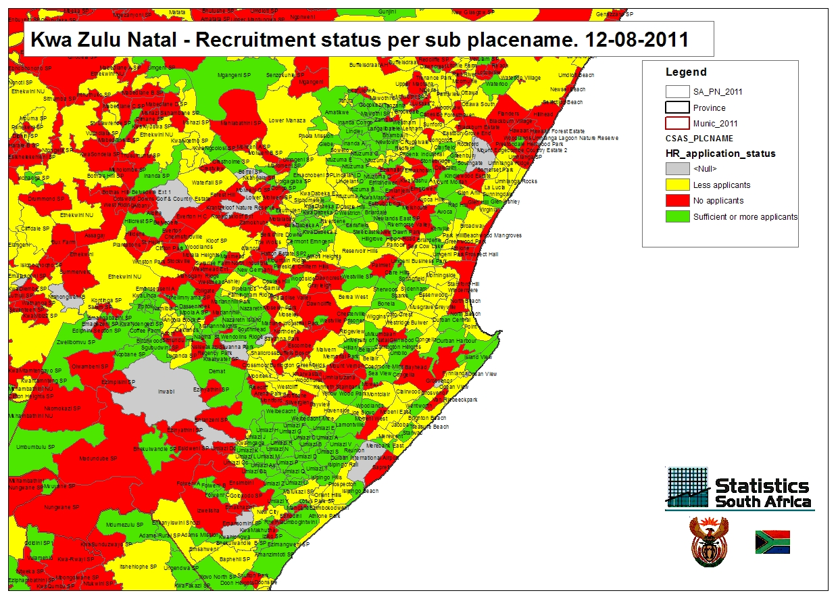

Slide 11
Way Forward
Implement recommendations from previous censuses and surveys into Census 2021 plans
Set up and run Census 2021 committees
Finalise the Census 2021 Charter and Budget
Implement Census 2021 activities

Slide 12
THANK YOU!

