Slide 1
UN Regional Workshop on 2020 World Programme on Population and Housing Censuses Census Geospatial Programme: Kenyan Experience Dar-es-Salaam, Tanzania, 29 May-1 June 2017
Emma Akelo Odhiambo
Kenya National Bureau of Statistics
P.O Box 30266-00100
Nairobi
Email: eodhiambo@knbs.or.ke

Slide 2
Outline
Background
Planning the census mapping processes
National Census Geography
Enumeration Areas
Development and Maintenance of geospatial infrastructure
Cost of Geospatial technology
Benefits of Geospatial technology
Challenges

Slide 3
Background
Kenya has conducted 7 censuses in 1948, 1962, 1969, 1979, 1989, 1999 and 2009.
The next is scheduled for August, 2019
Conducting a Census is a spatial undertaking
Geospatial technologies is essential in the three phases of census undertaking.

Slide 4
Background …
In1948, 1969, 1979 and 1989 census mapping methods were manual.
Use of prismatic compasses, sketching and drafting of enumeration area maps were achieved manually.
In1999 geospatial technology (GIS and GPS)was introduced
2009 Census fully embraced the use of geospatial technology (GIS, GPS and aerial photographs for major urban areas).

Slide 5
Background…
The following are being used to delineate Enumeration areas for the 2019 KPHC :
Geographic Information Systems
Smartphones with in-built GPS
Satellite imagery (rural areas)
Aerial photographs (urban areas)

Slide 6
Planning and Implementing a Census Geospatial Programme
Census project proposal outlines various activities to be implemented including geospatial ones
Development and testing of mapping tools and methodology
Piloting and finalization of geospatial mapping tools and methodology
Rolling out delineation of enumeration areas in the whole country
Map production for enumeration
Dissemination

Slide 7
Planning the Census processes using geospatial tools
Factors to being considered:
UN recommendations
Technical/human resource capacity
Staffing levels
Collaboration with other agencies
Cost implication
Time implication
Methodology
Software and hardware
Products to be generated
Accuracy of the products
Designing of geospatial database
Availability of base maps for mapping

Slide 8
Managerial Consideration in Developing geospatial infrastructure
Needs Assessment: is undertaken to assess the capacity and preparedness to undertake cartographic mapping in terms of:
Human resource (capacity and numbers)
Equipment (vehicles, hardware, IT gadgets)
Software (e.g. Applications, licenses)
Base maps
Office space
Maintenance of software and equipment
Licenses

Slide 9
Managerial Consideration in Development of geospatial infrastructure
Revamping the GIS Laboratory: to ensure that efficient and high quality maps are produced.
Capacity Building: The strategies employed here include:
In-house training (data collection)
short and long term courses (3 months training GIS/GPS- RCMRD; 18 months on cartography- local and international)
technical assistance from experts (US census Bureau, ESRI)
Benchmarking in countries that have used similar methodology

Slide 10
Managerial Consideration in Development of geospatial infrastructure
Collaboration with other institutions: to harmonize the relevant methodologies with a view to benefit from the experiences and best practices in various aspects of geo-spatial technology.(Survey of Kenya, Independent Electoral Boundary Commission, DRSRS RCMRD)
Contracting out: To help in completing the scheduled activities within the planned period (when necessary) ESRI on software, aerial and satellite imagery

Slide 11
Defining the National Census Geography
Census geography describes the subdivision of the country into geographical units for the purposes of the census.
There are two major uses of a census geography:
To facilitate the organization and management of the census itself;
To provide an appropriate framework for the publication and dissemination of disaggregated census statistics which meet users’ needs.
In defining the national census geography, the following are taken into consideration: administrative and political structures as well as users needs

Slide 13
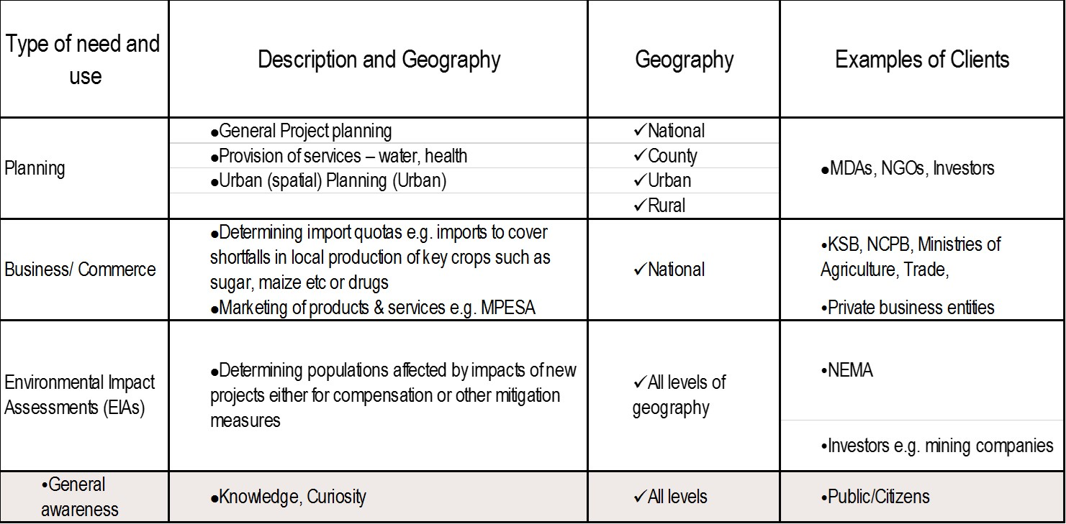
Defining the National Census Geography…

Slide 14
Defining the National Census Geography… Geographic Structure
COLLECTION GEOGRAPHY (Administrative)
Enumeration Area
COLLECTION GEOGRAPHY (Political)
COLLECTION GEOGRAPHY (Residence)
Rural
Urban
County
Sub County
Division
Location
Sub location
Village
National
County
Constituency
Ward
DISSEMINATION GEOGRAPHY
Sub Location
Location
Division
Sub County
County
Ward
Constituency
National

Slide 15
Constructing Enumeration Areas (EAs)
Factors considered when constructing an Enumeration Area (EA):
Follow administrative hierarchy
Village and administrative boundaries (no overlapping )
Size (number of Households average 100; range 50 to 149)
Physical features to form EA boundary( hydrology, communication, etc.)
Terrain
Vastness

Slide 16
Cost of investing in geospatial technology
About 15 % of the census budget is used for census geospatial programme
System design
Hardware and software acquisition
Human resource (capacity and numbers)
Outsourced services
Geo-database design

Slide 17
Cost of investing in geospatial technology…
Transitional costs: digitization etc.
Data acquisition and capture
Quality control
System maintenance and
Product development

Slide 18
Benefits of investing in geospatial technology
Time saving in some of the processes e.g production of duplicate maps
Long term cost saving
Improved accuracy and quality of maps
Credibility of map products
identification of gaps and overlaps
Tracking and monitoring of work progress
Enriched dissemination of census results
Mji Kumi initiative – improved Security
Enhanced data manipulation (integration, Querying, computation of areas etc.)
Better service delivery
Improved consistency
Improved analysis at various levels
Improved data sharing
Availability of georeferenced data for informed policy formulation
Capacity building achieved for many

Slide 19
Institutional, organizational and technological challenges in census mapping operations
Institutional
Lack of a central co-coordinating agency for both spatial and attribute data
Standardization of collection and management of geographical information
Lack of geo referenced spatial data
Geo spatial data is scattered in various institutions
Lack of clear dissemination policy on geospatial data & sharing amongst institutions
Varying definitions for urban, peri-urban and rural

Slide 20
Institutional, organizational and technological challenges with census mapping operations…
Organizational :
Slow uptake of emerging technologies
Bureaucracy (flow of funds, procurement procedures)

Slide 21
Institutional, organizational and technological challenges with census mapping operations…
Technical
Hardware reliability and software compatibility
Limitation in sharing the GIS software due to license restrictions
High cost of data collection and capture
Compatibility of data from different sources
The choice of the most suitable mapping application

Slide 22
Conclusion
The initial cost of implementing geospatial technology may be high; however, the long term benefits overweigh the costs, hence use of technology is unavoidable
The benefits of implementing geospatial technology greatly depend on proper planning and timely execution of the project activities

Slide 23
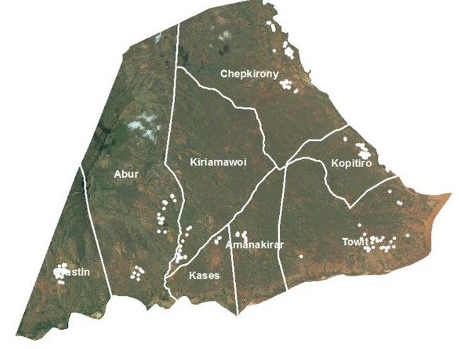
Enumeration Areas in Agricultural Areas
Enumeration in Hilly Terrain- North Pokot

Slide 24
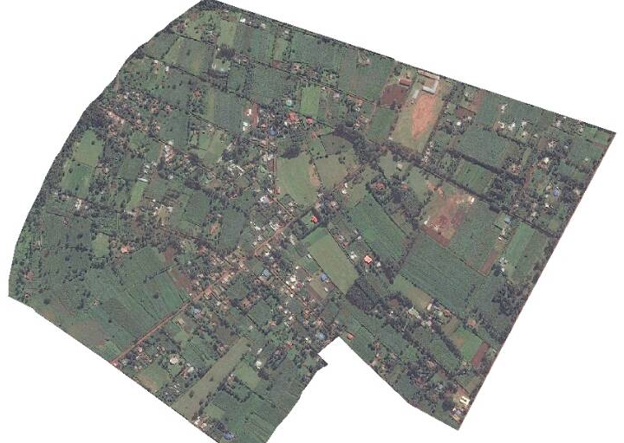
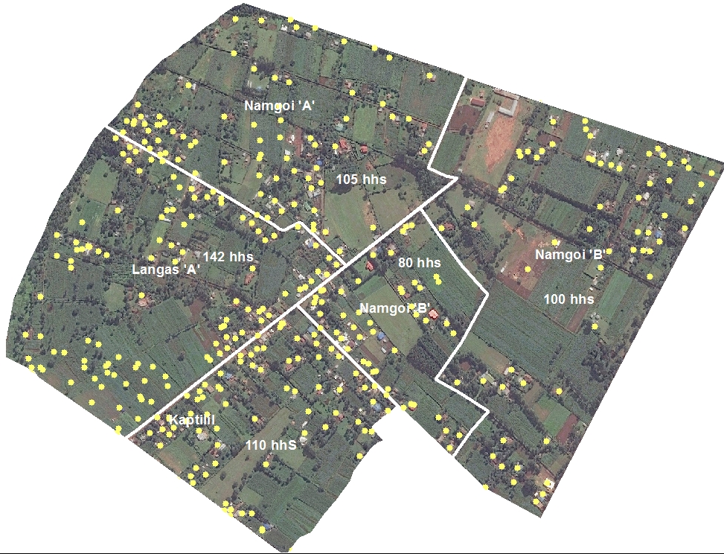
B: Enumeration Areas: with Homestead Coordinates
Points are picked using a smart phone, the points and all the data are sent to the server. Points are down loaded and organized and mapped in a GIS system Each mapping assistant is able to cover one EA in rural areas and two in Urban areas
A: Satellite Imagery before plotting Household coordinates

Slide 25
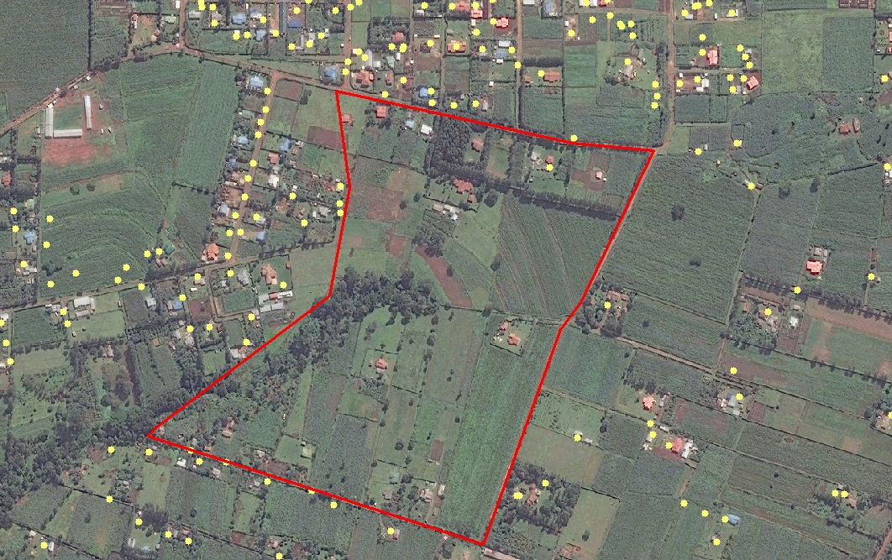
Monitoring of field work
Imagery is used to check on coverage – overlaps or gaps as shown in the area marked in red
The system is also used to monitor output of each mapping assistant on a daily basis

Slide 26
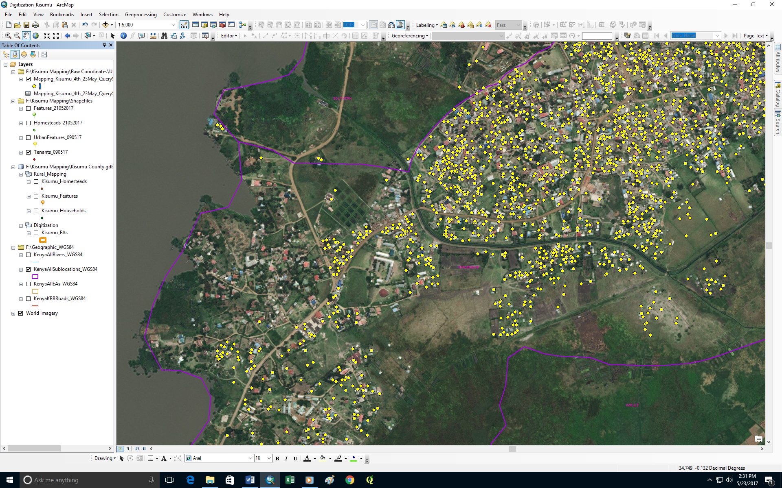

Slide 27
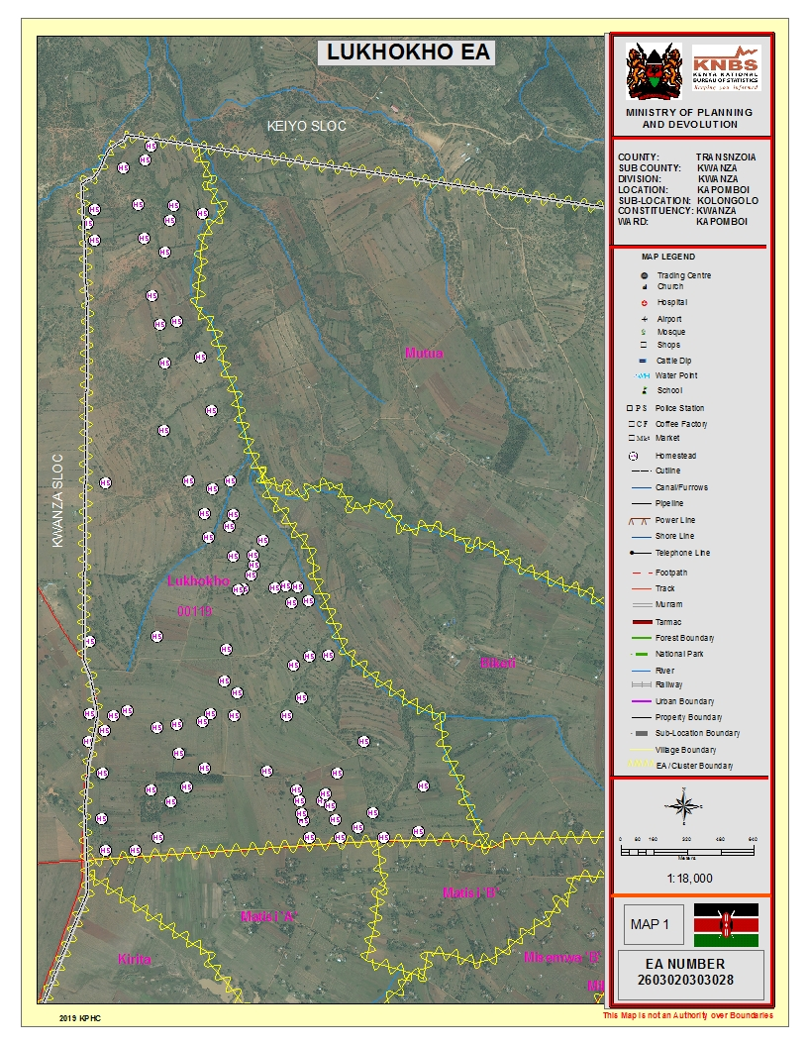
Final Enumeration Area Maps

