Slide 1

NATIONAL INSTITUTE OF STATISTICS OF RWANDA
United Nations Regional Workshop on the 2020 World Programme on Population and Housing Censuses: International Standards and Contemporary Technologies; DRES-ES-SALAAM 29 May- 1 June, 2017
Quality Assurance in Population and Housing Censuses
By HABARUGIRA Venant
Notes:
Quality Control refers to quality related activities associated with the creation of census deliverables. It is used to verify that deliverables are of acceptable quality.
Peer reviews
Testing process.
Quality Assurance refers to the process used to create census deliverables, and can be performed by census management.
Checklists
Preventive measures system
In-process census audits.

Slide 2
Introduction
NSOs are committed to provide accurate, timely, and cost-effective population count through censuses.
Experience reveals areas of potential risk that could hamper efforts in conducting censuses, particularly regarding: Quality assurance (QA), Quality control (QC)
Quality in the census context means
Conformance to requirements.
Conformance to mutually agreed-to expectations.
Fitness for use.

Slide 3
Conceptual Framework
Quality= Fitness of use.
It has to satisfy:
Utility: usefulness for user
Objectivity: accurate, reliable, and unbiased, clear
Integrity: protection from unauthorized access
Definition of utility, objectivity, and integrity in terms of six dimensions:
Relevance
Accuracy
Timeliness
Accessibility
Interpretability
Transparency.

Slide 4
0. OVERVIEW OF THE PHC IN RWANDA
So far, 4 rounds of Population and Housing Censuses have been Conducted:
1978 : Pop. 4,831,527
1991 : Pop. 7,157,551
2002 : Pop. 8,128,553
2012 : Pop. 10,515,973
Population projections in 2017: 11.8 millions
Population projections in 2022: 13.3 millions
The Next PHC is scheduled in 2022

Slide 5
  1. 2012 PHC Operations
No | Activity | Time line
1 | Planning | 2 years before census (2010) Consultations started early in 2009
2 | Budgeting | 2 years before census (2010)
3 | Resources mobilization | 2 years before census (2010)
4 | Census tools (Qres, Manuals……) | 1 year before census (2011)
5 | Mapping/GIS | 1 year before census (February 2011-January 2012)
6 | Pilot Census | 1 year before census (August 2011)
7 | Recruitment of field staff | 4 months before census (completed by April 2012)
8 | Procurement | 3 months before census (completed by May 2012)
9 | Training | 2 months before the census (June-July, 2012)
10 | Data collection (census) | Listing (10-13 August, 2012), Enumeration (16th - 30th August 2012), PES (September, 2012)
11 | Questionnaire repatriation and archived | 1 month after census (complete end September, 2012 )
12 | Preliminary results | 4 months after census end ( November, 2012)
13 | Data entry all census | End by April, 2013
14 | All synthetic reports& Dissemination | End April 2014-August 2014
Notes:
Quality assurance (QA) and quality control (QC) in Population Censuses are interrelated.
In the census context “Quality” means: Conformance to requirements, Conformance to mutually agreed-to expectations and Fitness for use.
Quality= Fitness of use.
It has to satisfy:
Utility: usefulness for user
Objectivity: accurate, reliable, and unbiased, clear
Integrity: protection from unauthorized access

Slide 6
2. Legal Instruments of the 4th PHC, 2012
  Legal Instruments establishing the general organisation of the 2012 Population and Housing Census Presidential decree No.02/01 of 07/02/2011, officially establishing and determining the organization of the Census.
  Ministerial order of the Minister of Finance and Economic Planning setting forth the official and statutory requirements for Census activities;
  The institutional framework for implementing the 4th RPHC with 3 main bodies: National Census Commission (NCC), The Census Technical Committee(CTC) and the decentralized branches of the NCC at provincial and District levels (DCC).
STRUCTURES OF THE ORGANIZATION OF THE 4TH PHC, 2012
National Census Commission (NCC)
  Chair Ministry of Finance and Economic Planning
  Vice –Chair Ministry of Local governance
Technical Census Commission(TCC)
National census commission branches at Province level and Kigali City.
National Census commission at District Level (DCC).

Slide 7
3. Pre-Enumeration (2010-2011)
  Project Document
  Mobilisation of Funds
  Consultations with different Ministries, development partners on the Census expectations and new variables to include
  Preparation of questionnaires and Manuals and approval by the NCC
  Procurement of Mapping Material
  Recruitment and Training of cartographers
Notes:
Census phases:

Slide 8
3.1. Pre-enumeration, Cartography
    The country is organized in four provinces in addition to the Kigali city, 30 Districts, 416 Sectors, 2,148 Cells and 14, 837 Villages, 16,716 Enumeration areas.
    Equipment :
  Trimble Nomad Devices with ArcPad software loaded were used for field mapping. The devices was used to tract on field boundaries for every Enumeration Area based on existing Village boundary. Attribute information were captured like the name, the code, and population estimate for every EA.
  Apart boundaries, existing infrastructures coordinates and attributes was also captured, Garmin Etrex legend, used as backup for point data in a case there is any problem with Nomad devices.

Slide 9
3.3. Approaches used, mapping (Ct’n )
80 staff worked for the field work in teams of 2 persons each. Each team equipped with a Mobile GIS device and Etrex GPS receiver.
5 staffs worked in GIS lab at the office for editing field data, designing, producing and packaging maps for census data collection.
The ArcGis 9.3 and 10.0 were used for map production.
Automation of 60,000 EA maps copies enabled through ArcGIS 10.0 software

Slide 10
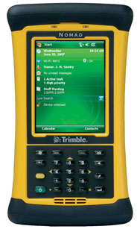

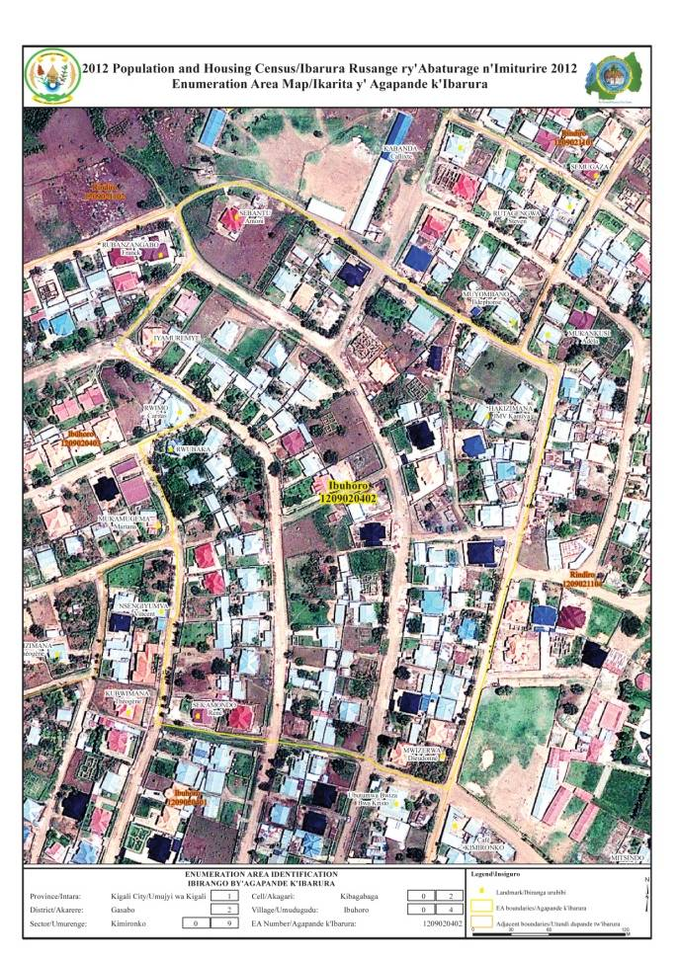
3.2. Approaches used, mapping (Ct’n )

Slide 11
3.4. Mapping, Innovation in the area
The mapping have updated the Rwandan base map
IMIDUGUDU/VILLAGES boundaries was captured. These boundaries did not exists in any GIS database in Rwanda before.
The delineation of Rural and Urban area based on Village level.
Spatial database of economic and Social infrastructures.
It was then used for the first time high definition aerial photographs on the whole Country supplied by the Rwanda National Land Center, Defined EAs gave 100% coverage of the geographic territory of Rwanda.
The existing of Village boundaries enabled the dissemination of census results at village level.

Slide 12
4. Pilot Census
Pilot Census was designed to simulate the actual Census processes on a small-scale;
It was also to evaluate all aspects of the census operations including concepts and definitions, adequacy of questionnaire, training of field enumerators, field organization, census methodology, and to test the readiness to carry out the actual Population & Housing Census.
In all, 75 Enumeration Areas were selected in 60 villages (2 villages by District)

Slide 13
4.1. Pilot Census: Lessons Learnt
Census Questionnaire and instruction manuals had been improved prior to the main training and census enumeration
EA maps used for pilot census had been improved for the main data collection;
The pilot census allowed setting up an operational readiness to retrieve, return and archive questionnaires
Distribution of bicycles was envisaged for the main data collection for long distance in sparsely populated areas so as to reduce commuting time;
Increased grassroot publicity before and during enumeration;
Increased training practical time and role-playing;
Centralized, functional and Equiped ‘command and control’ centre for reporting and monitoring of the data collection activities.
.

Slide 14
5. Training of Enumerators for the PHC 2012
After the Approval of questionnaire and manuals by the National census Commission
Robust Census Publicity started for sensitization and
Recruitment of enumerators
Cascading training of census functionaries
  Core master training and CDs were developed to assist trainers for the main training
  Training of Trainers National level
  Training of trainers Province levels
  Training of enumerators.

Slide 15
12 June, 2017
National Institute of Statistics of Rwanda
15

Slide 16
6. PUBLICITY AND COMMUNICATION STRATEGY
Publicity & Sensitization:
It has started with the Pilot Census Publicity: this activity began in March 2011 with some articles and broadcast in public press; and includes:
Radio & television spots, TV documentary explaining the census, Speech of the Minister of MINECOFIN, Press conference, Newspaper Articles, Workshops,
Publicity materials (Billboards, posters & banners), Promotional Materials (T-shirts, Face-caps, Banners, Stickers),
Community announcement during Umuganda/Community works.

Slide 17
6.2. Inter-Agency support for the census
MINECOFIN: Ministerial order, Resources Mobilization, Establishment of Provincial and Districts Census Commissions (NCC, P/DCC)
MINALOC: Collaboration with local administration, Recruitment of field staff, Est. of Census Commissions, Public awareness, Census messages at all levels, …
MINEDUC: Avail Head schools and teachers as Enumerators, Schools as training Centers
MININFRA: Definition of rural – urban areas, avail warehouses, vehicles for the Census operations
MINADEF: Enumeration of military, provide security and special logistics
National Police: Enumeration of police, provide security and special logistics
National Prison Service: Enumeration of prisoners, information on released prisoners
MINAFET: Enumeration of Rwandans abroad/foreigners In Rwanda, awareness of the Census among diplomatic community
ORINFOR: Mass communication for the Census sensibilization and publicity

Slide 18
7. PHC 2012 Enumeration
Identification of Enumeration Areas: this operation was undertaken on 11th August, 2012;
Household Listing: this operation was undertaken from 12th - 14th August, 2012;
House-to-House Enumeration: started on 16th August, 2012 in all the Enumeration Areas selected for 15 days (16th - 30th August 2012).
Archiving of census questionnaires in the warehouse

Slide 19
7.1 Innovation in Census Enumeration Activity tracking
NISR developed an SMS based tracking application for monitoring Census activities
The goal of application was to
  Enable registration of Census enumerators and their team leaders
  Enable SMS recording of the households listing activities
  Enable SMS recording of the households enumeration activities
  Enable visualization of both activities progress: Listings against targets, Enumerations against targets and listings
  Enable monitoring of progress by location, team leader, enumerator
  Facilitate the Command and Control Center team to quickly locate enumerators / team leaders to be able to assist them

Slide 20
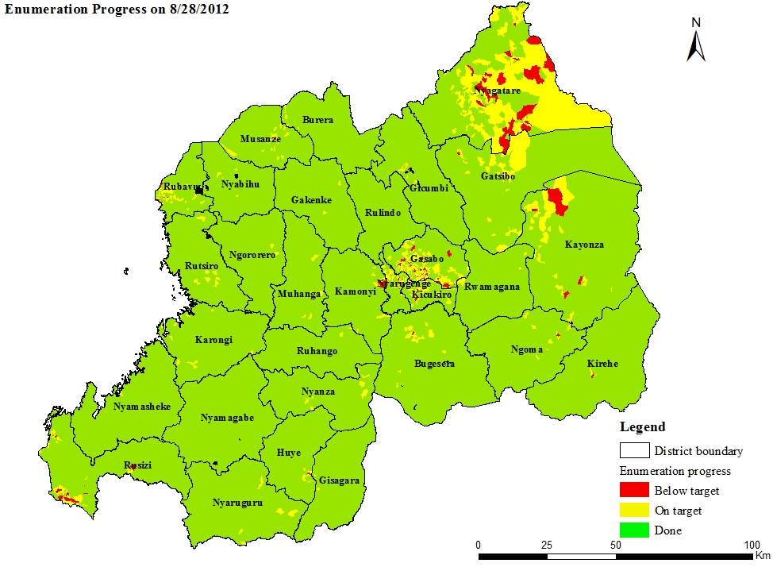
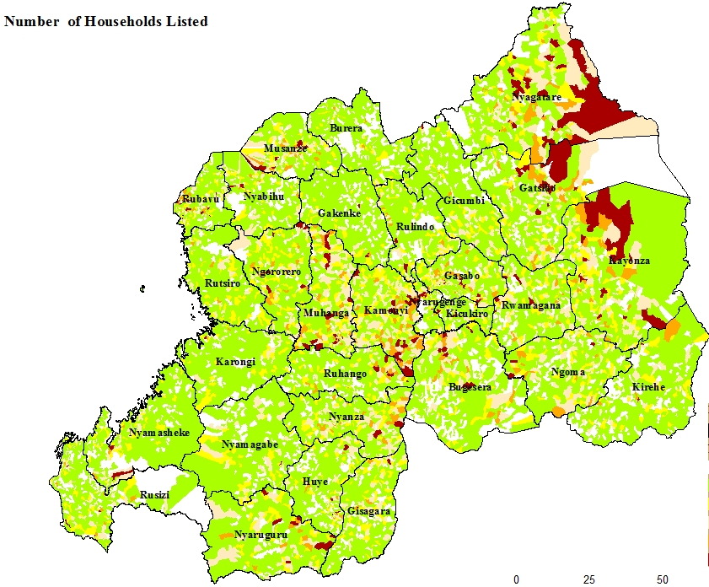
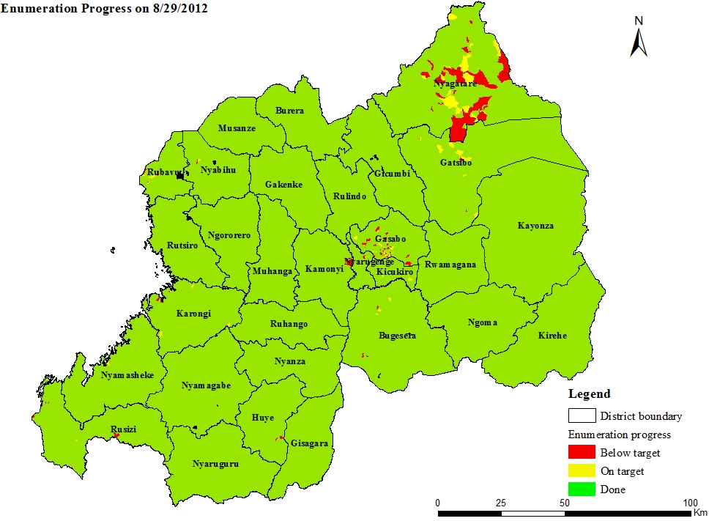
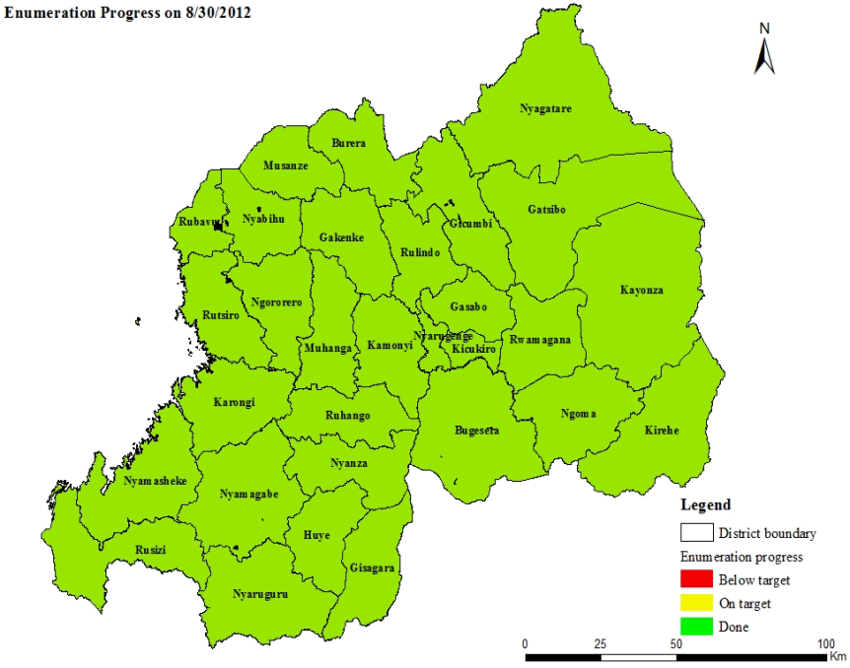
Monitoring: Control Command Report from 8th – 30August 2012

Slide 22
8. Post-Enumeration Activities
Data processing
Data processing plan designed in advance and implemented;
Data entry application in CSPro 4.1 (Census and Survey Processing System);
Questionnaires Coding and Verification from November 2012 up to Mid March 2013 (ISIC, ISCO)
Manual data capture from from December 2012 to April 2013;
100% of Data entry completed, Data cleaning and Tabulation done.
12 June, 2017
National Institute of Statistics of Rwanda
22

Slide 23
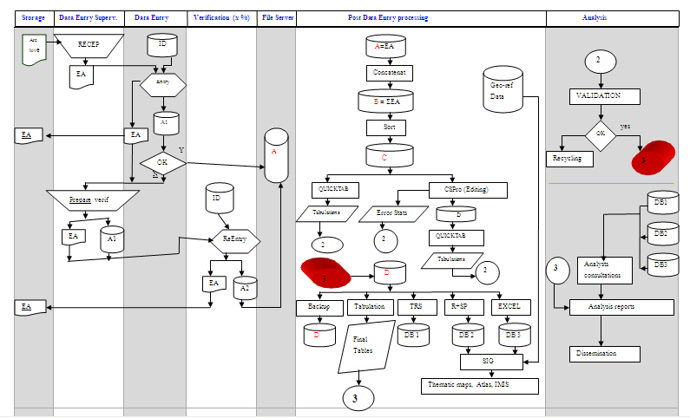
Census Data Processing Flow-Chart

Slide 24
8.1. Post- Enumeration 2012 -2013
Preparation and publication of provisional results ( November 2012):
Population size national level, province , district and sector
Annual population growth rate
Sex ratio
Population density
Data Analysis
Tabulation plan, analysis plan available
Four workshop for census analysis were planned for the production of census results

Slide 25
8.2. Road map of workshop of the census data analysis
Workshop | Activity
1st Workshop | Orientation on how to write a report . Presentation and Validation of the tabulation plan and analysis plan
2nd Workshop | Presentation of the first Chapter of the report Presentation of comments on the first tables and indicators
3rd Workshop | Presentation of comments on the final tables and indicators
4th Workshop | Presentation of the draft report
Editing | Edition of thematic reports
Printing | Printing of all thematic reports
Dissemination | National dissemination workshop of the final results of the 2012 Population and Housing Census, Provincial Disseminations.
Notes:
Under the technical support from the OXFORD POLICY MANAGEMENT (OPM); 15 persons, 16 National Analysts from NISR and Universities have analyzed 17 thematic areas:

Slide 26
8.3. Census key outputs
Updated national administrative map(s)
Preliminary and Final report on population count
17 Census thematic reports produced: Populationn size and Spatial Distribution, Marital Status and Nuptiality, Fertility, Mortality, Socio-cultural Characteristics of the population, Migartion and spatial mobility, Characteristics of Housing and Households, Labour Force, Measurement and mapping of non-monetary Poverty, Education, Gender, Socio-economic Status of persons with Disability/Children/Youth/Elderly people, Population Projections and Data Quality Assessment
30 Districts profiles
Geo-demographic Atlas of Rwanda
Census database

Slide 27
2012 PHC Validation
Internal validation:
Household size: Census 2012 about 4.37, DHS4 about 4.4
Sex Ratio: Census 2012; 51.8% women, DHS4; 52.7% women
Age Ratios
Population pyramid
Evaluation for age and sex reporting (Age heaping and age-sex reporting)
External validation:
Consistence with the other Surveys data
Consistence with population projections.
Consistent with administrative data from the Rwanda Identification Agency,
PES has been conducted shortly after the PHC enumeration to evaluate the completeness and coverage of the 2012 PHC (more than 99%).
Notes:
Graphical analysis
Population pyramids
Graphical cohort analysis
Age and sex ratios
Summary indices of error in age-sex data
Possible data errors in the age-sex structure
Age misreporting (age heaping and/or age exaggeration)
Coverage errors – net under- or over-count (by age or sex)

Slide 28
Dissemination and Archiving
Plan for the National Dissemination
Subnational dissemination (Province- District)
Printing and distribution of Census reports
Documentation of the Census Data
Archiving of Census Data
Census Results are published on the website

Slide 29
Requirement of Census Data Quality
Adequate selection and training of staff
There should be central/regional and sub-national committees for monitoring and controlling field work.
Developing accurate maps and checking its accuracy on regular basis through field visits and office checks.
Involve population, local authorities, religious/political/ leaders, associations/NGOs, field staff and other relevant bodies.
There should be strategies to minimize errors in advance
Communicate on the goals of the census, addressing the concerns of political/religious...

Slide 30
Requirement of Census Data Quality
Communicate on the strong quality control mechanism, and identify potential risks, areas and groups.
Maintain the general features of field control which should be a part of the quality assurance and improvement programme of the census
Ensure the commitment of all partners and standard application country wide.
Openness on international experiences is a wise step to provide sound technical support and motivate enabling environment
Understanding of national and political context of the census is a key factor
Setting up a comprehensive quality assurance system based on the results of the risk analysis is important

Slide 31
Conclusions
Activities within QA framework should start with design stage of the Census
QA system should cover all census stages including design, planning, implementation, supervision, dissemination and evaluation.
QA system should be comprehensive, integrated, sound, demand driven and country-specific.
Census management has to absorb national local conditions, public acceptance and political sensitivities.

Slide 32
THANK YOU

