Slide 1
The Fundamental Pillars necessary for a modern National Statistical System
Steve MacFeely
United Nations Conference on Trade & Development
STS 037

Slide 2
Key Question
How best do we help countries develop
flexible and responsive statistical systems
that allow SDG targets (but also other national priorities)
to be measured and monitored?

Slide 3
An important reminder
'Economic analysis cherishes the illusion that one good reason should be enough, but the determinants of complex processes are invariably plural and inter-related. Mono causal explanations will not work'
David Landes –
The Wealth and Poverty of Nations (1998: p.517)

Slide 4
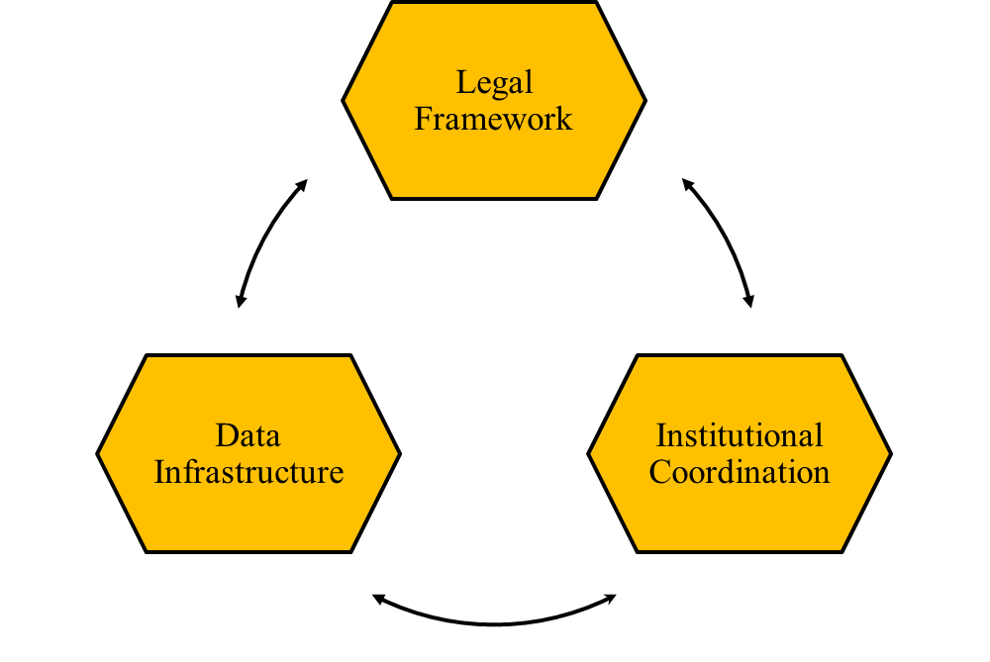
3 Key Pillars

Slide 5
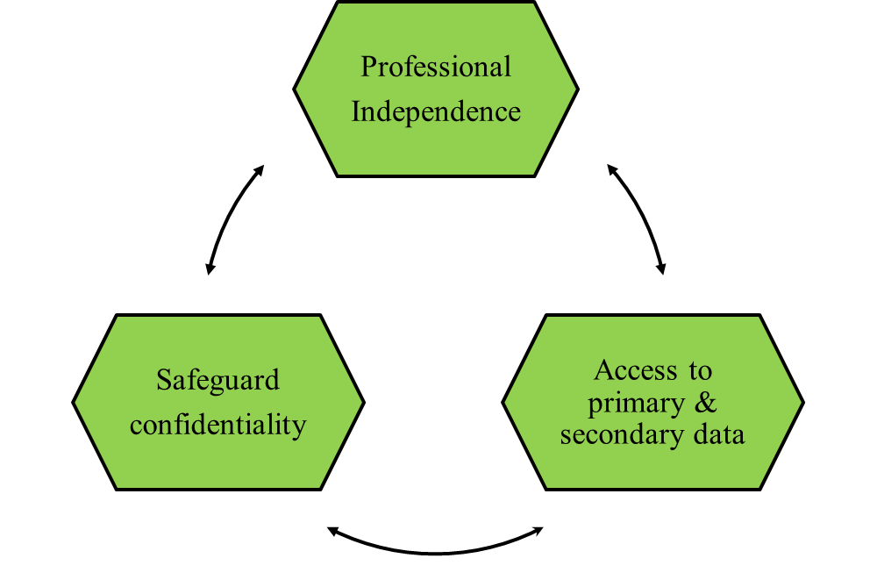
Pillar 1 – Legal Framework

Slide 6
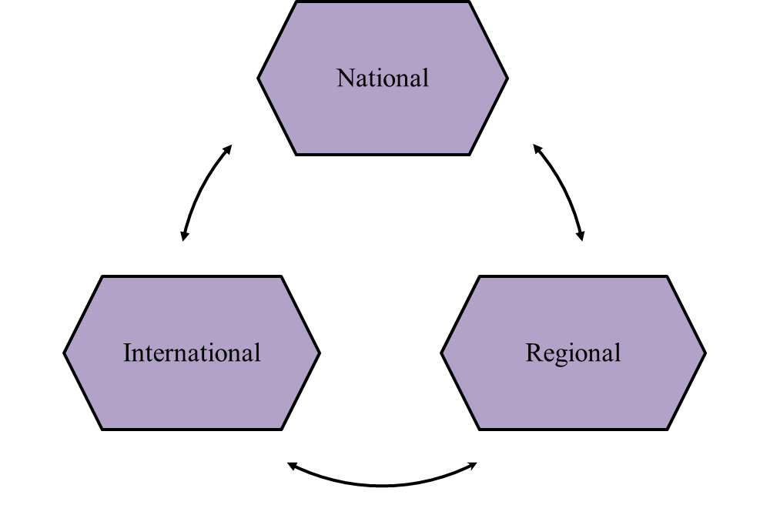
Pillar 2 – Institutional Coordination

Slide 7
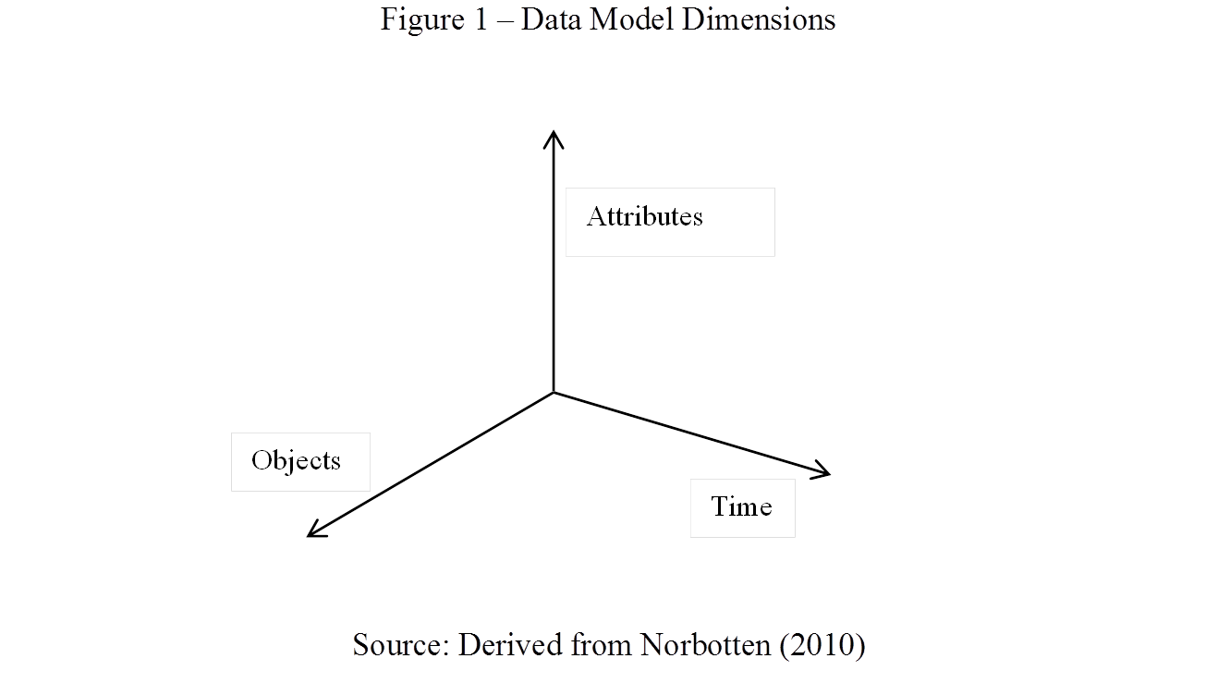
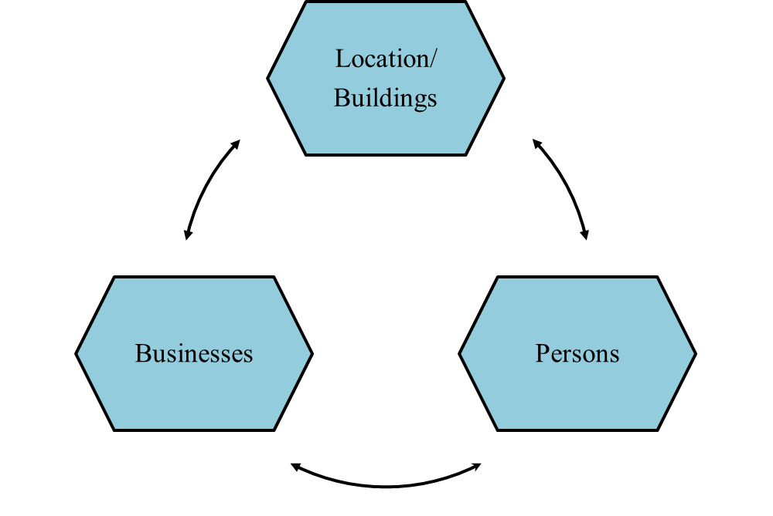
Pillar 3 – Data Infrastructure

Slide 8
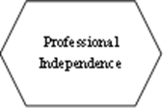
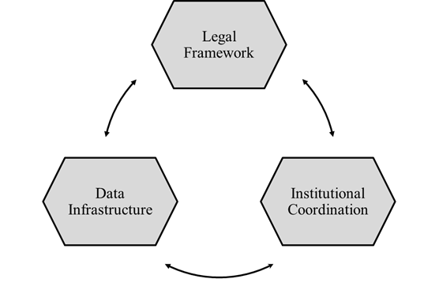
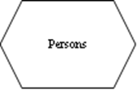
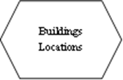
The 3 Pillars of a National Statistical System

Slide 9
Another Question
Do we need a more integrated approach across CCSA to statistical capacity building?
Opportunities – SDG Targets
9.1
‘Develop quality, reliable, sustainable and resilient infrastructure, including regional and trans-border infrastructure, to support economic development and human well-being, with a focus on affordable and equitable access for all’
17.18
‘By 2020, enhance capacity building support to developing countries, including for LDCs and SIDs, to increase significantly the availability of high-quality, timely and reliable data disaggregated by income, gender, age, race, ethnicity, migratory status, disability, geographic location and other characteristics relevant in national contexts’

Slide 10
Thank you
steve.macfeely@unctad.org

