Slide 1
The role of international organisations in defining standards that follow the quality requirements and ensure comparability of data
Session 39
Friday 3 June
Pieter Everaers
Eurostat
Pieter.everaers@ec.europa.eu

Slide 2






Role of statisticians - indicators for policy making
Agenda setting
Research & negotiation
Decision
Implementation
Policy monitoring
Reformulation
e.g. global 2030 Agenda
Role of statistical community:
(Help) select appropriate indicators
Define international standards and ensure quality
Ensure independent monitoring
Statistics
Politics
Science

Slide 3
Developing global SDG indicator list and SDG monitoring
March 2015: Technical
report to IGN session
List of preliminarily proposed
SDG indicators
June 2015: 1st IAEG-SDGs meeting in New York
Consultation rounds on SDG indicator proposals
October 2015: 2nd IAEG-SDGs meeting in Bangkok
Consultation rounds on
GREEN & GREY indicators
IAEG-SDG report
including final list of 241
proposed SDG indicators (Annex IV)
June/July 2016
Release of a global SDG report to be submitted to the 1st HLPF on July
March-Dec 2016
Possible release of
national and regional
SDG reports
2016 – 2020
Scaling-up of national, regional and global capacities to monitor the 2030 Agenda
46th UNSC session; March 2015
Adoption of indicator set
by ECOSOC & UN-GA during 2016
47th UNSC session; March 2016 adopts list of 241 indicators

Slide 4
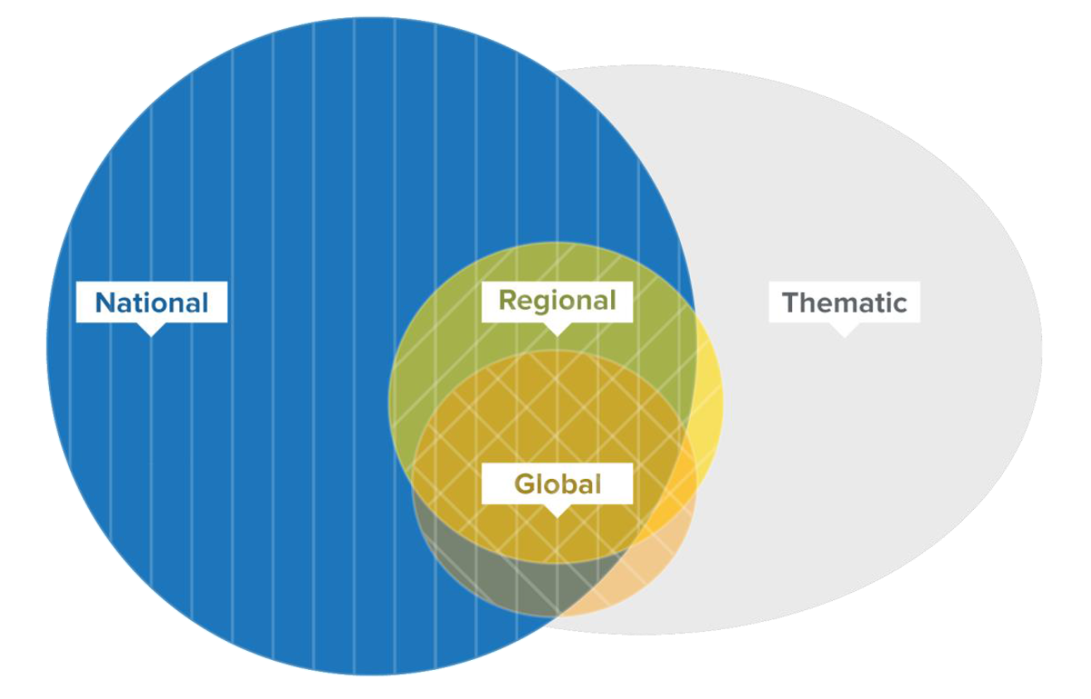
Different levels of SDG monitoring
But also different dimensions:
Geographic/regional
Tier system
Official vs non-official
Institutional and contextual quality

Slide 5
17 goals, 169 targets …

Slide 6
… and 241 (global) indicators!

Slide 7
Quality dimensions
Readiness of the indicator (tier system)
Geographical availability (UN regions are differently advanced in statistics)
Thematic dimension (UN thematic agencies have different statistical skills)
Example of dimension overlap: employment rate (a) under the supervision of the ILO (c) in Europe (b) is of high quality, but in another region may be of lower quality

Slide 8
Tier system for SDG indicators
Level of methodological development and overall data availability:
Methodology exists and data are widely available → tier I
Methodology has been established but data are not easily available → tier II
Internationally agreed methodology has not yet been developed → tier III

Slide 9
Quality levels
Conceptual
Methodological
Mathematical
Institutional
Contextual

Slide 10
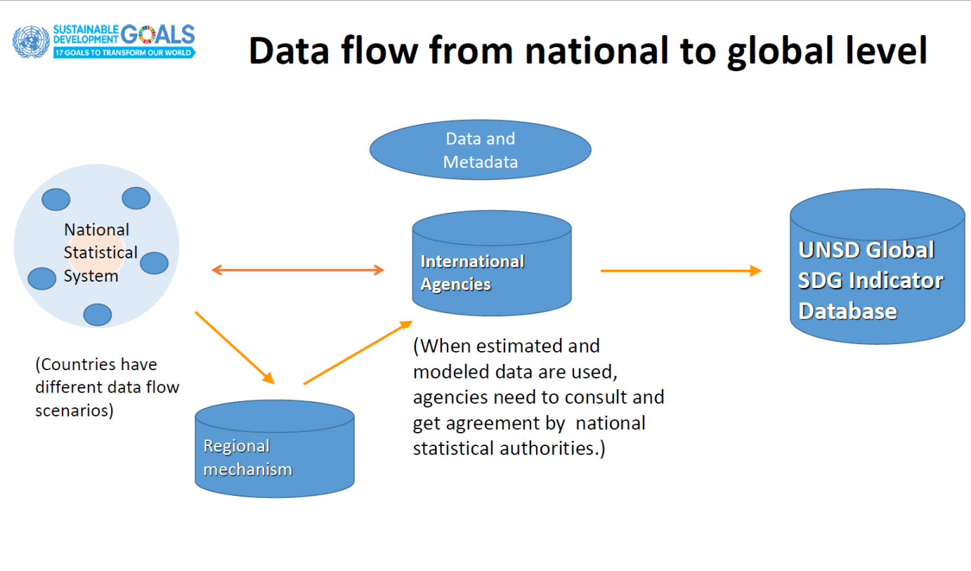

Slide 11
A country-lead process - what are the risks?
Weak role of international organisations in reporting and monitoring
Heterogeneous quality + conflict between agencies and countries' perceptions of quality
Uneven methodological development
Too many different channels (countries directly to "custodians", ONGs, etc.)
Reporting burden for countries
Lack of coordination among supranational, national and regional levels
Diverse availability of basic data

Slide 12
What are the solutions?
Strengthening quality frameworks
Specialised UN agencies as quality assessors
Improve supervision by supranational bodies such as WorldStat

Slide 13
Role for the CCSA
Reinforce implementation of FPOS to increase institutional quality (trust in the institutions)
Ensure coordination
Promote and support the required quality levels
Enhance work on internationally comparable procedures
Build consensus on a Quality Management System

