Slide 1
Measuring Development Progress: Looking forward
17 December 2013
Johannes Jütting
Secretariat Manager

Slide 2
A measurement framework
should not…
Simply increase the number of global surveys
Ignore lessons learnt from the MDG measurement exercise
Rely solely on technology innovations while ignoring the reality of poor countries

Slide 3
A measurement framework
should
Link National Strategies of Development of Statistics to Development Plans
Do a proper costing exercise and adapt funding structures
Do promote user – producer dialogues

Slide 4

Why do we need a data revolution?
Old problems
Emerging priorities
New opportunities

Slide 5
Old problem: what’s a data gap?
Data does not exist
Data exists, but not in a useable forms for users
Data exists, in useable forms, but nobody knows
Data exists, in useable forms, people know, but nobody knows how to use it
Notes:
Today, less than 6% of IDA and LMIC countries don’t have an NSDS. But this tool isn’t yet adapted to Po-st-2015 goals.

Slide 6
Unpacking the data revolution
It should …
build upon past successes
catalyse the expansion of more relevant and reliable data production
support decision makers, including politicians, business and citizens, to make informed decision for better lives
be implemented via new ways to support statistical capacity and data production
1
Notes:
Important to make the most of existing efforts instead of reinventing the wheel
“imitation is the highest form of flattery” – this shows that we’re on the right track. But 2015 is a tight deadline, so concerted action is needed.

Slide 7
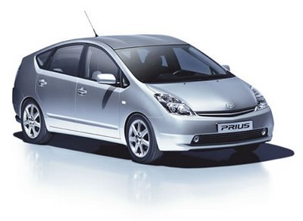
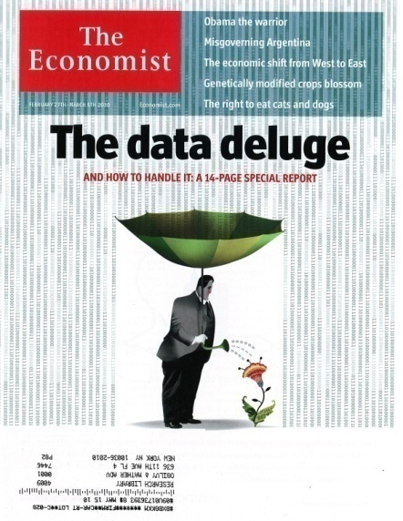


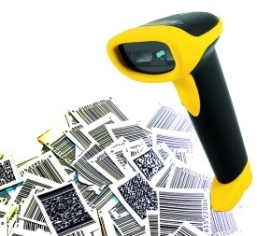
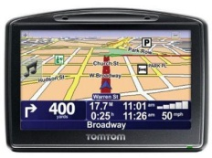

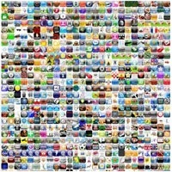
New opportunities
“Big data”, cloud computing, and “machine-to-machine” combined.
By 2020, 50 billion mobile wireless devices will be connected to the Internet (Ericsson)
The Internet as a general purpose technology with applications in energy, health, transportation, education etc.
Internet
(Wave3)
Notes:
Internet development is also on the cusp of a much larger expansion to “big data”, whereby:
Technologies such as RFID tags, sensors, cloud computing, and ubiquitous smart mobile devices that enable
both People and Objects/Machines that typically did not have communication capabilities (from electricity plugs, GPS devices, automobiles and even light bulbs and water levees)
to be increasingly connected to the Internet as a way to introduce new functionality.
At the same time, individual behaviour social networks, e-commerce and Internet apps continues to adapt and embrace a mobile, ubiqutous on-line environment
Unsung hero of this transformation -- storage -- increasingly means that people and companies do not delete data anymore.
This is the third wave of Internet connectivity that we are starting to see :
Ericsson estimates that there will be 50 billion mobile wireless devices connected to the Internet across the globe by 2020 and the total number of devices connected to the Internet in some way could reach 500 billion.

Slide 8
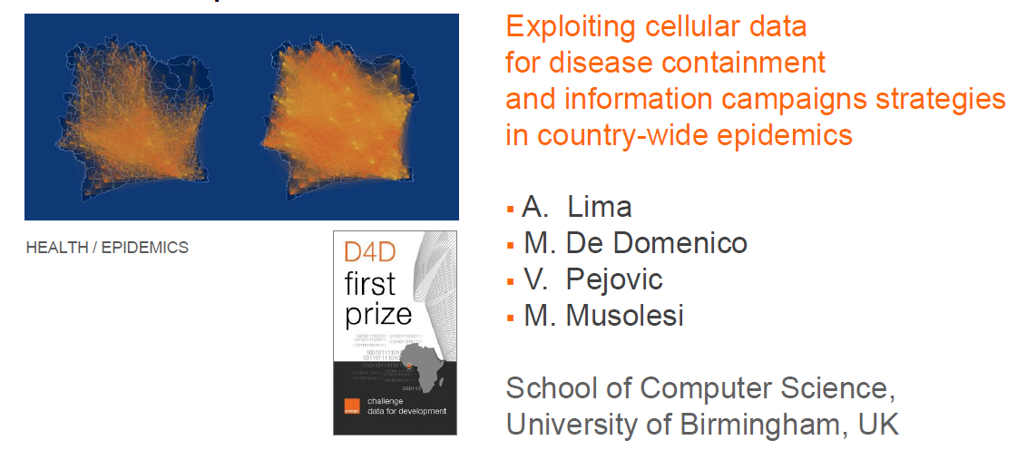
Big data and development
Source: Using ICT’s to shape the post-2015 framework, European Development Days 2013, Orange

Slide 9

Striking a balance
International comparison |  | National monitoring
Official/non-official |  | High-/ low-quality
Real-time data |  | Vetted stats
Innovative approaches |  | Global standards
Open data |  | Privacy protection

Slide 10
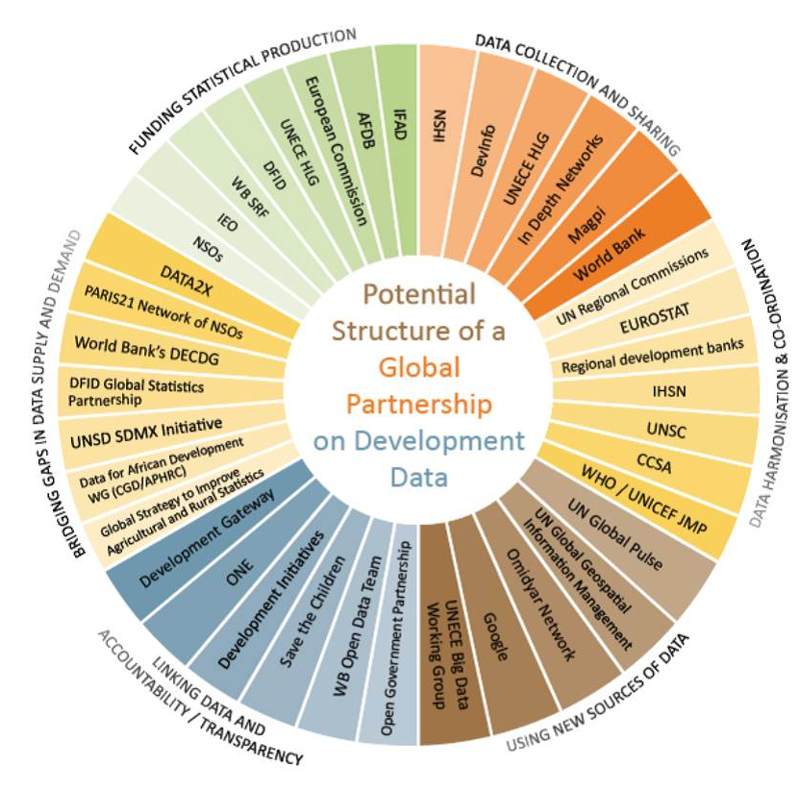
A new global partnership?

Slide 11


Conclusion
  Data revolution: yes, but …..
  Capacity development and sustainable statistics is key
  PARIS21 stands ready to support this process
(19

