Slide 1
Users and their needs as catalysts of Information Systems.

Slide 2
Introduction
The dissemination of information has registered an accelerated evolution in several perspectives, the channels used, the format, access speed, flexibility and the mobility.
This development deeply affects the processes of dissemination of statistical information, and requires a flexible behavior by the institutions and agencies of statistical production to respond positively to this requirements that accompany this development.
Currently dissemination of statistical information is sustained in many media. For each publication, there is also need to effectively communicate the data to users who increasingly present requirement and requirements of data access for each particular publication.
Notes:
Estatisticas por sms sao excelentes para disseminar indicadores chave (key indicators)

Slide 3
National Statistical System (NSS) of Mozambique
The Statistical Council
The National Institute of Statistics
NSS
The Bank of Mozambique
The Coordinating Council of Population Census

Slide 4
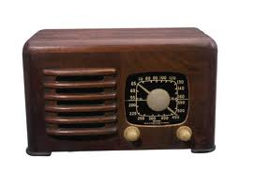
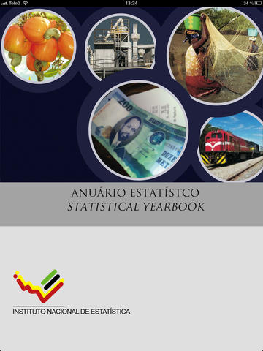
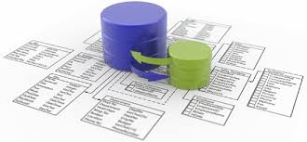
Overview of Dissemination In Mozambique
The National Institute of Statistics in Mozambique as a organ in charge and leading producer of statistical information in the dissemination process seeks to monitor and meet the demands and requirements presented by both, the evolution dissemination of information as well as the needs and requirements submitted by users.
Using tools such as:
Media
Print Publications
DataBases online

Slide 5
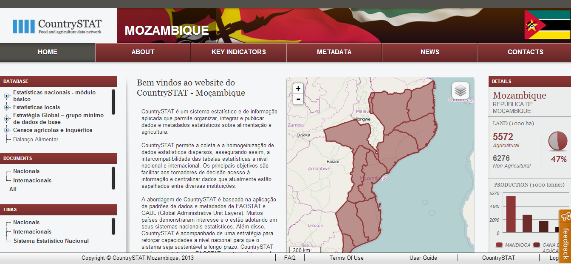
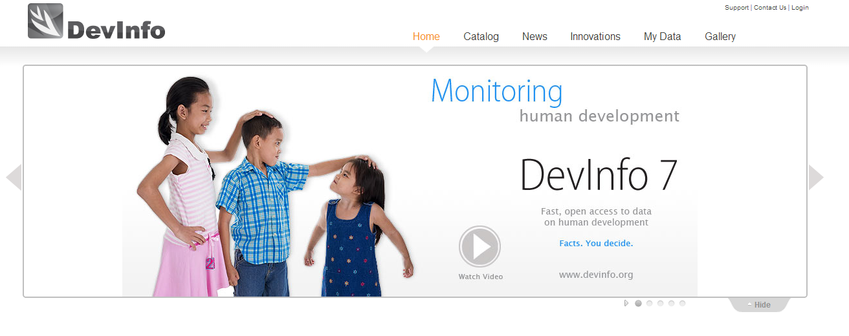
Overview of Dissemination In Mozambique
Main WebPage
PROGNOZ
SYSTEM
CountryStat
ESDEM
NADA

Slide 6
Overview of Dissemination In Mozambique
Yearbook for iPad
Satistics by sms

Slide 7
Overview of Dissemination In Mozambique
Press conferences
Publication of results:
Reports
CPI Montly
Other

Slide 8
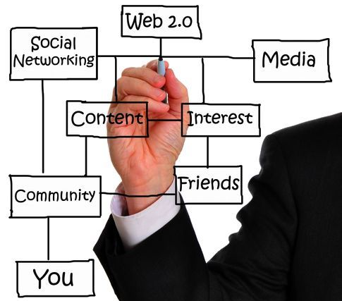
Overview of Dissemination In Mozambique
Planning to Migrating to social networks
Focus

Slide 9
Paradox
SYSTEMS EVOLVED | USERS WITH DIFFICULTIES
Crossings data / variables | users has difficulties to use / adapt this kind of systems
dynamic and Interactive maps | 3.9% have access to computers and 2.1% have internet
Databases Online | Financial difficulties (computers and internet has a cost)
Mobile Devices | 70.2% of the population is in rural areas, where the availability of computers and internet is limited by several factors.

Slide 10
Statistics by SMS
However according to the 2007 census about 24% of the Mozambican population has mobile phones, The national institute of statistics taken advantage of this situation by creating the system statistics by sms and consultations of agricultural markets Prices by sms.
statistics by sms :
Population
CPI
GDP
Index of economic activities
Index of confidence and economic climate
SIMA
System of agricultural markets
Prices of agricultural products in different
agricultural markets of the country

Slide 11
Why Users and their needs as catalysts
Information systems are one way to systematically and Automatically materialize
needs that user himself always had, (including producers of statistics), however with:
Better organization and control of information
Optimization and agility manipulating information
Etc.
Couse without user needs we dont need to produce informations and systems a useless
their behavior
New ways to search, research and data manipulation make necessary new
ways to achieve them
Notes:
3 – por essa razao estamos aqui nesta conferencia, o comportamento dos utilizadores mudou
Eles tem outra forma de buscar de pesquisar

Slide 12
Trends of Users
Users do not want to go to institutions requesting data, they want to find them within reach of their computers, phones, tablets, without geographical limitations or formats
Notes:
Disopnibilidade – muitas instituições são ricas em dados, mas n disponibilizam a mesma, ou o fazem de forma deficiente ou que n seja do alcance de todos.
Diversidade – a evolucao do conhecimento tornou o homem mais interessado em quantificar e analisar situacoes nas diversas areas, esta tendencia faz com que haja necessidade de se produzir estatisticas mais diversificadas

Slide 13
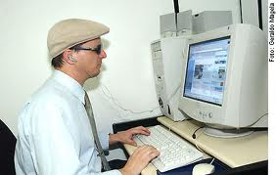
Trends of Users
Users are looking for data in formats that allow them to make their own crosses and produce their own tables;
Users want to access data in formats appropriate to their state of disability (auditory or visual), in your preferred language.
users looking for comparable data;
Notes:
Disopnibilidade – muitas instituições são ricas em dados, mas n disponibilizam a mesma, ou o fazem de forma deficiente ou que n seja do alcance de todos.
Diversidade – a evolucao do conhecimento tornou o homem mais interessado em quantificar e analisar situacoes nas diversas areas, esta tendencia faz com que haja necessidade de se produzir estatisticas mais diversificadas

Slide 14
Trends of Users
users share data and information (email, social networking, sms, etc.)
“Taking advantage of this tendency users can be converted in potential dissemination agents "
Notes:
Disopnibilidade – muitas instituições são ricas em dados, mas n disponibilizam a mesma, ou o fazem de forma deficiente ou que n seja do alcance de todos.
Diversidade – a evolucao do conhecimento tornou o homem mais interessado em quantificar e analisar situacoes nas diversas areas, esta tendencia faz com que haja necessidade de se produzir estatisticas mais diversificadas

Slide 15
Trends of Users
Note:
It is important to consider the user and their needs as primary elements because otherwise for the most useful and robust that it can be a system, if the user is not satisfied, it can make the system a failure simply by not using it.
Do not engage the user and the various stakeholders in the development process of systems has been one of the main reasons for failure.
Notes:
Penso que os utilizadores de estatísticas serão sempre os mesmos
Contudo a algo que “e dinamico – as necessidades destes

Slide 16
Challenges dissemination due User needs
users do not have needs and characteristics equal in every country, region or statistical organization, for each group of users there are particular needs that become a challenge institutions responsible for these users has its challenges.
2 exemples of Mozambique :
ensuring access to basic statistics the population that does not have internet access and large technological resources!
Develop systems within the standards of technology development, without running away from knowledge capabilities and resources of national users.
Notes:
zona rural, onde a disponibilidade de computadores e internet é limitada

Slide 17
Especial Challenges
the institutions must prepare for the future by focusing in a single repository of data that supports access from several platforms;

Slide 18
Recomendations
Being actual user characterized by the share data and information, the statistical institutions should take this trend to transform the simple user in a potential disseminator of statistics, providing tools and formats that facilitate
share by e-mail, social networks, sms, infographics and others.

Slide 19
Conclusions
We have to dream and prepare us for the future but without wings!
we can not detach ourselves of the floor, we must always consider that we are living in the present.
“users and their needs, should always be our focus”

Slide 20
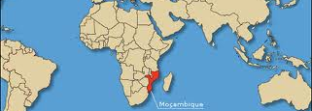
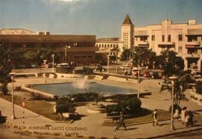
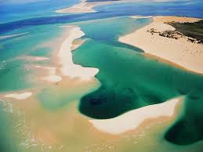
The End
Thank you
Kanimambo
Nikensile

