Slide 1
Developing a System for Web Based Data Dissemination CSO Experience
Strategies for Web based Data Dissemination
Ghusoon M. Hameed
IRAQ

Slide 2
Objectives
Building modern dissemination website in line with recent developments
Ensure that the published statistical data and metadata is transparent and comprehensible to the users
Provide downloadable data into user`s own technical environment
www.cosit.gov.iq
Notes:
- using most recent web design technology (CMS)
- work began on designing and developing new website in Nov. 2012
-- the website is compatible to different platforms ex: smart phones and tablets
- releasing of new website officially on 4th Sept. 2013 >>> www.cosit.gov.iq

Slide 3
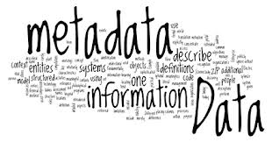
New Statistical Products and Tools
Press releases
Statistical publications
Analytical reports
Thematic reports on interested topics
Metadata
Downloadable Excel tables
Key Indicators
PUF`s (Microdata)
DevInfo Databases
“On Request” services
Notes:
Statistical publications: general results with tables, graphs, maps
Analytical reports – analysis of the results, interpretations-such as MICS report
Thematic reports on interested topics such as Gender statistics using various data sources
METADATA: Source of data, methodology, concepts and definitions, classifications, methods of calculation, data availability PUF: Public Use File – ex: Iraqi Women Integrated Social and Health survey DevInfo - ex: Listing2009, Gender, MDGs, I-WISH (Iraqi Woman Integrated Social & Health Survey)

Slide 4
Iraq Information Portal
Indicators:
By Sector
By Survey
Using:
FusionCharts
FusionMaps

Slide 5
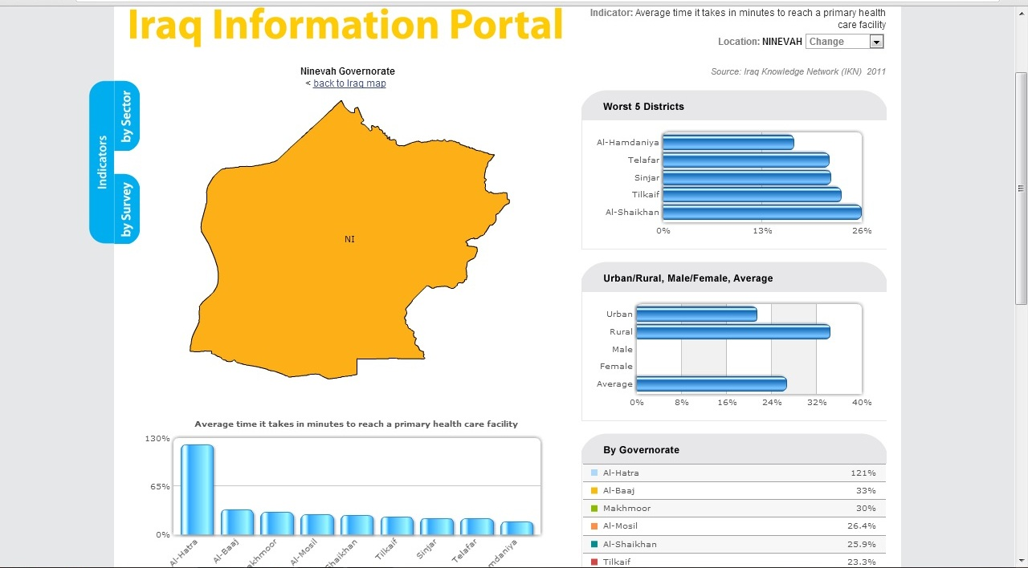
Iraq Information Portal

Slide 6
Future Tools
Interactive Online Dissemination database
Online Geo-Spatial database
Building database for “On request data”

Slide 7
Importance of consultation with users
Focus Group Meeting to collect users` opinion on the content of new website
New website presents different products considering the needs of different types of users- media, general users, decision makers, researchers
Short questionnaire presented on the website for collecting information about the opinion of users – Possible next year in Spring and conduct every year
Long questionnaire using sampling methodology for selecting the users and conducting survey for multiple purposes – possible every five year period
Notes:
- Focus Group Meeting was conducted in June 2013

Slide 8
Challenges and Management of the System
Management of the content of website
Collaborate with ministries to improve available statistics
Using intranet facilities
Clear job description of the departments involved in dissemination- Which department, When, Which product , How to send

Slide 9
Challenges and Management of the System
Improving analysis of data
Analysis forces the staff to look closer at the concepts, definitions. Measurements, sampling, etc.
Analysis provides a necessary feedback into the statistical production process and helps raise the quality of statistics
Analysis of data should be undertaken by Technical Departments

Slide 10
Challenges and Management of the System
Improving the system for data request services:
Building database for data requests
Monitoring the progress in additional data requests
Analysis of data requests in regard to users` profile and reasons for not available data

Slide 11
Challenges and Management of the System
Improving relation with media
Important in increasing the visibility and improving the reputation of the CSO and in creating confidence and trust in the statistics

