Slide 1
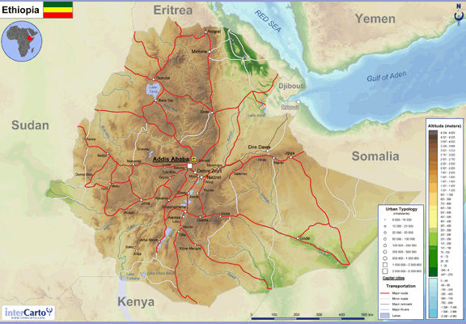
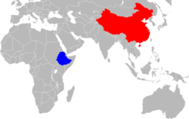

Central Statistical AgencyEthiopia

Slide 2

Module 2:
Strategies for Web-based Data Dissemination
My title:
  Electronic Data Dissemination of CSA Ethiopia
Presenter:
Yohannes Gulilat
Senior DBA and Web Master
CSA-Ethiopia
Email: shagiz444@gmail.com
POBox: 28866, A.A, Ethiopia
Skype: Joye.mikoo

Slide 3
Presentation Outline
Overview of Ethiopia
The CSA
Surveys in CSA
CSA Data Dissemination methods.

Slide 4
Overview of Ethiopia
Time Zone: EAT (UTC + 3)
Drive on the: Right
Internet Tld: .et
Calling code: +251
Location: in the Horn of Africa

Slide 5
Overview of Ethiopia
Geo-Status: Land locked:
Neighbors: Eritrea(N), Djibouti & Somalia(E), Kenya(S), Sudan & South Sudan (W)
Is the 2nd most populous Country in Africa
One of the Oldest site of human existence

Slide 6
Overview of Ethiopia
One of the only four African member of the League of Nations.
Ethiopia is The founding member of UN
Currently, Addis Ababa is the place for:
    Head Quarter of AU
    Head Quarter of UNECA- Pan African Chamber of Commerce.
    Africa Standby Force.
Ethiopia is a Multilingual and Multiethnic society of around 80 different group

Slide 7
Overview of Ethiopia
Ethiopia
  is the Site of the first Hijra in Islamic history and the oldest Muslim settlement in Africa at Negash.
  has the largest number of UNESCO world heritage in Africa-9
  is ironically referred to as The “Water Tower” of East Africa.
  Has its own callandar and Alphabets.

Slide 8
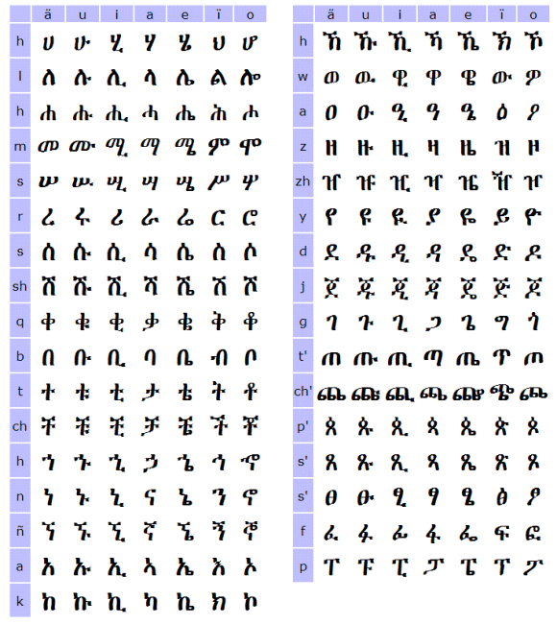
Ethiopian-Alphabets
(Totally about 380+ characters)

Slide 9
Central Statistical Agency-Ethiopia
CSA is a centralized gov’tal organization responsible for conduction, analyzing and dissemination statistical data to the nation.
Mission
  To produce comprehensive, Timely reliable, and standardize information, using scientific and statistical method.
    Role of IST Directorate
      Facilitate the communication
      Facilitate the processes
      Facilitate the Dissemination

Slide 10
Central Statistical Agency-Ethiopia
Vision
  The vision of the Central Statistics Agency (CSA) is to be a center of excellence in providing official statistics that can be used as an input for sustainable socioeconomic development.

Slide 11
CSA-Ethiopia
Branches
  We have, at the moment, 25 branches all over the
  country and 5 more branches are under construction.

Slide 12
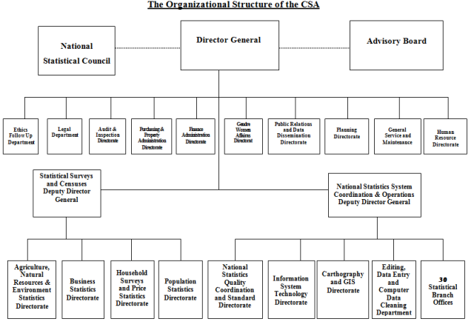
CSA-Organizational Structure
IST Directorate

Slide 13
Surveys in CSA
Survey Name | Survey Interval | Survey Level
Agricultural Sample Survey | Annually | Country, Region, Zone
Industry (Large/medium and Small scale) | Annually Every two years. | Country, Region, Zone
Welfare Monitoring Survey | Every Five years | Country, Region, Zone
Livestock | Annually | Country, Region, Zone
Household | Every Five years | Country, Region, Zone
Urban Employment unemployment | Annually since 2009 (Before, Every 2 years) | Country, Region, Zone
Labor force |  | Country, Region, Zone
DHS | Every Five years | Country, Region, Zone
Price | Monthly | Country, Region, Zone
Population and Housing census | Every Ten Years | Country

Slide 14
Our Customers
Students
Researchers
Organizations
  Governmental
  NGO
  International
Individuals
And More…

Slide 15
CSA Data Dissemination methods
Electronic (Softcopy)
  Websites
  CD Rom
  On Demand – email / other portable storages
Non Electronic (hardcopy and others)
  Company publications
    Survey report books
    Occasional publications
  Quarterly magazine
  News letter
  Library supply and services

Slide 16
Electronic Methods (contd…)
CD Rom
  CD-Rom Dissemination We have more than 100 surveys prepared on the CD
  The CD basically contains
    Metadata of the survey
    Dataset
    Technical document used to conduct the survey
    Survey Report

Slide 17
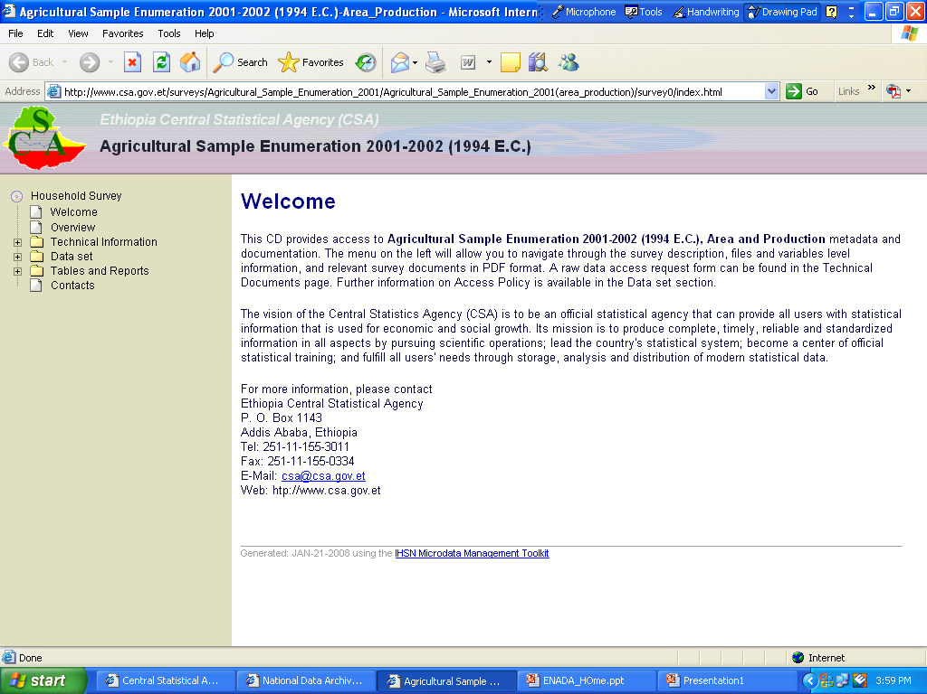
Sample view of the
CD Rom data

Slide 18
Electronic Methods
Websites
  IMIS
  Country Stat
  EthioInfo
  Price database
  ENADA
  Main Website

Slide 19
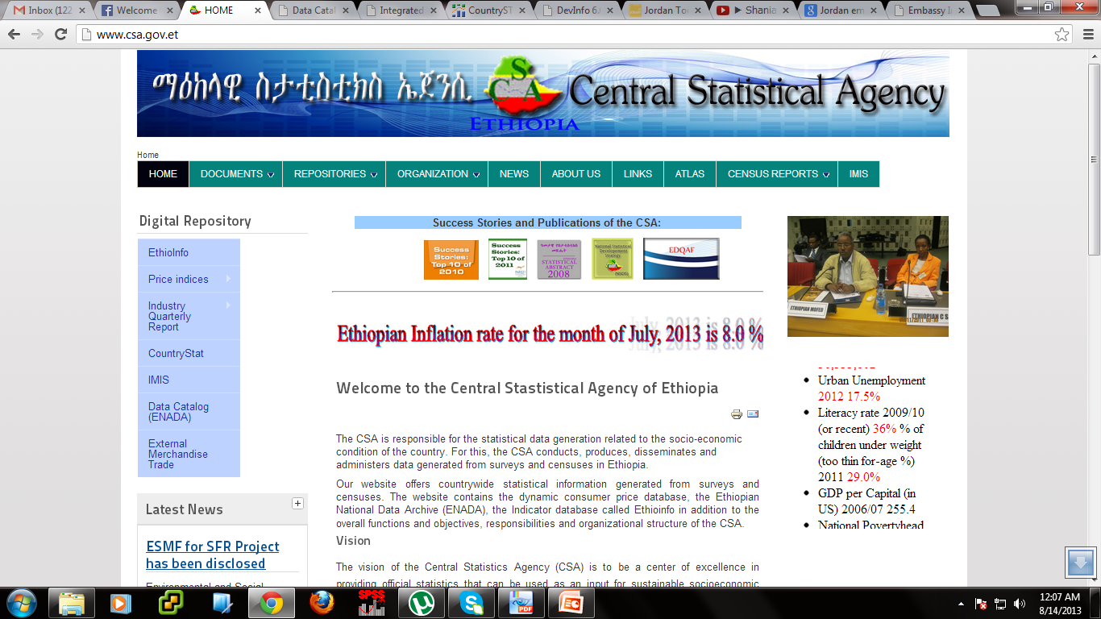
CSA Main Website
www.csa.gov.et

Slide 20
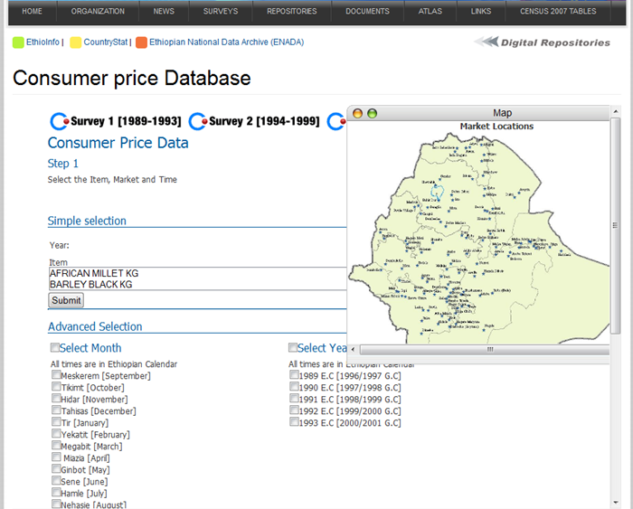
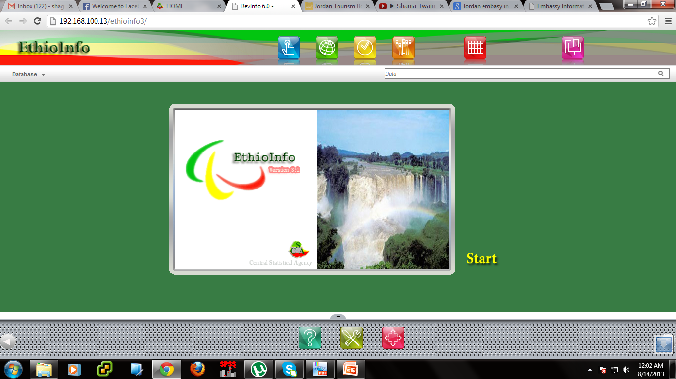
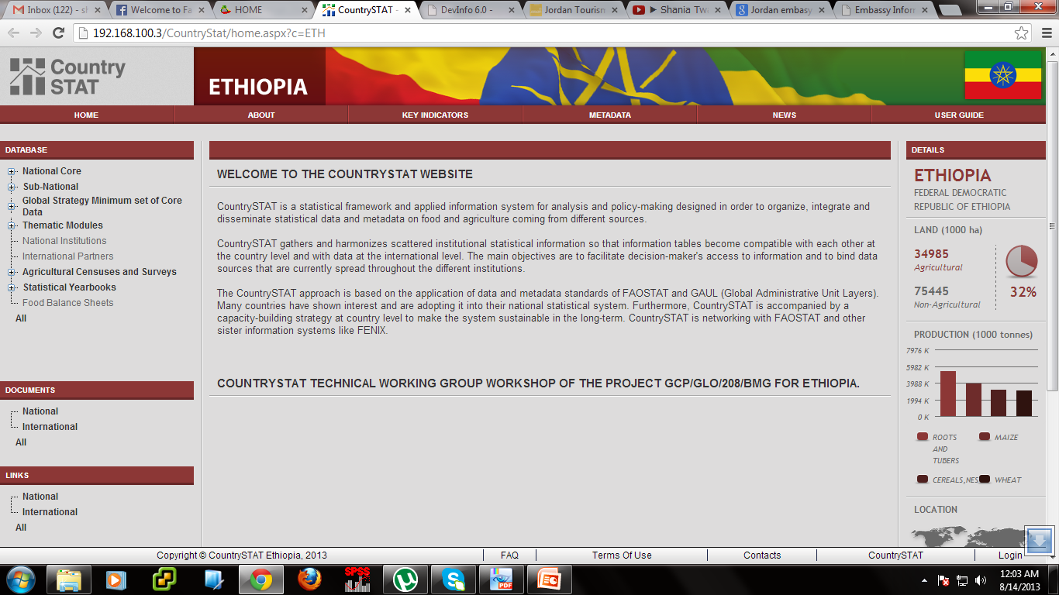
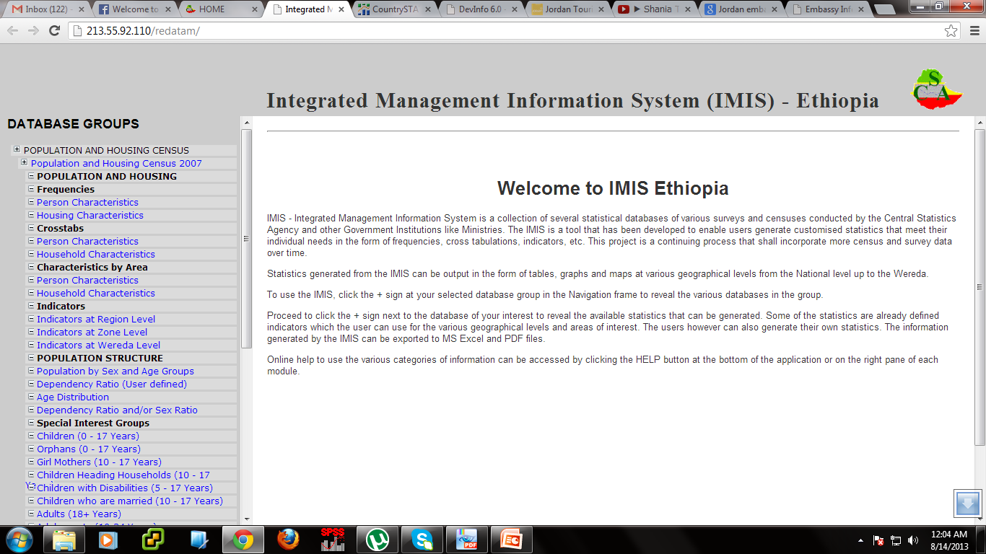
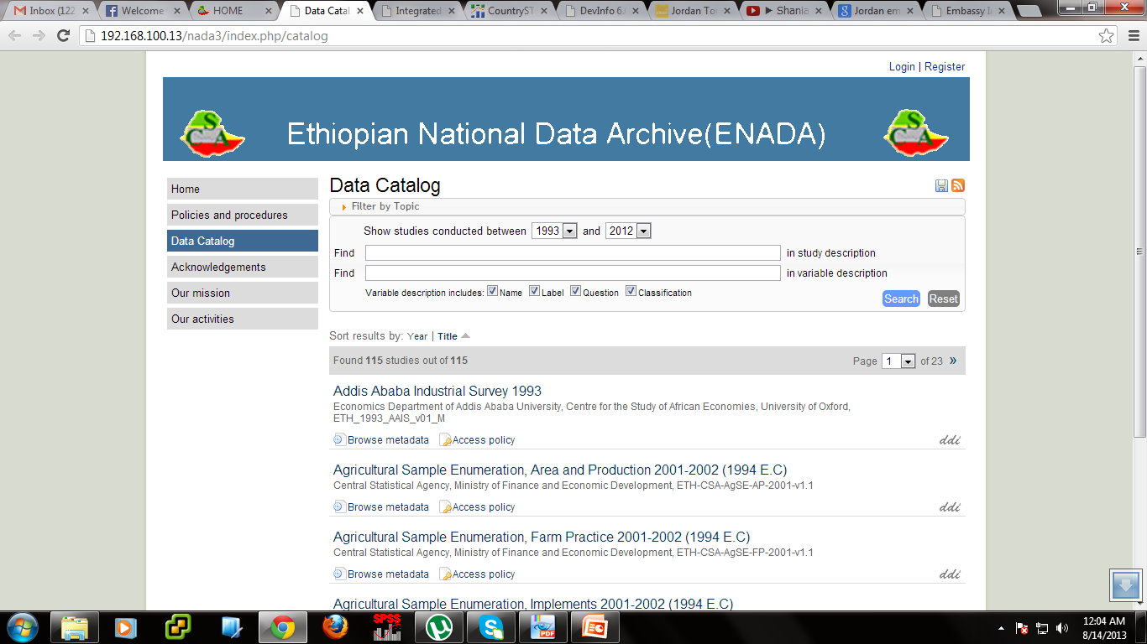

Slide 21
Price Database

Slide 22
The Consumer Price Database
Provide users to access raw data online from anywhere as long as they have internet connection
Information about the price of item in any market by year and region

Slide 23
Consumer Price Database
Our data set to be manageable in RDBMS we have divided the data sets in three parts.
  The first part is surveys from year [1989-1993]
    It has 409 number of Items
    It has 1252 markets and
    It has 4,393,564 number of Records

Slide 24
Consumer Price Database
  The second part surveys from year [1994-1999]
    It has 392 number of Items
    It has 119 markets and
    It has 1,876,551 number of Records
  The third part survey is year from[2000]
    It has 423 number of Items
    It has 119 markets and
    It has 326,633 number of Records up to July

Slide 25
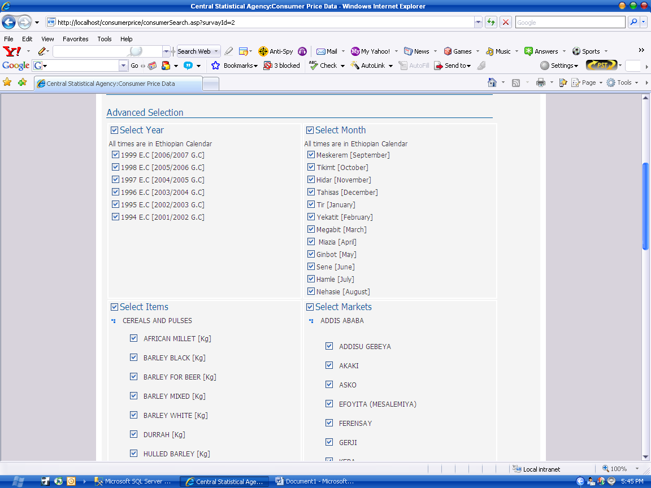

Slide 26
EthioInfo

Slide 27
EthioInfo
Ethioinfo indicator based database system which has
  User-Friendly interface
  Powerful Presentation and report generation
  Can present better reports on the form of Tables, Graphs and Maps
EthioInfo is a tool for easy data retrieval and presentation

Slide 28
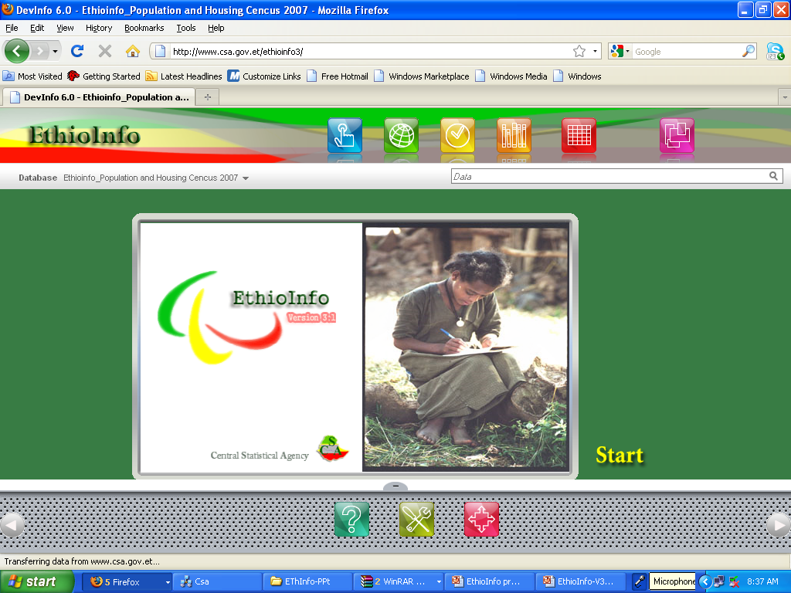
EthioInfo
Ethioinfo acts between you (the user) and the data (database) and allows you easier access to the data stored in databases

Slide 29
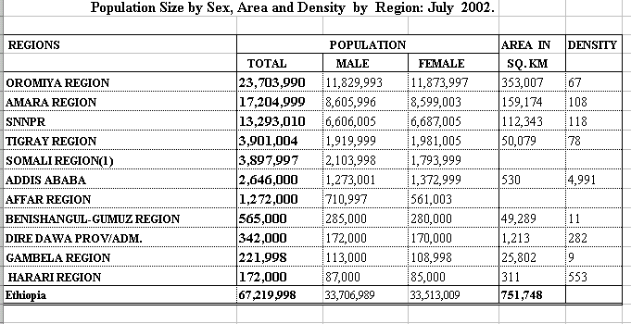
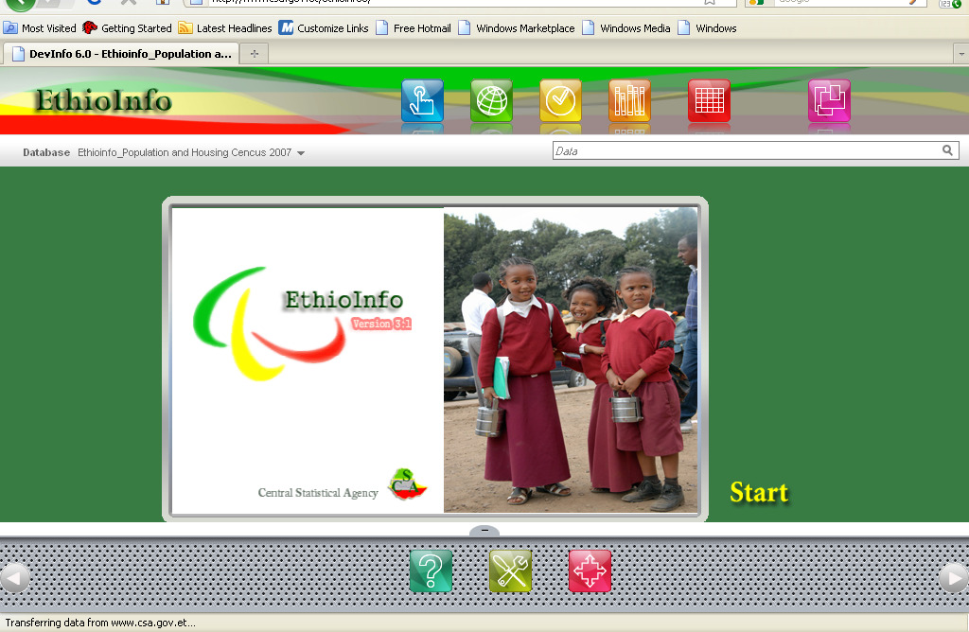
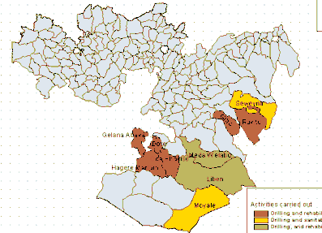
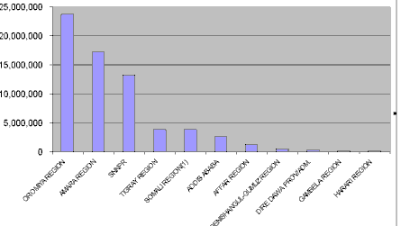
EthioInfo….. presentation of data
EthioInfo allows you to easily and effectively present data through tables, graphs and maps

Slide 30
CountryStat

Slide 31
CountryStat
Is an integrated system for national food and agricultural statistics.
Used worldwide by approximately 50 Governments
Promote international standards
Facilitate exchange of data and metadata
Improve access to statistics

Slide 32
CountryStat
Differ from the other system b/c
Provide standardize data for the calculation of supply utilization accounts and food balance sheet
Monitor national and regional food security programs
Supports analysis informed policy-making and monitoring with the goal of eradicating extreme poverty and hunger
Monitor progress towards MDGs and World food summit goals

Slide 33
IMIS

Slide 34
ENADA

Slide 35
ENADA
Ethiopian National Data Archive
IHSN (International Household Survey Network).
is a Searchable data Catalog which allow us
    to easily retrieve rich metadata
    request access to datasets
    Export features (to pdf,html)
    Everything is searchable by Google

Slide 36
ENADA
In the Data catalog menu we have about 95 Surveys available at the moment.
Our Data Catalog links to:
  Survey Overviews
  Questioner
  Sampling
  PDF reports providing detailed metadata of the surveys.
  Data Access policies
  Data request form

Slide 38
Thank you Very Much
شكرا

