Slide 1
Per Nymand-Andersen European Central Bank CCSA session on International Statistics Ankara, 5 September 2013
Turning statistics into knowledge

Slide 2
Outline
1
The importance of communicating statistics
2
Users of statistics and what do they want
3
Future ideas on communication
4
Is it really that simple?
5
What is our communication challenge

Slide 3
1
The importance of communicating statistics
Good sustainable decisions
Professional users and citizens
Policy-making
Knowledge-based society
Policy validations
Policy accountability
Policy decisions
Communication
Communication
Analysis & assessment
Policy options
Statistical and financial literacy
Analysis & assessment
Reliable and independent statistics
The communication of statistics contributes to building public support for and trust in the pursuit of price and financial stability and prudent economic policies.
Notes:
3
3

Slide 4
1
The importance of communicating statistics
The ten values of communicating central banking statistics
1 | Supporting sustainable and sound policies
2 | Assisting the acceptance process of policy decisions
3 | Enhancing the effectiveness of monetary policy
4 | Facilitating the functioning of financial markets
5 | Building trust in central banking and contributing to positive reputation
6 | Contributing to the responsibility of independent institutions in being transparent and accountability for decisions
7 | Enriching the analytical contribution and enhances the political debate
8 | Fostering a knowledge-based society
9 | Enhancing statistics and financial literacy
10 | Increasing welfare in society
Notes:
4
4

Slide 5
The users of statistics and what do they want
2
Request for
Statistics
Core users of statistics
Policy users
Journalists/Media
Financial analysts
Research/Academia
General public
High volume data users
Serving the core professional market segments will amplify the statistics message and reach a significantly broader audience, including the general public

Slide 6
The users of statistics and what do they want
2
tailor-made user surveys:
Interview with ECB journalists
ECB website users
Statisticians
Large data users/vendors
15 Recommendations from journalists/media
Facilitate the understanding and use of statistics
Provide user-friendly and interactive web-sites
300 barriers and proposals from web-site users and statisticians 9 blocks of functionalities

Slide 7
2
Focus on few core professional user segments
Redistributors of statistics
Spread statistics throughout the economy
Provide automatic downloads of large data volumes
From the pool of research of similar and comparable NSIs and IOs,
62 recommendations were selected as most valuable and fit
The majority of recommendations are already standard practice and applied with success by other NCBs, OECD, FED, Eurostat or NSIs

Slide 8
Future ideas in communications
3
Island of Excellence (# of recommendations in brackets) |  | Examples of TFA recommendations
 | Media /Journalists (8) | Workshop, training, webinars Using descriptive statistics in press releases Adding deep links to series in press releases Communicate in common terminology
 | Financial analysts (7) | Easy to select country comparisons Ability to select charts, graphs and associated statistics directly from e-publications
 | Research /Academia(4) | Promoting research based on central bank’s statistics Availability of micro data
 | High volume users (3) | Facilitate the re-distribution of statistics Easy to use download facilities
 | Reporting institutions (3) | Provide reporting agents with monthly comparable statistics (national & other national)
Notes:
8

Slide 9
3
Future ideas in communications
Island of Excellence (# of recommendations in brackets) |  | Examples of TFA recommendations
 | Mobile statistics (2) | E-book formats User required and user friendly statistics applications for mobile devices
 | Visualisation (2) | Explore common off-the-shelf visualisation tools fit for statistics use Competition on use of visualisation of statistics
 | Website (24) | Sharing of chart gallery One shop for euro area and associated national statistics
 | User interaction (9) | Website monitoring User surveys and needs Online call centre Use of video to present statistics
Notes:
9

Slide 10
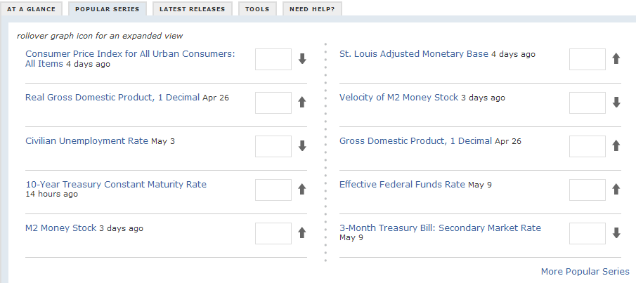
Is it really that simple ? “news”
Interaction
4

Slide 11
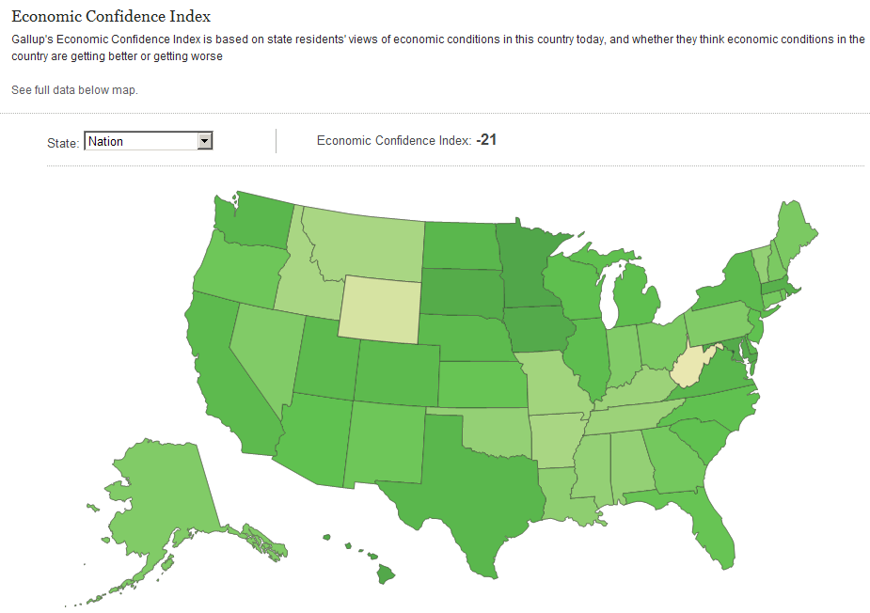
Is it really that simple ? “point and click”
Interaction
4

Slide 12
4
Is it really that simple ? own language
Interaction

Slide 13
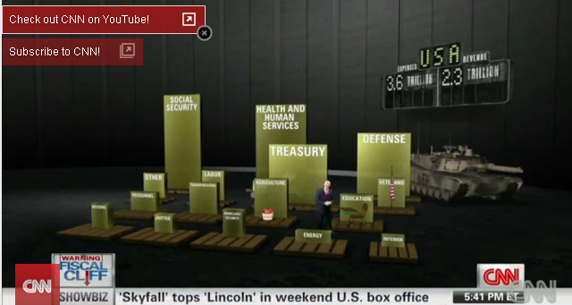
4
Visualise the fiscal cliff
Interaction

Slide 14
Our challenge of communicating facts and figures
4
Extract wisdom from statistics, what is the statistical message, guide the users in using quality statistics
Users can not be expected to understand statistics language and the impact of different statistics methods
Combine text, statistics, tables and graphs for easy reuse
Boost the user of visualisations and graphics
Tailor internet portal for core professional users based on economic concepts and an user centric approach
Notes:
14

Slide 15
Our challenge of communicating facts and figures
4
Implementation to be driven by business & economic concepts
Redistribution facility of statistics
Releasing articles within Statistics Paper Series
e-publications and chart gallery (see, copy and use)
Statistics news in easy to use press releases
Using press briefings/webinars to reach a larger audience
A web-portal to serve the few core professional users
Building synergies between statisticians, designers, communicators
Sharing and re-use of tools among the IO community
Cooperation with Universities
Notes:
15

Slide 16
Questions?
Q&A
Source: pictures are from freedigitalphoto.net
Notes:
16

