Slide 1
Committee for the Coordination of Statistical Activities
22nd Session, 4-6 September 2013, Ankara, Turkey
Africa Information Highway and SDMX implementation in Africa
Beejaye Kokil
Economic & Social Statistics Division
African Development Bank
B.Kokil@afdb.org
Statistics Department African Development Bank

Slide 2
Overview
Africa Information Highway
Country Data Portal
Open Data Platform
Data Submission Tool
Implementation challenges &Way forward
Statistics Department African Development Bank

Slide 3
Africa Information Highway
Objective:
Improve data dissemination and facilitate access to country data with the installation of an Integrated Data Dissemination System in all 54 African countries, 9 Regional and Sub-regional organizations and 6 Statistical Training Centers.
Rationale:
Policy and other government decision-making not data- driven.
Access to data from countries quite difficult
When accessible, data not often in easy-to-use format.
Issues of data quality (lack of metadata, timeliness, accuracy)
Components:
Country Data Portal
MDG Data Portal
Open Data Platform (with Data Submission Tool)
Data Management Tool (to be added)
Statistics Department African Development Bank

Slide 4
Data Portal
Statistics Department African Development Bank

Slide 5
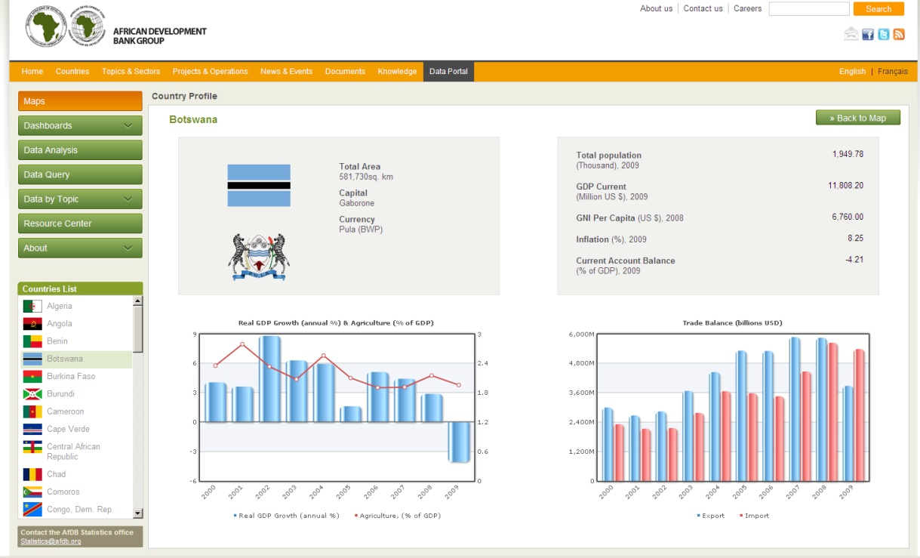
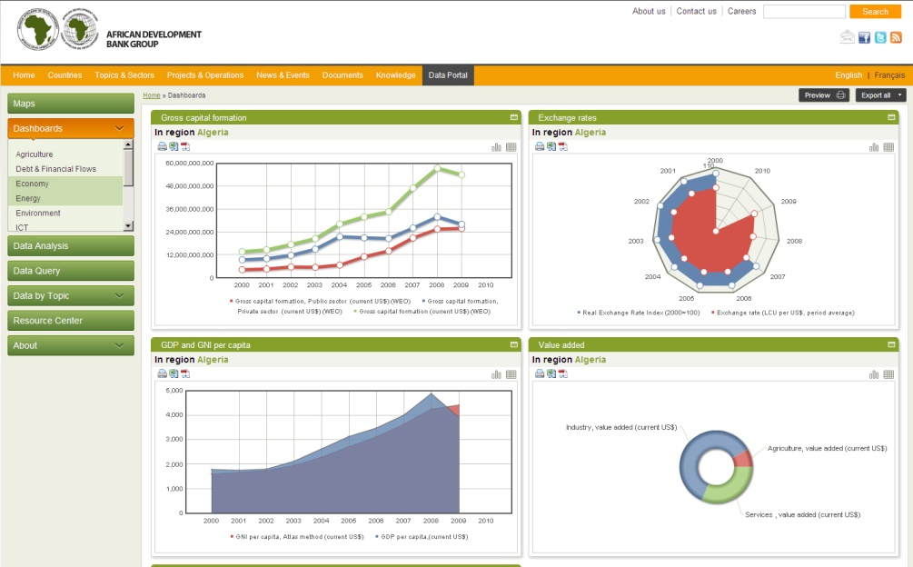
Data Portal
Overview
The Data Portal provides multiple customized tools to gather indicators, analyze them, and export them to multiple formats.
Statistics Department African Development Bank

Slide 6
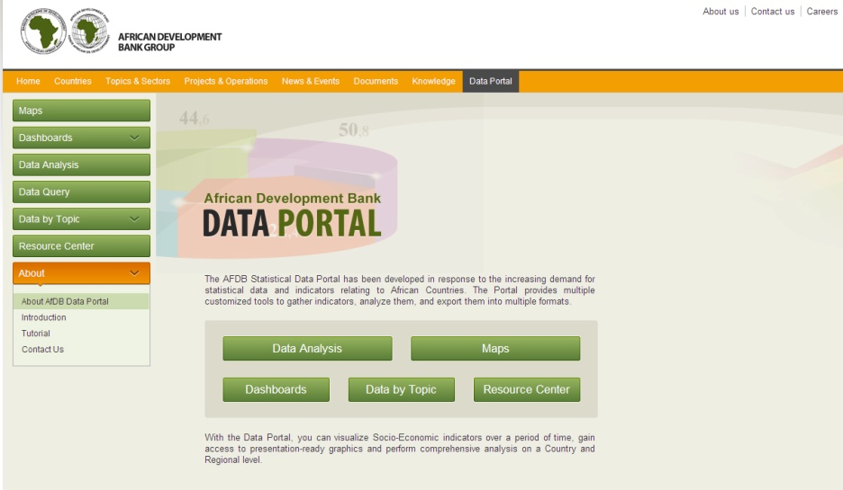
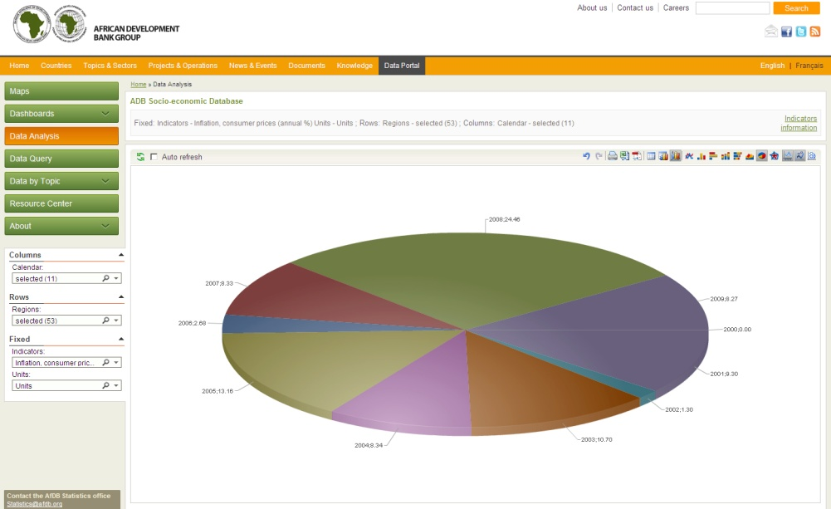
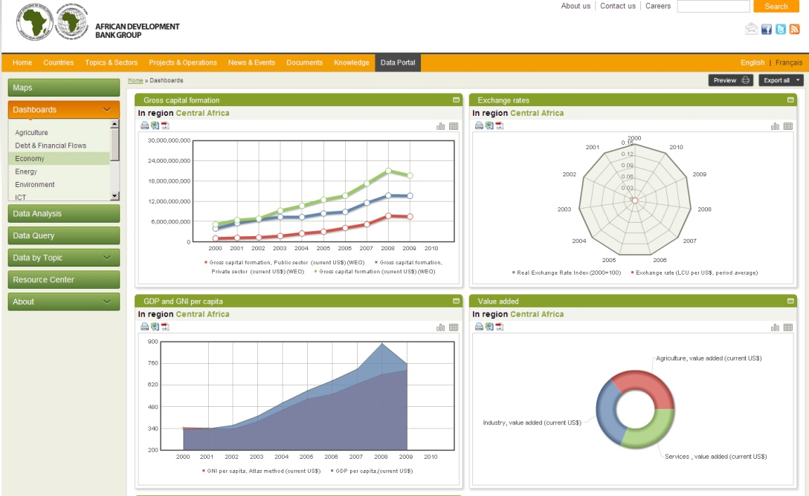
Data Portal
About the Data Portal
With the Data Portal users can:
Visualize time-series analysis on an indicator over a period of time
Perform calculations with built-in tools
Provide presentation-ready graphics
Perform comprehensive analysis on country, regional, and global levels
Export report tables and graphics to popular formats
Statistics Department African Development Bank

Slide 7
Data Portal
Components of Data Portal
Maps module displays an interactive map of the country where users can select an indicator to view comparisons across regions.
Reports module contains a series of predefined reports. Users can update the reports dynamically by changing selections of countries or years.
Data Analysis module is a platform for user-generated data management, graphical display, and quantitative analysis.
Data Query is an alternative analytical tool of the portal. It is an easy-to-use and powerful tool for data visualization in table, chart, and map mode
Dashboards provide a snapshot of specific preselected indicators. The Dashboard section’s main advantages are its visualization capabilities and its simultaneous representation of data in tables, charts, and maps. This tool provides users with presentation-ready reports with high-quality statistics.
Resource Center provides users with a library of publications, reports, case studies, and so on. Users can search by keyword in the document’s source, name, and publication date.
Statistics Department African Development Bank

Slide 8
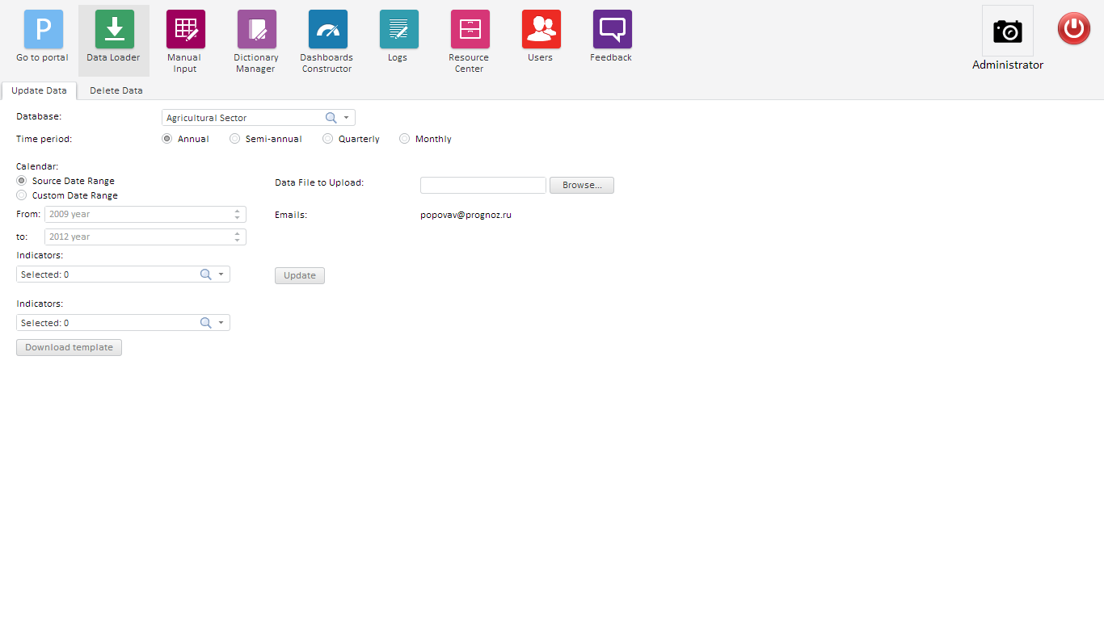
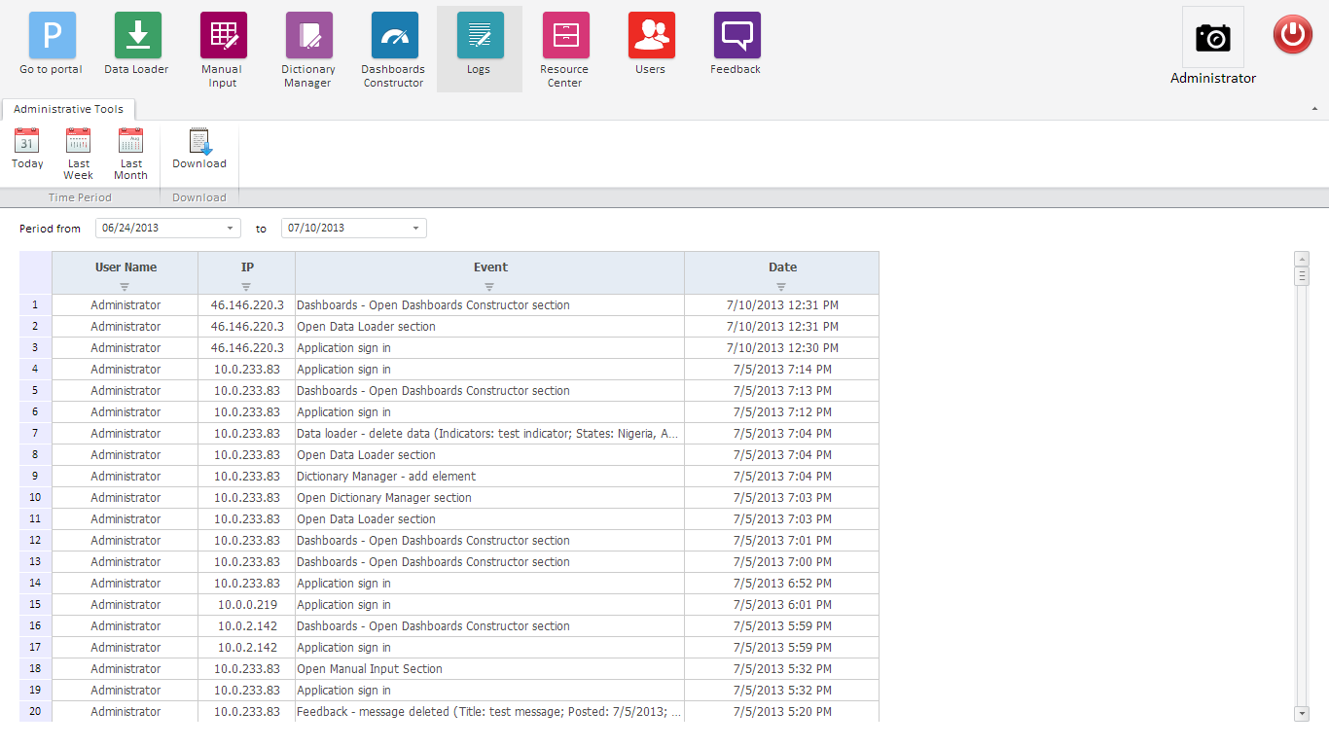
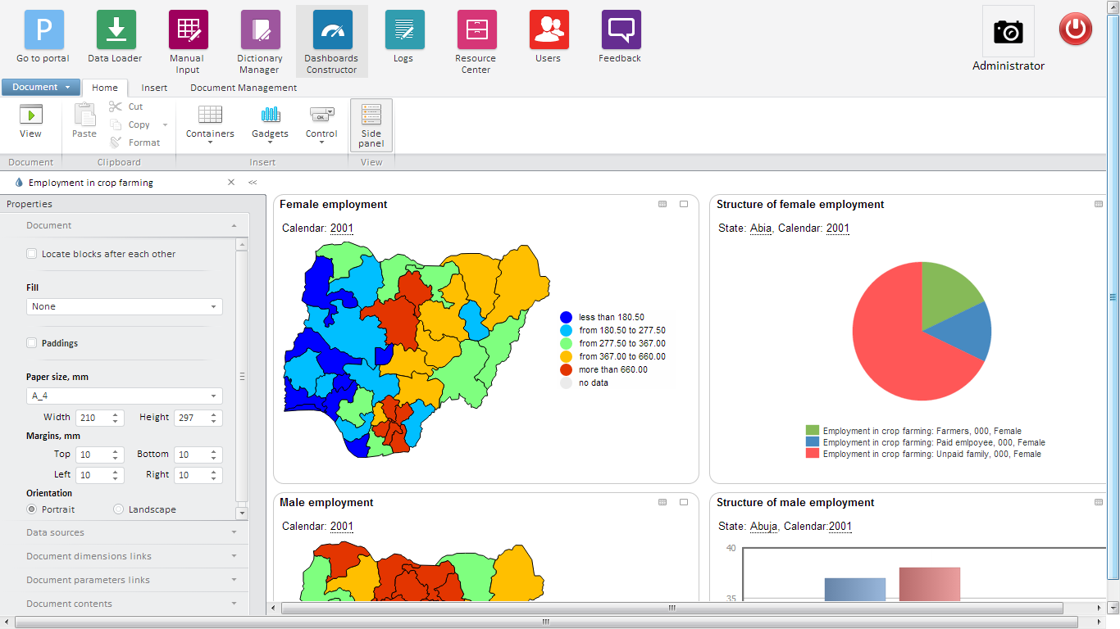
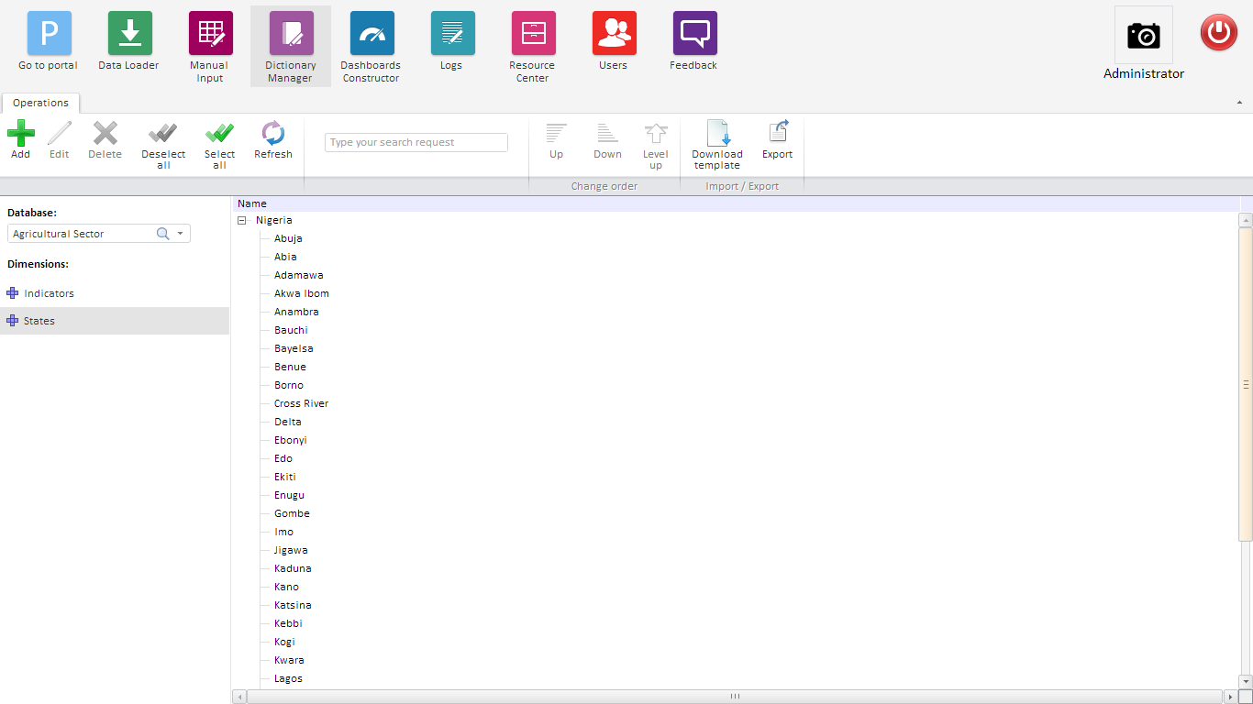
Data Portal for African Countries
Web-based administrative tools
Administrative tools are available in any place all over the world via the Internet. They allow to manage data and portal content.
Statistics Department African Development Bank

Slide 9
Africa/Country
Open Data
Statistics Department African Development Bank

Slide 10
Country Open Data portal
Overview
Country Open Data is ready-to-use solution for implementing country’s Open Data program.
provides a public website on Internet
end-to-end experience for data users
data access
data analysis
content building
sharing/dissemination.
All country’s datasets on various topics as well as relevant international statistics can be published and found by people in a single place and provide a very convenient search engine on top of it.
Country Open Data solution allows for creation of highly visual, interactive dashboards. Users can build their own dashboards with combination of tables, charts, maps and text supporting a specific story to tell
Statistics Department African Development Bank

Slide 11
Data Submission Tool
& SDMX implementation
Statistics Department African Development Bank

Slide 12
Data Submission Tool
Existing data submission process by countries
IMF
AfDB
Other…
Country data
Data mapping to
Requested formats
Submission to partners
and Int. Organizations
As-Is process
Organization specific data mapping and formats leading to repetitive work
Lack of common standards
Reporting burden
Statistics Department African Development Bank

Slide 13
Data Submission Tool
Future data submission process by countries
IMF
AfDB
Other…
Data mapping to
International Standards
in OpenData platform
Country data
Submission to partners
and Int. Organizations
To-be process
Countries map data to international standards and load in the OpenData platform
Data collecting organizations pick from the OpenData platform
Common standards
Statistics Department African Development Bank

Slide 14
Overall Framework of the Platform
[Country]
Open Data Platform
Central Bank
AfDB
Central Bank ODP
WB
National Statistical Office
Natl. Stat. Office ODP
IMF
Min. Of Finance ODP
Ministry Of Finance
others
Dashboards and Visualizations
National Summary Data Page (SDMX)
* ODP stands for OpenData Platform.

Slide 15
Data Submission Tool
Data Submission through ODP
How the data submission tool works in practice:
Country uploads data once to their OpenData Platforms
OpenData Platform
Maps data to standard codes
Store all data in a multilateral data repository
Enables data exchange using SDMX standards
Users query the repository and subscribe to get notification when updates are available
Statistics Department African Development Bank

Slide 16
Data transition scheme based on the SDMX technology
Country Classification
Dissemination
Multilateral data Repository ”SDMX”
Data Mapping
DSDs
Data Query
Data Notification
AfDB
IMF
World Bank
etc.
Statistics Department African Development Bank

Slide 17
Data Submission Tool
Benefits of OpenData Platform
Reduced reporting burden on countries
Timely and more accessible data
Users get up-to-date data
In the formats they want
Visual and Analytical outputs
Easy to use dashboards with tables, charts & maps
Create and maintain National Summary Data Pages in SDMX formats
A common data message for accessing key economic and financial data
Data meets “Open Data” criteria and international standards, and easily re-usable
Data can be retrieved using the SDMX web service by users and machines (like mobile applications and websites)
Statistics Department African Development Bank

Slide 18
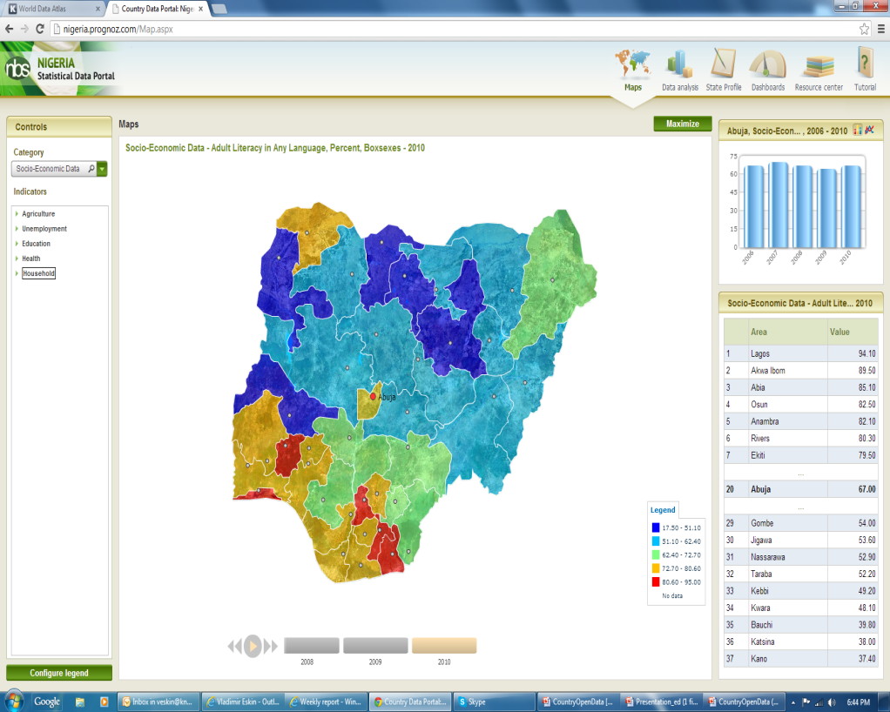
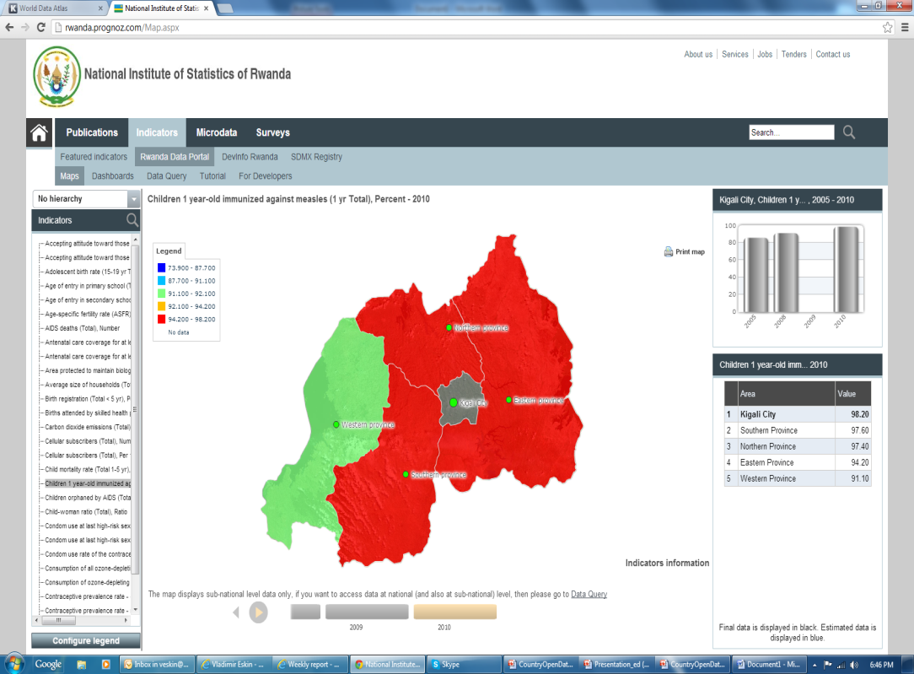
AIH - Implementation Status
All Countries are scheduled to be implemented in 2013
Data Portal implementations have started in more than 60 countries & RECs.
43 countries and RECs already have uploaded the real data into the Data Portals.
30 of them have been trained.
Examples below: Nigeria and Rwanda.
OpenData are now accessible for all African Countries
Data submission tool : Piloted in 3 countries (Nigeria, Rwanda, Tunisia) jointly with IMF
Statistics Department African Development Bank

Slide 19
Implementation Challenges & Way Forward
Implementation Challenges
Internet infrastructure still weak in many African countries and/or Stat offices.
Information Technology (IT) staffing levels still very low in Statistical offices.
Countries still face data management challenges
Access to data does not guarantee its use
Way forward
Introduce robust Data Governance program
Advocate for governments to release timely data
Advocate the use of data for decision making
Improve data management in countries
Promote the use of Open data
Statistics Department African Development Bank

