Slide 1

Gender work Statistics
Day 1, Session 3,
UN Workshop on Improving the Intergation of a Gender Perspective inti Official Statistics
@
Chiba, Japan
16-19 April 2013
Saidah Hashim (Ms.)
Manpower & Social Statistics Division
Department of Statistics Malaysia (DOSM)

Slide 2
DEMOGRAPHY
SOSIO-ECONOMIC
2)Health
1)Population
3) Education
GENDER STATISTICS @
DOSM
4) Work
Marital Status
5) Decision Making
6) Violence
Against Women
Vital Statistics
7) Environment
8) Income & Poverty

Slide 3
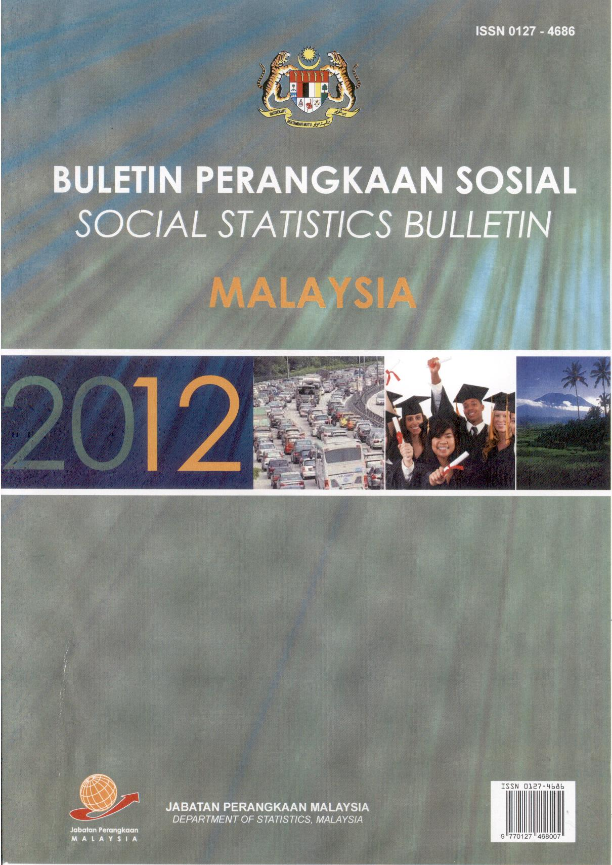
Since 1969 DOSM has come up with a compilation of secondary social statistics.
Population
Housing
Education
Health
Welfare Services
Public Safety
Employment
Communication & Recreation
Area

Slide 4
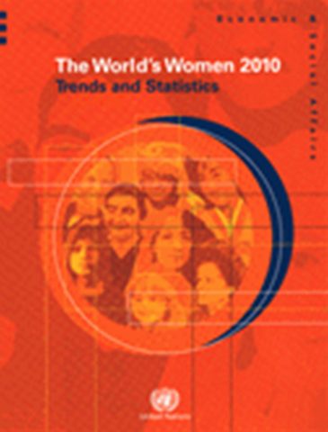
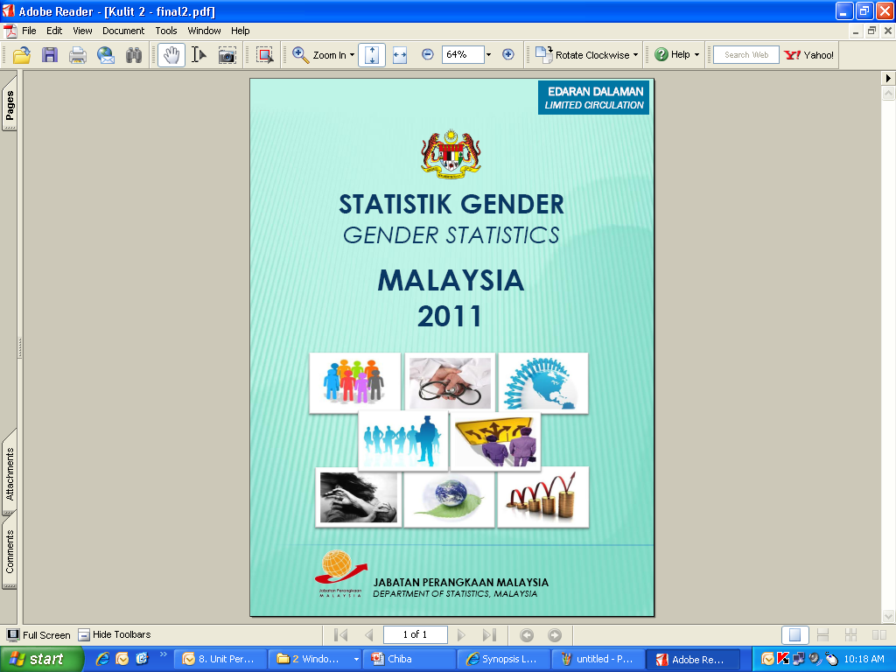
Follow-up to 43rd UNSC @ Feb 2012, DOSM started work on its first Gender Statistics Report, with reference to The World Women’s Report, 2010
Conducted a data gap study

Slide 5
Gender Statistics: List of sources
1. Population
2. Work
3. Household Income & Poverty
Violence Against Women
Royal Malaysia Police
http://www.rmp.gov.my
Department of Statistics
http://www.statistics.gov.my
Education
Health
Ministry of education
http://www.moe.gov.my
Ministry of health
http://www.moh.gov.my
Decision Making
Malaysia’s Parliament
http://www.parlimen.gov.my

Slide 6
Gender Statistics : List of Indicators
CHAPTER | INDICATORS
Population | Statistics on population
 | Total fertility rate and age-specific fertility rate
Health | Statistics on health
 | Statistics on maternal health, Malaysia
Education | Number of teacher and student in government & government-aided primary and secondary schools by sex
 | Number of lecturer and student in higher education institutions by sex
 | Sex ratio in higher education institutions
 | Literacy rate, net enrolment ratio and gender parity index

Slide 7
Gender Statistics: List of Indicators (contd.)
CHAPTER | INDICATORS
Work | Statistics on labour force for the employed population by sex
 | Number and percentage distribution of employed persons by occupation and sex
 | Percentage distribution of employed persons by industry and sex
 | Number and percentage distribution of persons outside labour force by highest certificate obtained, reasons for not seeking work and sex
 | Number and percentage distribution of persons outside labour force by working experience, stratum and sex
 | Mean monthly salaries & wages and gender wage gap by industry and sex
Household Income and Poverty | Statistics on household income and poverty by stratum

Slide 8
Gender Statistics: List of Indicators (contd.)
CHAPTER | INDICATORS
Power & Decision Making | Percentage of parliament members by sex
Violence Against Women | Number of cases by type of offense
Environment | Percentage distribution of households by type of basic amenities

Slide 9
GENDER WORK STATISTICS
Sources of data used to generate gender work statistics:
  Topics covered (such as labour force; status in employment; informal employment; time use; family-work balance; child labour; farm labour etc.)
  Efforts made to improve, from a gender perspective, the quality of work data obtained (such as certain formulation of questions and answers, use of activity lists, use of probing questions, sampling, selection of interviewers, guidelines in selection of appropriate respondents, training, etc)
Examples of gender work statistics and indicators used to address relevant gender issues in your country, analysis used and results obtained.
Dissemination of gender work statistics (in regular reports on labour force, employment, etc/ gender-focused reports/ regular databases/ gender-focused databases/ user-specific packages, etc.)
Main users of gender work statistics and challenges in meeting their expectations

Slide 10
Manpower and Social Statistics Division
Department of Statistics (DOSM)
Labour Force Section
Social Section
Primary Data
Labour Force Survey
Informal Sector Survey
Salaries and Wages Survey
Migration Survey
Secondary Data
Social Statistics Bulletin
Data Bank State/District
Millennium Development Goals
Gender Statistics

Slide 12
Percentage distribution of population
 | Population and Housing Census 2010 | Labour Force Survey 2010
Sex
Male | 51.4 | 51.5
Female | 48.6 | 48.5
Total | 100.0 | 100.0
Age group
0-14 | 27.6 | 27.4
15-64 | 67.3 | 67.7
> 65 | 5.0 | 4.9
Total | 100.0 | 100.0

Slide 13

Labour Force Survey
Conducted since 1982;
Canvassed throughout Malaysia, both in urban & rural areas
Available information:
- Labour Force Participation Rates
- Labour Force
Employed Persons
Unemployment
Outside Labour Force
Statistics can be made available by socio-demographic breakdown.

Slide 15
BPTMS,DOS

Slide 16
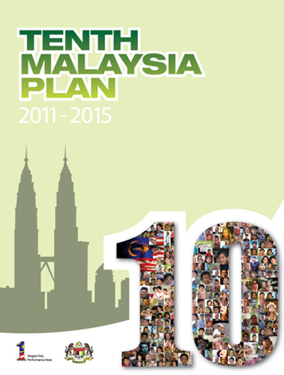
Gender work statistics and addressing gender relevant issues:
Encouraging Greater Participation in the Workforce
“......In addition, to fully leverage the availability of women as a source of untapped labour, measures will be undertaken to increase the female labour force participation rate from 46% in 2010 to 55% in 2015.”
Source: Tenth Malaysia plan 2011-2015
Chapter 4, page 231: Developing and Retaining a First-World Talent Base
Please visit Economic Planning Unit website to access the document:
http://www.epu.gov.my

Slide 17
1b. Improve Quality
Continuous monitoring of data collection
Housewives: Probing further
Sampling: Stratified Random Sampling, probability proportionate to size
Biannual review of survey results
In line with ILO recommendations

Slide 18
3. Dissemination of gender work statistics
Results released monthly, quarterly & annually
Available on-line DOSM at: www.statistics.gov
Need to improve content of Gender Statistics Report
4. Main Users of gender work statistics
Main User Committee (Economic Planning Unit, MOF, Central Bank, MOHR, et el)

Slide 19
Terima Kasih
Thank you
Arigato

