Slide 1

Integrating a gender perspective into health statistics
United Nations Statistics Division

Slide 2
Objectives
What are the gender issues?
  certain areas of concern where women and men may not enjoy the same opportunities or status
  where women’s and men’s lives may be affected in different ways – life style
Data sources
Quality of data; avoid gender bias
Understanding gender difference in health - Biological vs social impact

Slide 3
Areas of health to focus on
Health and nutrition of children
Maternal health
Mortality and causes of death
HIV and AIDS
But you may explore further …

Slide 4
Gender issues in health: examples

Slide 5
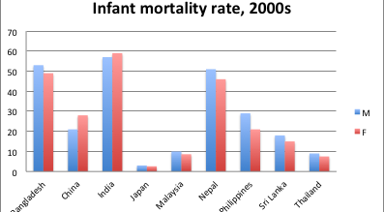
Infant mortality rates, by sex
Source: Based on 2010 Population Prospect

Slide 6
Treatment of diarrhoea
Source: Constructed based on DHS data

Slide 7
Gender differential in Life expectancy at birth
Source: Based on 2010 Population Prospect

Slide 8
Life expectancy at birth
Women live longer than men
Unhealthy life style for men
Higher mortality level; HIV/AIDS; maternal mortality
What is this?
Source: Based on 2010 Population Prospect

Slide 9
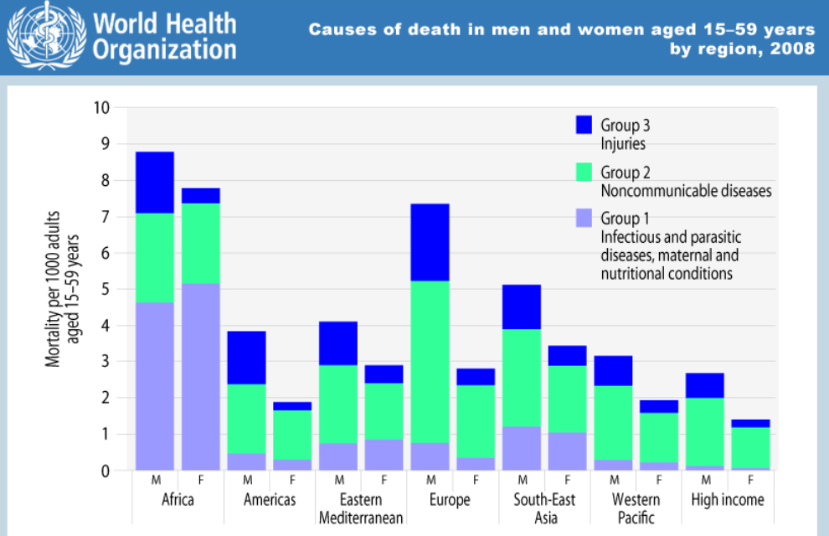
Cause of deaths
Source: WHO

Slide 10
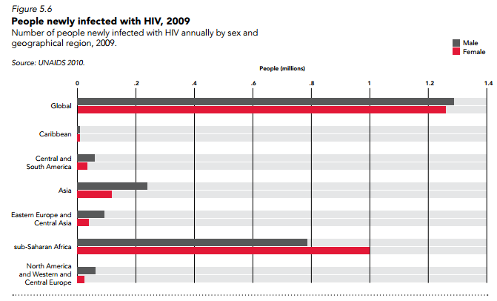
People with newly infected HIV
Source: UNAIDS Report on the Global Aids Epidemic, 2010

Slide 11
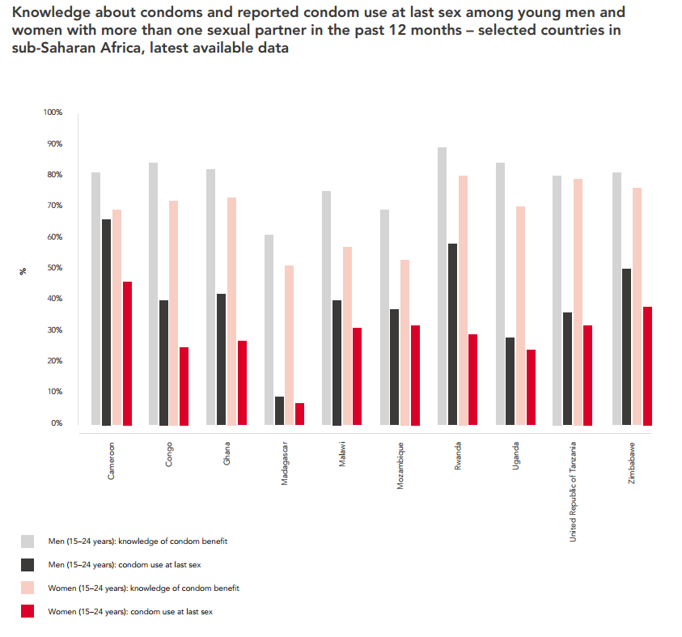
Source: UNAIDS Report on the Global Aids Epidemic, 2012

Slide 12
Sometimes it looks fine in one dimension…
But if we dig deeper

Slide 13
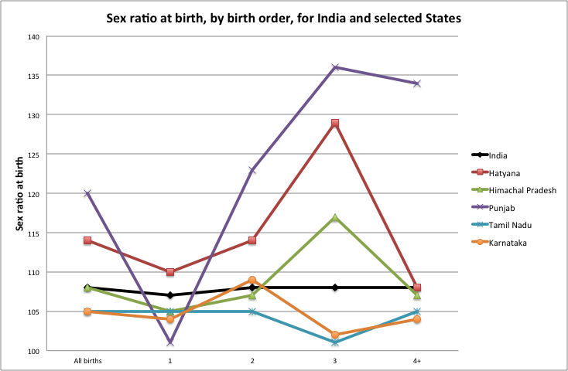
Reconstructed based on data from Sekher and Hatti, Discrimination of Female Children in India: from Conception through Childhood
Notes:
What year of data is this?

Slide 14
We have gender issues
and
where are the data?
Notes:
So we all agree there are gender issues in all those aspects of health – the next step, as statistician/gender specialist working in NSO is to find data and identify the gaps – to convey the messages to policy makers

Slide 15
Sources of gender statistics in health
Civil registration systems (complete coverage): preferred source of data on deaths and cause of deaths
Household surveys – complementary source
  DHS and MICS: retrospective data on births, deaths, anthropometrics, immunization, and health care of women and children
  LSMS: health expenditure
Population censuses: child/adult mortality, by various characteristics
Health administrative sources and immunization coverage surveys: data on vaccinations.
Notes:
Data sources are listed here, each has its pros and cons. Will not go into details, is on the manual
Data sources are complementary.
- For example, a great civil registration system will give us good data on deaths and cause of deaths. But we need to have census to provide us data for various population groups. And we need sample surveys to tell us what is behind the difference in gender differences in mortality, is it access to medical service? Is it behavior problem that impact on mortality?

Slide 16
Sources of gender statistics in health (2)
Demographic surveillance systems
  usually maintained by research institutions
  provide information on births and deaths by cause of death in small populations of selected areas, such as a community, or a district. Where death certificates are not available, a cause of death is assigned based on interviews with family members (a method called “verbal autopsy”).
  useful, but expensive and time-consuming to conduct, usually not representative
Reproductive-age mortality studies (RAMOS)
  Involve identification of causes of all deaths of women of reproductive age (and to classify those deaths as maternal or otherwise) in a selected population by using multiple sources of data for a defined area or population.
  Sources used: civil records; health facility records; burial records; interviews with traditional birth attendants; and interviews with family members.

Slide 17
Sources of gender statistics in health (3)
Sentinel surveillance may collect data on HIV status and sexual behaviour for populations with high risk behaviours such as sex workers, injecting drug users and men who have sex with men.
Population-based surveys with HIV testing such as Demographic and Health Surveys and AIDS Indicators Surveys provide data on HIV prevalence. These surveys as well as MICS and reproductive health surveys also provide other HIV-related data, such as: knowledge of HIV transmission and prevention, multiple sex partners, use of condom during sexual intercourse with a non-marital, non-cohabiting sexual partner in the last 12 months, and access to antiretroviral therapy.
Integrated Biological and Behavioural Surveillance (IBBS) Surveys can provide data on key populations at higher risk of HIV infection, such as men who have sex with men, sex workers, and people who inject drugs.
Reports from health facilities, including antenatal clinics attended by pregnant women, may provide information on results from HIV-tested blood from sample of patients, and information on access to antiretroviral therapy.
Time use surveys can provide data on time spent caring for household members who are HIV infected.

Slide 18
Data quality
Why is it an issue?
  Impact on identifying gender gaps
    Is it a real gender issue? Or data error?
  Every data source comes with limitations
  Communication with users/policy makers: gives more credibility to your analysis

Slide 19
What are the data quality issues?
Coverage and accuracy of data from the civil registration system
Sex-biases in reporting: are girls more omitted than boys?
Censuses and surveys: recall-bias, errors (sampling and non-sampling), under-reporting, estimates rely heavily on assumptions and modeling
Notes:
Even complete civil registration system (90%+) may have issues with coverage of children
One example of variation in estimates of adult mortality: using different methods – GGB and SEG

Slide 20
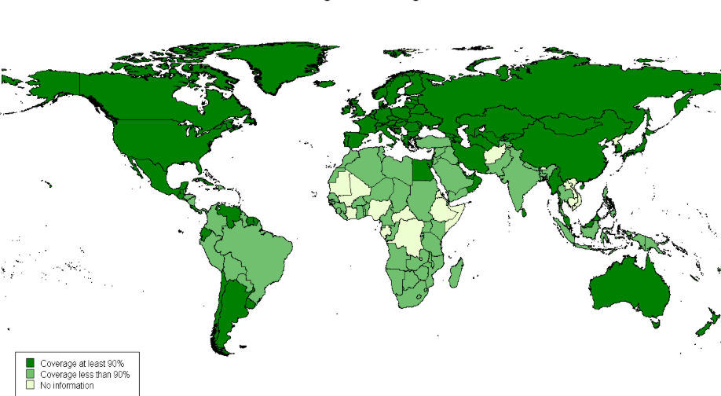
Coverage of death registration
Notes:
This is just an indication on the % deaths registered, but good registration does not always link to good statistics. The linkage between registration and statistics sometimes is not working well

Slide 21
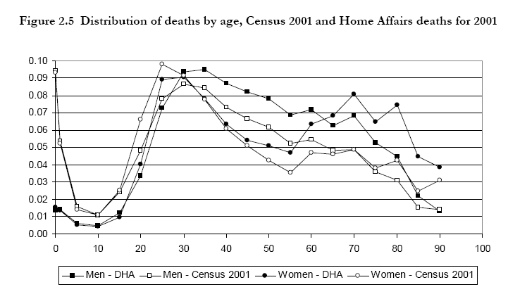
Death registration: under-reporting of children
much lower % of child deaths in registration than in census
Source: Estimation of mortality using the South African Census 2001 data, Dorrington and Moultrie, 2004

Slide 22
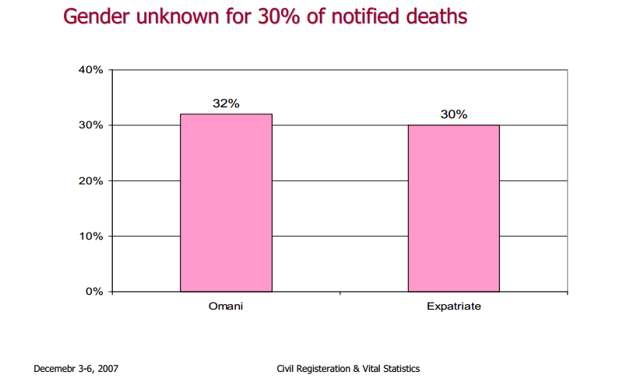
Death registration: missing value on sex??
Sex
Source: United Nations Workshop on Civil Registration and Vital Statistics in the ESCWA Region, 2007

Slide 23
Are girls less likely to be registered?
Source: UNICEF

Slide 24
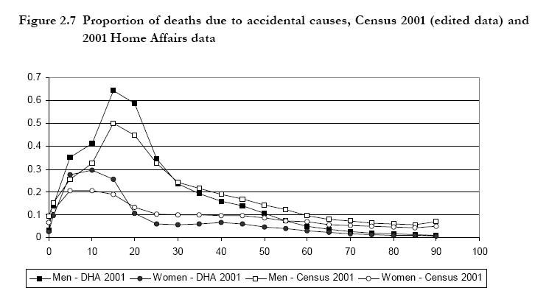
Census data: under-reporting
Source: Estimation of mortality using the South African Census 2001 data, Dorrington and Moultrie, 2004

Slide 25
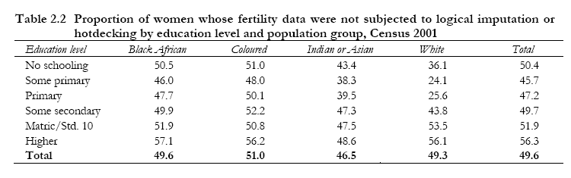
Census data: content error
Source: Estimation of fertility using the South African Census 2001 data, Dorrington and Moultrie, 2004
Fertility data for 50% of the records need to be edited

Slide 26
Estimates that come with confidence intervals
Source: United Nations MDG database

Slide 27
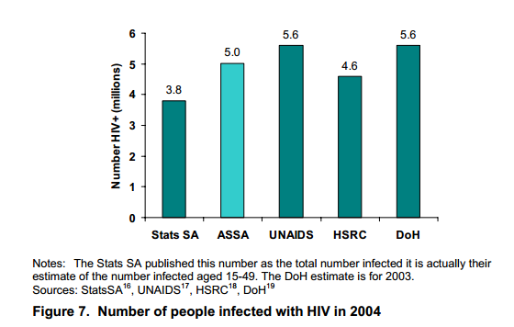
Estimates from different sources
South Africa

Slide 28
Data quality issues, what to do?
Understanding the quality issues:
  Poorly phrased questions? Proxy respondent? Qualification of interviewer? Data coding/entry/editing mistakes?
  Improving future data collection activities
Adjusting estimates
Using multiple data sources
Using different methods
Communicating with users

Slide 29
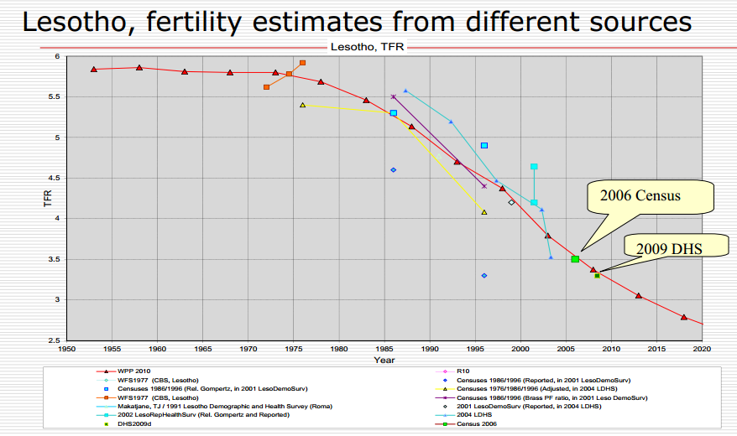
Fertility estimates
Source: United Nations Workshop on Census Data Evaluation for English-speaking African Countries, 2012

Slide 30
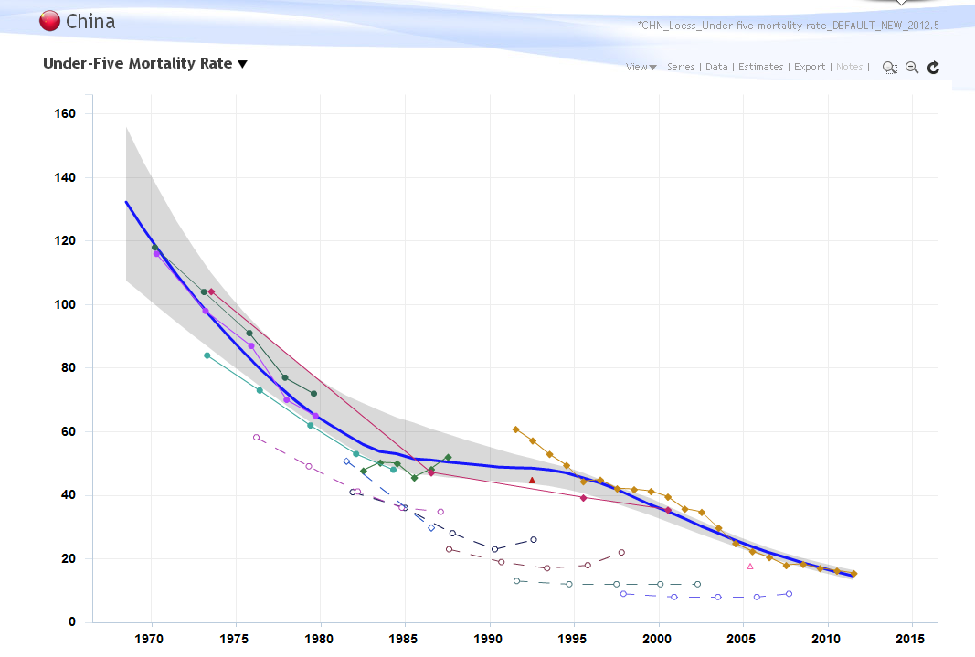
Child mortality estimates
Source: UNICEF

Slide 31
Understanding gender difference in health: biological vs social factors
Equal outcome ≠ Equality
Why?

Slide 32
Biological factors
Girls: biological advantage in mortality
Not very clear on the entangled biological vs social factors for adult mortality
  Cardiovascular diseases etc: is it biological or behavioral?
Sex-differentiated biological risk for some diseases such as HIV/AIDS
Some causes of death are specific to women or men.

Slide 33




Social factors: disadvantages for men
Life threatening jobs
Higher-risk lifestyle

Slide 34
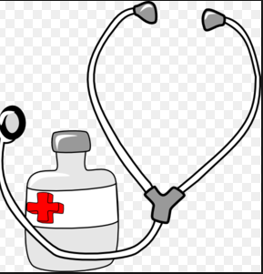
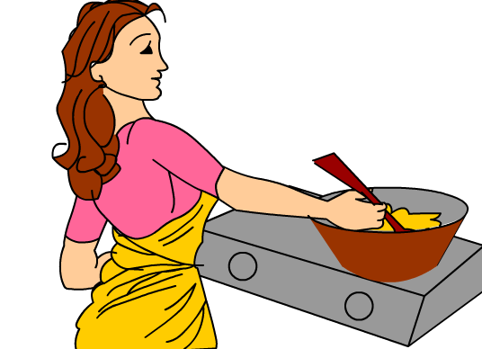

Social factors: disadvantages for women
Less access to health care
More exposure to indoor pollution
Difficult in negotiating use of condoms → risk of HIV/AIDS ⬆
Sexual behavior at younger age → STD

Slide 35
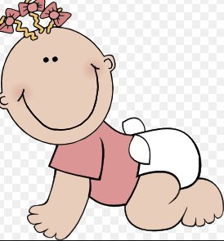

Infant mortality: biological factors
High mortality
Low mortality
Perinatal
Infections

Slide 36
How to identify the “real” gender gap?
Using appropriate measures/indicators:
  Child mortality (between ages 1 & 5) preferred: more likely to highlight the potential disadvantage of girls, compared to IMR and U5MR
  Sex differentials in nutrition: better if disaggregated by age: biological factors less relevant after age 2
Benchmarking!

Slide 37
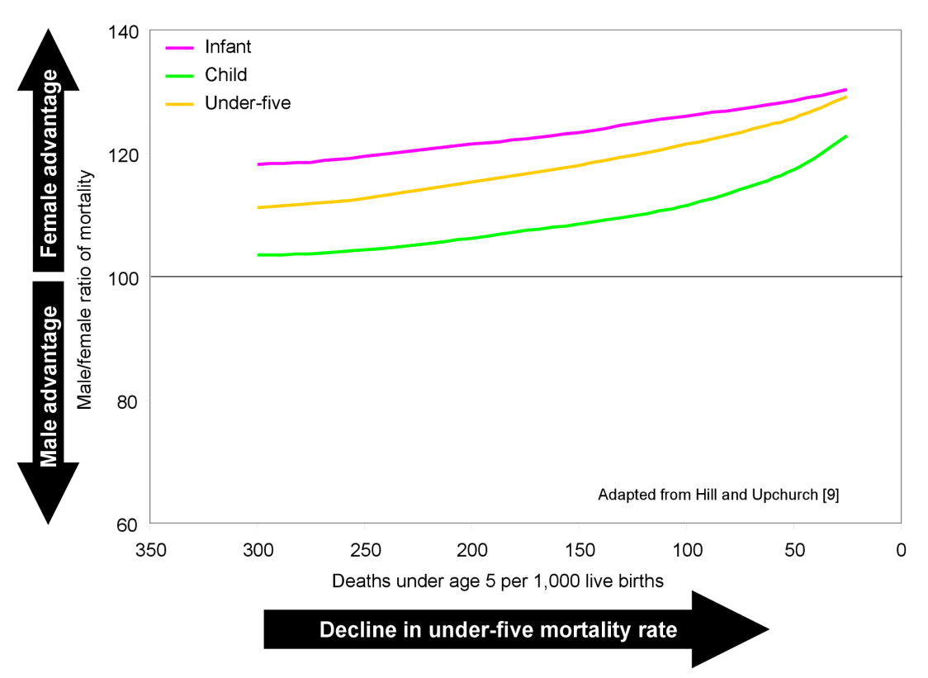
Historical change in the male-to-female ratio of mortality as under-five mortality declined in selected developed countries
Source: Sawyer, C.C. 2012. "Child Mortality Estimation: Estimating Sex Differences in Childhood Mortality since the 1970s." PLoS Med 9(8):e1001287.

Slide 38
How to identify the “real” gender gap?
Source: Constructed based on data from United Nations Population Division

Slide 39
Key messages
Gender issues, not limited to basic ones
Available data and limitations
Quality of data and reflection on future data collection
Analysis: biological vs social

Slide 40
Group exercises
Prepare a table on gender issues, data needed and sources of data for the topic health risk factors (life style related)

Slide 41
Example of gender issues | Data needed | Data source
Are young women or young men more likely current drinkers? | Number of current drinkers by sex and age | Household surveys such as World Health Surveys School-based surveys such as Global School-based Student Health Survey (GSHS)

