Slide 1
Japanese practice: role of statistics for realizing a gender-equal society
4/16/2013
Shizuka TAKAMURA
Cabinet Office
Government of Japan

Slide 2
Shizuka TAKAMURA
Counsellor for Gender Equality Analysis
sizuka.takamura@cao.go.jp
Part1：Basic structure to formulate a gender-equal
society in Japan
Part2： Basic statistical system and gender statistics
in Japan
Part3： Resent Japanese situation relevant to
“Minimum Set of Gender Indicators”
Part4： Examples of gender impact assessment
and evaluation in Japan

Slide 3
Part1：Basic structure to formulate a gender-equal
society in Japan

Slide 4
Contents of Part1
１．The Basic Act for a Gender-equal Society
２．Main actions taken towards gender equality in Japan and the United Nations
３ ．Framework for the promotion of Gender Equality
4 ．The Third Basic Plan for Gender Equality

Slide 5
1．The Basic Act for a Gender-equal Society (Enacted in 1999)
Foregoing remark
(P30, Women and Men in Japan 2012 )
Considering respect for individuals and equality under the law expressly stipulated under the Constitution, steady progress has been made in Japan through a number of efforts toward the realization of genuine equality between women and men together with efforts taken by the international community. However, even greater effort is required.
At the same time, to respond to the rapid changes occurring in Japan's socioeconomic situation, such as the trend toward fewer children, the aging of the population, and the maturation of domestic economic activities, it has become a matter of urgent importance to realize a Gender-equal Society in which men and women respect the other's human rights and share their responsibilities, and every citizen is able to fully exercise their individuality and abilities regardless of gender.
In light of this situation, it is vital to position the realization of a Gender-equal Society as a top-priority task in determining the framework of 21st-century Japan, and implement policies related to promotion of formation of a Gender-equal Society in all fields.
This law is hereby established in order to clarify the basic principles with regard to formation of a Gender-equal Society, to set a course to this end, and to promote efforts by the State and local governments and citizens with regard to formation of a Gender-equal Society comprehensively and systematically.

Slide 6
5 Pillars (principles) Regarding the Creation of a Gender-equal Society
Respect for the human rights of women and men
Consideration of social systems or practices
Joint participation in planning and deciding policies, etc.
Compatibility of activities in family life and other activities
International cooperation
Roles of the State, Local Governments and Citizens
-formulation of the Basic Plan
-comprehensive formulation and implementation of policies
The state
-formulation of the Basic Plan
-comprehensive formulation and implementation of policies
Local governments
-implementation of policies pursuant to the basic policies
-implementation of other policies in accordance with the
nature of the areas of local governments
-implementation of policies pursuant to the basic policies
-implementation of other policies in accordance with the
nature of the areas of local governments
Citizens:
-expected to contribute to the formation of a gender-equal society

Slide 7
２．Main actions taken towards gender equality in Japan and the United Nations (UN)
(P67, Women and Men in Japan 2012 )
1975
The World Conference of the International Women’s Year 【UN】
1979
Adoption of the Convention on the Elimination of All Form of Discrimination against Women (CEDAW) 【UN】
1985
Promulgation of Law on Securing, Etc. of Equal Opportunity and Termination between Men and Women in Employment
1985
Ratification of the Convention on the Elimination of All Form of Discrimination against Women (CEDAW)
1991
Promulgation of the Child Care Leave Law
1995
The Four World Conference on Women 【UN】
1999
Promulgation and enforcement of the Basic Act for a Gender-equal Society
2000
Formation of the Basic Plan for Gender Equality
2001
Establishment of the Gender Equality Bureau
2005
Formation of the Second Basic Plan for Gender Equality
2010
Formation of the Third Basic Plan for Gender Equality

Slide 8
3． Framework for the promotion of Gender Equality
National Machinery for the Formation of a Gender Equality
3 Specialist Committees
line ministries ; Ministry of Health, Labour and Welfare,
Ministry of Education,Culture,Sports,Science & Technology, etc.

Slide 9
3 Special Committees in the Council for Gender Equality
-Study and deliberate
on issues of great
concern for people and
closely related to the
basic perception
-Study and deliberate on
government measures
and other matters affecting the formation of a gender equal society
-Study and deliberate on
measures for the future in consideration of each relevant fields, such as violence from husbands or partners, sexual crimes, prostitution, trafficking in persons,
sexual harassment and
stalking behavior
-Study and deliberate on whether or not the Basic Plan for Gender Equality is being steadily implemented in each ministry and agency
Specialist Committees on Basic Issues and Gender Impact Assessment and Evaluation
Specialist Committees on Violence against Women
Specialist Committees on Monitoring
↑Monitoring
←Gender Impact Assessment and Evaluation
Working Group on “Women and Economy” (2011.3～2012.2)”
Working Group on “Positive Action” (2011.3～2012.2)
Working Group on “Promotion of Women” (2012.9～2012.12)

Slide 10
4. The Third Basic Plan for Gender Equality
(1) Highlights of the Plan
(P31～P36 Women and Men in Japan 2012 )
In December 2010, the Cabinet approved the Third Basic Plan for Gender Equality, as A basic plan based on the Basic Act for Gender-Equal Society.
Creation of new priority fields in response to change in the socioeconomic situation
- for example, “gender equality for men and children” “support for men and women facing living difficulties such as poverty” are the newly introduced fields
2) Setting “performance objectives” for each of 15 priority fields
(Totally 82)
- Specialist Committee on Monitoring continue to monitor the performance regard to each performance objective
Promotion of efforts aimed at increasing the share of women in leadership positions to at least 30% by 2020 in all fields of society

Slide 11
15 Priority Fields and Performance Objectives of the Third Basic Plan
for Gender Equality
Newly introduced priority fields are shown in red letters.
1. Expansion of women’s participation in policy decision-making processes
2. Reconsideration of social systems and practices and raise awareness
from a gender equal perspective
3. Gender equality for men and children
4. Securing equal opportunities and treatment between men and women
in employment
5. Men’s and women’s work-life balance
6. Promotion of gender equality aimed at bringing about vibrant
agricultural, forestry, and fisheries communities
7. Support of men and women facing living difficulties such as poverty

Slide 12
8. Creation of an environment in which people such as the elderly, the
disabled, and non-Japanese people can live comfortably
9. Elimination of all forms of violence against women
10. Support for women’s lifelong health
11. Enhancement of education and learning to promote gender
equality and facilitate diversity of choice
12. Gender equality in science and technology and academic fields
13. Promotion of gender equality in the media
14. Promotion of gender equality in the area of regional development,
disaster prevention, environment, and others
15. Respect for international regulations and contributions to the
“Equality, Development, and Peace” of the global economy

Slide 13
Part2：Basic statistical system and gender statistics
in Japan

Slide 14
Contents of Part2
１. Gender statistics
２．Statistical system in Japan

Slide 15
１. Gender statistics
“Gender statistics ”
refers to
  an area of statistics and statistical work
  which cuts across all statistical areas of work
  to identify, produce and disseminate statistics
  that reflect the realities of the lives of women and men
  and policy issues relating to gender equality
  and women’s empowerment.

Slide 16
“Beijing Platform for Action” (1995)
Strategic objective H.3. 【§206～§209】
Generate and disseminate gender-disaggregated data and information for planning and evaluation
§206. By national, regional and international statistical services and relevant government and United Nations agencies, in cooperation with research and documentation organizations, in their respective areas of responsibility:
  Ensure that statistics related to individuals are collected, compiled, analysed and presented by sex and age and reflect problems, issues and questions related to women and men in society;
(b) Collect, compile, analyse and present on a regular basis data disaggregated by age, sex, socio-economic and other relevant indicators, including number of dependants, for utilization in policy and programme planning and implementation and to reflect problems and questions related to men and women in society;
(c) Involve centres for women's studies and research organizations in developing and testing appropriate indicators and research methodologies to strengthen gender analysis, as well as in monitoring and evaluating the implementation of the goals of the Platform for Action;
・・・
29

Slide 17
“Global Gender Statistics Programme”
United nation Statistics Division established it in 2006
The objective is
    enhancing the capacity of countries to collect, disseminate and use quality gender statistics through effective use of networking
    building strong and supportive partnerships
    establishing collaborative arrangement among governmental, intergovernmental, as well as individual experts
    fostering effective management and sharing of information among stakeholders
  Under the program
    the Global Forum on Gender Statistics was hold
    Rome in 2007; Accra in 2009; Manila in 2010; Dead Sea in 2012
  an Inter-Agency and Expert Group on Gender Statistics was set up
  to promote collaboration among the key stakeholders
30

Slide 18
the Global Forum on Gender Statistics
Manila in 2010
31

Slide 19
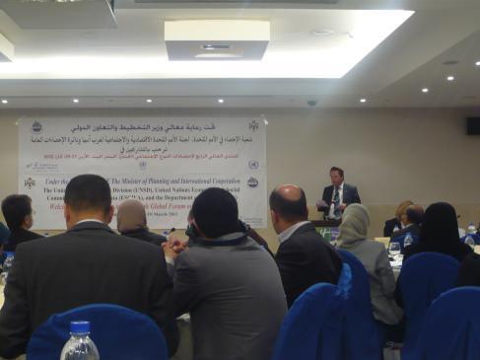
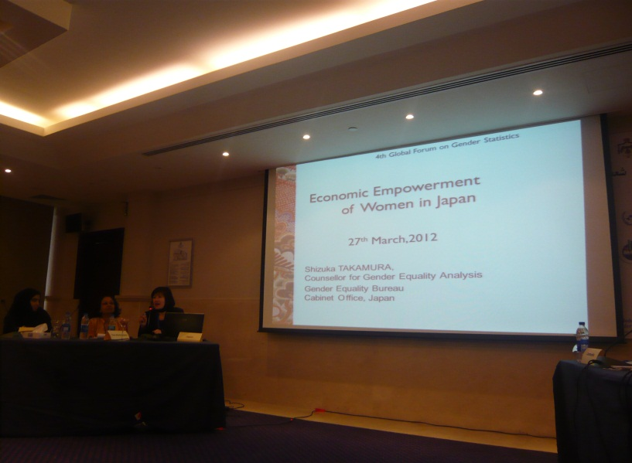

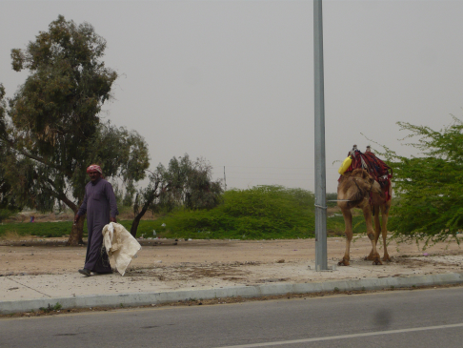
the Global Forum on Gender Statistics
Dead Sea in 2012
31

Slide 20

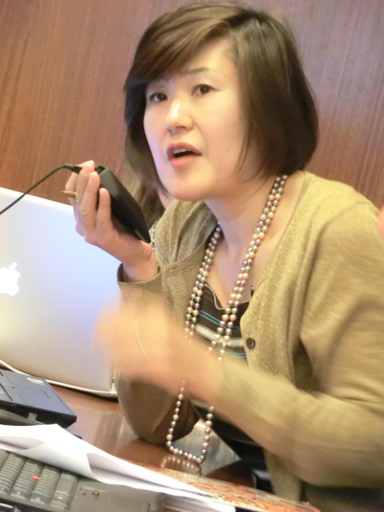
an Inter-Agency and Expert Group on Gender Statistics
New York in 2011
31

Slide 21
Programme review: gender statistics;
at Statistical Commission Forty-second session in 2011
the commission requested
  the UN Statistics Division
  to assume a leadership role in charting the path for the development of gender statistics globally
  the Inter-agency and Expert Group on Gender Statistics (IAEG-GS)
  the to expand the scope of its work to include:
  reviewing gender statistics with the aim of establishing a minimum set of gender indicators;
  guiding the development of manuals and methodological guidelines for the production and use of gender statistics;
  serving as the coordination mechanism for the global programme on gender statistics;
31

Slide 22
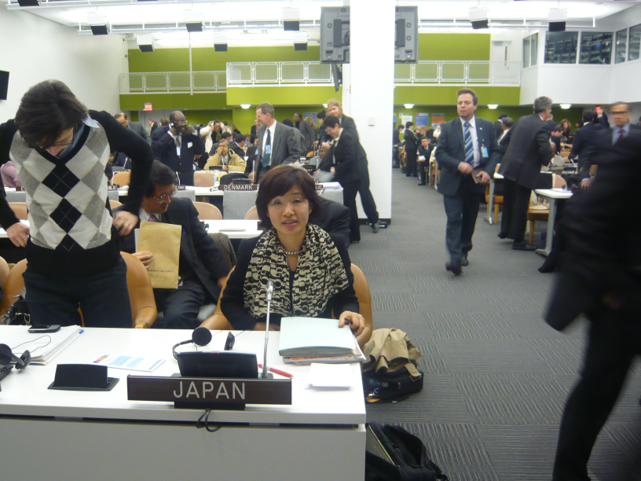

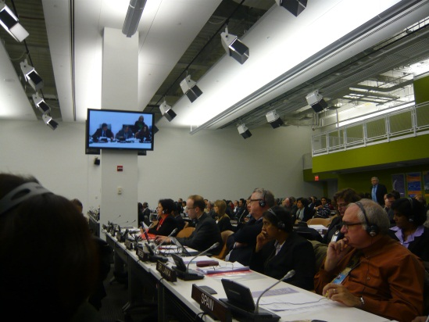
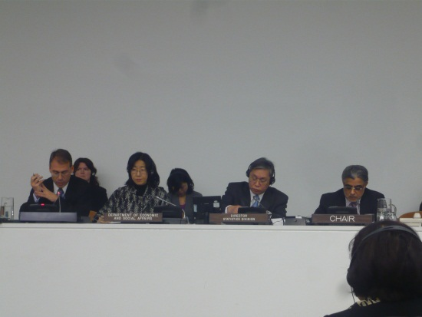
Statistical Commission Forty-second session in 2011
New York in 2011
31

Slide 23
minimum set of gender indicators
A subgroup of technical experts of IAEG-GS developed the list of indicators, should address key policy concerns as identified in the Beijing Platform of Action and other more recent international concerns .

Slide 24
2．Statistical system in Japan
The statistical system of the Japan
The statistical system of the Japanese government is decentralized
Ministries
responsible for collecting, publishing
and analyzing sex-disaggregated data
in each field.
＝
＝
Gender Equality Bureau,
Cabinet Office
Director-General for
Policy Planning
on Statistical Standards,
Ministry of Internal Affairs
and Communications
＝

Slide 25
The gender statistics in Japan
Enhancing data collection segregated by sex among Japanese ministries
  “Basic Plan Concerning the Development of Official Statistics” and “the Third Basic Plan for Gender Equality ” state the current objectives and strategies for gender statistics
  Especially “the Third Basic Plan for Gender Equality” requires the government to publish the situation regarding performance objectives segregated by sex as much as possible
Such data make it possible
to analyze the differences in situations between men & women
to measure the distribution of resources and benefit
between men & women
to assist policy making to improve gender equality

Slide 26
Major Statistical Surveys in Japan
Statistics | Ministry | Sex-segregated data
Population Census Labour Force Survey Family Income and Expenditure Survey |  | ○
Comprehensive Survey of Living Conditions Longitudinal Survey of Adults in 21st Century |  | ○
Japan's Education at a Glance Survey on Full Time Equivalent (FTE) data for Research Staff members in Higher Education Organization |  | ○
Survey on Violence Between Men and Women | Cabinet Office | ○
Ministry of
Internal Affairs and
Communications
Ministry of
Health, Labour
and Welfare
Ministry of Education, Culture, Sports, Science
and Technology

Slide 27
Part3： Resent Japanese situation relevant to
“Minimum Set of Gender Indicators”

Slide 28
Contents of Part3
1. Overview
2 ．Economic structures, participation in productive activities
and access to resources
3. Education
4. Health and related services
5. Public life and decision-making
6. Human rights of women and girl children

Slide 29
１．Overview
(P1, Women and Men in Japan 2012 )
Total Population
(1,000 persons)
 | Total | Women | Men | Sex-ratio
1970 | 103,720 | 52,802 | 50,918 | 96.4%
1980 | 117,061 | 59,467 | 57,594 | 96.9%
1990 | 123,611 | 62,914 | 60,697 | 96.5%
2000 | 126,926 | 64,815 | 62,111 | 95.8%
2005 | 127,768 | 65,419 | 62,349 | 95.3%
2008 | 128,084 | 65,662 | 62,422 | 95.1%
2011 | 127,799 | 65,615 | 62,184 | 94.8%
Source: Population Estimates by the Statistics Bureau, Ministry of Internal Affairs
and Communications
Note: Data as of October 1 every
hit
the peak
Proportion of Children and the Elderly to the Total Population(2011)
 | Total Population (1,000) | Proportion of 0 – 14 years of age to the total population (%) | Proportion of 65 years of age and over to the total population (%) | Proportion of 75 years of age and over (%)
Total | 127,779 | 13.1 | 23.3 | 11.5
Women | 65,615 | 12.4 | 26.0 | 13.9
Men | 62,184 | 13.8 | 20.4 | 9.0
Source: “Population Statistics of Japan 2010,” National Institute of Population and Social Security Research

Slide 30
(P2, Women and Men in Japan 2012 )
Average Age of First Marriage
 | Wife | Husband | Age difference (husband – wife)
1970 | 24.2 | 26.9 | 2.7
1990 | 25.9 | 28.4 | 2.5
2000 | 27.0 | 28.8 | 1.8
2010 | 28.8 | 30.5 | 1.7
Source: “Population Statistics of Japan 2010,” National Institute of Population and
Social Security Research
Changes in Live Births and Total Fertility Rate
1.58
1.57
Baby boomer
Source: “Vital Statistics of Japan,” Ministry of Health, Labour and Welfare
Replacement level (2.1)
2nd Baby boomer
1.39
in 2010,2011
High economic growth period

Slide 31
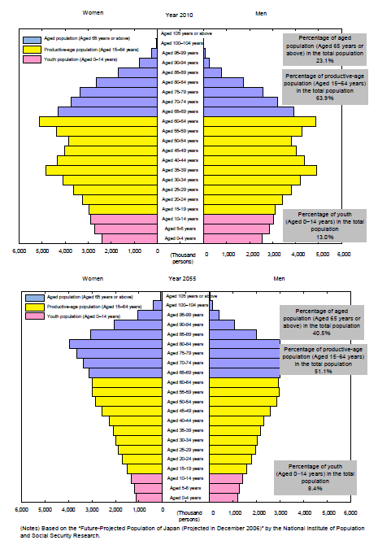
Demographic pyramid in the future
Japan is one of the most rapidly aging society, where people will have to cope with demographic onus. That is exactly why more active participation of women into society is urgently needed in Japan.
Women
Men
Percentage of aged population 24.2%
2012
Percentage of aged population 39.4%
2055
(White paper on Gender Equality 2012)

Slide 32
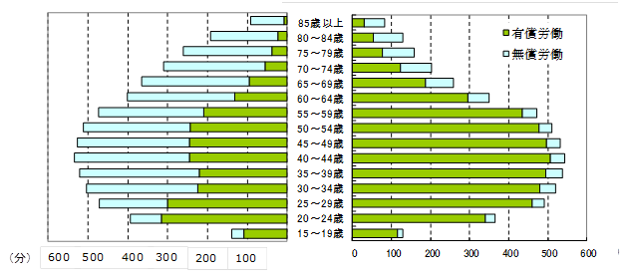
Ⅰ． Economic structures, participation in productive activities
and access to resources
1. Average number of hours spent on unpaid domestic work by sex.
2. Average number of hours spent on paid and unpaid work combined
(total work burden), by sex
Time spent for paid and unpaid work according to sex and age
Women
( Age)
Men
85+
80～84
75～79
70～74
65～69
60～64
55～59
50～54
45～49
40～44
35～39
30～34
25～29
20～24
15～19
Paid work
Unpaid work
( Minutes)
( Minutes)
Source: “Survey on Time Use and Leisure Activities 2006”
Ministry of Internal Affairs and Communications.

Slide 33
Reference
Employed worker annual income according to sex
15～
10～15
9～10
8～9
7～8
6～7
5～6
4～5
3～4
2.5～3
2～2.5
1.5～2
1～1.5
0.5～1
～0.5
Women
Men
( million Yen )
Source: “Employment Status Survey ,”
Ministry of Internal Affairs and Communications.

Slide 34
3. Labour force participation rates for 15-24 and 15+, by sex
14. Proportion of employed persons working part-time, by sex
Labor force participation rates by sex
100.0
100.0
%
8.6
5.9
%
90.0
4.8
4.0
90.0
80.0
3.7
3.9
80.0
70.0
7.3
2.7
2.0
4.3
70.0
12.6
6.3
2.1
5.7
9.0
9.6
8.0
7.8
7.4
5.7
60.0
2.3
60.0
50.0
19.8
3.5
50.0
16.0
4.4
15.0
22.0
31.8
40.0
75.5
74.1
73.0
69.9
40.0
18.6
23.8
29.9
29.6
30.0
69.5
64.8
30.0
25.0
4.2
55.4
9.6
0.9
0.9
20.0
0.7
38.5
20.0
36.4
42.8
17.2
10.0
9.8
19.9
3.7
10.0
12.6
31.3
26.7
25.9
26.3
24.9
19.6
3.3
5.7
4.4
3.7
8.5
2.1
0.0
3.3
0.0
Ages
15-19
Ages
20-24
Ages
25-29
Ages
30-34
Ages
35-39
Ages
40-44
Ages
45-49
Ages
50-54
Ages
55-59
Ages
60-64
Ages
≥ 65
Ages
15-19
Ages
20-24
Ages
25-29
Ages
30-34
Ages
35-39
Ages
40-44
Ages
45-49
Ages
50-54
Ages
55-59
Ages
60-64
Ages
≥ 65
Regular staffs
Part-time workers/
temporary workers
Dispatched workers/
entrusted employees/others
Source: “Employment Status Survey ” (2007) Ministry of Internal Affairs and Communications.
Note 1: Employees excluding executives of companies or corporations
Note 2: “Regular staffs” are officers and employees; and “dispatched workers/entrusted employees/others” are dispatched workers from temporary labor agencies, contract employees, entrusted employees, and others.

Slide 35
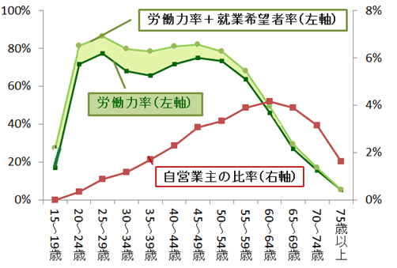
Reference
Women’s Huge potential
Potential labor participation rate (left axis)
Women who are willing to work but are not included in the labor force
Labor participation rate (left axis)
Ratio of self-employed (right axis)
3.4million women, non-labor-force but willing to work,
could boost the Japanese GDP by 1.5%.
Source: “Labour Force Survey ” Ministry of Internal Affairs and Communications

Slide 36
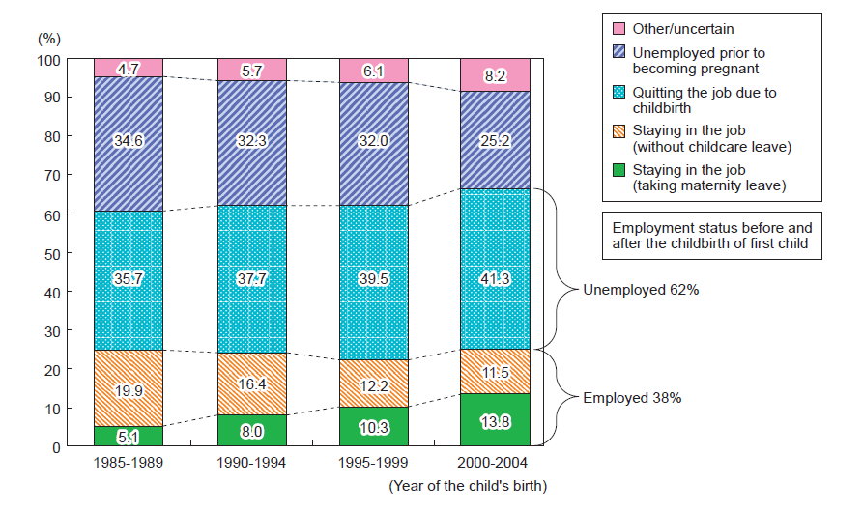
Reference
(Examples of performance objectives)
-Rate of continued employment for women before and after delivering their
first child 38%(2005)→55%(2020)
Employed worker annual income according to sex
Rate of women working in the labor market before having 1st child
(P8, Women and Men in Japan 2012 )
Source: “The 13th National Fertility Survey “ (Survey of Married Couples)
The National Institute of Population and Social Security Research

Slide 37
Reference
(Examples of performance objectives)
-Percentage of men who take child care leave: 1.72%(2009)→13% (2020)
Time spent on housework and child care by husbands with a child or
children less than six years old (per day)
Source: “Basic Survey on Equal Employment, 2009,”
Ministry of Health, Labour and Welfare
(refer to P11, Women and Men in Japan 2012 )

Slide 38
Reference
(Examples of performance objectives)
-Time spent on housework and child care by husbands with a child or children
less than six years old: 60 min. a day (2006) → 2hr. 30min. a day (2020)
Time spent on housework and child care by husbands with a child or
children less than six years old (per day)
Source: “Survey on time use and leisure activities” (2006) Ministry of Internal Affairs and Communications
(P10, Women and Men in Japan 2012 )

Slide 39
8. Percentage distribution of the employed population by sector, each sex
Number of Employees by Industry and sex
Source: “Labour Force Survey,” Ministry of Internal Affairs and Communications
(refer to P6, Women and Men in Japan 2012 )

Slide 40
Reference
Increase and decrease in the number of male and female employees in each industry （Year 2002⇒Year 2012)
(million people)
2
1.5
1
0.5
0
-0.5
-1
-1.5
Men
Women
Manufacturing industry
△1.15 million people
Construction industry
△0.99million people
Medical and welfare industry
1.8million people
All industries
1.32million people
Source: “Labour Force Survey ” Ministry of Internal Affairs and Communications

Slide 41
13. Gender gap in wages
Change in Average Hourly Wage for Workers
(hourly wage of male regular workers = 100)
71.9 (2011)
55.5 (2011)
50.3 (2011)
(refer to P9, Women and Men in Japan 2012 )
Source: ““Basic Survey of the Wage Structure”
Ministry of Health, Labour and Welfare

Slide 42
Reference
In Japan , the total wages for female is less than 40% of males’.
That is because, female/male ratio of 1)employed workers, 2)working hours and 3)wages are around 70%.
Female/male ratio of total wages
Female/male ratio of total wages: Around 40%
⇒
Female/male ratio
of employed workers： Around 70%
×
Female/male ratio
of working hours: Around 70%
×
Female/male ratio of wages: Around 70%
Finland
Sweden
Denmark
France
USA
Canada
Australia
UK
Germany
South Korea
Japan
(White paper on Gender Equality 2010)

Slide 43
Ⅱ． Education
25. Share of graduates in science, and engeeniring, manufacturing and
construction tertiary level, who are women
OECD Program for International Student Assessment (PISA)
＆ Proportion of females awarded tertiary degrees
Source: OECD
PISA mean scores in mathematics (2009)
women
men
PISA mean scores in science (2009)
women
men
Proportion of females awarded tertiary degrees in engineering, manufacturing and construction (2008)

Slide 44
Reference
Number of Undergraduate Students by Specialization
Source: “School Basic Survey”
Ministry of Education, Culture, Sports, Science & Technology
(refer to P22, Women and Men in Japan 2012 )

Slide 45
25. Proportion female among third-level teachers or professors
Proportion of Female Full-time Teachers to the Total of Full-time Teachers (2009)
Source: “School Basic Survey,”
Ministry of Education, Culture, Sports, Science & Technology
(P23, Women and Men in Japan 2012 )

Slide 46
Ⅲ． Health and related services
33. Under-five mortality rate by sex
Maternal / Perinatal / Neonatal / Infant Mortality Rate
(year)
Source: “Vital Statistics of Japan,” Ministry of Health, Labour and Welfare
(refer to P20, Women and Men in Japan 2012 )

Slide 47
41. Life expectancy at age 60, by sex
Reference
Life Expectancy at Birth
85.90(2011)
79.44(2011)
Source: “Abridged Life Tables for Japan 2009”
Ministry of Health, Labour and Welfare
Refer to P19, Women and Men in Japan 2012 )

Slide 48
Ⅳ．Public life and decision-making
42. Women's share of Government ministerial positions
43 . Proportion of seats held by women in national parliament
44. Women's share of managerial positions
46. Percentage female among judges
Share of Women in Leadership Positions in Various Fields
“Target of increasing the share of women in leadership positions to at least 30% by 2020”
(P4, Women and Men in Japan 2012 )

Slide 49
Reference
Women are decision makers in their households
Q:Who is the decision maker in the household?
N=6,432 (married males=3,023 married females=3,409）
Source: “A survey on concerns bout the saving and consumption”
Cabinet office, Japan (2010)

Slide 50
Ⅴ．Human rights of women and girl children
47. Damage Caused by Violence from Spouse
Damage Caused by Violence from Spouse
Source: “Survey on Violence between Men and Women (2008)”
Data from the Cabinet Office,

Slide 51
Ⅵ．Poverty
Relative Poverty Rates by Gender and Age Group
Relative Poverty Rates by Gender and Age Group
Note: Created from a special calculation by a working group on women and the economy (member Aya ABE) from the Specialist Committee on Basic Issues and Gender Impact Assessment and Evaluation under the Council for Gender Equality, based on Comprehensive Survey of Living Conditions (Ministry of Health, Labour and Welfare)
(P12, Women and Men in Japan 2012 )

Slide 52
An evidence of disparity between Men and Women in economic activities
“There is no country that significantly underperforms the others in all
outcome areas, except for Japan.”
 | OECD Average | Japan
Labor participation rate （male－female）/male | ＋18 | ＋26
Employment to population ratio （male－female）/male | ＋18 | ＋25
Employment to population ratio-fulltime equivalent （※１） （male－female）/male | ＋32 | －
Temporary employment as a proportion of dependent employment （female－male）/female | ＋15 | +78
Average minutes of unpaid work per day （female－male）/female | ＋15 | +78
Median earnings （male－female）/male | ＋16 | ＋31
（※1） Full-time equivalent employment rates are calculated by multiplying the employment to population ration by the average weekly hours worked by all employees and dividing by 40.
Source; Report on the Gender Initiative: Gender Equality in Education,
Employment and Entrepreneurship Meeting of the OECD Council at Ministerial Level
Paris, 25-26 May 2011

Slide 53

Global Gender Gap Index (GGI)
Japan invested in “Health” and “Education” enough, but haven’t removed the barriers of women’s “economic participation” and women’s “political empowerment”. Japan are not reaping the rewards of those initial investment.
Ms.Saadia Zahidi,
Senior Director, Head of Constituents at the World Economic Forum
World Economic Forum “ The Global Gender Gap Report”

Slide 54
Global Gender Gap Index (GGI)
Japan ranks at 101st among 135 countries of the Global Gender Gap Index (GGI). Japan performs relatively well especially concerning health. However, Japanese performance in the area of economic participation and opportunity and political empowerment isn’t so good, which is the main reason that Japan is generally regarded lagging left behind other developed countries.
Gender Gap Index
 |  |  | Economic participation and opportunity | Educational attainment | Health and Survival | Political Empowerment
rank | country name | score | rank | rank | rank | rank
1 | Iceland | 0.8640 | 27 | 1 | 98 | 1
2 | Finland | 0.8451 | 14 | 1 | 1 | 2
3 | Norway | 0.8403 | 4 | 1 | 94 | 3
8 | Philippines | 0.7757 | 17 | 1 | 1 | 14
39 | Sri Lanka | 0.7122 | 105 | 48 | 1 | 33
44 | Mongolia | 0.7111 | 1 | 50 | 1 | 127
65 | Thailand | 0.6893 | 49 | 78 | 1 | 93
69 | China | 0.6853 | 59 | 85 | 132 | 58
101 | Japan | 0.6530 | 102 | 81 | 34 | 110
105 | India | 0.6442 | 123 | 121 | 134 | 17
123 | Nepal | 0.6026 | 120 | 126 | 111 | 37
127 | Iran, Islamic Rep. | 0.5927 | 130 | 101 | 87 | 126
134 | Pakistan | 0.5478 | 134 | 129 | 123 | 52
World Economic Forum “ The Global Gender Gap Report 2012”

Slide 55
The Strategy for Rebirth of Japan (Thursday, December 22, 2011)
- Overcoming crises and embarking on new frontiers
Women will be in the front line
as ”the greatest potential to move Japan forwards”
Raising female participation could provide an important boost to growth, but women face two hurdles in participating in the workforce in Japan. First, few working women start out in career-track positions, and second, many women drop out of the workforce following childbirth. To increase women’s attachment to work Japan should consider policies to reduce the gender gap in career positions and to provide better support for working mothers.
“Can Women Save Japan?”
Working Paper of IMF, October 15, 2012

Slide 56
Part4： Examples of gender impact assessment
and evaluation in Japan

Slide 57
Contents of Part4
1. Gender impact assessment and evaluation
2. Measurement of Caring Responsibilities of Women and Men in Japan

Slide 58
1．Gender impact assessment
foundation
The Basic Act for Gender-Equal Society (Article 22) stipulate the gender impact assessment (impact survey ) and statement of opinion to the Prime Minister or relevant Ministers is a task of the Council for gender equality
The Council shall be in charge of the following tasks:
In addition to the task referred to in the preceding item, to study and deliberate on basic and comprehensive policies and important matters with regard to promotion of formation of a Gender-Equal Society in response to the consultation by the Prime Minister or other respective Ministers concerned.
The Council may submit its opinions to the Prime Minister or other respective Ministers concerned with regard to the matters stipulated in the preceding paragraph.
Monitoring of the state of implementation of government policies for promoting the establishment of a gender equal society, conduction of impact surveys to determine the effect of these government policies on the establishment of a gender equal society and when deemed necessary, statement of opinions to the Prime Minister or relevant Ministers.

Slide 59
2．Measurement of Caring Responsibilities of Women and Men in Japan
Main Surveys regarding Caring
“Comprehensive Survey of Living Conditions”
“Comprehensive Survey of Living Conditions”
(every 3 years)
“Survey of Long-term Care Benefit Expenditures”
(monthly)
        Ministry of Health, Labour and Welfare
“Survey on Time Use and Leisure Activities”
(every 5 years)
        Ministry of Internal Affairs and Communications”
“Survey on Independent Life of Elderly”
（2008, ad hoc）
        Cabinet Office
“Survey of Long-term Care Benefit Expenditures”
“Survey on Time Use and Leisure Activities”
“Survey on Independent Life of Elderly”

Slide 60
2．Measurement of Caring Responsibilities of Women and Men in Japan
Main Surveys regarding Caring
“Comprehensive Survey of Living Conditions”
“Comprehensive Survey of Living Conditions”
(every 3 years)
“Survey of Long-term Care Benefit Expenditures”
(monthly)
        Ministry of Health, Labour and Welfare
“Survey on Time Use and Leisure Activities”
(every 5 years)
        Ministry of Internal Affairs and Communications”
“Survey on Independent Life of Elderly”
（2008, ad hoc）
        Cabinet Office
“Survey of Long-term Care Benefit Expenditures”
“Survey on Time Use and Leisure Activities”
“Survey on Independent Life of Elderly”

Slide 61
Situation and estimation of our society
Issues of rapid aging and falling birthrates
The rate of senior citizens aged ≧65
The number of seniors
requiring nursing care
The Change of
family structure
about
about
The number of …
23％ (2010)
2.2 million (2000)
・Children
about
about
・Nuclear families
40％ (2055)
4.7 million (2009)
*estimated under certain assumptions)
*number of users of Long
-term Care Insurance system
・Elderly single-person
households
Established
“Long-term Care Insurance System” (2000)

Slide 62
Reference 1
Increase in the Number of Elderly People Aged 75 or over

Slide 63
Outline of the Long-Term Care Insurance System
System to support the nursing care of elderly people across society
Premiums are decided based on financial condition and projected service cost so that financial conditions can be balanced
Needed and constructed Statistical system
to collect national data on
insured and users segregated by sex

Slide 64
Reference 2

Slide 65
Caring Responsibilities of Women and Men
Points
1. Main caregivers in households are females.
2. Most care workers are female. About 40% of females care workers are non-regular employees.
3. Most users of Long-term Care Insurance aged 65+ are also females.
4. Females tend to need care for longer periods than males.
5. The cause of care needs are different between women and men.
6. There are differences in time spent on caring activities between women and men.

Slide 66
1. Main caregivers in households are females.
Main caregiver in the household by sex
Male 30.6%
Female 69.4%
Data: “Comprehensive Survey of Living Conditions,” Ministry of Health, Labour and Welfare (2010)

Slide 67
2-1. Most care workers are female. About 40% of females care workers are non-regular employees.
Care workers by sex and employment situation
 | N | Regular employment | Non-regular employment | Unknown
Female | 23,330 | 60.7% | 39.2% | 0.1%
Male | 5,681 | 86.9% | 12.9% | 0.1%
Both sexes | 29,124 | 65.8% | 34.1% | 0.1%
Data: Survey of working conditions of care workers, Care Work Foundation (2006)

Slide 68
2-2. Earnings of care workers tend to be lower than average earnings
Contractual cash earnings by job and sex
 |  | Ave. age | Ave. service years |  |  |  | Estimate of annual earnings
All | Male workers | 41.9 | 13.3 | 372.4 | 336.7 | 1078.4 | 5118.8
 | Female workers | 39.2 | 8.7 | 241.7 | 225.2 | 568.4 | 3270.8
Care workers | Nursing home care workers (Male) | 32.6 | 4.9 | 225.9 | 213.6 | 514.2 | 3077.4
 | Nursing home care workers (Female) | 37.4 | 5.2 | 204.4 | 193.7 | 446.8 | 2771.2
 | Home-care worker (Female) | 45.3 | 5.1 | 207.4 | 194.0 | 304.8 | 2632.8
 | Certified Care Manager (Female) | 45.0 | 7.1 | 261.8 | 253.3 | 636.3 | 3675.9
Contractual cash earnings
(monthly)
Other allowance
(‘000 yen)
Without overtime
allowance
(‘000 yen)
(‘000 yen)
Data: “Basic Survey on Wage Structure,” Ministry of Health, Labour and Welfare (2007)

Slide 69
3. Most users of Long-term Care Insurance aged 65+ are also females.
Number of users of Long-term Care Insurance System
Female about 2.8 million > Male about 1.1 million
 | N | Support Level 1 | Support Level 2 | Care Level 1 | Care Level 2 | Care Level 3 | Care Level 4 | Care Level 5
Female | 2,821.0 | 280.4 | 353.4 | 494.9 | 507.5 | 435.6 | 400.5 | 348.7
 | (100.0%) | (9.9%) | (12.5%) | (17.5%) | (18.0%) | (15.4%) | (14.2%) | (12.4%)
Male | 1,103.5 | 87.8 | 106.6 | 195.3 | 238.1 | 201.9 | 159.8 | 114.6
 | (100.0%) | (8.0%) | (9.7%) | (17.7%) | (21.6%) | (18.3%) | (14.5%) | (10.4%)
Both sexes | 3,924.5 | 368.2 | 460 | 690.2 | 745.6 | 637.5 | 560.3 | 463.3
 | (100.0%) | (9.4%) | (11.7%) | (17.6%) | (19.0%) | (16.2%) | (14.3%) | (11.8%)
(thousand)
(Users aged 65 years old and over)
Data: “Survey of Long-term Care Benefit Expenditures,” Ministry of Health, Labour and Welfare (July 2010)

Slide 70
4. Females tend to need care for longer periods than males.
Total life expectancy and active life expectancy by sex
Male
At age 65
Female
active life expectancy
Male
At age 75
Female
+
Male
total life expectancy
At age 85
Female
Data: Tsuji, I., Minami, Y., Fukao, A., et al. Active life expectancy among the elderly Japanese.
Journal of Gerontology, 1995; 50A:M173-M176.

Slide 71
5. The cause of care needs are different between women and men.
Major reasons for need of assistance or care by sex
Data: “Comprehensive Survey of Living Conditions,” Ministry of Health, Labour and Welfare (2007)

Slide 72
6. There are differences in time spent on caring activities between women and men.
Average time spent on caring or nursing activities
 | The number of caregivers (thousand) | Participation rate (%) | Average time spent by all caregivers (hours:minutes) | Total time
 |  |  |  | (10 thousand) | Composition ratio (%)
Female | 3,329 | 38.6% | 1:00 | 333 | 76.4%
Male | 2,008 | 21.4% | 0:31 | 104 | 23.8%
Both sexes | 5,336 | 32.2% | 0:49 | 436 | 100.0%
(Weekly average, persons aged 15 years old and over)
Data: “Survey on Time Use and Leisure Activities,” Ministry of Internal Affairs and Communications (2006)

Slide 73
Measures proposed by the Council regarding Caring
Council for Gender Equality proposed (2008):
Promotion of employment and social participation of elderly people of both sexes
Improvement of systems and environments that increase the economic independence of elderly people
Support for the independent living of elderly people within families and communities
Ensure initiatives in medical services and preventive care take into account differences between women and men
Construct foundations for quality healthcare services

Slide 74
Last Note
Unexpected disaster
On March 11, Japan was hit by one of the most powerful earthquakes in recorded history.
The number of the deceased people – off the Great East Japan earthquake
(in devastated area, as of 11 Sep.)
(refer to P24-25, Women and Men in Japan 2012 )
I extend our heartfelt thanks for the assistance we have received from all over the world.

