Slide 1
Expert Group Meeting On Revising The Principles And Recommendations On Population And Housing Censuses CENSUS OUTPUT AND DATA UTILISATION
30 October 2013

Slide 2
Presentation Outline
Preamble
Product development processes
Census products
New approaches to data dissemination
Data utilization
Notes:
2
2

Slide 3
Preamble
Census 2011 was the 3rd Census conducted in a democratic South Africa
This momentous endeavour generated diverse:
Demographic and socio-economic information that enhance policy decision-making.
It also gives insight into performance in relation to the implementation of government policies and programmes
As well as the Millennium Development Goals
Notes:
3
3

Slide 4
Statistics for dissemination
Need for reliable information to measure progress and development
Relevant statistics describe the country’s position in relation to its economics, poverty alleviation strategy, infrastructure, etc
Stats SA is mandated to collect, produce and disseminate official statistics
Stats SA collects statistics through various surveys and administrative records, but the largest project for the organisation is the census which takes place every ten years.
Notes:
4
4

Slide 5
Why marketing Census data?
The need for a census data marketing strategy was prompted by:
Increase of importance of statistics
Government’s vision to increase economic literacy, of which statistical literacy plays an important role
Increase in users of statistics
A well implemented marketing strategy will:
Identify and meet the data needs of different kinds of stakeholders and users of statistics
Increase awareness of statistics where they are needed the most (eg, in local municipalities)
Enable Stats SA to create and disseminate easy-to-use and cost-effective statistical products
Notes:
5
5

Slide 6
Product Development Processes
Census 2011 dissemination was driven by the need to provide relevant products accessible in a number of formats
Planning and development of census products was undertaken by products team comprising of various Stats SA divisions
Notes:
6
6

Slide 7
Topics Covered
Topics covered were selected on the basis of:
Recommended UN and African Core topics
National priorities
Census data user needs
User consultations on Census 2011 data items and products were held prior to questionnaire design and product development in 2008
Notes:
7
7

Slide 8
Topics Covered – UN Recommended
Demographics - Migration - General Health and functioning (Disability) - Parental survival - Education - Labour market status - Fertility - Mortality - Housing - Access to services - Household goods
Notes:
8
8

Slide 9
Country specific topics included in Census 2011
Population group/race
Language
Income
Occupancy status
Bathing facilities
Kitchen Availability
Ownership
Drinking water-Main source
UN core topics excluded from Census 2011
Notes:
9
9

Slide 10
Census 2011 Questionnaires
South Africa conducts a de-facto census
Based on the location of persons on reference night
Three sets of questionnaires were developed for Census 2011
Each type was administered to a targeted group
population in households (questionnaire A)
population in collective living quarters (questionnaire C)
population in transit (departing) and those on holidays on census night (questionnaire B)
Notes:
10
10

Slide 11
Transient and Tourist Hotel questionnaire (B)
Basic Information (Demographics)
Migration
Province of birth
Province of usual residence
Citizenship
Notes:
11
11

Slide 12
Institutional questionnaire (C)
Basic Information (Demographics)
Institutional services
Source of water
Toilet facilities
Source of energy
Notes:
12
12

Slide 13
Products
Based on census data user recommendations, the following types of products were developed:
Print products
Electronic products
Geography related products
Products developed based on stakeholder segmentation
Notes:
13
13

Slide 14
Print Products
Print products
Census 2011statistical report
Census 2011 in Brief
Key Results Pamphlet
Fact sheets (new)
Provincial reports
Thematic reports (new)
Highlight of Key Results
How the count was done
All accessible on the website (www.statssa.gov.za)
Notes:
14
14

Slide 15
Spatial Products
Digital Atlas,
A0 maps,
Maps alive (new)
Notes:
15
15

Slide 16
Electronic products
PRODUCT | DESCRIPTION
ROAMBI | iPad application that uses interactive components to visualise data from Apple store
Interactive Web Products | Users access and manipulate Census data via Stats Online in SuperWeb.
Community Profiles | CDs containing 12 summarized databases on certain topics Can also be viewed online using (SuperWEB)
NeSSTAR | Data repository that allows users to download and analyse census datasets and metadata in various formats. Data sets can be downloaded in ASCII, STATA, SPSS, SAS formats. This are available on Stats Online on the Web.
10 % sample and meta data | A CD containing the unit records in ASCII format plus a Readme file, metadata, record file, code-list and questionnaire

Slide 17
Products still to be finalised
10 % Sample
Census data series (1996,2001 and 2011)
Monographs
Age and sex structure
Migration
Youth
Disability
Education
Labour
Aging
Nuptiality
Fertility
Mortality and
Households
Administrative report
Notes:
17
17

Slide 18
Dissemination Strategies
The marketing team at Stats SA is responsible for:
Identifying important stakeholders that use Stats SA data
Dividing all stakeholders into manageable market segments
Disseminating census products to these market segments
Interacting with stakeholders on a regular basis
Notes:
18
18

Slide 19
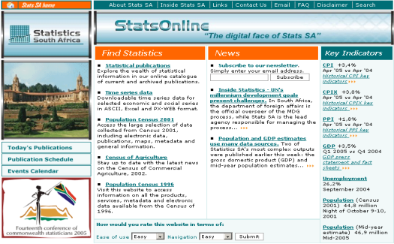
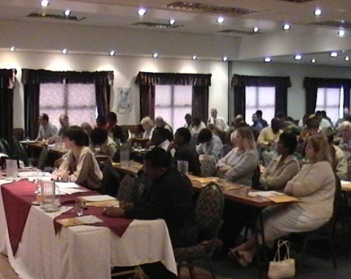
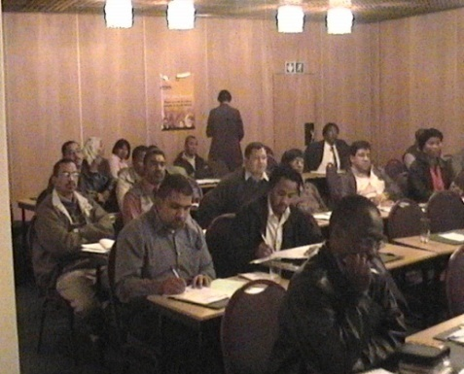
Dissemination Strategies
Interaction with stakeholders occurs through:
Workshops
Exhibits at various conferences or shows
Presentations
Installation of Community Profiles, targeting particularly all three levels of government
Training sessions on Stats SA products
StatsOnline (Stats SA’s website)
Special requests
Meetings
Annual User Satisfaction Survey
Notes:
19
19

Slide 20
Innovative approaches in data dissemination
Use of Interactive web based products such as:
Roambi Apple-based application (new)
Google Data Explorer (new)
Maps Alive (new)
Development of Indepth analytical reports to provide insights on different themes: Education, ageing, disability, migration, mortality,
Direct interactions with strategic users such as municipalities to provide support and explanations of indicators
Development of Census data series
Data disseminated one year after data collection
Free access to data and products; no cost recovery
Notes:
20
20

Slide 21
Dissemination strategies-market segments
Internal stakeholders
User information services component
Subject matter specialists
Methodology and Standards division
Project management office
Health and Vital Statistics division
Demographic analysis division
Integrative analysis component
Integrated Household Surveys division
Social Stats division
Census operations division
Stakeholder Relations and Marketing
Geography division
South African Statistics Council
Corporate Communication
Notes:
21
21

Slide 22
External Stakeholders
External stakeholders
National and provincial departments
Municipalities
Academia and Researchers
International Agencies
Private sector
General Public
Statistical agencies
Notes:
22
22

Slide 23
Data Utilisation
Overwhelming response from the public after release of Census results
Various forms of data access exist
Online
User information Services (UIS) attending to requests on regular basis
Census management invited to participate in different fora to give highlights of Census 2011
Most requests are on small area data
Municipal level
Ward level
Notes:
23
23

Slide 24
Data Utilisation
Overwhelming demand from national and provincial departments release of Census results
National treasury
Monitoring and evaluation at the presidency
Political parties
Academic institutions
Notes:
24
24

Slide 25
Thank you

