Slide 1
United Nations Expert Group Meeting
on Revising the Principles and Recommendations for Population and Housing Census, 29 Oct. 2013 – 1 Nov. 2013
New York, USA
Session 8:
CENSUS 2010 : MALAYSIA
CENSUS OUTPUTS AND UTILIZATION
Presented by:
Ms. Rozita TALHA
Director,
Population & Demography Division, Department of Statistics Malaysia,
Putrajaya

Slide 2
CONTENT
Introduction
Background on Census 2010
Census Planning
Census Implementation
Innovations in Census 2010
Data Dissemination Strategy
Products of Census 2010

Slide 3
INTRODUCTION
ABOUT MALAYSIA:
  Geographical location – located between 2⁰and 7⁰
  ^{to} the north of equator, Peninsular Malaysia is separated from the Sabah and Sarawak by the South China Sea.
  The capital city is Kuala Lumpur.
  Major ethnic: Malay, Chinese and Indians.
  Religion: Islam is the official religion while other religions are also practiced.
  Climate: between 70 – 90 ⁰ all year long.
  Population – 28.4 , LQ 7.3 mil. & HH 6.3 mil.
ABOUT THE DEPARTME mil.NT OF STATISTICS MALAYSIA (DOSM) – was est. in 1949 and is a premier government agency under the Prime Minister’s Office entrusted with the responsibilities to collect, interpret and disseminate latest and real time statistics in the monitoring of national economic performance and social development.

Slide 4
BACKGROUND ON CENSUS 2010
DOSM – responsible in the planning and implementation of the Census.
The Census is carried out every 10 years. Since the formation of Malaysia in 1963, 5 series of Census have been carried out.
The Census 2010 was the fifth series of Census conducted by DOSM after the formation of Malaysia in 1963.
Census Date was fixed on 6 July 2010.
The objective is to have a total coverage and to accurately count and measure the numbers and key characteristics of the population, households and living quarters in Malaysia.

Slide 5
BACKGROUND ON CENSUS 2010 - Cont’d
The census represents the principal means of data collection aimed at providing a comprehensive set of statistical information for planning, formulation and implementation of government policies and programmes.
The census data are also widely used in business and industry, academic and research institutions as well as individuals.
Census Act 1960 (revised 1969)
Follows UN recommendations

Slide 6
CENSUS PLANNING
Various group committees within the Department were set up see to the smooth flow of the Census Project.
An Inter Agency Collaboration was set up to finalize the codes & classification and the questions to be included.
Co-operation & assistance among agency was sought particularly for publicity, transport and enumeration.
The 2010 Census saw New approaches & Technology advancement being introduced. For this purpose Pilot tests were carried out to ensure the viability of the different stages in Census taking ( questionnaire – coverage & content errors; processing (ICR scanner); field operations and others)

Slide 7
Census Implementation
Approach
  As in the 2000 Census, the de jure approach was used in the 2010 Census whereby the population (citizens and non-citizens) residing in Malaysia are enumerated based on their usual place of residence on the Census Day (6 July 2010)
Enumeration Period
  The enumeration period was from 6 July to 22 August 2010.
  Due to constraint of budget, the enumeration period was lengthened to 6 weeks compared to the previous 4 censuses (2 weeks)

Slide 8
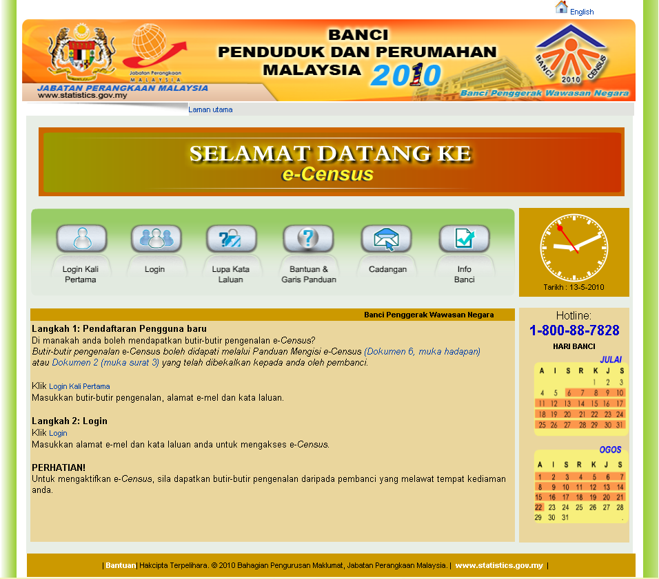
Census Implementation – cont’d
Enumeration methods
MULTI-MODAL:
FACE TO FACE INTERVIEW
SELF ENUMERATION :
- HARD COPY FORM - DROP OFF PICK UP
- ELECTRONIC FORM (ON LINE) - e- Census
e-Census Main Menu

Slide 9

INOVATIONS IN 2010 CENSUS TAKING
Mapping
Digital Maps –
Enhancement of GIS system - expanded from Head Office to State.
THE USE OF GIS HAS ADDED VALUE TO DOSM PRODUCTS
(small area statistics)
USER’S NEEDS ARE MET

Slide 10

INOVATIONS IN 2010 CENSUS TAKING-cont’d
Census Questionnaire
Long questionnaire (ICR format)
51 questions
12 page booklet
  2 types of questionnaire used:
  Living quarters, household and person particulars (Doc. 2)
  Institutional living quarters (Doc. 3a & 3b)

Slide 11
INOVATIONS IN 2010 CENSUS TAKING-con’t
Processing of Census Data
Scanning method to capture census data from the questionnaires
  Questionnaire : ICR Technology
  CAC – Computer Assisted Coding system where electronic data dictionary was used instead of flipping through coding manuals. Topics selected were Education, Occupation, Industry and Migration.
  OQCC - Onscreen Quality Control Checks

Slide 12
DATA DISSEMINATION STRATEGY
Ad-hoc data requests –via email, letter & telephone
Printed reports/ publications
Micro data -
2% –LQ, HH & Persons
CD ROM
MEDIUM
Tabulations :
SPSS & GIS ( small area statistics).
Online database management and warehousing (Internal using NEWSS/Speedminer
Online web based tabulation
(Speedminer)
Census Portal –
Key Census Data available from the website (free downloads); online data request forms & publicity on Census publications (with synopsis)

Slide 13
Products - Publications
TO DATE RELEAES:
Preliminary Count Report (field count) - 12/2010
Population Distribution and Basic Demographic Characteristics (adjusted for PES) – 6/2011
Population Distribution by Local Authority Areas and Sub-Districts – 12/2011
Population Distribution by Parlimentary/Constituencies – 5/2012
BY TOPICS:
5. Characteristics of Living Quarters – 9/2012
Education and Social Characteristics of the Population – 3/2013
PES Report (limited circulation)

Slide 14
Products - Publications – cont’d
TO BE RELEASED:
1. Economic Characteristics
2. Household Characteristics
3. Migration Trends
PES Report (limited circulation)
Monograph series - present a more detailed representation and interpretation of statistical data from the Census.
Micro data – Sample 2 percent
Others - Census Time Series Data Report
  GIS products :
  Census Atlas
    Small area statistics (for user needs)
    Digital Maps
    GIS Portal (under construction)

Slide 15
MICRO DATA RELEASE:
The ever increasing demand from users both the public and private sectors and ICT development have led to a high expectations for statistical services, new product as well as request for detailed data.
Thus in 2010, DOSM formulated and introduced Policy on Microdata Dissemination.
The policy provide guidelines to disseminate anonymized data and at the same time safeguards confidentially of the data.
Measures have been taken to safeguard on the privacy, archiving and security of the Census data set.

Slide 16
MICRO DATA RELEASE: (con’t)
The dissemination methods of statistical information outlined in the Microdata Disseminatioan Policy are as follows:
i. the provision of data cubes or statistical tables;
ii. anonymized micro data files which is divided into two categories namely public users file and licensed file; and
iii. On-site access files through remote access facilities and data laboratories.
In the aspect of archiving the 1991 and 2000 census data set which is stored in the mainframe is being planned to be transferred/migrated to a statistical data warehouse (StatsDW)

Slide 17
ISSUES:
Questionnaire – too many questions/topics. Detail information on education and economic can be obtained from surveys. Enumerators are not well-trained to code using ISIC/ISCO/ISCED, thus data is inaccurate.
Non-response especially in urban areas.
PES - should we release or shouldn’t ? Having 2 set of data (adjusted and unadjusted) can confuse users.
Small area statistics – currently being published at Local Authority Areas, Administrative Districts and Sub-Districts level. Can’t release data at EB/EA level. High demand for data at smaller area/level.
Enumeration period – what is the ideal period??
Use of administrative data – need to be studied, problem of under registration, data owner /source conflict.

Slide 18
Thank You
(Terima kasih)
rozita_talha@stats.gov.my
Department of Statistics, Malaysia

