Slide 1


International Workshop on
Introduction to the DDI and the IHSN Microdata Management Toolkit
UNITED NATIONS DEPARTMENT OF ECONOMIC AND SOCIAL AFFAIRS STATISTICS DIVISION
NATIONAL BUREAU OF STATISTICS OF CHINA
Beijing, 17-19 June 2013

Slide 2
Workshop objectives - Context
2
Generic Statistical Business Process Model (GSBPM)
Describes statistical processes (e.g., implementation of a survey) in 9 phases, each divided into sub-processes.
A convenient tool for assessment, planning of statistical processes.
Quality Management
Specify the needs
Metadata Management
Design
Build
Collect
Process
Analyze
Disseminate
Archive
Evaluate

Slide 3
Workshop objectives
3
The workshop will introduce standards and tools for:
Quality Management
Specify the needs
Metadata Management
Metadata management
  The DDI standard
  IHSN Metadata Editor
Dissemination
  Policy, technical and ethical issues
  NADA software
Archiving
  Preservation of digital information
Design
Build
Collect
Process
Analyze
Disseminate
Archive
Evaluate

Slide 4


Metadata management
4
Part 1
Documenting your surveys and censuses using
the DDI Metadata Standard
and the IHSN Metadata Editor (Nesstar Publisher)

Slide 5
Why do data producers need metadata?
5
To increase the credibility and transparency of their statistical outputs
To preserve institutional memory
To allow replication of data collection and analysis
To allow re-use or re-purposing of the metadata

Slide 6
Why do data users need metadata?
6
To fully understand the (micro)data and make good use of them
  To minimize the risk of misuse/misinterpretation, users need to fully understand the data. Why, by whom, when, and how data were collected and processed are important information.
For making data discoverable in on-line catalogs
  Users will know about the availability of your data by searching or browsing detailed metadata catalogs.

Slide 7
Standards and tools
7
The Data Documentation Initiative (DDI) metadata standard helps structure, preserve and share survey or census metadata
The IHSN Microdata Management Toolkit, a.k.a. Nesstar Publisher, provides a free and user friendly solution to document and catalog surveys/censuses in compliance with the DDI standard and international best practices

Slide 8
What is the DDI?
8
A checklist of what you need to know about a study and its dataset
  A structured and comprehensive list of hundreds of elements that may be used to document a survey dataset
An XML metadata standard
Developed by academic data centers / the DDI Alliance.
Designed to encompass the kinds of data generated by surveys, censuses, administrative records.
For microdata, not indicators.
Two versions:
  Version 2.n (DDI codebook), used by the IHSN Toolkit
  Version 3.n (DDI life cycle)

Slide 9
What is XML ?
9
XML stands for eXtensible Markup Language. It is used to structure information to be shared on the Web or exchanged between software systems.
XML is a file format, readable by any text editor (e.g., Notepad).
XML tags text for meaning. HTML tags text for appearance. The “tags” are conceptually the same as “fields” in a database.
In an XML file, the information is wrapped between an opening tag and a closing tag. The tag name indicates its content.

Slide 10
DDI and XML - An example
10
“The National Statistics Office (NSO) of Popstan conducted the Multiple Indicators Cluster Survey (MICS) with the financial support of UNICEF. 5,000 households, representing the overall population of the country, were randomly selected to participate in the survey, following a two-stage stratified sampling methodology. 4,900 of these households provided information.”
In XML/DDI this would look like this:
  <titl> Multiple Indicator Cluster Survey 2005 </titl>
  <altTitl> MICS 2005</altTitl>
  <AuthEnty> National Statistics Office (NSO) </AuthEnty>
  <fundAg abbr= "UNICEF">United Nations Children Fund </fundAg>
  <nation> Popstan </nation>
  <geogCover> National </geogCover>
  <sampProc> 5,000 households, stratified two stages </sampProc>
  <respRate> 98 percent </respRate>

Slide 11
Advantage of XML
11
Can be transformed into many kinds of outputs:
  Databases, HTML, PDF, on-line catalogs, others
Plain text files. Not specific to any operating system or application
Easy to generate using specialized tools such as the IHSN Metadata Editor

Slide 12
Structure of the DDI 2.0 standard
12
The DDI elements are organized in five sections:
Document Description. Used to document the documentation process (“metadata on metadata”).
Study Description. Information about the survey such as title, dates/method of data collection, sampling, funding, etc.
Data File Description. Content, producer, version, etc.
Variable Description. Literal question, universe, labels, derivation and imputation methods, etc.
Other Material. Description of materials related to the study such as questionnaires, coding information, reports, interviewer's manuals, data processing and analysis programs, etc.

Slide 13
Exercises
13
Workshop participants will install the IHSN Metadata Editor (a.k.a. Nesstar Publisher) and document a small census dataset.

Slide 14
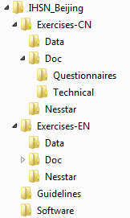
Exercise data files
14
Content of the USB provided to participants
Chinese version of:
Popstan census data files (2) in Stata format
Census questionnaire
Enumerator manual
Same content in English
Selected technical and policy guidelines
IHSN Metadata Editor software and templates

Slide 15

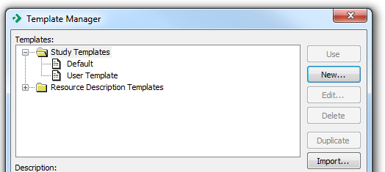
Exercise 1 – Installation
15
Run NesstarPublisherInstaller_v4.0.9.exe to install the software
Next step is to install the IHSN templates
Open the Template Manager

Slide 16
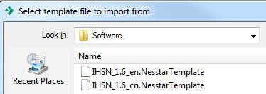
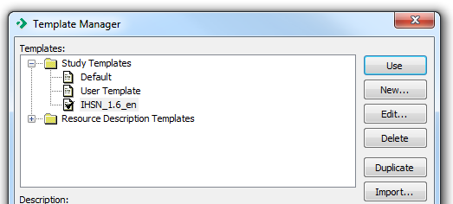

Exercise 1 – Installation
16
Click on “Import” and select the English (EN) or Chinese (CN) template found in folder “Software”
Then select the added template and click “Use” to activate it. This will now be the default study template.
Repeat the exact same process for the Resource Description Template

Slide 17
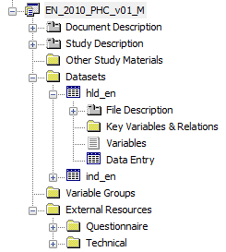
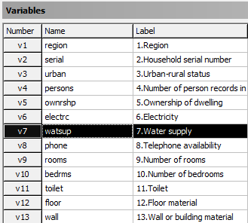
Exercise 2 - Documentation
17
The next steps will be to document the Census:
Import the data files (Stata)
Add metadata in the Document Description, Study Description, Data Files Description, and Variables Description sections
Attach and document the questionnaire and manual as external resources
Export the metadata to DDI (and RDF) formats

Slide 18
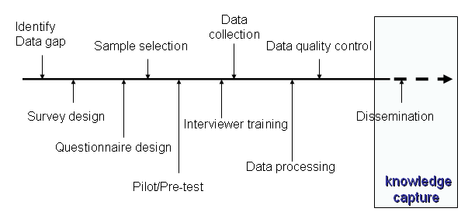
When should data be documented?
18
Document “as you go” – not after completion of the operation. When documentation is done as a “last step”, much information is lost.
Much information loss, or never generated

Slide 19
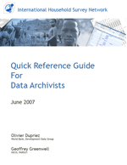
Software and guidelines
19
Available at www.ihsn.org
http://www.ihsn.org/home/node/117
http://www.ihsn.org/home/software/ddi-metadata-editor

Slide 20
Metadata and microdata dissemination
20
Part 2
Formulating a microdata dissemination policy, disseminating data and metadata, and the
IHSN National Data Archive (NADA) software

Slide 21
Benefits of dissemination
21
Diversity of research work. Data producers usually publish tabular and analytical outputs. But they will never identify all the research questions that can be addressed using the data. Microdata dissemination encourages diversity (and quality) of analysis.
Credibility/acceptability of data. Broader access to metadata and microdata demonstrates the producer’s confidence in the data, by making replication (or correction) possible by independent parties.

Slide 22
Benefits of dissemination
22
Reduced duplication. Non accessibility to microdata forces users to conduct their own surveys. Microdata dissemination would reduce the risk of duplicated activities. It will also reduce the burden on respondents, and minimize the risk of inconsistent studies on a same topic.
Funding. Better use of data means better return for survey sponsors, who will thus be more inclined to support data collection activities.
Quality of data. It is often through the use of data that insights for improvement for survey design can be identified.

Slide 23
Costs and risks of dissemination
23
Exposure to criticism. Quality itself often puts a brake on microdata dissemination. Some data producers may fear to be exposed to criticism when data are not fully reliable, and to be confronted to the obligation to defend their results when challenged by secondary users.
Loss of exclusivity. When disseminating microdata, data owners lose their exclusive right to discoveries. This is more of an issue for academic researchers than official producers.

Slide 24
Costs and risks of dissemination
24
Official vs. non-official results, and exposure to contradiction. Dissemination of microdata may lead to a proliferation of differing -and possibly contradictory- results and statistics. It may become more and more difficult to distinguish between official figures and other sources of statistics.
Financial cost. Properly documenting and disseminating microdata has a cost. This includes not only the costs of creating and documenting microdata files, but also the costs of creating access tools and safeguards, and of supporting enquiries made by the research community.

Slide 25
Costs and risks of dissemination
25
Confidentiality. One of the biggest challenges of microdata dissemination is to minimize the risk of disclosure of any data that would compromise the identity of respondents.
Legality. All countries have a specific national statistical and data protection legislation.

Slide 26

Principles - UNECE
26
It is appropriate for microdata collected for official statistical purposes to be used for statistical analysis to support research as long as confidentiality is protected.
Provision of microdata should be consistent with legal and other necessary arrangements that ensure that confidentiality of the released microdata is protected.
Managing Statistical Confidentiality and Microdata Access - Principles and guidelines of Good Practice, by the Conference of European Statisticians (CES) and United Nations Economic Commission for Europe (UNECE)

Slide 27
Anonymization
27
Statistical agencies are charged with protecting the confidentiality of survey respondents.
Protecting confidentiality necessitates some sort of data anonymization so that individual respondents can not be identified.

Slide 28
Anonymization concepts
28
Identifying variables include:
  Direct identifiers, which are variables such as names, addresses, or identity card numbers. They should be removed from the published dataset.
  Indirect identifiers, which are characteristics whose combination could lead to the re-identification of respondents (e.g., region, age, sex, occupation). Such variables are needed for statistical purposes, and should not be removed from the published data files.
Anonymizing the data involves determining which variables are potential identifiers and modifying the specificity of these variables to reduce the risk of re-identification to an acceptable level. The challenge is to maximize the security while minimizing the resulting information loss.

Slide 29
Anonymization techniques
29
Removing variables (e.g., detailed geographic identification)
Removing records (outliers)
Global recoding (e.g., from age to age groups)
Top- or bottom-coding (e.g., create “65+” age category)
Local suppression (replace with missing)
Micro-aggregation (e.g., for income variable)
Data swapping
Post-randomization
Noise addition
Resampling

Slide 30
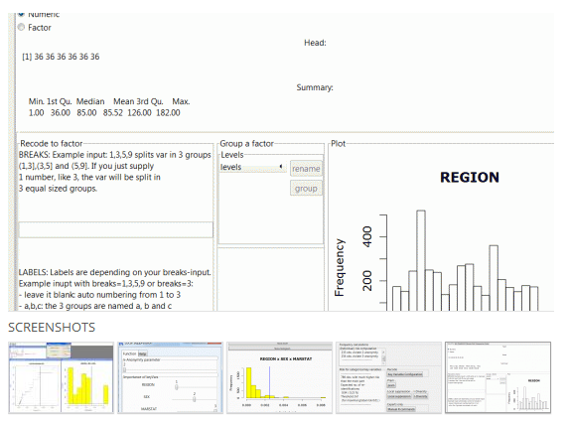
Anonymization tools and guidelines
30
Software: sdcMicro
An open source (R-based) package
Technical guidelines
http://www.ihsn.org/home/node/118
More practical guidelines are being produced by the IHSN.
NOTE :
Anonymization is a complex process. It requires analytical skills and involves some arbitrary decisions.

Slide 31
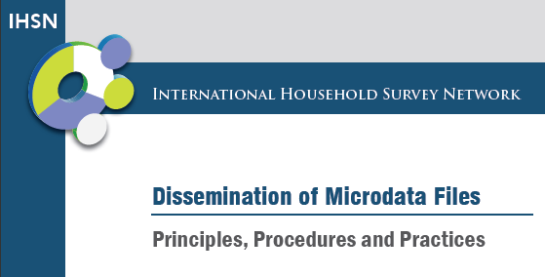
Policy guidelines on dissemination
31
Formulating a microdata access policy
http://www.ihsn.org/home/node/120

Slide 32
Cataloguing
32
Data and metadata need to be made visible.
Users will benefit from advanced data discovery tools, in particular on-line searchable catalogs.
The IHSN developed an open source application, compliant with the DDI standard, to help disseminate metadata and (optional) microdata. This application (NADA) complements the Metadata Editor.

Slide 33
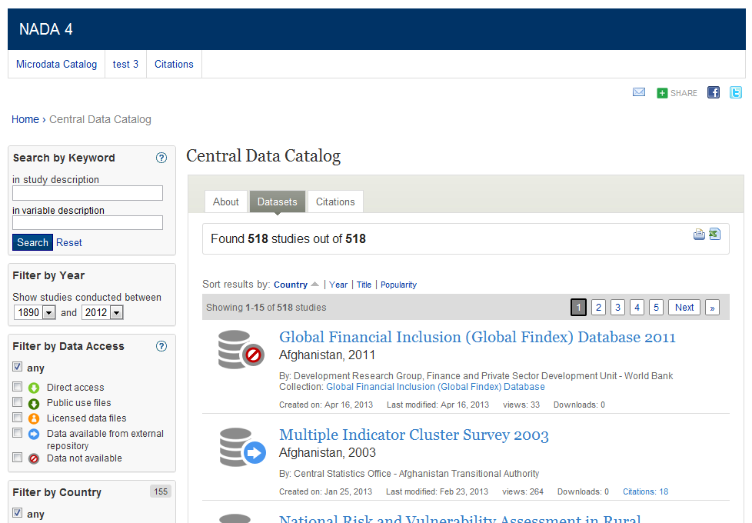
Dissemination Exercise
33
Workshop participants will upload their DDI metadata (generated during the documentation exercise) in an on-line, searchable survey catalog

Slide 34
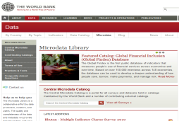
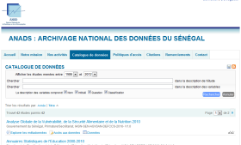
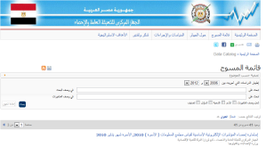
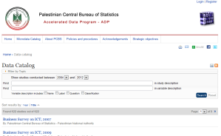
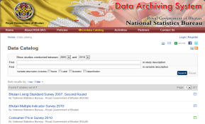
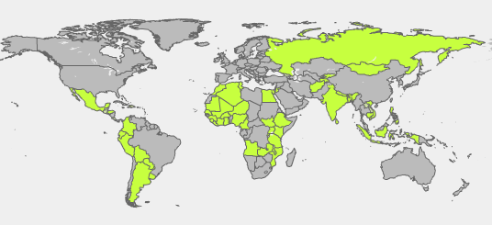
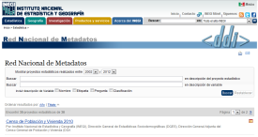
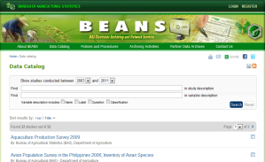
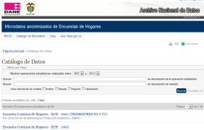
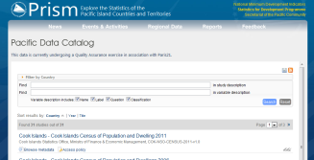
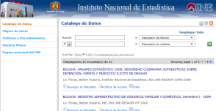
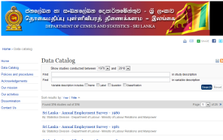
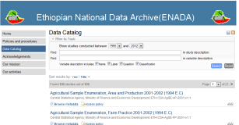
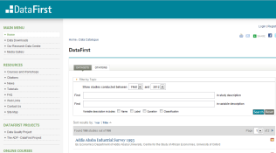
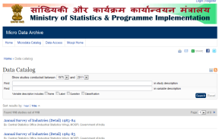
Survey catalogs
34
100+ agencies in 65+ countries have started establishing a microdata archive using IHSN tools

Slide 35
Archiving
35
Part 3
Preserving data and metadata

Slide 36
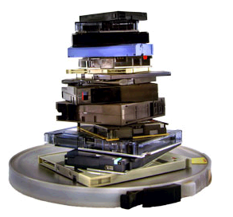
Issues
36
Common issues include:
  Loss of data and metadata, because of human error, technical problems, or disasters such as fire or flood
  Data available, but on unreadable formats/media (hardware and software obsolescence)
  Data available, but undocumented
  Documentation only available in hard copy
  Multiple versions of datasets
  available, with no “versioning”
  information

Slide 37
Physical threats
37
Physical damage can occur to hardware and media due to:
Material instability
Improper storage environment (temperature, humidity, light, dust)
Overuse (mainly for physical contact media)
Natural disaster (fire, flood, earthquake)
Infrastructure failure (plumbing, electrical, climate control)
Inadequate hardware maintenance
Human error (including improper handling)
Sabotage (theft, vandalism)

Slide 38

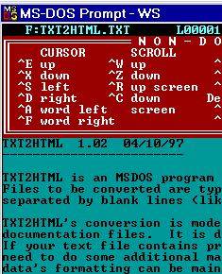
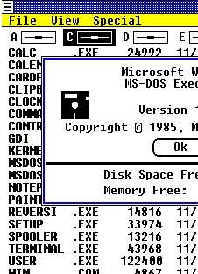



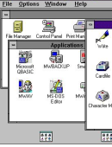






Software obsolescence
38
A file format may be superseded by newer versions and no longer be supported.
<XML>
Html 2
1976 1977 1978 1979 1980 1981 1982 1983 1984 1985 1986 1987 1988 1989 1990 1991 1992 1993 1994 1995 1996 1997 1998 1999 2000 2001 2002 2003 2004 2005 2006 2007 2008

Slide 39

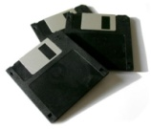


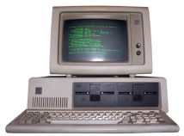
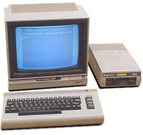
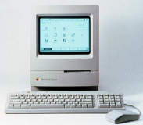


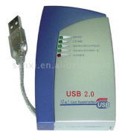
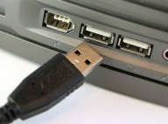
Hardware obsolescence
39
Storage medium are rapidly superseded by smaller, denser, faster media. The device needed to read an “old” medium may no longer be manufactured.
1975 1976 1977 1978 1979 1980 1981 1982 1983 1984 1985 1986 1987 1988 1989 1990 1991 1992 1993 1994 1995 1996 1997 1998 1999 2000 2001 2002 2003 2004

Slide 40
Preservation policies
40
  Microdata preservation refers to the management of digital data and related metadata over time to guarantee their long term usability. It requires the establishment and implementation of a preservation policy and procedures.
  Back up your data
  Ensure suitable data storage
    Refreshing media: copy digital information from one medium to another.
    Technology preservation: preserve old operating systems, software, media drives as a disaster recovery strategy.
    Migrating data: copy or convert data from one technology to another, whether hardware or software.

Slide 41
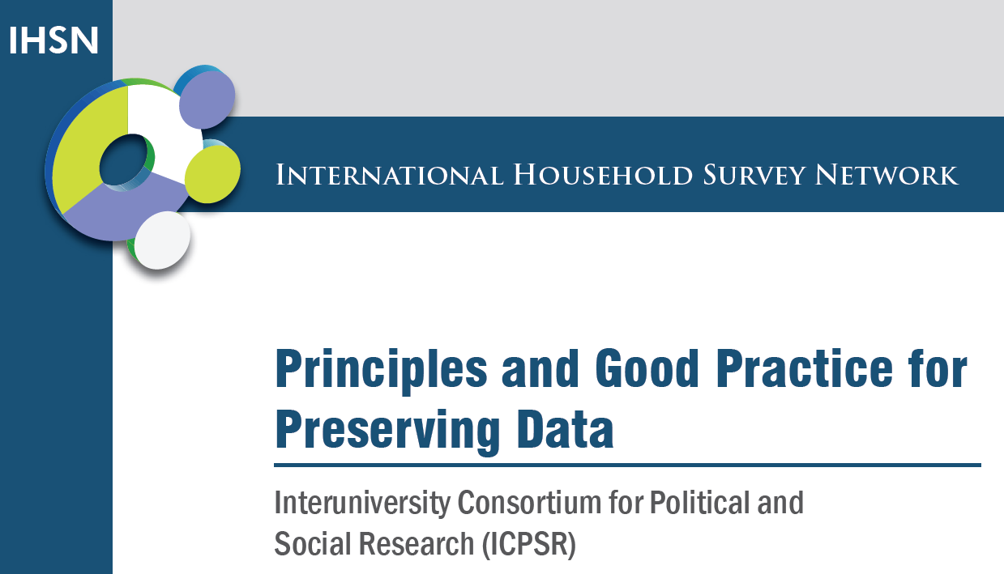
Guidelines
41
Unlike the preservation of information on paper, the preservation of digital information demands constant attention.
Guidelines: complex, but useful as a “technical audit manual”
http://www.ihsn.org/home/node/121

