Slide 1
Islamic Finance in National Accounts- Palestine
Amina Khasib

Slide 2
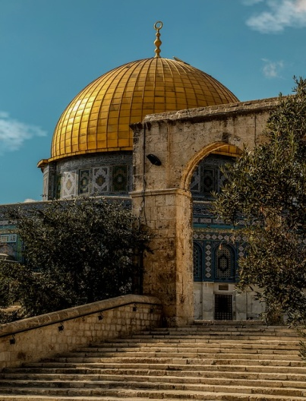
Banks in Palestine
All Banks in Palestine 2016
Conventional Banks
15 Banks
304 Branches
Islamic Banks
3 Banks
622 ATM
46 Branches
98 ATM
15%
16%
Notes:
The first attempt to establish the Islamic Banks at Palestine was in 1990 when some of the businessmen apply for the establishment of Islamic bank which was refused by the Israeli governor that he is not ready to discuss the idea. Those businessmen apply then for the establishment of a Finance company (Beit Elmal Al Philistini) which was licensed on 1994 as a shreholding company.
15 Conventional banks operating in Paletine with 304 branches and 622 ATMs, while the Islamic banks are 3 banks with 15% of the total branches and 16% of the ATMs.

Slide 3
Performance of Islamic Banks
Total Assets

Slide 4
Performance of Islamic Banks
Direct Credit Facilities- Net
49% of Total Assets
Notes:
Credit facilities granted by Islamic Banks were in the form of Murabaha and investment in securities. Credit facilities were increased from 9% of Total Credit facilties to reach 14% of total. Credit facilities represent about 49% of the total assets of which Murabaha represented about 27% of total assets.

Slide 5
Performance of Islamic Banks
Customers’ Deposits

Slide 6
Performance of Islamic Banks 2009, 2016
Notes:
Islamic banks’ assets in Palestine increased at a rapid rate, they were about 130 million in 1998 and reached about 600 million in 2009 then increased to 1.7 billion. Assets of Islamic Banks increased 2.5 times in a period of 5 years, meanwhile the shareholders’ equity increased 3 times and net income before tax 7.7 times

Slide 7
Performance of Islamic Banks compared with Jordan

Slide 8
Islamic Banks’ share of the Market
Notes:
Islamic banks share of the market is still small, but their performance shows that it is increasing year by year

Slide 9
Uses Of Funds…Types

Slide 10
Uses Of Funds…Sectors

Slide 11
Measurement of Output for Islamic Banks
National Accounts

Slide 12
Finance and Insurance Survey Banking activity
Annual Survey for financial intermediation and Insurance (1994-2016).
All enterprises engaged in the activities classified under category K according to ISIC,4 including money exchangers.
# of financial intermediation enterprises and insurance enterprises was 53 enterprises and holding companies (Establishment census 2012).
Money exchangers sample size is 122 enterprises.

Slide 13
Finance and Insurance Survey Banking activity
# of enterprises and employed persons
Fixed Assets in financial Intermediation enterprises
Output for Principal and secondary activities for financial enterprises
Production Inputs and Investments in financial and real assets
Compensation of employees

Slide 14
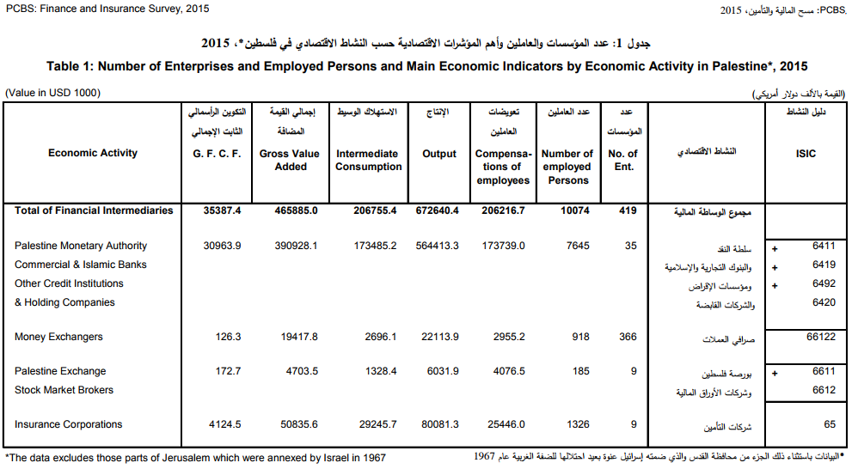
Finance & Insurance Report

Slide 15
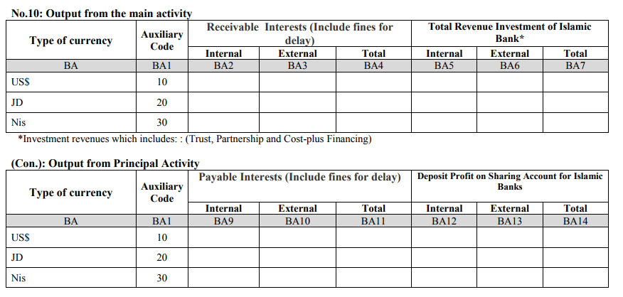
Finance and Insurance Survey Questionnaire

Slide 16
FISIM (SNA 2008)
Conventional Banks
Islamic Banks
FISIM is calculated only on Loans and Deposits- like instruments
FISIM formula applied independently to each side
Borrowers: Implicit services to borrowers= (rL- rr)× Loans
Depositors: Implicit services to depositors= = (rD- rr)× Deposits
FISIM= (rL- rr)× Loans + (rD- rr)× Deposits
Equivalent terms are Financings and Funding
Returns on financings (rFin) substitute rL
Distribution of Profits to depositors/ investors (rFund) substitute Rd
FISIM= (rFin –rr)×Financing + (rFund –rr)× Funding
Qu banks2016.docx
Notes:
FISIM is calculated only on Loans and Deposits- like instruments handled by banks and similar financial institutions. For Islamic banks, the equivalent terms are Financing and Fundings. It cannot be assumed that the amount of financing offered directly corresponds to an equivalent amount of funding, and therefore the FISIM formula is applied independently to each side then summed to obtain the total production of the banks.
Formula: Production on lending side is measured as interest receipts in excess of the market rate of return (reference rate):rL (interest rate charged on Loans)
Rd (interest rate paid on deposits
The parallel formula constructed for Islamic banks

Slide 17
Finance and Insurance Survey Questionnaire

Slide 18
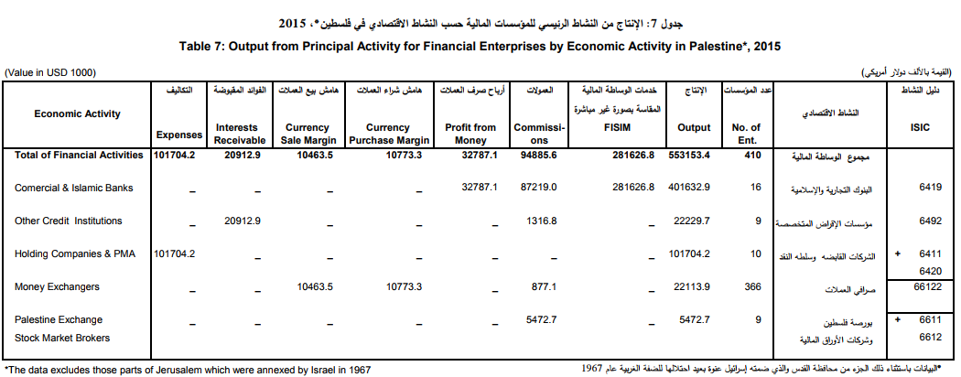
Finance & Insurance Report

Slide 19
Total Output of IB is 10% of total Output

Slide 20
Challenges for Islamic Finance
Large share of clients do not know about the services offered by Islamic Banks, they don’t know the meaning of Murabaha, Mudarabah and Musharaka.
Majority of people are unware of the difference between Islamic Banks and Conventional Banks (only the name).
Islamic banks succeeded in attracting deposits, but were not able to channel them into long term investment: invested mainly in Murabaha (short term investment) which is low- risk method and provide rapid returns (Cash)

Slide 21
Challenges for Islamic Finance
Other methods (Musharaka and Mudarabah) are highly risk, and not all firms want to give up part of their profits to their Partner (Islamic Bank).
Islamic banks still play a minor role in the Palestinian Economy. Their assets represent less than half the percentage of total banks assets, and 10% of total branches.
The Sharia Control Committee of Islamic banks should include consultants in the field of finance to give Fatwa based on understanding banking concepts.

