Slide 1


Compilation and estimation of islamic finance statistics: the malaysia’S experience
Workshop on Islamic Finance in the National Accounts
Beirut, Lebanon
24 – 26 October 2017
Department of Statistics Malaysia

Slide 2
Outline
Introduction
Development of Islamic Finance in Malaysia
Islamic Banking and Takaful Statistics in Malaysia
The Compilation of Islamic Finance Value Added:
The Malaysian Experience
Issues and Challenges
Conclusion

Slide 3
Malaysia Financial System & Structure
Financial System
Provident Fund (EPF)
Capital Market
Non-Bank Financial Intermediaries
Insurance / Takaful
Development Financial Institutions
Money Market / Foreign Exchange
Stock / Equity
Bond / Sukuk
Derivatives
Offshore
Labuan Offshore
Banking System
Bank Negara Malaysia
Banking Institutions
Saving Institutions
Foreign Exchange /Money Changer

Slide 4
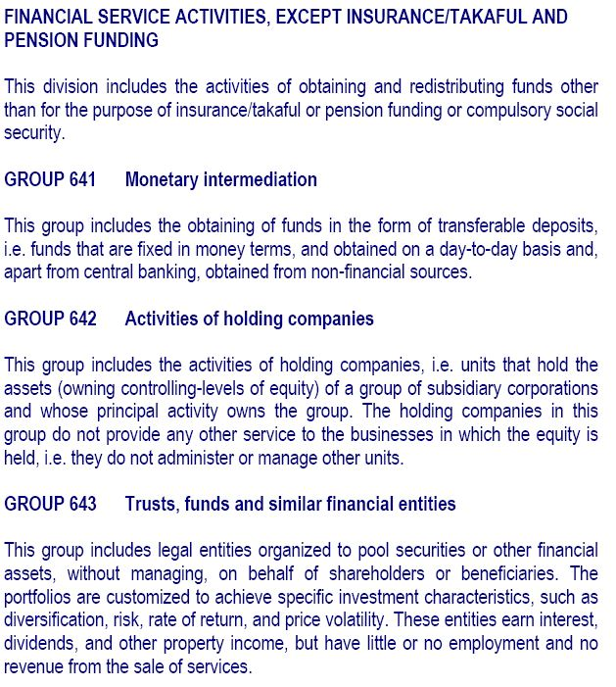
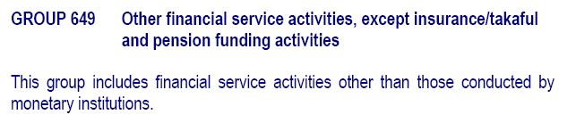
Malaysia Industrial Classification of Financial Sector

Slide 5
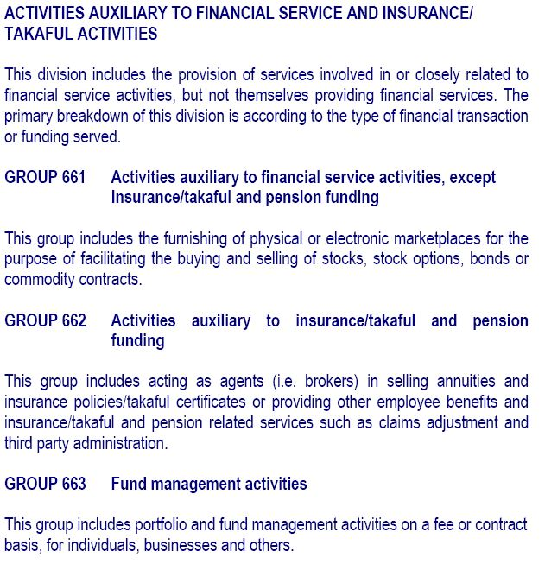
Malaysia Industrial Classification of Financial Sector

Slide 6
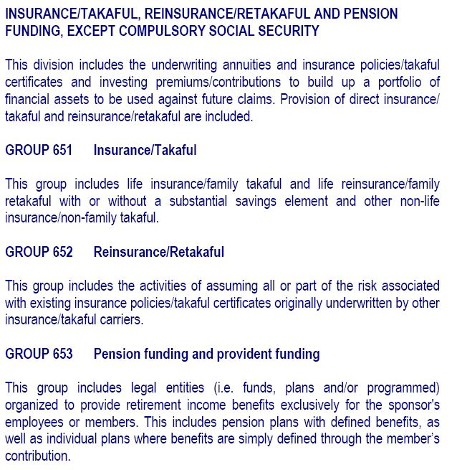
Malaysia Industrial Classification of Financial Sector

Slide 7
Islamic Banking Governance
Islamic Banking Act 1983
“Islamic banking business” means banking business whose aims and operations do not involve any element which is not approved by the Religion of Islam;
Islamic Financial Services Act 2013
An institution shall at all times ensure that its aims and operations, business, affairs and activities are in compliance with Shariah.
Securities Commission (Amendment) Act 2015 And Capital Markets And Services (Amendment) Act 2015
Capital Markets and Services Act 2007
Securities Commission Malaysia Act 1993
Securities Industry (Central Depositories) Act 1991
Demutualisation (Kuala Lumpur Stock Exchange) Act 2003 (pdf)
Securities Industry Act 1983
Futures Industry Act 1993
Comparison Between the Securities Industry Act 1983 and the Capital Markets and Services Act 2007
http://www.bnm.gov.my/index.php?ch=en_policy&pg=en_policy_banking

Slide 8
Malaysia Islamic Banking -Development
1969 - Pilgrims Management Fund and Board of Malaysia
1983 - First Islamic bank established (Bank Islam Malaysia Berhad)
1984 – First full-fledge takaful company established (Syarikat Takaful Malaysia Bhd )
1. Islamic Banking Act 1983
2. Government Investment Act 1983
1993 - Introduction of Interest-free banking Scheme or Skim Perbankan Tanpa Faedah (SPTF) - ‘Islamic window ’
1994 - Islamic Interbank Money Market
1996 - New Financial Disclosure (GP8)
1. Income recognition for SPTF from cash basis to accrual basis
2. SPTF allowed to set up full-fledged Islamic Banking branch
3. Establishment of Syariah Advisory Council (SAC)

Slide 9
Malaysia Islamic Banking -Development
1999 - Bank Muamalat Malaysia Berhad started operation as second Islamic bank
2004 – Three licenses issued to foreign Islamic bank:
1. Kuwait Finance House
2. Al-Rajhi Banking & Investment Corporation
3. A consortium of Islamic financial institutions (Qatar Islamic Bank, RUSD Investment Bank Inc. and Global Investment House)
2006
2008 - Issuance International Islamic Banking licenses (IIB)
Malaysia International Islamic Financial Centre (MIFC)
International Centre for Education in Islamic Finance (INCEIF)
2010 Onwards
NKEA - National Key Economic Areas – NKEA#5 Financial Services, EPP 10: Becoming the Indisputable Global Hub for Islamic Finance
2011 Onwards
Financial Sector Blueprint 2011 - 2020

Slide 10
SHARE OF FINANCE TO MALAYSIA GDP
Share of Finance and Insurance to GDP at Constant prices 2010
YEAR | 2010 | 2011 | 2012 | 2013 | 2014 | 2015 | 2016
FINANCE | 5.8 | 5.9 | 5.9 | 5.7 | 5.5 | 5.2 | 5.0
INSURANCE | 1.7 | 1.7 | 1.9 | 1.9 | 1.8 | 1.7 | 1.7
TOTAL FINANCE & INSURANCE | 7.5 | 7.6 | 7.8 | 7.6 | 7.3 | 6.9 | 6.8

Slide 11
Islamic Banking Statistics
 | 2005 | 2006 | 2007 | 2008 | 2009 | 2010 | 2011 | 2012 | 2013 | 2014 | 2015 | 2016
Number of Institutions | 43 | 42 | 47 | 54 | 54 | 55 | 56 | 56 | 55 | 54 | 54 | 54
Commercial Bank | 27 | 22 | 22 | 22 | 22 | 23 | 25 | 27 | 27 | 27 | 27 | 27
Merchant/Investment Bank | 10 | 10 | 14 | 15 | 15 | 15 | 15 | 13 | 12 | 11 | 11 | 11
Islamic Bank | 6 | 10 | 11 | 17 | 17 | 17 | 16 | 16 | 16 | 16 | 16 | 16
 | 2005 | 2006 | 2007 | 2008 | 2009 | 2010 | 2011 | 2012 | 2013 | 2014 | 2015 | 2016
Office Network | 2,244 | 2,139 | 2,245 | 2,271 | 2,298 | 2,312 | 2,435 | 2,481 | 2,479 | 2,494 | 2,500 | 2,498
Commercial Bank | 2,072 | 1,952 | 1,968 | 1,979 | 1,999 | 2,006 | 2,050 | 2,056 | 2,029 | 2,045 | 2,048 | 2,019
Merchant/Investment Bank | 19 | 19 | 120 | 131 | 131 | 133 | 133 | 148 | 135 | 135 | 119 | 130
Islamic Bank¹ | 766 | 1,167 | 1,272 | 2,039 | 2,087 | 2,102 | 2,147 | 2,171 | 2,177 | 2,192 | 2,206 | 2,197
¹ Includes Islamic bank branches that are shared with conventional bank branches
^{p} Preliminary
source : Bank Negara Malaysia

Slide 12
Islamic Banking Statistics
source: Bank Negara Malaysia

Slide 13
Islamic Banking Statistics – Asset
CAGR = 18.8%
1
1
¹ Including development financial institutions under the Development Financial Institutions Act 2002
^{p} Preliminary
source: Bank Negara Malaysia

Slide 14
Islamic Banking Statistics - Financing
Financing refers to assets / financing funded by investment accounts
CAGR = 21.1%
1
1
¹ Including development financial institutions under the Development Financial Institutions Act 2002
^{p} Preliminary
source: Bank Negara Malaysia

Slide 15
Islamic Banking Statistics - Deposits
CAGR = 18.2%
1
1
¹ Including development financial institutions under the Development Financial Institutions Act 2002
^{p} Preliminary
source: Bank Negara Malaysia

Slide 16
Islamic Banking Statistics
Pre-tax Profit | For the Calendar year
 | 2006 | 2007 | 2008 | 2009 | 2010 | 2011 | 2012 | 2013 | 2014 | 2015 | 2016p
 | RM million
Banking System¹ | 12,949 | 17,702 | 19,170 | 16,991 | 22,959 | 26,196 | 29,219 | 29,758 | 31,929 | 28,996 | 32,221
Commercial Bank¹ | 12,083 | 15,655 | 18,489 | 15,759 | 22,207 | 25,095 | 28,199 | 28,766 | 30,756 | 28,263 | 31,451
Investment bank | 866 | 2,046 | 681 | 1,232 | 752 | 1,101 | 1,020 | 992 | 1,173 | 733 | 770
Islamic Bank | 1,612 | 1,894 | 1,811 | 2,641 | 3,199 | 3,027 | 4,852 | 4,913 | 5,112 | 5,034 | 5,576
Total Capital Ratio | As at end
 | Ratio
 | 2006 | 2007 | 2008 | 2009 | 2010 | 2011 | 2012 | 2013 | 2014 | 2015 | 2016p
Banking System | 13.5 | 13.2 | 12.6 | 15.4 | 14.8 | 15.7 | 15.7 | 14.9 | 15.9 | 16.6 | 16.5
Islamic bank | 17.0 | 15.8 | 14.0 | 15.6 | 15.5 | 15.0 | 14.5 | 15.1 | 16.2 | 16.1 | 16.6
Total capital ratio refers to the ratio of a bank's capital to its risk
¹ Includes Islamic Banks
^{p} Preliminary
source : Bank Negara Malaysia

Slide 17


























List of Banking Institutions with Islamic Business as at August 2017
Commercial Banks
Islamic Banks
Investment Banks

Slide 18
Islamic Banking Statistics - Takaful and Conventional Insurance
source : Bank Negara Malaysia

Slide 19










Islamic Banking Statistics - Takaful
 | As at end
 | 2005 | 2006 | 2007 | 2008 | 2009 | 2010 | 2011 | 2012 | 2013 | 2014 | 2015 | 2016
No. of Registered Takaful Operator | 5 | 8 | 8 | 8 | 8 | 9 | 11 | 12 | 12 | 11 | 11 | 11
No. of Agents | 14,059 | 15,194 | 43,843 | 60,197 | 88,895 | 74,089 | 100,308 | 105,552 | 77,804 | 64,106 | 65,387 | 64,200
Family | 11,781 | 11,188 | 32,987 | 44,222 | 55,898 | 42,698 | 66,338 | 68,009 | 58,984 | 50,529 | 50,334 | 49,836
General | 2,278 | 4,006 | 10,856 | 15,975 | 32,997 | 31,391 | 33,970 | 37,543 | 18,820 | 13,577 | 15,053 | 14,364
No. of Office | 147 | 151 | 146 | 157 | 104 | 197 | 207 | 213 | 215 | 129 | 112 | 87
No. of Employees | 2,670 | 2,967 | 2,846 | 2,411 | 2,499 | 2,713 | 2,846 | 2,758 | 3,162 | 2,720 | 2,896 | 3,766
Takaful
source : Bank Negara Malaysia

Slide 20
Islamic Capital Market
Islamic Capital Market activities:
- Stock broking
- Unit Trust
- Other financial activities
In 2010, MIFC, BNM, SC, Labuan FSA, Bursa Malaysia and DOSM work together in estimate value added Islamic capital market activities .

Slide 21
Islamic Banking Statistics - Debt Securities Issuance in Malaysia
Notes: Refers to those of all tenors, i.e. both short-term and long-term securities listed on FAST, BNM. Reflects nominal value as at time of issue.
source : Bank Negara Malaysia

Slide 22
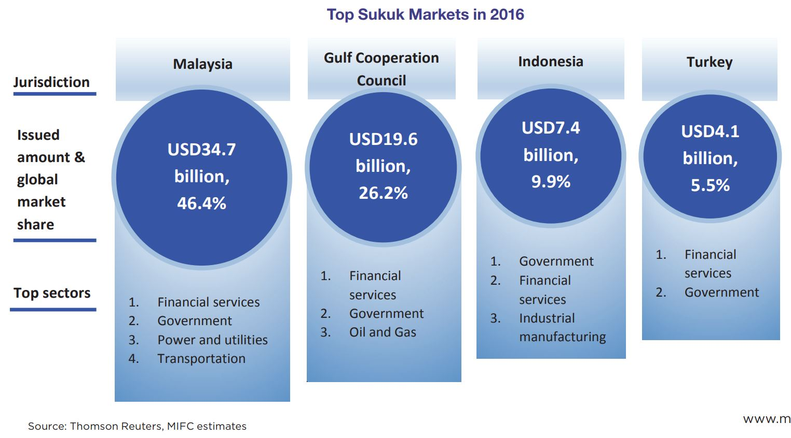
Global Sukuk
source: Thomson Reuters, MIFC 2016

Slide 23
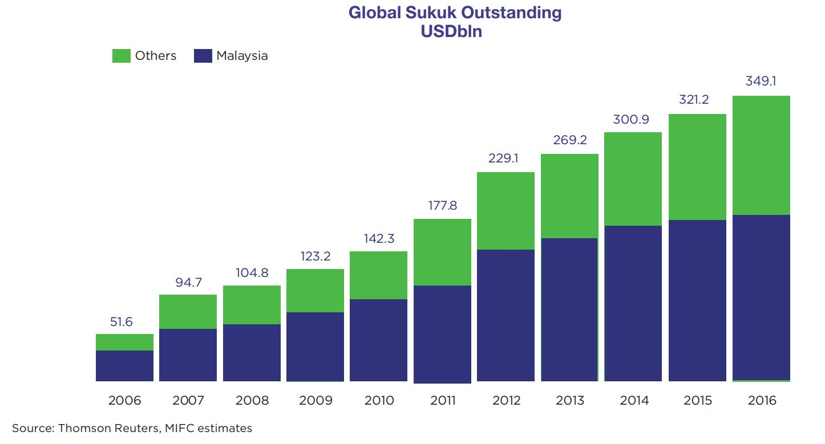
Global Sukuk
source: Thomson Reuters, MIFC

Slide 24
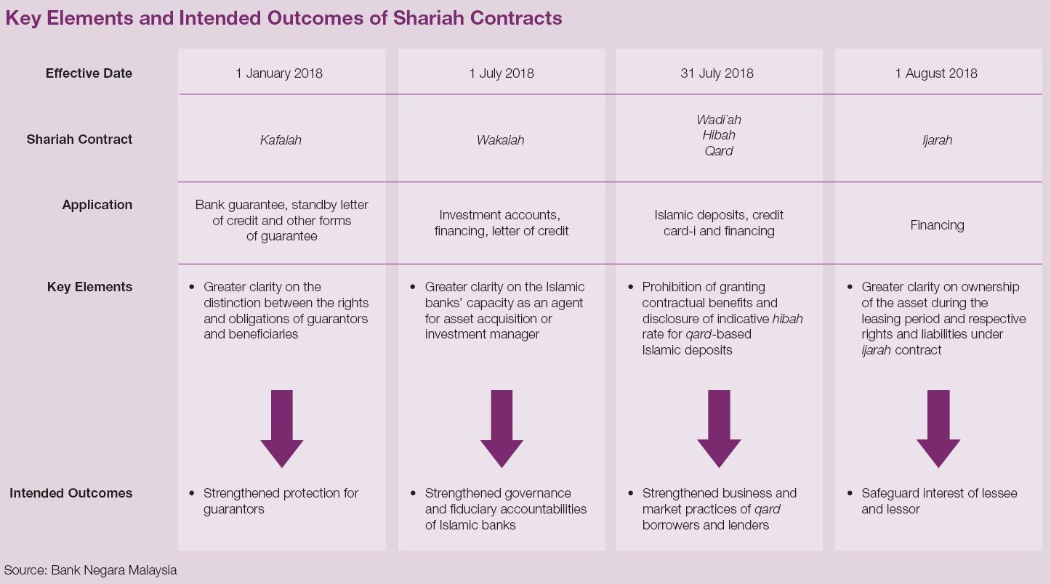
Islamic Banking Development
Additional Shariah Standards and Operational Requirements were issued in 2016 to be implemented in Islamic financial products and services.

Slide 25
Islamic Banking-Value added Calculation
DOSM as official statistics provider.
DOSM produce wide range social and economy statistics.
Islamic banking and Takaful Value Added was calculated separately since 2000 (1993 SNA).
System of National Accounts 2008 (and SNA1993) recommended FISIM framework in estimating output for Financial Intermediation activity and it has been applied in Malaysian GDP since 2005, fully replacing the IBSC (SNA1968).

Slide 26
Data availability

Slide 27
Data availability

Slide 28
Data availability

Slide 29
Data availability - Insurance

Slide 30
Data availability - Insurance

Slide 31
Measurement of FISIM in Malaysia
Estimation of FISIM - Conventional
FISIM is calculated using the following formula:
FISIM = FISIM on Loans + FISIM on Deposits
FISIM on Loans
= Stock of Loans * [Lending Rate – Reference Rate]
FISIM on Deposits
= Stock of Deposits * [Reference Rate - Deposits Rate]
Reference Rate: Midpoint between the loan and deposit rate
less volatile
FISIM values with greater transparency

Slide 32
Measurement of FISIM in Malaysia – Islamic Finance segment
Estimation of FISIM – Islamic Finance
FISIM is calculated using the following formula:
FISIM = FISIM on Loans + FISIM on Deposits
FISIM on Loans
= Stock of Financing* [Financing Rate – Reference Rate]
FISIM on Deposits
= Stock of Deposits * [Reference Rate – Profit Rate]
Reference Rate: Midpoint between the loan and deposit rate
less volatile
FISIM values with greater transparency

Slide 33
Islamic Banking & Takaful-Value added
CAGR
(2010 to 2016): 3.1%
Islamic Bank
2.1%
Commercial Bank
Investment Bank
1.4%
-3.5%
CAGR
(2010 to 2016):
6.2%
Takaful
0.6%
Conventional Insurance
6.2%
Based on Constant 2010 prices

Slide 34
Issues & Challenges
While estimation of VA of Islamic Banking by industry is very clear, estimation and contribution by Islamic Finance product is a challenge due to complexity of data and ability to split between the conventional and Islamic product.
Islamic Capital Market: Single enterprise offering both Islamic and conventional products.
Development of Services Producer Price Index (SPPI)for banking activities

Slide 35
Potential and Advantages
Fully coverage through Economic Census
Well regulated financial sector (Central Bank, Securities Commissions, Bursa Malaysia)
Depth and breadth in Capital Market
Advisory board and promotion agency (MIFC)
Nurturing talents and experts in Islamic Finance e.g INCEIF
Structured development plan e.g Financial Sector Master Plan 2011-2020.

Slide 36
Conclusions & recommendation
Islamic banking and finance in Malaysia has become one of the most progressive and innovative in providing Islamic banking services and products.
In line with development in Islamic banking and finance, DOSM from time to time continuously evaluating the methodology used in compiling the value added in Islamic banking and Islamic capital market.
DOSM continuously engaging and collaborate with regulators such as BNM, SC, Bursa Malaysia and Labuan FSA in compiling the statistics.
Moving forward, a universal guidelines is needed to make the estimate of Islamic banking and finance more comparable among countries. Malaysia willing to share the experience and involve actively in any efforts undertaken by international bodies.
To form National Accounts Experts Group on Islamic Finance

Slide 37
References
Department of Statistics Malaysia: www.dosm.gov.my
Bank Negara Malaysia: www.bnm.gov.my
Securities Commissions Malaysia: www.sc.com.my
Bursa Malaysia: www.bursamalaysia.com
Labuan Financial Services Authority (offshore): www.labuanibfc.com
Malaysia International Islamic Financial Centre (MIFC): www.mifc.com
International Centre for Education in Islamic Finance (INCEIF): www.inceif.org
International Shari’ah Research Academy (ISRA): www.isra.my

Slide 38

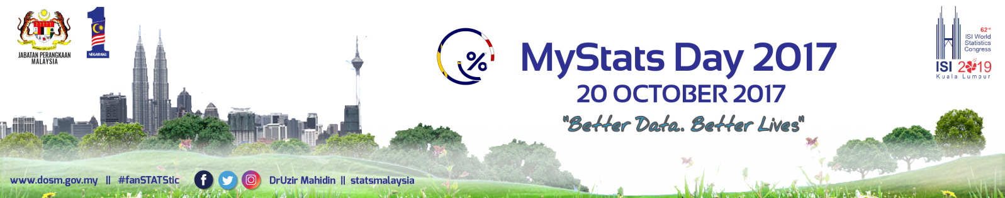
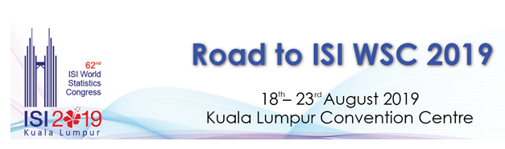
https://www.facebook.com/StatsMalaysia
Department of Statistics, Malaysia
https://www.dosm.gov.my
https://twitter.com/StatsMalaysia
Thank You
For Your Attention
shared by : MOHD YAZID BIN KASIM
myazid_kasim@stats.gov.my

