Slide 1
End Use Survey: Manufacturing, Residential and Commercial Sector
11th UN Oslo Group Meeting
8 – 11 May 2017
Stockholm, Sweden

Slide 2
Outline
Introduction
National Energy Balance
Energy Flow Chart, 2015
Manufacturing Survey
Residential Survey
Commercial Survey
Way Forward and Conclusions

Slide 3
Introduction
The National Energy Balance (NEB) report is an extension of Suruhanjaya Tenaga / Energy Commission’s (ST) role from regulator of electricity and gas supplies to the main reference point for energy data in Malaysia. A complete statistical publication for energy supply and demand of the nation, it is based upon an energy balance format using similar energy units for all reported data
NEB covers three major areas, namely the Energy Supply, Transformation and Final Usage - Including natural gas, crude oil, petroleum products, coal and coke, electricity, hydropower and renewable energy
With this extended role, ST has formed various cooperation arrangements, to supply monthly, quarterly and annual energy data to the relevant agencies such as the International Energy Agency (IEA), International Energy Forum Secretariat (IEFS), United Nations Statistics Division (UNSD), The Institute of Energy Economics, Japan (IEEJ), Asia Pacific Economic Cooperation (APEC) and ASEAN Centre for Energy (ACE). This cooperation demonstrates ST’s commitment in providing accurate information while providing an opportunity to further enhance the Commission’s capacity and expertise in related areas.

Slide 4
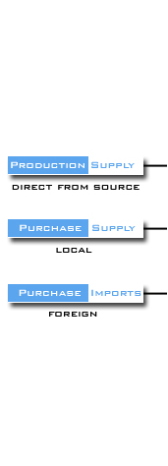
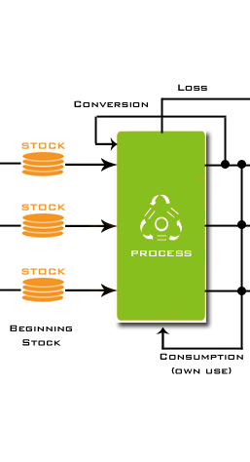
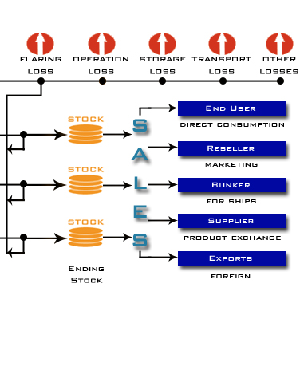
National Energy Balance

Slide 5
National Energy Balance
Currently, about 70 data providers
Divided into fuel types ; oil, gas, electricity and coal
In quarterly basis based on region
Questionnaire based on energy balance format
Collected via email, fax and postage
Primary and secondary sources
Common unit of measurement based on fuel types

Slide 6
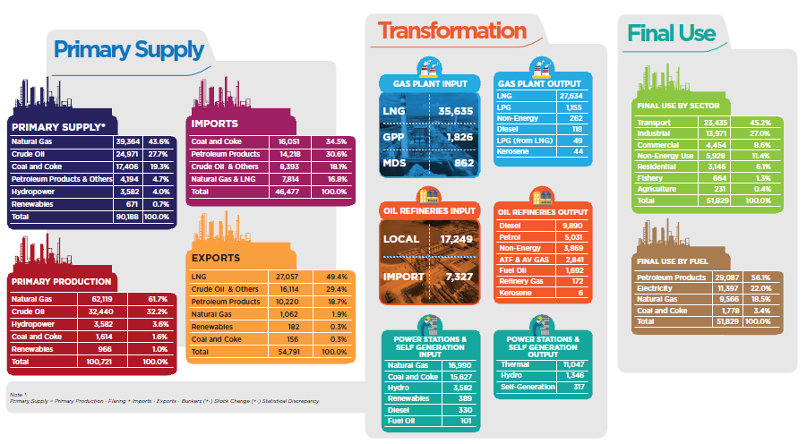
Energy Flow Chart, 2015 (ktoe)

Slide 7
Manufacturing Survey
A survey was conducted with 520 manufacturing companies in Peninsular Malaysia to understand the energy consumption pattern of manufacturing industry in Peninsular Malaysia. Monthly data of energy consumption was collected for the year 2010 to 2013 for eight types of energy; electricity, natural gas, petrol, diesel, fuel oil, LPG, kerosene and coal
Manufacturing industry sub-sectors included are; Iron and Steel, Chemical (including Petro-Chemical), Non Ferrous Metals, Non Metallic Mineral Products, Transportation Equipment, Machinery, Food, Beverages and Tobacco, Pulp, Paper and Printing, Wood and Wood Products, Textiles and Leather and Not Elsewhere Specifies (Industry)
This is in accordance to the breakdown of the manufacturing sub-sectors by the International Energy Agency (IEA) and APEC format of classification of the industrial sector.

Slide 8
Manufacturing Survey

Slide 9
Manufacturing Survey

Slide 10
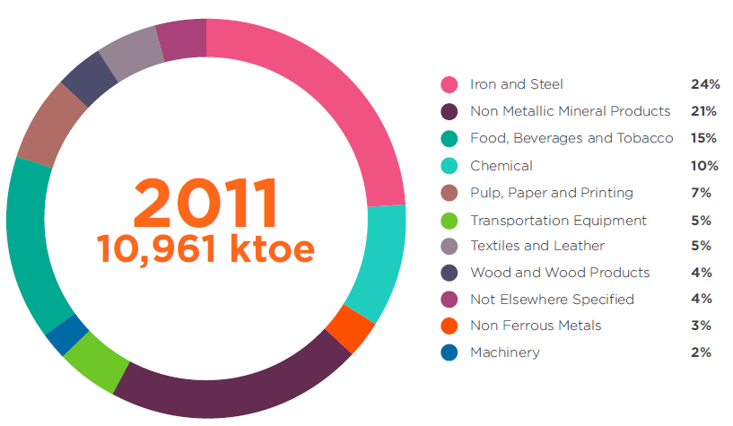
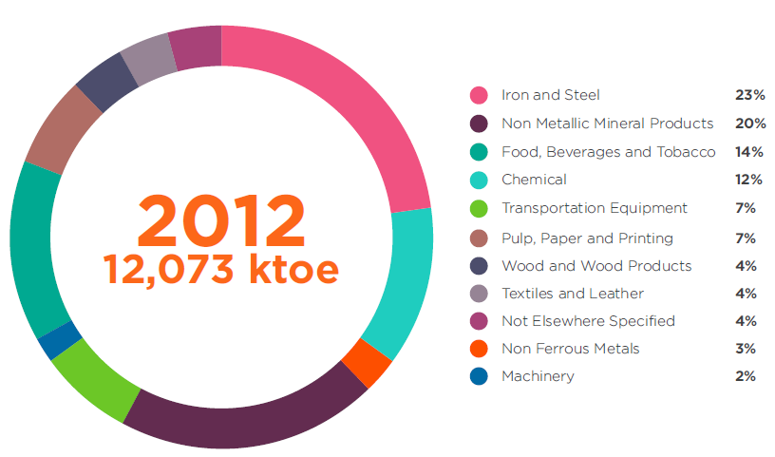
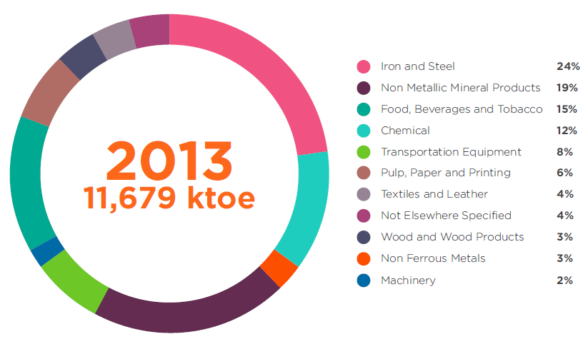
Manufacturing Survey

Slide 11
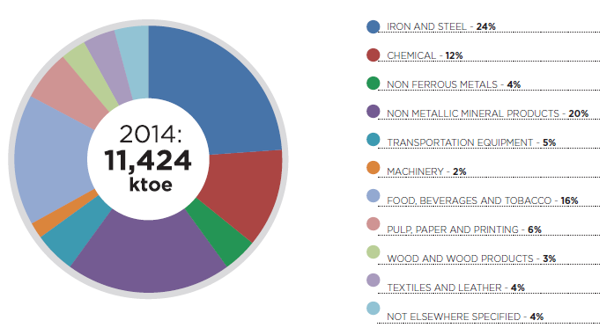
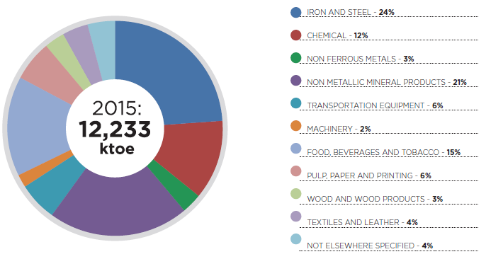
Manufacturing Survey

Slide 12
Residential Survey
Energy Commission has successfully conducted a survey with 2,000 households in Peninsular Malaysia with the aim to have an in-depth understanding of energy consumption pattern within households. There are many variables and factors that affect a household’s energy consumption of which were not properly identified before. This survey enabled us to have a better view of where, when and how the energy is consumed within households.
The number of samples is calculated based on the actual number of households in Malaysia. Hence, 2,000 households were selected across Peninsular Malaysia for this survey. The samples were broken down to four (4) main regions, namely Central, South, East Coast, and North, and then further broken down to ten (10) types of houses. The energy consumption for each household is categorised into fuel types (natural gas, LPG, kerosene and electricity) and five (5) end-uses as described by the IEA (International Energy Agency).
Overall, electricity, LPG and natural gas are the major form of energy used in households in Peninsular Malaysia, where electricity accounted for more than 80% of energy consumption. Electricity consumption is distributed evenly among the four regions of Peninsular Malaysia, whereas LPG showed a slightly bigger contribution from the central region. In terms of end-uses, appliances have the biggest share in energy consumption, followed by air-conditioning system, cooking, lighting, and water heating. Appliances category covers a wide range of item which explains the high percentage of appliances in household’s energy consumption.

Slide 13
Residential Survey

Slide 14
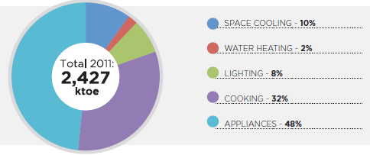
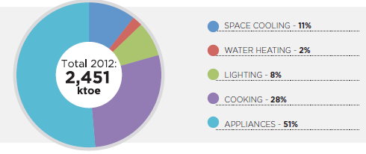
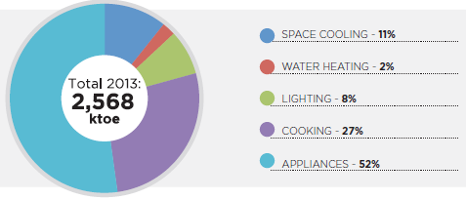
Residential Survey

Slide 15
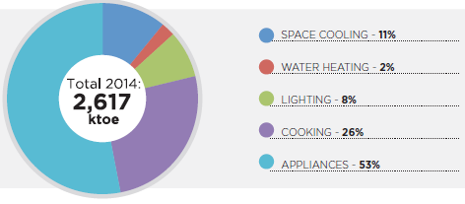
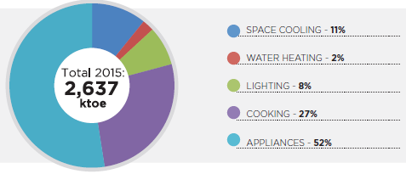
Residential Survey

Slide 16
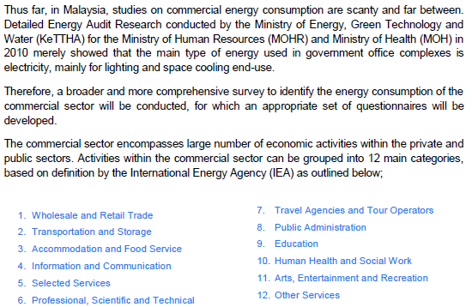
Commercial Survey

Slide 17
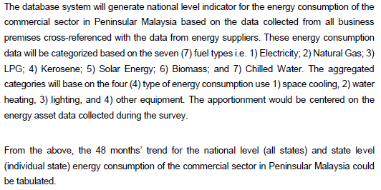
Commercial Survey

Slide 18
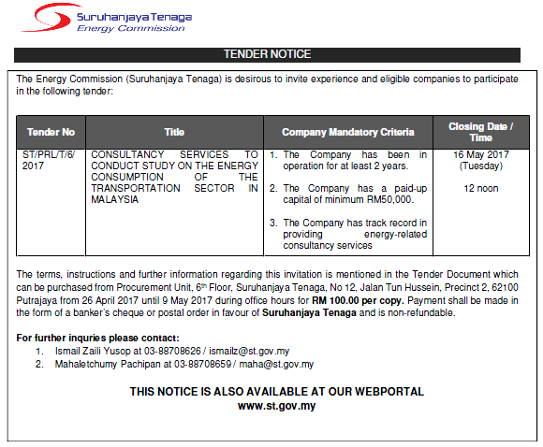
Way Forward

Slide 19
Conclusions
Sample size is small and not reflect the real population
Limited budget
Coverage only in Peninsular Malaysia
Consultant experience is very important
No secondary source to benchmarking the survey results
Some of the results is not make sense and need some modification to reflect the true situation
Need to have expert judgement before adopting the survey results.

Slide 20
Thank You www.meih.st.gov.my

