Slide 1
Digital publication on energy and Sankey Diagrams Oslo Group meeting – Stockholm 2017
Marek Šturc
European Commission - Eurostat

Slide 2
Eurostat's copyright policy:
Eurostat has a policy of encouraging free re-use of its data, both for non-commercial and commercial purposes.
All statistical data, metadata, content of web pages or other dissemination tools, official publications and other documents published on its website, with few exceptions, can be reused without any payment or written license provided that:
the source is indicated as Eurostat;
when re-use involves modifications to the data or text, this must be stated clearly to the end user of the information.
http://ec.europa.eu/eurostat/about/policies/copyright

Slide 3
From hard copies to digital
During last decade, printed publication are on very sharp decline
Publication are now available only as pdf files
Printed publication are mostly cross-cutting publications
flagship publications
support to monitoring key policies and EU initiatives
pocketbooks
http://ec.europa.eu/eurostat/web/energy/publications

Slide 4
Online dissemination
Database & Data tables
Extraction tools for automatic downloads
Data visualization tools
Statistics illustrated & flexible dashboards
Publications as pdf files
Statistics explained articles
Press/News releases
Applications for mobile devices
Social media: Twitter, Facebook
http://ec.europa.eu/eurostat/help/first-visit/tools

Slide 5
Eurostat's energy flow charts Sankey diagrams
http://ec.europa.eu/eurostat/cache/sankey/sankey.html
Notes:
Energy balances can be graphically represented by means of flow diagrams. These flows can be combined, split and traced through a series of events or processing stages. The width of the flows is proportional to the amount of material or energy contained in the respective flow. These visual representations are based on so-called Sankey diagrams, which are typically used to visualize energy transfers between processes. They are named after the Irishman Matthew H. P. R. Sankey, who used this type of diagram in a publication on energy efficiency of a steam engine in 1898.
A Sankey diagram is a very practical tool to represent energy balances in a visual way: an energy balance compiles the contributions and interrelations of various energy commodities (fuels, heat and power, i.e. energy carriers in a marketable form) in the different sectors of the economy (e.g. supply, transformation and consumption) in energy units. While energy balances are often presented in the form of a table or a spreadsheet, a Sankey diagram allows the user to visualise the interrelations of energy commodities in a much more illustrative and intuitive way.

Slide 6
http://ec.europa.eu/eurostat/cache/infographs/energy/
Notes:
This new type of publication aims to answer questions on energy most frequently asked by citizens in an original way: through short texts, dynamic infographics, maps, videos, graphs, photos etc.
To answer questions on energy in an original way: through short texts, dynamic infographics, maps, videos, graphs, photos, etc.
Both those not so familiar with the energy sector and experts in the domain should find something of interest.

Slide 7
Key links to Eurostat website
Digital publication on energy
http://ec.europa.eu/eurostat/cache/infographs/energy/
Sankey diagrams (energy flow charts)
http://ec.europa.eu/eurostat/cache/sankey/sankey.html
Full energy database (all energy data)
http://ec.europa.eu/eurostat/web/energy/data/database
Statistics explained articles on energy
http://ec.europa.eu/eurostat/statistics-explained/index.php/Category:Energy

Slide 8
Thank you for your attention!
Marek.Sturc@ec.europa.eu
http://ec.europa.eu/eurostat

Slide 9
ANNEX

Slide 10
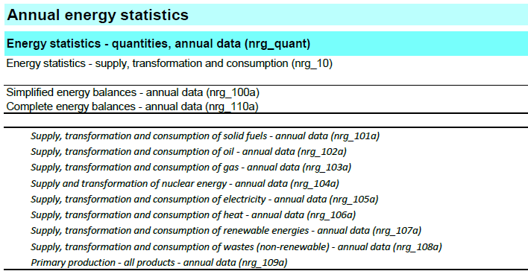
Release calendar
http://ec.europa.eu/eurostat/web/energy/data

Slide 11
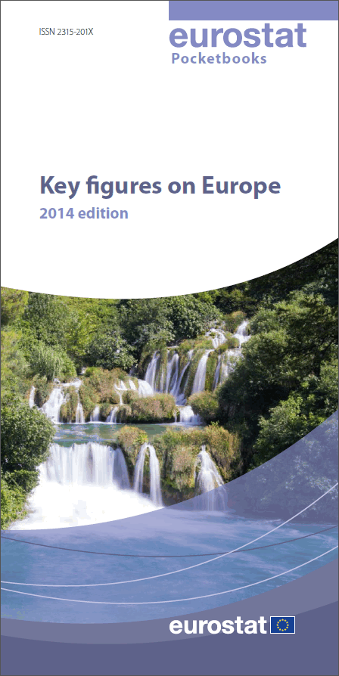
Printed publications (paper copies) on decline during last decade:
Shift from "classical" paper
publications to electronic dissemination
Publications are now available as pdf files.

Slide 12
News Releases
Household electricity prices rose by 2.4%
Share of renewables in energy consumption rose further to 16% in 2014
The EU was dependent on energy imports for slightly over half of its consumption in 2014
In 2015, CO2 emissions in the EU estimated to have slightly increased compared with 2014

Slide 13
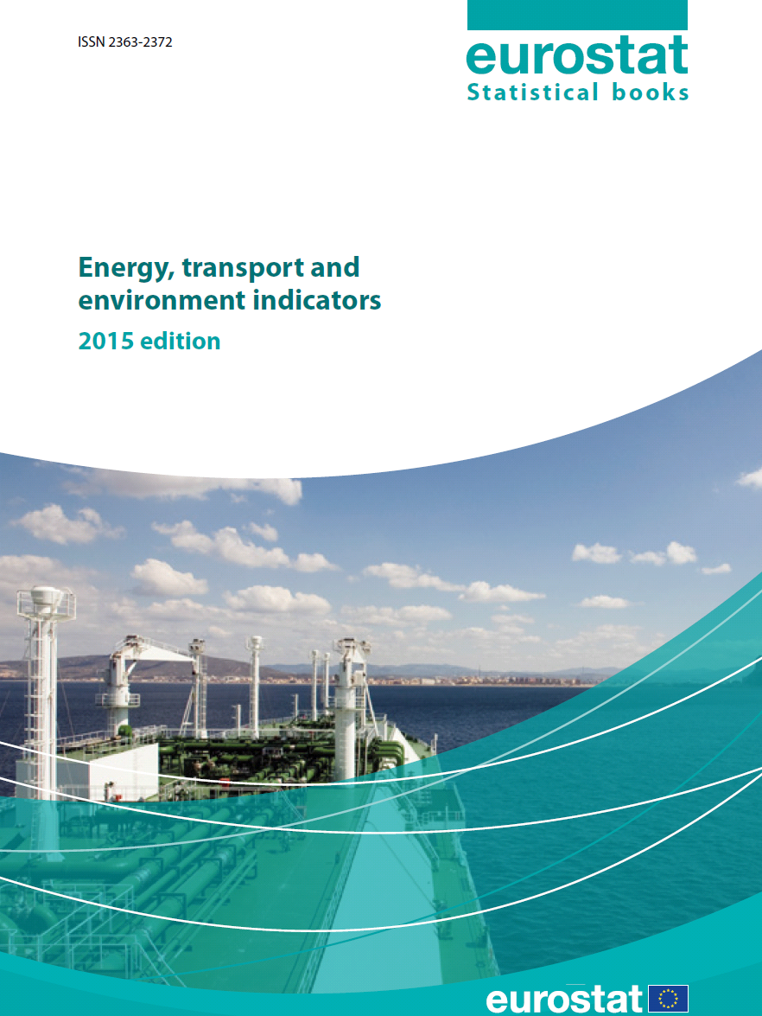
POCKETBOOK
"Energy, transport and environment indicators“

Slide 14
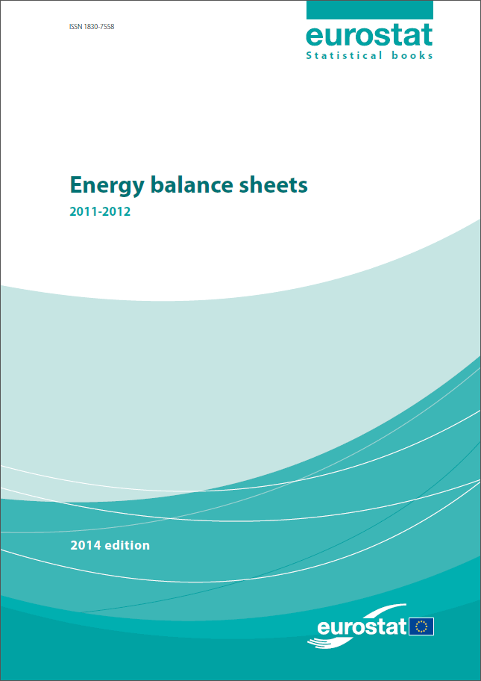
Electronic publication
"Energy Balance sheets“

Slide 15
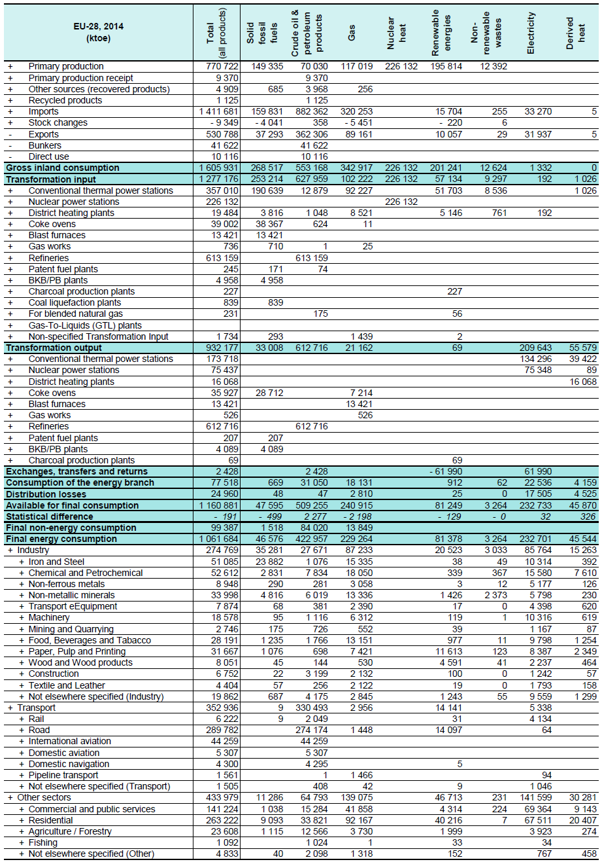
Energy balances: Simplified & Complete
Notes:
http://ec.europa.eu/eurostat/web/products-statistical-books/-/KS-EN-16-001

Slide 16
Statistics Explained articles ➔

Slide 17
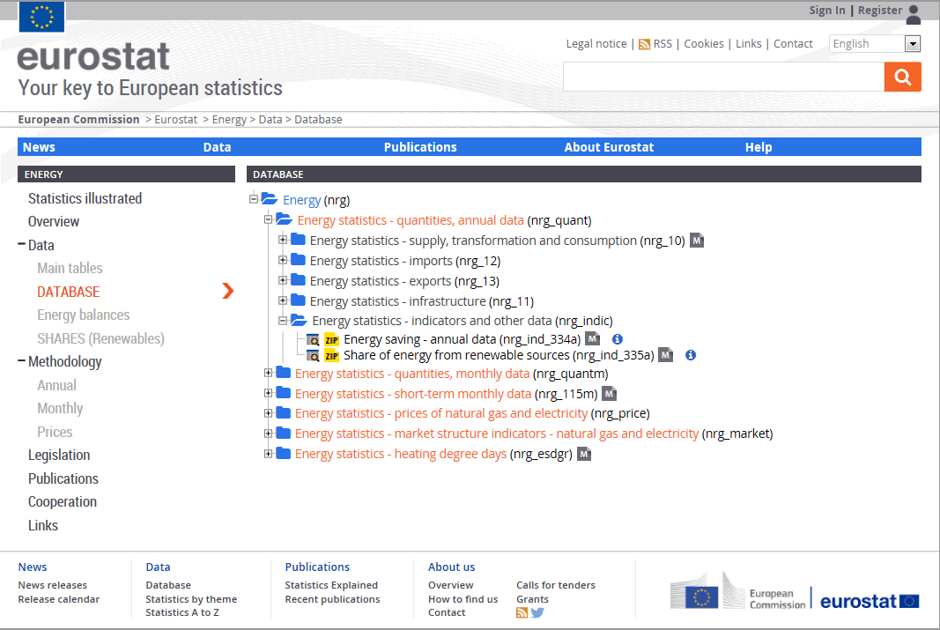
Electronic datasets ➔

