Slide 1
Admin data and other
The use of administrative data sources in the Netherlands
May 9, 2017
Otto Swertz

Slide 2
Three subjects in one presentation
Admin data
IRES manual
IT system

Slide 3
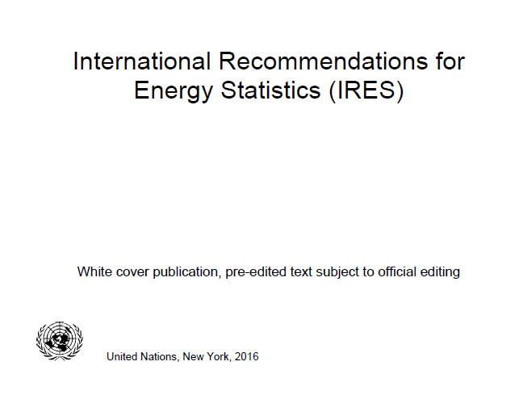
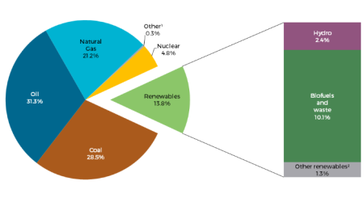
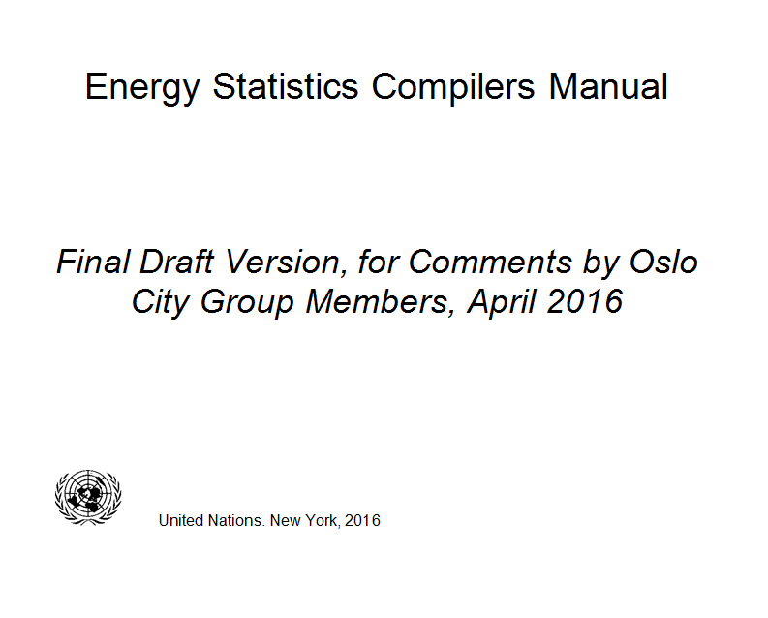
1. Findings regarding IRES

Slide 4
Own use autoproducers
Main producers
Auto producers
Contradiction

Slide 5
Energy statistics are semi-functional
Business statistics are institutional
Energy statistics are based on institutional concepts for describing final energy consumption
However, for describing transformation processes they are funtional
This means, a transformation can take in any NACE and only there is a difference between main and auto

Slide 6
What is everybody looking at?
The share of renewable energy

Slide 7
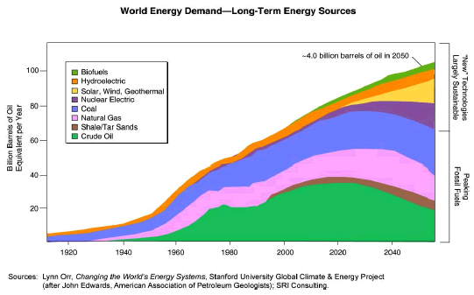
What are the visions on the future?
The share of renewable energy

Slide 8
Where is renewable energy in IRES?

Slide 9
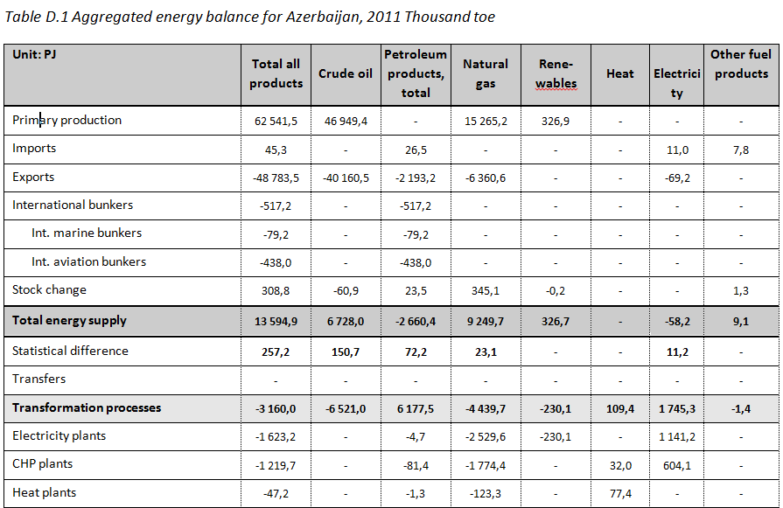
Example of energy balance in ESCM

Slide 10
Netherlands’ classification
Statistics Netherlands Energycarrier Classification
1 | Coal | (incl. peat and shale oil)
2 | Oil | (crude and products)
3 | Natural gas | (gaseous, LNG, CNG)
4 | Renewables | (wind, solar, biomass etc.)
5 | Waste and other | (primary sources)
6 | Electricity & heat | (source independent secondary sources)

Slide 11
Question
Do we need to get a classification of renewable energy in IRES?
And, if yes, how?

Slide 12
2. New IT system Statistics Netherlands

Slide 13
Institutional arrangements
Databases
Micro
Meso
Input
Output
Editing
Aggregate
Processing

Slide 14
Institutional arrangements
Central co-ordination
Micro
Meso
Input
Output
Editing
Aggregate
Expert
responsability

Slide 15
Process design
Checks w.i. source
Checks between source
Complete popu-lations
Confronting statistics
Finetune output tables
1
2
3
4
5
6
Input
Micro
Micro
Meso
Macro
Output

Slide 16
IT design
SQL server for databases
SQL for easier and C# (C sharp) for complexer steps
Webinterface for interactions
ODBC link to MS Access
Macroview: a tool to analyse

Slide 17
Information modelling
Here, we used the sentence approach.
Most microdata fit in basic sentences, like:
According to Source A has Business Unit B in Period C an Import (D) of Crude Oil (E) with the Value (G) of 1,000 tonnes (H)

Slide 18
Data model (simplified)
Data source
Business Unit
Installation
Type
Value
Energy Carrier
Variable
Place
End Use

Slide 19
Colums in data input file
Main | Optional | Quality
Data Source | Contra Sector | Quality-info
Period | Contra BU
Business Unit | Contra BU #
BU # | Type of End Use
Installation | Type of Installation
Energy Carrier | Location
Variable | Contra Location
Measuring Unit | Extra Location
Value
Own Calorific Value

Slide 20
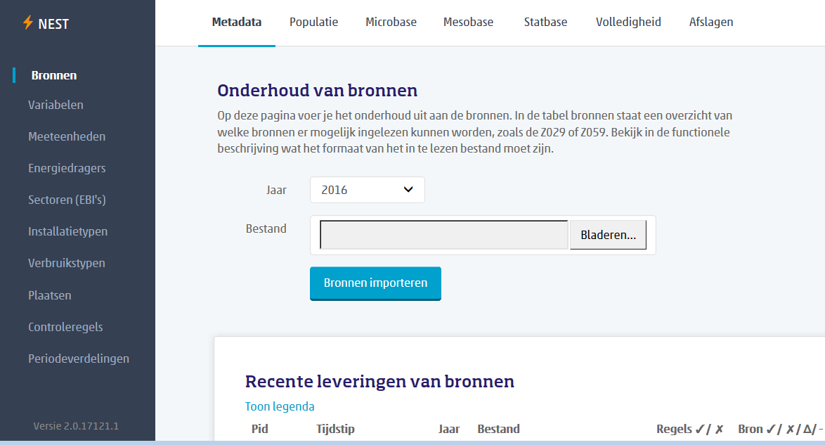
Webinterface

Slide 21
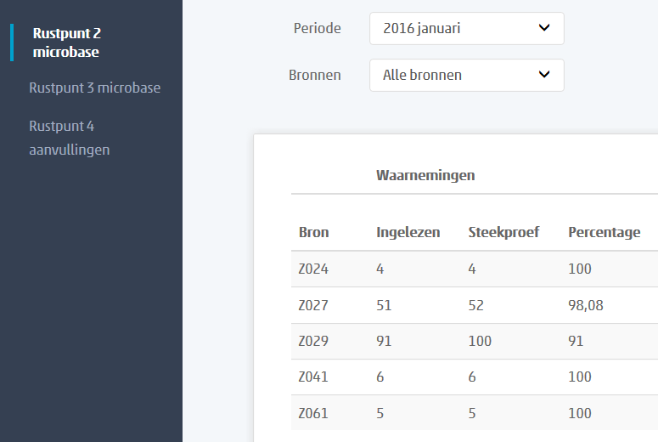
Showing response rate

Slide 22
Quality indicator for every value
Sector | Value (PJ) | Quality | Max Quality
Total NL | 2.418 | 85 | 130
Energy Sector | 771 | 130 | 130
Consumers | 1.647 | 29 | 130
Total Primary Energy Supply for Total Energy Carriers in 2014

Slide 23
3. Using administrative sources
Last year I presented a model. That’s the analytics.
And the use of our client files of network companies. That was the statistics.
What happened in between?
Where are we going?

Slide 24
Classifying admin data sources
 | Open data | Confidential data
 |  | Held publicly | Held privately
Governmental, obliged | No problem | Statistics law | Problem
Commercial, voluntarily | No problem | Nice to have | Nice to have

Slide 25
Classifying admin data sources
 | Open data | Confidential data
 |  | Held publicly | Held privately
Governmental, obliged | No problem | Statistics law | Problem
Commercial, voluntarily | No problem | Nice to have | Nice to have
Big Data

Slide 26
Center for Big Data Statistics
Official launch on 27 September 2016
during the official trade mission to South Korea led by Dutch Prime Minister and State Secretary for Economic Affairs.
Innovative external partners
National statistical institutes (NSIs), Eurostat, from the private or the public sector, for instance TNO, DNB, IBM, KPN and SURFsara
https://youtu.be/Y2CJMh_h5L8

Slide 27
Three objectives for Big Data
To realise faster production of our statistics: real-time statistics. This will enhance our responses to our society’s need to receive usable information more quickly.
Existing statistics to become available at a lower aggregation level (data on regional and urban areas). In addition, big data offers opportunities to make statistics production more flexible and to formulate new indicators.
To work based on the zero footprint concept. This means reducing the administrative burden at companies and for individuals further by deploying new sources.

Slide 28
Examples, beta products etc.
How many people here?
https://www.cbs.nl/en-gb/our-services/innovation/project/how-many-people-here-
Traffic intensities on national roads
http://research.cbs.nl/verkeerslus/
National Energy Atlas
http://www.nationaleenergieatlas.nl/en/kaarten

Slide 29
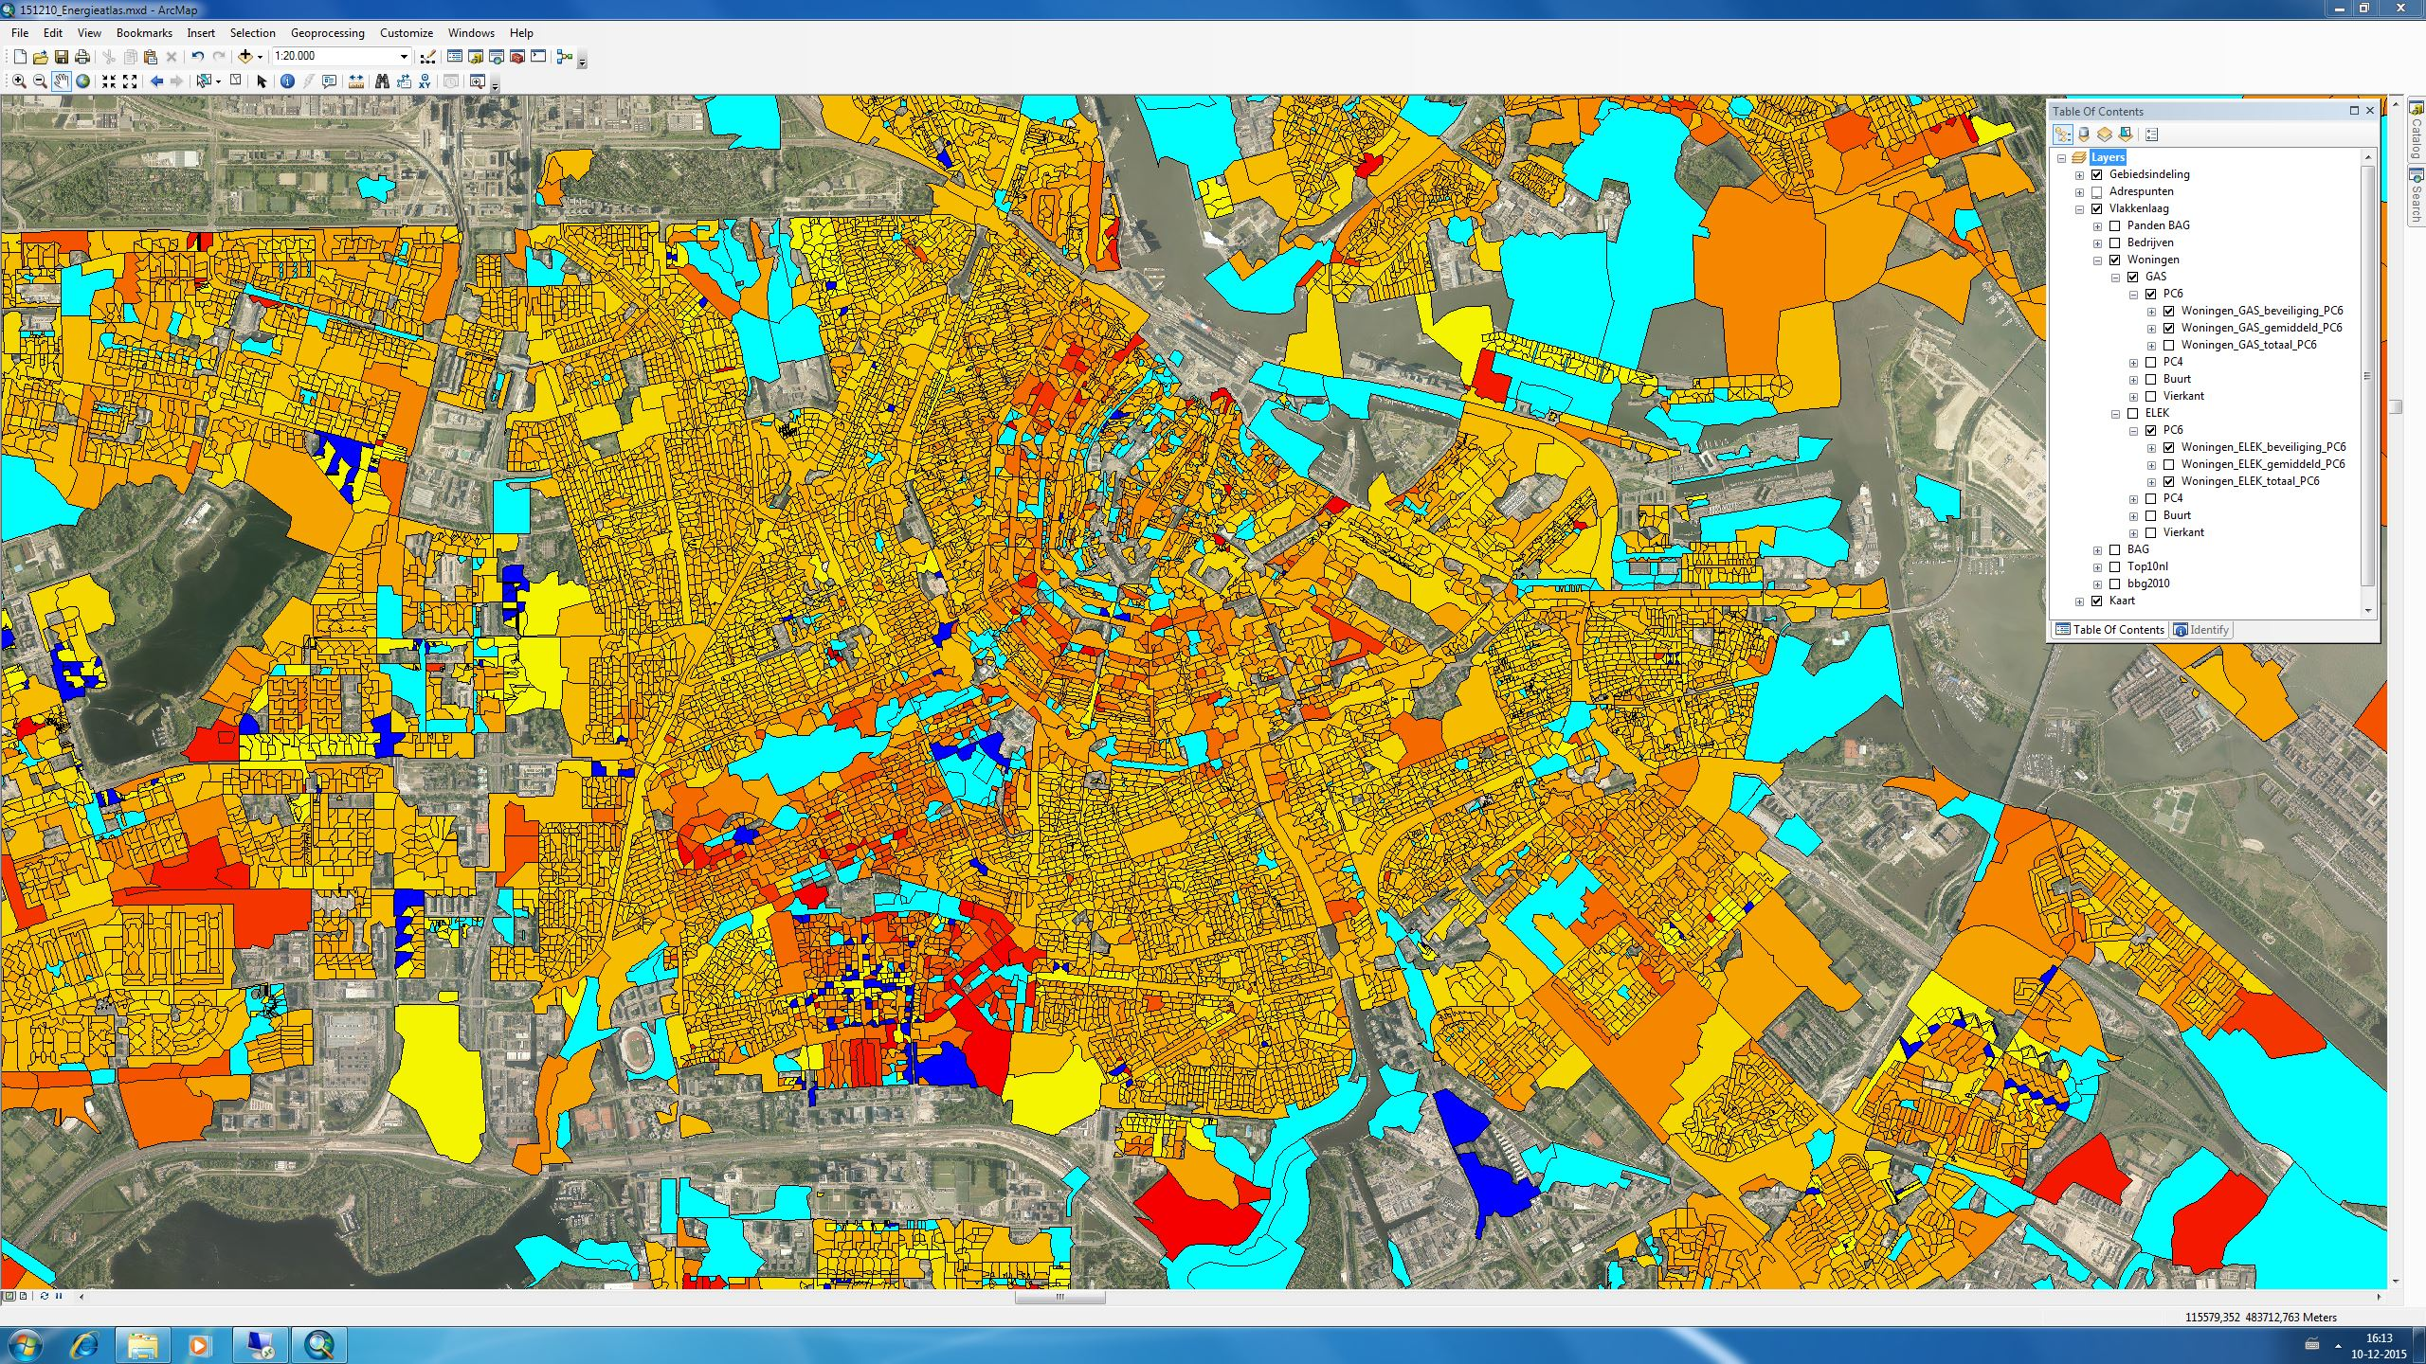

Slide 30
New work for energy transition
Energy supply of buildings on micro level. Using building registers, subsidy data, satellite images, smart meter data etc.
Energy consumption for transport regionalized. Using big data, traffic intensities, vehicle registrations, energy and emission factors per vehicle, car-navigation data etc.
Socio-economic effects on labour, investments, energy poverty etc. Some of this might benefit from big data, this is work in progress.

Slide 31
Thank you!
Questions?
o.swertz@cbs.nl

