Slide 1
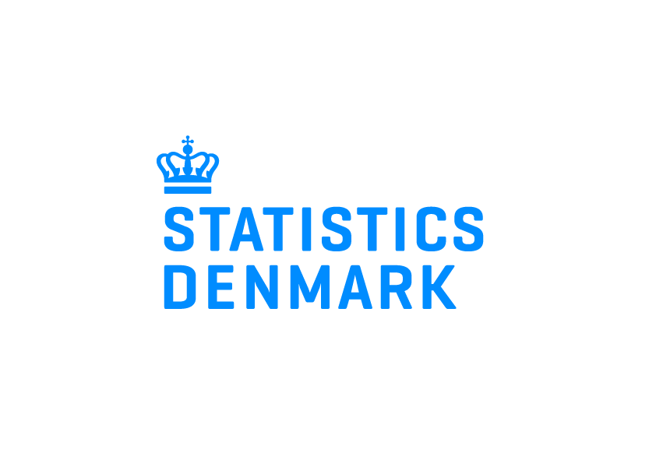
Electricity data hub (datahub) – Forthcoming data source in Statistics
Niklas Notstrand (Swedish Energy Agency)
Jukka Pakola (Statistics Finland)
Oslo Group on Energy Statistics
Stockholm, 8.-11.5.2017

Slide 2
Contents
What is an Electricity data hub?
Main data content
Potential data source for Energy and Other Statistics
Quality Assurance
Next steps

Slide 3
What is an Electricity data hub (datahub)?
Datahub is a centralized information exchange system for the electricity retail market, which will contain data from electricity metering points.
Used by electricity suppliers and distribution network companies serving electricity consumers.
All parties with equal access to the information. The information is available to third parties, e.g. reporting to authorities given legislation and confidentiality regarding micro-data.

Slide 4
Data content
Readings from electricity metering points by customer and meter. Frequency: hourly to annual. In the future: hourly, 15 min(?).
Unique identifiers for persons and enterprises. Location information, group of classifiers (like industry code, consumer type)
Coverage: entire electricity retail market. Including non-market, market sector units and households. About 3 million meters per country.
Does not include electricity price information. Includes, at least in Finland, the information on distribution tariff.

Slide 5
Potential data source for Energy statistics
All Energy statistics regarding especially to the use of electricity potentially benefit. E.g. Electricity statistics (monthly and annual), Energy use in the manufacturing sector.
Better quality information by sector and/or industry activity, or by consumer group.
Even the annual figures almost in real-time from the datahub
In the future: small-scale electricity production (like solar power) figures. The goal is to have also capacity information by meter.

Slide 6
Potential data source for other statistics
Statistical Business Register. Update unit structure by updating e.g. new construction sites. Indirect source to find potential errors in NACE.
Households’ consumption. Electricity consumption per apartment (household) can be used as a source to calculate the expenditure on electricity.
Dwellings and housing. Matching metering point location and use of electricity to addresses could give an indication of where people live.

Slide 7
Quality Assurance
Accuracy and Reliability. Improve e,g. the accuracy of the breakdown on sectors. Note: The measuring errors ?
Timeliness and Punctuality. Almost real-time data.
Coherence and Comparability. Dimishing the gap consumption vs generation. The coherence will improve over time and countries.
Non-excessive Burden on Respondents. Less surveys.
Note: Identifiers and the location information not yet good enough. The inconsistency of addresses between datahub and the statistical registers and the multiple meters within one location having many enterprises will persist (to some extent).

Slide 8
Next steps
Statistics Denmark is planning to implement data in the validation process of energy statistics in spring 2017.
Statistics Norway is planning to produce the monthly electricity statistics by using the datahub data in the 4th quarter of 2017.
Discussions about having pilot data, data transmission technique, etc. will begin later in Finland and Sweden.

Slide 9
Thank You! Questions? Comments?

