Slide 1
Use of Administrative Data in EIA’s Data Program
For
11th Meeting of the Oslo Group on Energy Statistics
May 2017 | Stockholm, Sweden
By
Debra Coaxum, Director, Office of Oil, Gas, and Coal Supply Statistics

Slide 2
U.S. Energy Information Administration (EIA)

Slide 3
What EIA does
Statistical and analytical agency within the U.S. Department of Energy
Collect, analyze, and disseminate independent and impartial energy information
Committed to promoting:
Sound policymaking
Efficient markets
Public understanding
of energy and its interaction with the economy and the environment
By law, EIA data, analyses, and forecasts are independent of approval by any other officer or employee of the U.S. government

Slide 4
Selected EIA strategic data objectives
Maintain an integrated, comprehensive data program
Improve the data planning and development process
Establish and implement standard, reusable processes
Evaluate and implement improvements on a regular basis
Improve the survey respondent experience through
Effective communications
Clear definitions and instructions
Facilitated submissions through technology
Protect the confidentiality of data entrusted to EIA

Slide 5
Federal Policy Regarding the Use of Administrative Data in Official U.S. Statistics

Slide 6
U.S. Federal Statistical System

Slide 7
U.S. federal statistical policy promotes the increased use of administrative data
U.S. Office of Management and Budget (OMB) Memorandum M-14-06 “Guidance for Providing and Using Administrative Data for Statistical Purposes,” February 14, 2014,
Definition: “..administrative, regulatory, law enforcement, adjudicatory, financial, or other data … collected for other than statistical purposes.”
“The increased use of administrative data for statistical purposes can generate a range of benefits. Most notably, individuals, businesses, and institutions will benefit through agencies' use of existing information that would otherwise need to be collected from them again through costly and duplicative surveys.”

Slide 8
Four goals of U.S. policy on the use of administrative data
Increase the utility of and access to administrative data
Promote collaboration
Establish best practices
Identify barriers and monitor progress
Office of Management and Budget (OMB) Memorandum M-14-06 “Guidance for Providing and Using Administrative Data for Statistical Purposes,” February 14, 2014, https://www.whitehouse.gov/sites/default/files/omb/memoranda/2014/m-14-06.pdf

Slide 9
EIA Program Use of Administrative Data

Slide 10
EIA already makes extensive use of administrative data
Fill data gaps
Review quality of survey results
Calculate non-sample estimates
Provide inputs to models
At least 62 administrative datasets used for data publications and models

Slide 11
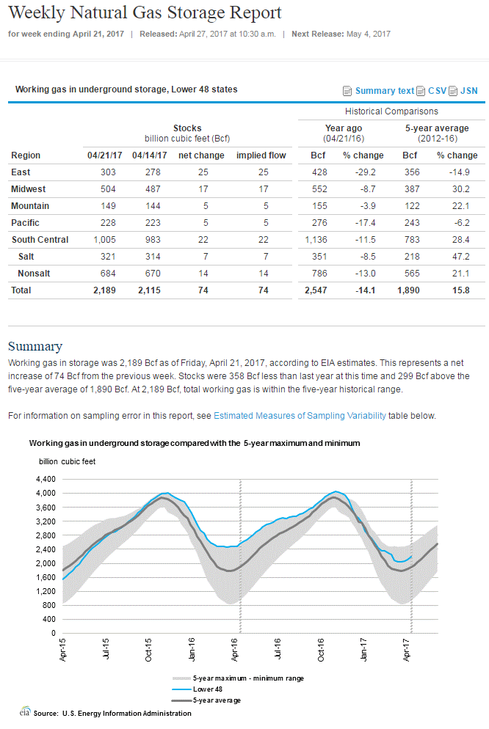
Administrative data used for survey enhancement
Federal Energy Regulatory Commission requires electronic bulletin boards (EBB) for all interstate pipelines
Information is compared to weekly survey data for data quality
Limitations include coverage, definitions, and data formats
For More Information: Weekly Natural Gas Storage Report

Slide 12
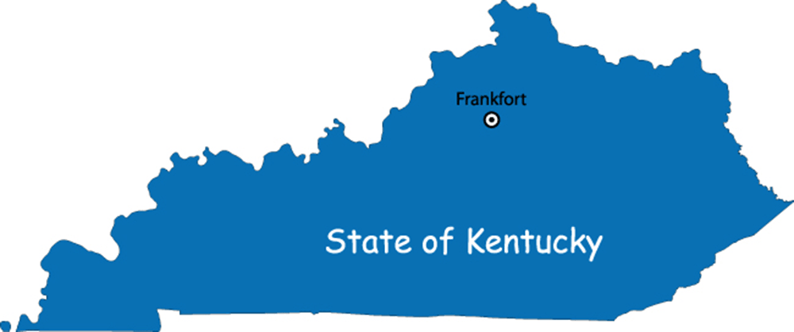
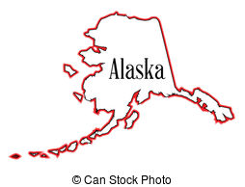
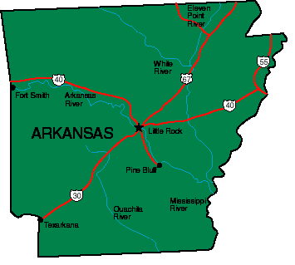
Administrative data used as a data source
Data from States fill gaps and improve data quality
Important to understand the limitations of administrative data
Work with State agencies to improve the quality of the State data: Win-Win
For More Information: Natural Gas Annual

Slide 13
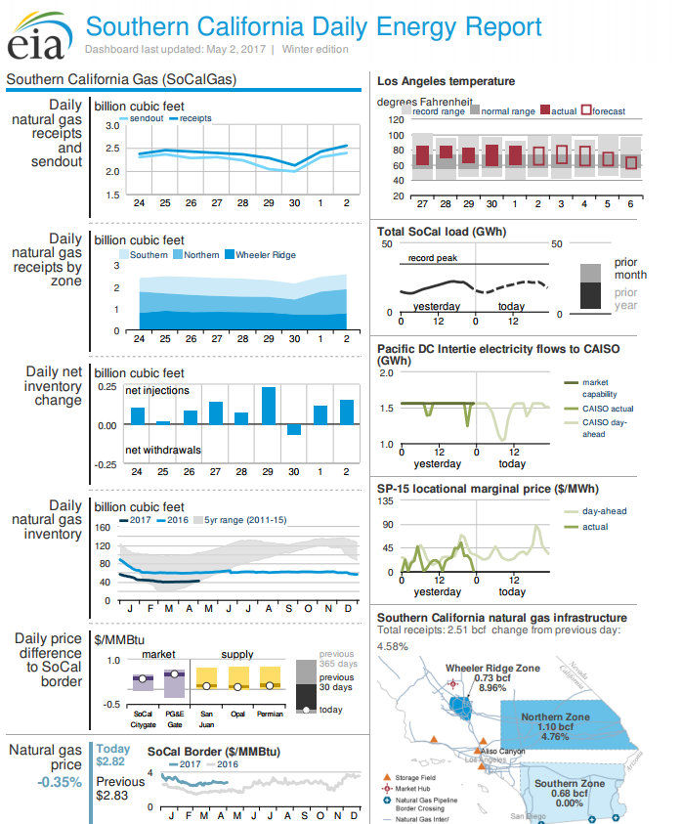
Administrative data used as a product
Updated daily based on public sources
Coverage: natural gas and electricity supply and prices; gas infrastructure and weather
Timing: provides historical data and estimates for today
Benefit: consolidates key market indicators in one-page format
Automated: report is updated automatically
For More Information:
Southern California Daily Energy Report

Slide 14
Administrative Data: Conclusion
Valuable uses in a statistical program
All data sources have limitations
Be curious and question data
Understand the data including definitions and coverage
Keep limitations in mind when using administrative data
Work with administrative data sources to improve the data

Slide 15
For more information
U.S. Energy Information Administration | www.eia.gov
Short-Term Energy Outlook | www.eia.gov/steo
Annual Energy Outlook | www.eia.gov/aeo
Monthly Energy Review | www.eia.gov/mer
EIA Information Center
InfoCtr@eia.gov
(202) 586-8800
24-hour automated information line about EIA and frequently asked questions.

