Slide 1
Oslo Group on Energy Statistics Use of Administrative Data Sources
Gerry Brady
CSO Environment Statistics and Accounts, Ireland
May 10th, 2017

Slide 2
Presentation Structure
Overview
Legal basis and procedures
Business Energy Use survey
Energy utilities meter data
Building Energy Ratings
CSO Household Survey
Future work
Conclusions

Slide 3
1. Overview
Sustainable Energy Authority of Ireland is main compiler of energy statistics for Ireland
In last five years, Environment Division of Central Statistics Office has slowly become involved
Mainly cross-cutting activities rather than direct involvement in data collection for Eurostat
Statistical releases based on administrative data
Data collection advantage is access to CSO Business Register and ability to conduct and process a survey
Weakness is lack of detailed subject-matter knowledge

Slide 4
2. Legal Basis and Procedures
Legal basis for access to administrative data is the Statistics Act, 1993 – options to request actual or sample microdata file
DG issues legal request to data owner
Role of Administrative Data Centre Division (ADC)
Data protection protocols (source tiers security)
http://www.cso.ie/en/aboutus/csodataprotocol/annex1/
Register of data matching projects
http://www.cso.ie/en/aboutus/csodataprotocol/csodataprotocolregister/

Slide 5
Statistics Act, 1993 Section 30
For the purpose of assisting the Office in the exercise of its functions under this Act, the Director General may by delivery of a notice request any public authority to -
(a) allow officers of statistics at all reasonable times to have access to, inspect and take copies of or extracts from any records in its charge, and
(b) provide the Office, if any such officer so requires, with copies or extracts from any such record,
and the public authority shall, subject to subsection (2) of this section, comply with any such request free of charge.
-> This approach is to get a microdata file

Slide 6
Statistics Act, 1993 Section 31
The Director General may request any public authority to consult and co-operate with him for the purpose of assessing the potential of the records of the authority as a source of statistical information and, where appropriate and practicable, developing its recording methods and systems for statistical purposes, and the public authority shall comply with any such request, in so far as resources permit.
-> two-step approach (assess sample before requesting full file)

Slide 7
Administrative Data Centre
Coordinates access and management of administrative microdata
Most microdata is received directly by ADC and then made available to user areas
Access for CSO staff to microdata with personal information is strictly controlled through Privacy Impact Assessment requests
ADC makes data available at source tier level (contains identifiers)
Access to anonymised data is more straight-forward
Anonymised research files can be made available
Data protection policies across government departments and agencies are increasingly pro-active often involving obtaining legal advice

Slide 8
3. Business Energy Use survey
https://eforms.cso.ie/Public/beu.htm
Annual CSO enterprise survey covering both Industry and Services
Collects quantity and purchase cost data
Survey started in 2009 in a business area with alternating coverage of Industry and Services (twice every 3 years)
Environment Division has expanded it to cover all sectors of NACE annually and increased the sample size
Supplemented with EPA/SEAI administrative data and CSO data from Industry and Services structural business surveys
Response rate of around 65%

Slide 9
Business Energy Use Questionnaire
Electricity purchased
Electricity self-generated
Natural gas
Petroleum products
Road transport
Coal
Renewable energy and energy from waste
Other energy (steam, heat pumps)
Heating systems and Air conditioning

Slide 10
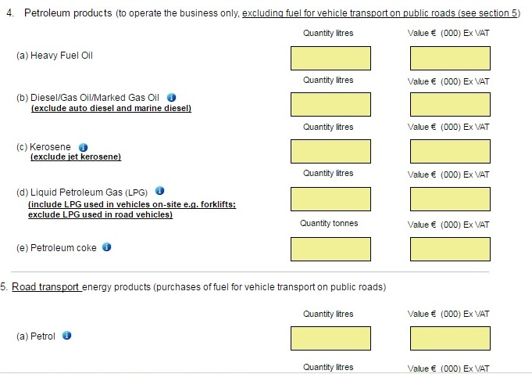

Slide 11
BEU Additional Data
EPA Emissions Trading Scheme (fuel quantity by product from licensed local units) – specialised returns that are not typical of all enterprises
SEAI Large Industry Energy Network (quantity and cost by energy product from enterprises in energy programme) – specialised returns
SEAI Public Sector Energy Efficiency Programme (quantity by energy product) – specialised returns
CSO Census of Industrial Production (total fuel costs no quantity) – multi-purpose survey from 10+ employees
CSO Annual Services Inquiry (total fuel costs no quantity) – multi-purpose – enterprises with 2+ employees surveyed
-> CIP and ASI before 2009 occasionally collected a fuel breakdown

Slide 12
BEU Additional Data continued
Additional administrative data has to be matched with CSO Business Register to get NACE codes (no unique identifier to facilitate data matching process but agency identifier so less work for additional years)
Objective is to achieve a larger effective sample at NACE Division level
Weighted at NACE Division (ETS and LIEN returns set = 1) to get reliable final energy consumption by sector
Very important not to give general weights to non-typical returns
Imputations needed for energy product distribution and quantity or cost have to be estimated using average prices for Industry and Services sectors

Slide 13
Integrated Data File
 | Number of Returns (excl. sole trader administrative data from ASI)
Year | BEU | ETS | LIEN | PSEP | CIP | ASI | TOTAL
2009 | 2,456 | 27 | 48 | 81 | 4,315 | 7,953 | 14,880
2010 | 1,890 | 23 | 54 | 90 | 3,506 | 7,687 | 13,250
2011 | 3,276 | 46 | 98 | 81 | 4,877 | 6,591 | 14,969
2012 | 3,175 | 22 | 41 | 352 | 3,922 | 6,740 | 14,252
2013 | 3,194 | 26 | 44 | 1,281 | 4,052 | 6,591 | 15,188

Slide 14
Advantages of Additional Data
Availability of high-quality administrative data
Create validation bridge between old and new methodologies
Increased effective sample size
Provide reliable Industry/Services split
ETS/Non-ETS estimates
Energy sector / Non-Energy sector split
Cross-validation between data sources in cases where enterprise is in more than one data source – at some stage we will try to exclude enterprises from sample that we will have quantity and cost administrative data for
Indicators comparing fuel costs with employment & economic measures

Slide 15
Disadvantages of Additional Data
Makes methodology more complex
Delays calculation of results as all data sources need to be available and validated
CIP and ASI only collect monetary data
CSO structural surveys now only collect cost of total fuel purchases so other data and historical data must be of sufficient quality to distribute that by energy product and convert fuel cost data to quantities
Danger of double-counting if enterprise is kept from two data sources (different units in Business Register)

Slide 16
4. Energy Utilities Meter Data
We obtained mains gas meter consumption data for domestic and non-domestic customers
Data are quarterly from 2011 and are geocoded
Domestic data will give us an estimate of seasonal space heating for Energy Consumption of Households e.g. Quarter 1 median against Q3 median
Non-domestic data has to be matched to CSO Business Register to integrate with survey data
Only covers mains gas consumers (on pipeline)

Slide 17
Energy Utilities Meter Data continued
Request in for access to electricity meter data
No equivalent national utility for oil
Working towards bottom-up estimates of energy consumed by households
Utility data can indirectly provide indicators of new buildings and of vacant dwellings and holiday homes
Utility company may have link to GIS co-ordinates
Domestic and non-domestic sectors

Slide 18
Energy Utilities Meter Data continued
Spatial, seasonal and time-series dimensions
May only cover physical data not monetary
Utilities data may not be nationally representative e.g. of rural areas
Meter readings may be estimated and subsequently revised (meter reading series could result in negative consumption if earlier reading too high)
Census of Population could be used to weight the data e.g. under assumption that households with oil central heating are using same amounts of heat as gas central heating households with similar characteristics (number of occupants, dwelling type, etc.)

Slide 19
5. Building Energy Ratings
Covers domestic and non-domestic sectors
http://www.seai.ie/Your_Building/BER/National_BER_Research_Tool/
Very detailed energy audits and household construction data
EU Energy Performance of Buildings Directive
Few other datasets on non-domestic buildings
Dwellings with better ratings can achieve a sale or rental premium
CSO publishes the data quarterly
http://www.cso.ie/en/releasesandpublications/er/dber/domesticbuildingenergyratingsquarter12017/

Slide 20
EPBD Legislation
Energy Performance of Buildings Directive (EPBD), 2002/2010
Required all EU Member States to introduce energy certification schemes for buildings
Obliges “that when buildings are constructed, sold or rented out an energy performance certificate is made available to the owner or by the owner to the prospective buyer or tenant”
Transposed into Irish law from 2006 onwards
Could be basis for EU-wide statistics?

Slide 21
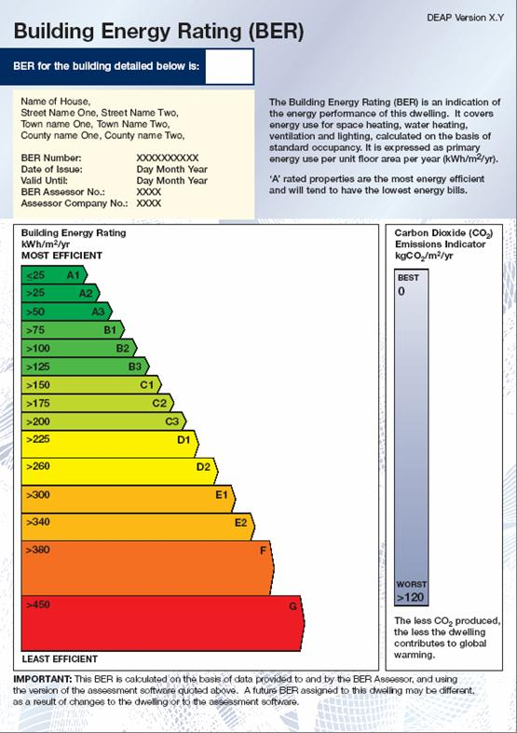
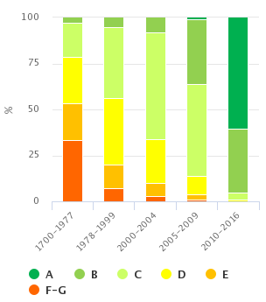

Slide 22
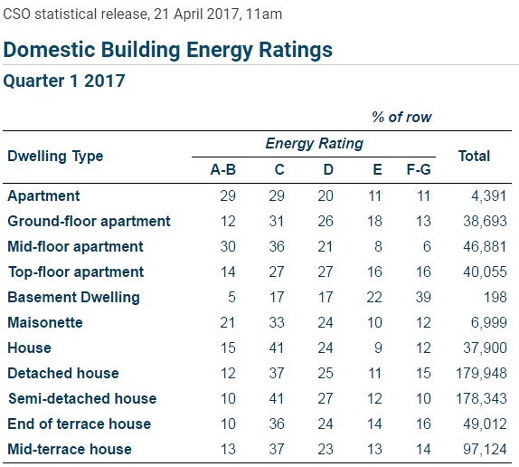

Slide 23
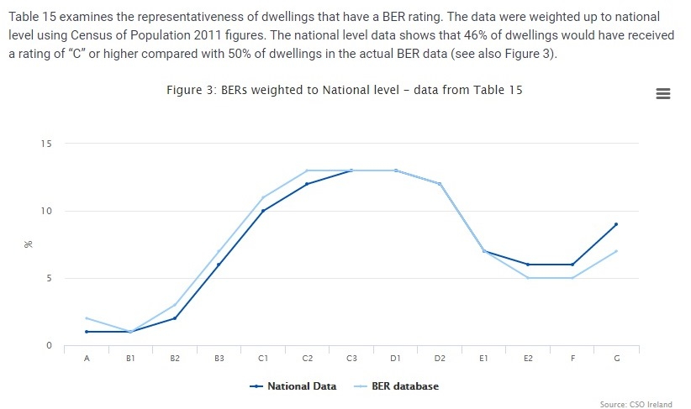

Slide 24
6. CSO Household Survey
Conducted as an environment module added on to quarterly household survey
Module questions developed by project group that included Environment and Energy agencies
Focused on energy use and waste management
Sample of 13,000 households
Data can be cross-classified by main survey variables
Sample weighted to national level and results classified by household characteristics
http://www.cso.ie/en/releasesandpublications/er/q-env/qnhsenvironmentmoduleq22014/

Slide 25
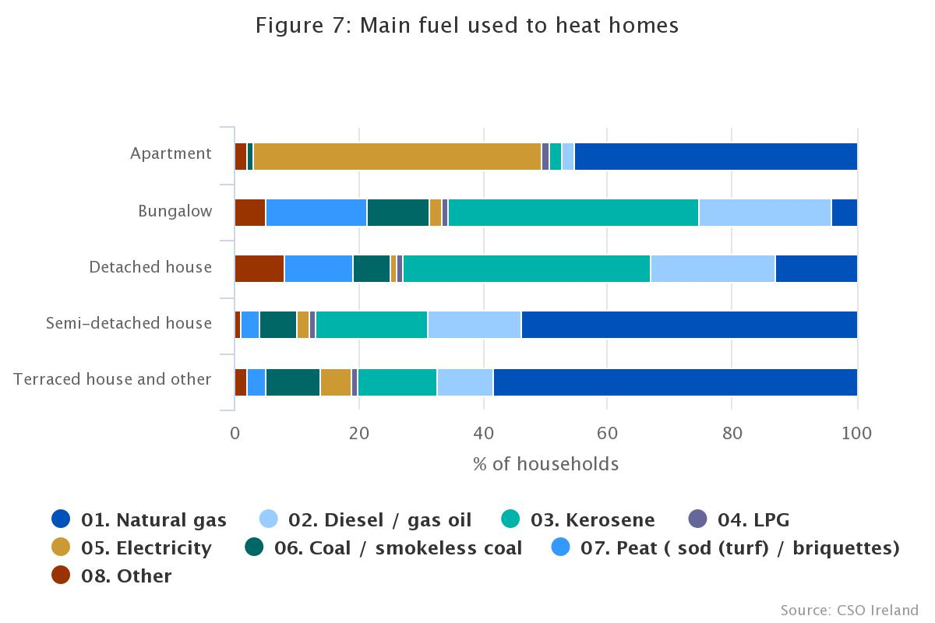

Slide 26
7. Future Work (sometime)
Road transport use is an important statistical data gap
Combine CSO business register with vehicle register and vehicle test data
-> NACE data by kilometres travelled and vehicle characteristics (fuel type, vehicle type and age, emissions test results)
Households consumption of home heating oils (suppliers are private companies rather than public utility)
On social side: connect household socio-economic data with energy efficiency data

Slide 27
8. Conclusions
An administrative data source can be much more complete than a survey e.g. 750,000 gas meters
Once data flow is established may not require large staff input to obtain more data
Data may not be nationally representative
Data linking may involve a jigsaw of combining inconsistent data variables and coverage
Data may need to be manually matched to business register
Other areas of office may find the administrative data useful e.g. number of vacant households, house price indices

Slide 28
Conclusions continued
As more administrative microdata are obtained, the procedures to manage and protect the microdata should become more formal
Data protection concerns and obligations of data owners have increased
Data Protection Commissioners more proactive
CSO established a dedicated Division to ensure a consistent office-wide approach to obtaining and using microdata
Ideally data provider wants something back!

