Slide 1
The London group on environmental economic accounting
Nancy Steinbach,
Chair of the London group

Slide 2
City group for the System of Environmental and Economic Accounts (SEEA)
Created in 1993 to collaborate on development
An informal group of experts primarily from national statistical agencies but also international organizations. Participation by representatives is voluntary
To work on the further improvement of methodology, implementation and application of environmental economic accounts

Slide 3
What is the system of environmental and economic accounts about?
Showing the resource use and environmental pressure by industry according to NACE/ISIC.
Coupling this environmentally related information with the Economic National Accounts to be able to say how the national economy (production and consumption) and the environment interact.
Allowing for integrated analysis in economic models and for making connections to the rich economic and social statistics.

Slide 4
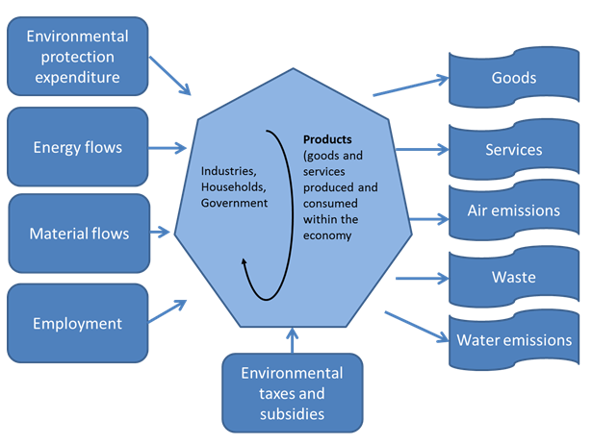
Some important environmental and economic components described by the System of Environmental-Economic Accounts
Trade
Notes:
In the statistical area the need for broader information systems has partly been addressed through the development of The System of Environmental-Economic Accounting, SEEA.
It is a statistical framework that latches on the System of National Accounts as a so called satellite account and it is a global statistical standard since 2012 (UN 2014).

Slide 5
The organisation of it
UN Statistical Commission (UNSC)
UN Committee of Experts on Environmental Accounts (UNCEEA)
Technical Committee on SEEA CF
Technical Committee on SEEA EEA
The London group
The London group bureau

Slide 6
Current plan
A three year workplan was developed setting out the process
Work actively with the two research agendas: one for SEEA CF and one for SEEA experimental ecosystem accounting
Sharing expertise and experience in policy use and implementation of methodology
23rd meeting to be held in Costa Rica autumn 2017

Slide 7
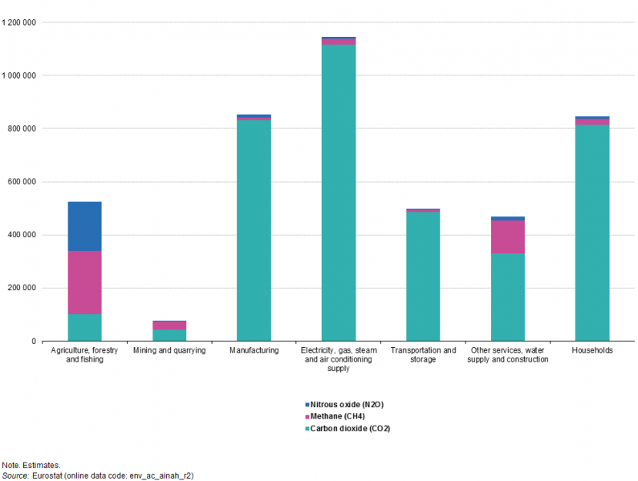
Important area 1 related to energy statistics: Air emissions
Greenhouse gas emissions by NACE and pollutant, EU-28, 2014 (thousand tonnes of CO₂ equivalents

Slide 8
Important area related to energy statistics: Energy accounts
Energy supply by industries (NACE) and households, combined country summary 2013
Data source: Eurostat, extraction date August 2016

Slide 9
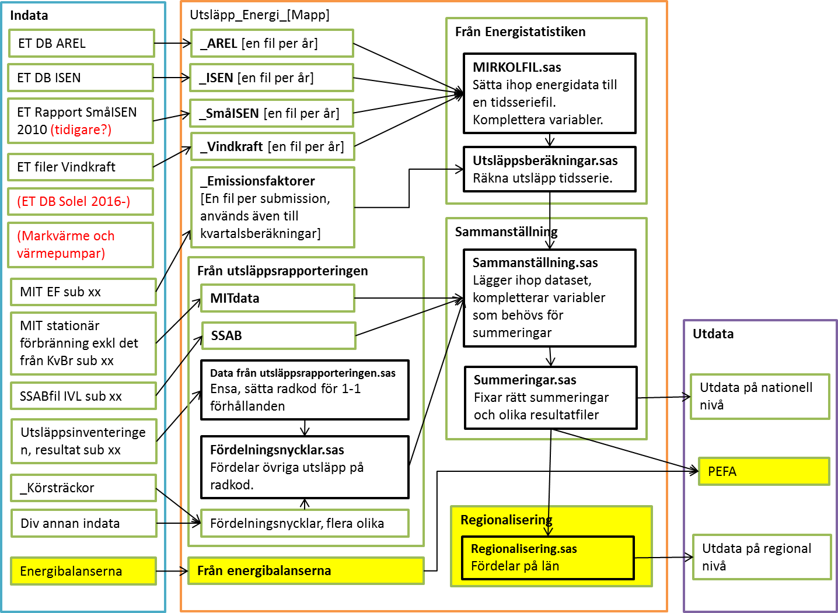
An example of compiling annual air emission accounts - Sweden

Slide 10
Challenges to go quarterly
Challenges:
To capture all emissions
Finding relevant information for the most reecent quarter
Solution:
Use monthly and quarterly statistics as far as possible
Fill gaps with modelling and forecasting of annnual data

Slide 11
Quarterly air emissions
Stationary combustion
Mobile combustion
Other emissions
missing
short period data sources!
Mining, quarrying, manufacturing, electricity, gas and heat production :
Quarterly fuel statistics
Calibrated for complicated industries
Other industries:
Annual energy balances
Monthly fuel, gas and warehouse statistics
Emissions factors the same as annual calculations
Montligh fuel, gas and warehouse statistics
Industry allocation and emission factors as the annual calculations
2008-2013: Annual data/4
2014-2015 as trends in annual data:
CH4 from waste disposal:
Decrease rate 8% per year
Industry processes and product use:
Modell according to industry prodcution index per industry and quarter
Diffuse emissions, agriculture, other emissions from waste management :
Same values as for 2013

Slide 12
Concerning energy accounts
A legal obligation in Europe to report physical flow energy accounts – supply and use
Following national accounts definitions – but with some adjustments
Important to establish cooperation between the environmental accountants and energy statistics!
Energy balance approach vs. UNFCCC thinking

Slide 13
Conclusions
The London group is active and an open community for cooperation!
Energy statistics and energy balances important data source for the air emission accounts and the physical energy accounts!
Encourage cooperation for improved statistics and enhanced knowledge about the areas in question!

