Slide 1
Quality reporting on energy statistics
Framework and experience at EU level
United Nations Oslo Group on Energy Statistics
Aguascalientes (Mexico), 10-13 May 2016
Fernando Diaz Alonso
European Commission, Eurostat - Energy Unit

Slide 2
Legal basis
Quality criteria
Objectives of quality reporting
Previous quality reporting cycle on energy statistics at EU level
Good examples, lessons learned and recommendations for the future
Presentation of the new template

Slide 3
Legal basis
Regulation (EC) No 1099/2008 on energy statistics, article 6 paragraphs 4 and 5.
Every five years, EU Member States provide Eurostat with a report on the quality of data and any methodological changes.

Slide 4
European Statistical System (ESS) Framework for Quality
European Statistical Code of Practice (CoP) http://epp.eurostat.ec.europa.eu/portal/page/portal/quality/code_of_practice/
ESS Standard for Quality Reports (ESQR) http://epp.eurostat.ec.europa.eu/portal/page/portal/ver-1/quality/documents/ESQR_FINAL.pdf
ESS Handbook for Quality Reports (EHQR) http://epp.eurostat.ec.europa.eu/portal/page/portal/ver-1/quality/documents/EHQR_FINAL.pdf
EU energy statistics section on Methodology and Quality reports http://ec.europa.eu/eurostat/web/energy/methodology
Eurostat webpage for Quality Reporting http://epp.eurostat.ec.europa.eu/portal/page/portal/quality/quality_reporting

Slide 5
IRES (International Recommendations for Energy Statistics)
http://unstats.un.org/unsd/energy/ires/default.htm
Chapter 9 (Data Quality Assurance and Metadata), points 3 (Quality reports) and 4 (Quality Reviews)

Slide 6
Quality criteria
Quality dimensions:
relevance
accuracy
timeliness
punctuality
accessibility and clarity
comparability
coherence
Relevance
Coherence
Timeliness
Accuracy

Slide 7
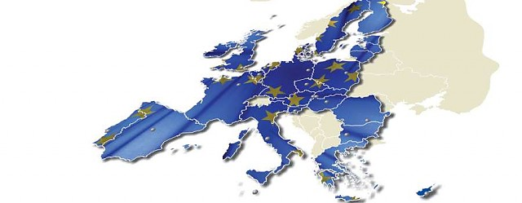
Objectives of EU quality reporting
Inform on quality criteria of a certain statistical process
Identification of problems and potential improvements in statistical processes and output quality
Comparison across processes / outputs and countries
Notes:
Obtain information from data quality in order to provide more information on the data (on the quality criteria we just saw) in order to know how reliable they are.

Slide 8
Previous quality reporting cycle
Objectives :
Get a first insight on national statistical process to compare between MS methodologies and find improvement areas
Share best practices
Time framework:
Standard template presented in 2010
Deadline to provide quality reports: end 2011
Follow-up with countries: 2012 and 2013
Approach:
One questionnaire in Word for each country's internal data collection process.

Slide 9
Previous quality reporting cycle
Extract of the questionnaire :

Slide 10
Good examples, lessons learned and recommendations for the future
Good examples
Some countries (e.g. Austria, France, Germany, Ireland, Slovakia, Slovenia, Spain and UK) provided complete and informative quality reports
Lessons learned
Harmonisation / comparability needs to be improved
Clarity and more precise information for some answers
Missing information on some surveyed variables (sample size, data collection process for renewables, etc.), which should be easily available
Sometimes difficult to understand underlying processes

Slide 11
Good examples, lessons learned and recommendations for the future
Recommendations for the future
Implement the findings from this first exercise
Take into account what we have learnt to create the next template, using best practices from countries and from other statistical areas
Propose more closed-ended questions (Multiple choice or Yes/No) to improve comparability among countries

Slide 12
Adopted approach for the QR template
More appropriate IT tool to reduce burden on respondents
Better compliance with QR standards
More structured and comparable information by using more closed-ended questions
Link between national and EU data collections
Flexibility to adapt to different national systems

Slide 13
Structure of the questionnaire
START page
COVER page
Background, legal basis and instructions
National data collections
Link with EU data collections:
EU ANNUAL
EU M-2/M-3
EU M-1
Glossary of statistical terms
Remarks
Closed-ended questions
Mapping between national and Eurostat data collections

Slide 14
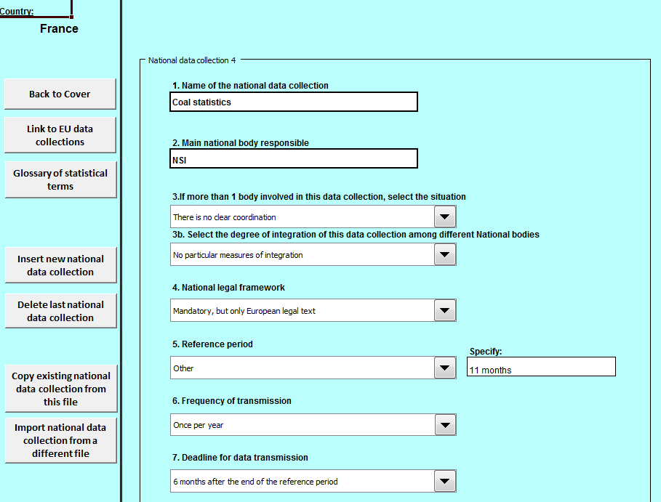
National data collections

Slide 15
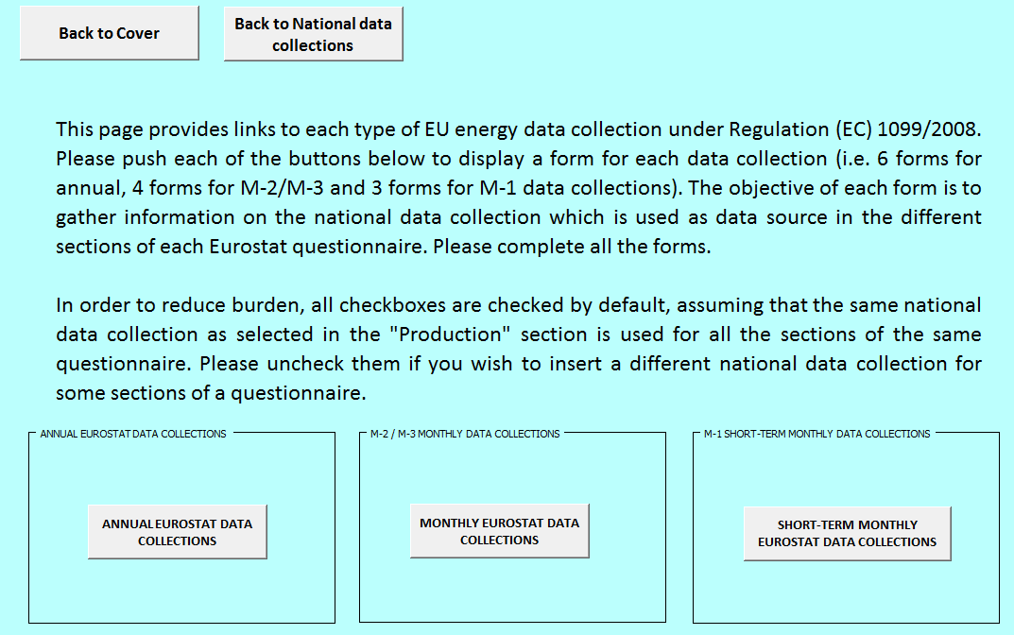
Link with EU data collections

Slide 16
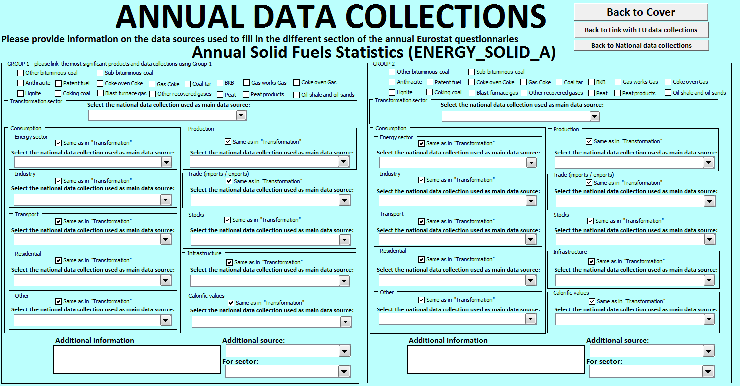
EU ANNUAL

Slide 17
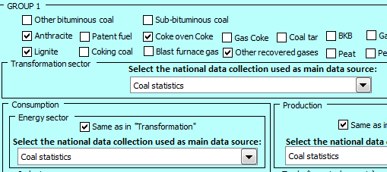
EU ANNUAL
3 groups of products per EU data collection
Individual products to be selected by user
Sectors

Slide 18
Quality reporting instructions

Slide 19
Quality reporting at EU level has a strong legal basis and needs to follow well-defined standards
The first EU QR exercise in energy statistics obtained preliminary information on statistical process at MS level
The main lessons learnt were the need to obtain more detailed information in a more harmonised way
The current exercise goes deeper and tries to obtain more precise and comparable information

Slide 20
fernando.diaz-alonso@ec.europa.eu

