Slide 1
The use of Administrative Sources in Energy Data Collection in Ghana
  10th MEETING OF OSLO GROUP OF ENERGY STATISTICS
  at
  Aguascalientes, Mexico
  10th – 13TH MAY, 2016
  by
  Salifu Addo
  Energy Commission, Ghana

Slide 2
Presentation Outline
Introduction
Legal Framework
Data Collection Framework
Overview of Ghana Energy Statistics
Administrative Data Sources
Benefits of Administrative Data
Challenges
Conclusion

Slide 3
Introduction
Reliable and detailed data are critical for informed policy decision making and effective regulation.
Statistics plays a very important role in the development, implementation, monitoring and evaluation of policies at both national and international level.

Slide 4
Legal Framework
Legal framework for energy data collection was enshrined in the Energy Commission Act (Act 541) which was passed by the Parliament of Ghana in 1997
Act mandates the Commission to collect energy data to;
    Perform its regulatory and policy advisory functions
    Serve as a repository of energy data for research by establishing an energy database

Slide 5
Data Collection Framework
ELECTRICITY
Generation – VRA, IPPs;
Transmission, Import/Export – GRIDCo
Distribution – ECG, NEDCo, ENCLAVE
Consumption/Sales – ECG, NEDCo, ENCLAVE
WOODFUELS
PETROLEUM
Charcoal Export - GCNet
Crude oil Reserve/Prod – GNPC, PC
Refined Products – TOR
Import/Export – TOR, NPA
Consumption – NPA,
ENERGY COMMISSION
OTHERS
Demographic &
Macroeconomic data - GSS
ENERGY
PRICES
SURVEYS
Electricity – PURC
Petroleum - NPA
Sectoral Energy Consumption by fuel type etc

Slide 6
Overview of Energy Statistics

Slide 7
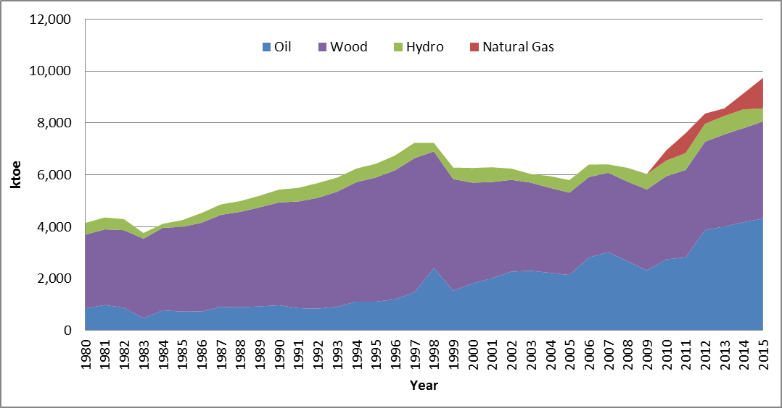
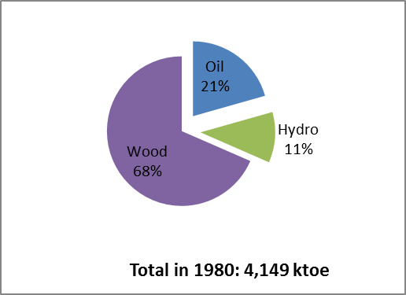
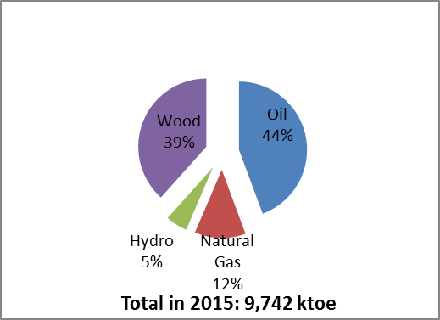
Total Primary Energy Supply

Slide 8
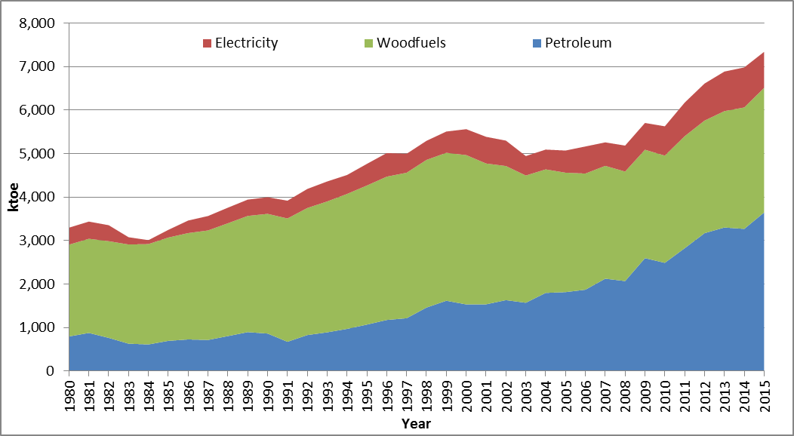
Final Energy Consumption by Fuels
Increased from 3,299 ktoe in 1980 to 7,237 ktoe in 2015

Slide 9
Installed Electricity Generation Capacity

Slide 10
Electricity Generation

Slide 11
Energy Balance 2014, ktoe
SUPPLY AND CONSUMPTION | Crude Oil | Natural Gas | Petroleum Products | Wood | Charcoal | Hydro | Solar | Electricity | Total
Indigenous Production | 5,435.0 | 52.6 | - | 3,628.7 | - | 721.3 | 0.3 | - | 9,837.8
Imports | 707.1 | 568.0 | 3,512.1 | - | - | - | - | 4.4 | 4,791.6
Exports | -5,446.5 | - | - | 0.0 | -0.4 | - | - | -44.9 | -5,491.7
International Marine Bunkers | - | - | -11.0 | - | - | - | - | - | -11.0
International Aviation Bunkers | - | - | -105.6 | - | - | - | - | - | -105.6
Stock Changes | 149.9 | - | -64.7 | - | - | - | - | - | 85.2
Total Energy Supply | 845.4 | 620.6 | 3,330.8 | 3,628.7 | -0.4 | 721.3 | 0.3 | -40.5 | 9,106.3
Electricity Plants | -599.7 | -595.6 | -1.5 | - | - | -721.3 | -0.3 | 1,114.8 | -803.6
Oil Refinery | -177.3 | - | 131.2 | - | - | - | - | - | -46.1
Other Transformation | - | - | - | -2,049.0 | 1,212.4 | - | - | - | -836.6
Own use | -12.1 | - | - | - | - | - | - | -5.0 | -17.1
Losses | -51.2 | - | - | - | - | - | - | -150.4 | -201.6
Final Energy Consumption | - | - | 3,271.9 | 1,579.7 | 1,212.0 | - | - | 919.8 | 6,983.4
Residential Sector | - | - | 185.0 | 1,304.8 | 1,101.7 | - | - | 396.0 | 2,987.6
Commerce & Services Sector | - | - | 15.0 | 31.6 | 106.7 | - | - | 208.3 | 361.6
Industry | - | - | 357.6 | 243.3 | 3.6 | - | - | 314.9 | 919.4
Agriculture & Fisheries Sector | - | - | 104.5 | - | - | - | - | 0.2 | 104.7
Transport | - | - | 2,609.8 | - | - | - | - | 0.5 | 2,610.3
Statistical Difference | 5.1 | 25.0 | -82.9 | - | - | - | - | -0.9 | -53.7

Slide 12
Energy Balance 2015, ktoe
SUPPLY AND CONSUMPTION | Crude Oil | Natural Gas | Petroleum Products | Wood | Charcoal | Hydro | Solar | Electricity | Total
Indigenous Production | 5,669.7 | 662.4 | - | 3,738.7 | - | 502.7 | 0.3 | - | 10,573.8
Imports | 316.7 | 519.8 | 3,897.9 | - | - | - | - | 19.2 | 4,753.6
Exports | -5,312.7 | - | - | 0.0 | -0.7 | - | - | -50.5 | -5,363.9
International Marine Bunkers | - | - | -10.8 | - | - | - | - | - | -10.8
International Aviation Bunkers | - | - | -108.1 | - | - | - | - | - | -108.1
Stock Changes | -71.4 | - | - | - | - | - | - | - | -71.4
Total Energy Supply | 602.3 | 1,182.2 | 3,779.0 | 3,738.7 | -0.7 | 502.7 | 0.3 | -31.3 | 9,773.2
Electricity Plants | -235.5 | -1,059.9 | -1.0 | - | - | -502.7 | -0.3 | 988.3 | -811.1
Oil Refinery | -105.9 | - | 94.5 | - | - | - | - | - | -11.4
Other Transformation | - | - | - | -2,143.2 | 1,269.7 | - | - | - | -873.6
Own use | 0.0 | - | - | - | - | - | - | -2.7 | -2.7
Losses | -48.8 | - | - | - | - | - | - | -120.0 | -168.7
Final Energy Consumption | - | - | 3,543.8 | 1,595.2 | 1,269.0 | - | - | 829.0 | 7,237.0
Residential Sector | - | - | 200.4 | 1,317.6 | 1,153.5 | - | - | 402.9 | 3,074.4
Commerce & Services Sector | - | - | 16.2 | 31.9 | 111.7 | - | - | 175.4 | 335.2
Industry | - | - | 387.3 | 245.7 | 3.8 | - | - | 250.1 | 886.9
Agriculture & Fisheries Sector | - | - | 113.2 | - | - | - | - | 0.2 | 113.3
Transport | - | - | 2,826.7 | - | - | - | - | 0.3 | 2,827.0
Statistical Difference | 212.1 | 122.3 | 140.8 | - | - | - | - | 5.4 | 480.5

Slide 13
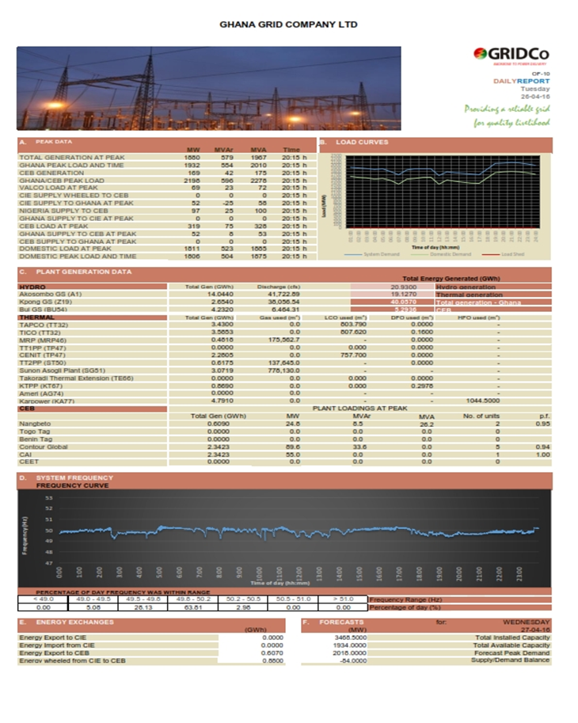
Administrative Data Source
Electricity Data
Electricity Generation Data
  Daily report from Supervisory Control and Data Acquisition (SCADA);
    Generation
    Import & Export
    Peak load etc
  Quarterly performance report from electricity generators;
  Annual data;

Slide 14
Administrative Data Source cont’d
Electricity Distribution and Sales
  Quarterly performance statistics from DISCOs to meet regulatory requirement;
  Annual data from DISCOs;
  Data include;
    Electricity purchased from GENCOs;
    Electricity sale to customers (in quantity (GWh) and revenue generated (GHS));
    Distribution losses (Technical & Commercial losses);
    Street & Public lighting consumption;

Slide 15
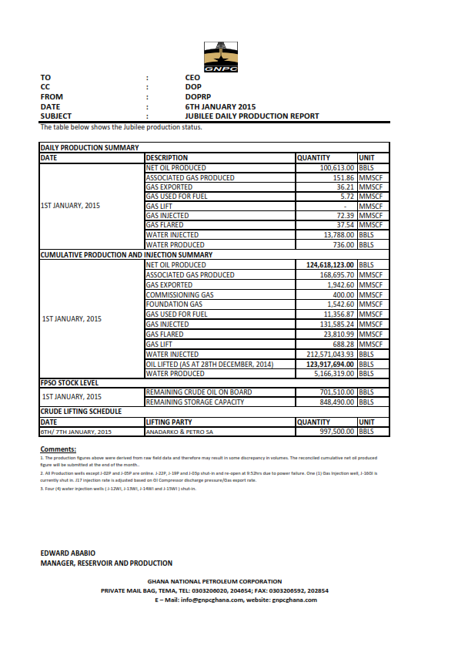
Administrative Data Source cont’d
Petroleum
Crude Oil and Natural Gas production
  Daily production report : from GNPC
      Crude Oil production
      Natural gas production; flared, re-injected
      Export
  Monthly & annual data for reconciliation;

Slide 16
Administrative Data Source cont’d
Refinery Production
TEMA OIL REFINERY
MONITORING & CONTROL DEPT.
METRIC TONNES | JAN. | FEB. | MAR.
CRUDE OIL IMPORTS | 6,169 | 0 | 0
CRUDE OIL EXPORTS(VRA REPLACEMENT) | 0 | 0 | 6
CRUDE OIL INTAKE | 23,827 | 41,567 | 18,016
IMPORTED FEED TO RFCC | 0 | 0 | 6,598
GRANDTOTAL FEED | 23,151 | 41,390 | 24,614
THROUGHPUT | 88,383 | 117,821 | 78,344
GASOLINES(PUSH INTO CRUDE OIL) | 0 | 0 | 0
KEROSENE(PUSH INTO CRUDE OIL) | 0 | 0 | 0
GASOIL(PUSH INTO CRUDE OIL) | 0 | 0 | 0
FUEL OILS/SLOP (PUSH INTO CRUDE OIL) | 0 | 0 | 0
SHUTDOWN CONS. & LOSSES (1) | 9,201 | 13,627 | 5,643
ON-STREAM CONS. & LOSSES (2) | 534 | 16,003 | 7,365
TOTAL CONS & LOSS | 9,735 | 29,630 | 13,007
TOTAL CONS. | 1,169 | 2,740 | 2,680
TOTAL LOSS | 8,565 | 11,398 | 9,207
% C&L (2) ON GRANDTOTAL FEED | 2.31 | 38.66 | 29.92
% TOTAL C&L ON THROUGHPUT | 11.01 | 25.15 | 16.60
% TOTAL CONS. ON THROUGHPUT | 1.32 | 2.33 | 3.42
% TOTAL LOSS ON THROUGHPUT | 9.69 | 9.67 | 11.75
SERVICE FACTOR ( % ) | 25.63 | 46.62 | 15.87
CAPACITY UTILIIZATION ( % ) | 51.83 | 52.43 | 59.97
OPERATING RATE | 13.29 | 24.44 | 9.52
P R O D U C T I O N | 0 | 0
L. P. G. | 306 | 334 | 2,500
GASOLINES | 8,300 | 8,468 | 15,944
KEROSENE | 672 | 335 | 452
A. T. K. | 2,257 | 4,177 | 2,396
GASOIL | 5,075 | 9,126 | 5,622
RESIDUAL FUEL OIL | 0 | 0 | 8,031
T O T A L :- | 16,609 | 22,441 | 34,945
Quarterly production data received from refinery
Data include
  Crude oil imported for refinery
  Total crude intake
  Consumption & losses
  Petroleum product produced
Annual data collected for quality checks and reconciliation

Slide 17
Administrative Data Source cont’d
Crude oil and Petroleum Product Import
    Quarterly data collected from NPA – petroleum downstream regulator

Slide 18
Administrative Data Source cont’d
Petroleum Product Consumption data
    Monthly & Quarterly data from NPA
    Annual data collected for reconciliation and validation

Slide 19
Administrative Data Sources - Benefits
Minimizes cost
    Reducing cost of undertaking surveys
Reduces data collection errors
    Data collected covers all entities engaged in that activity
Source of information for planning surveys
        Useful source of information to be used as sampling frames for undertaking surveys
More efficient
    Uses data already in existence thus avoiding duplication of work

Slide 20
Challenges
Legal barriers and obligations
  Public institutions/regulators hence not obliged to provide data
Timeliness
  Data not provided on a timely basis to meet publication deadlines
Increased workload
  More work added to the officer in charge
Data quality
  data collected to serve a particular purpose not necessarily for energy statistics
  Regulatory requirement; manipulation of data

Slide 21
Conclusion
Administrative data
    will continue to be an important source of information for energy statisticians;
    Reduces respondents burden, cost and increased output
Continuous dialogue and cooperation with institutions/officers, and always ensuring a win - win situation

Slide 22
Thank You

