Slide 1
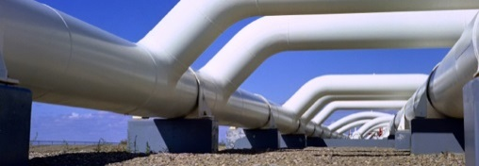
North American Cooperation on Energy Information (NACEI)
Oslo Group on Energy Data
May 12, 2016 | Mexico
Canada: Mike Scrim (StatCan) and James Zeni (Nrcan)
Mexico: Rafael Alexandri Rionda (SENER)
United States: Shirley Neff (EIA)

Slide 2
Goals of trilateral cooperation on energy information
Energy trade statistics
Consistent energy trade data across and within jurisdictions; harmonized methods and definitions; aligned international reporting practices
Geographic energy information
Fully integrated maps of North American energy infrastructure
Outlooks for energy supply and demand
Process for exchanging views and projections of cross-border energy flows
Cross reference for energy terminology
Catalogue of concepts, terms and definitions consistent across North America and translated into each country’s official language(s)

Slide 3
Milestones in cooperation
Dec-2014
MOU Signed
Apr-2015
Meetings in Mexico City
Jun-2015
180-day progress report
Oct-2015
Meetings in Washington D.C.
Feb-2016
nacei.org website launched & MOU expanded to include climate change
Jun-2016
Additional mapping layers launched
1
2
3
4
5
6

Slide 4
New Trilateral website: www.nacei.org
Hosted by U.S. EIA and launched on February 12, 2016 at North American Energy Ministerial in Winnipeg
Currently provides access to each of the three Trilateral country’s websites
Over coming months, migrate all information products onto NACEI portal in three official languages (English, French and Spanish) for easier access and maintenance
Make use of open data development for efficient updating of data series

Slide 5
A) Energy Trade Data Statistics

Slide 6
Energy Trade Data Statistics: Summary
Tables and graphs presenting respective country energy trade data for easy comparison have been compiled and a tool for systematic and efficient refreshing of data tables is in development
Graphical examples demonstrating variations in data series have been posted
Guide detailing the specific methodologies for each country’s energy trade data series has been developed
Glossary cross referencing terminology used by the Trilateral countries and the International Energy Agency (IEA) and the United Nations (IRES) has been developed for ease of analysis and to help identify opportunities for harmonization
Commodity sub-working groups (liquids, natural gas, electricity) have been established and dialogue has been initiated for targeted adjustment and improvements.

Slide 7
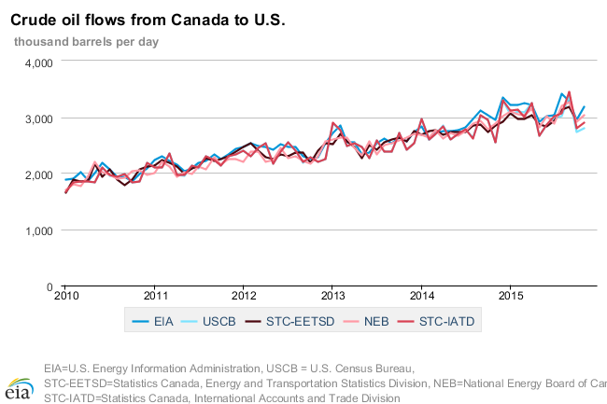
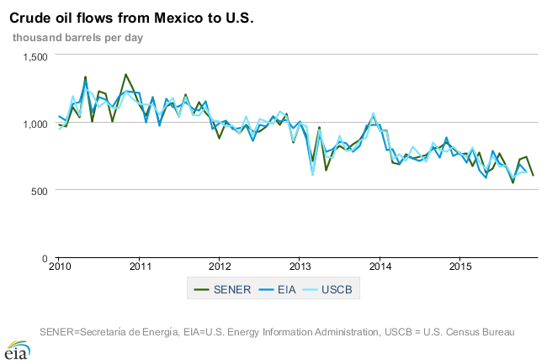
Energy Trade Data Statistics: Crude oil and condensate
Variations exist between U.S., Mexican, and Canadian data sets and the graphs demonstrate visually the need for harmonization across the three countries.
Conduct systematic comparison of crude oil and equivalents definitions by statistical data source and associated data series, supported by cross reference glossary, to facilitate understanding and ensure coherence in reporting and dissemination.

Slide 8
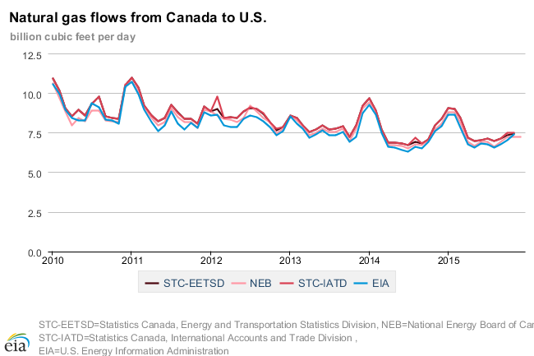
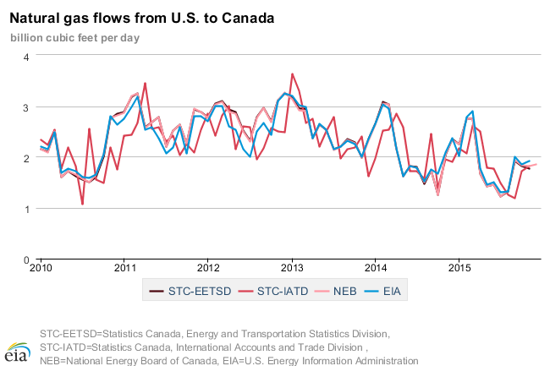
Energy Trade Data Statistics: Natural Gas
Close alignment for Canada to U.S. flow, between the U.S. Energy Information Administration (EIA) and the Canada National Energy Board (NEB), some adjustment applied by Statistics Canada to NEB data.
More discrepancy between EIA and NEB for U.S. to Canada flows, however closer match between Statistics Canada and NEB.
Micro-level data analysis, by border crossing, to be organized by EIA to verify U.S.-Canada, and U.S.-Mexico flows.
Note: Prior to the energy reform in Mexico, PEMEX was the sole data source. There are now multiple entities involved in gas trade. SENER recognizes the need to develop a survey.

Slide 9
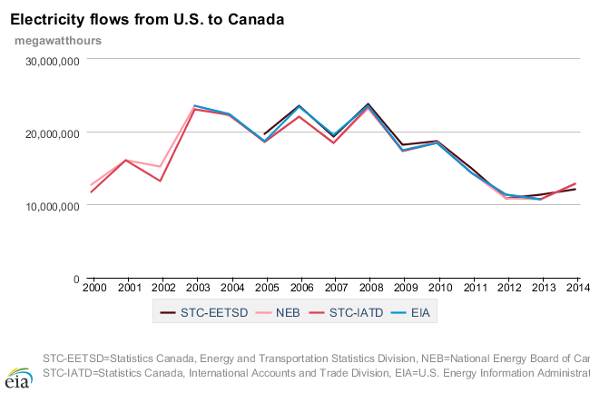
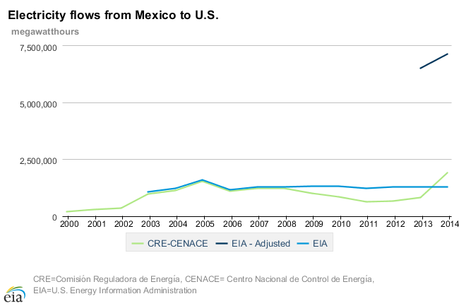
Energy Trade Data Statistics: Electricity
Electricity flow data from Canada to the United States is fairly consistent because it is primarily based on NEB data. EIA is collecting and testing its own electricity import/export information collection.
Electricity flow data from Mexico to the United States is fairly consistent because it is primarily based on actual interchange data. Mexican import data is augmented with other import data not captured by actual interchange.
EIA’s new collection uses several measures and will likely be the closest of all sources to a census for all flows. Data set will be used for micro-level analysis and verification between U.S.-Canada, and U.S.-Mexico.
Notes:
“EIA’s new collection uses several measures ” several ways include: purchase and sales transactions (method used by NEB), actual interchange between balancing authorities, implemented and scheduled interchange between balancing authorities, metered flow at border crossings.

Slide 10
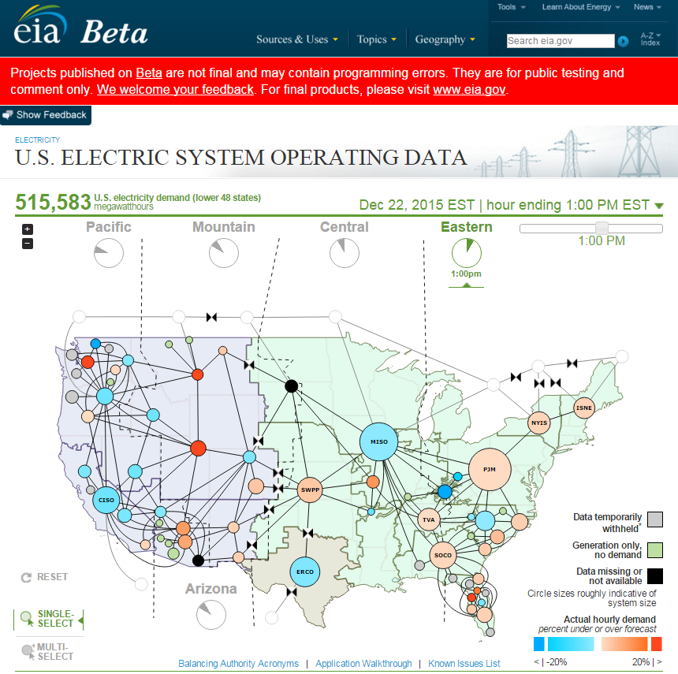
Hourly Electric System Operating Data
EIA has been collecting and will soon be posting publicly near real-time hourly data on the operation of the U.S. electric system
Availability of data will inform investments in technologies and programs to take advantage of the time varying nature of electric system operations
Data collection and a highly visible webpage will serve situational awareness, policy, and educational objectives
Readily accessible long-term data series will support analysts interested in intra-day and seasonal patterns of demand
Mexico has signed on to participate; Canada to encourage provinces to do the same

Slide 11
B) Geographic Energy Information

Slide 12
Geographic energy information: North American Energy Maps now available via NACEI portal
Interactive maps (Link to video) are now available on each country’s website using common underlying data and information with functionality to:
Display over 20 different elements
Obtain information on individual facilities
Change base\background map
Change zoom level
Static maps are also available with text, labels and legends in 3 languages for:
Natural Gas Processing Plants
Liquefied Natural Gas Import and Export Terminals
Refineries and Upgraders
Electric Power Plants
Renewable Electric Power Plants
Underlying data on energy infrastructure across North America available in Excel and Shapefile format

Slide 13
Geographic energy information: Next steps for 2016
Continue validation of GIS data and expand energy infrastructure maps to include renewable energy resource layers and cross border pipeline and transmission line points
Working towards goal of releasing expanded NA maps with new layers at Clean Energy Ministerial in San Francisco in early June
Develop a consolidated web map viewer that will be made available on the NACEI web portal

Slide 14
C) Trilateral Energy Outlook D) Cross References for Energy Terminology

Slide 15
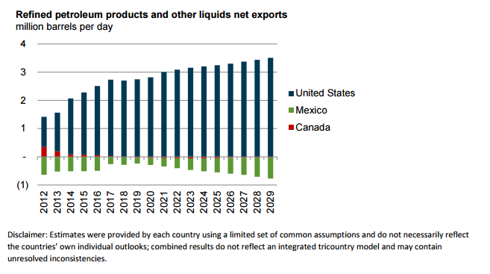
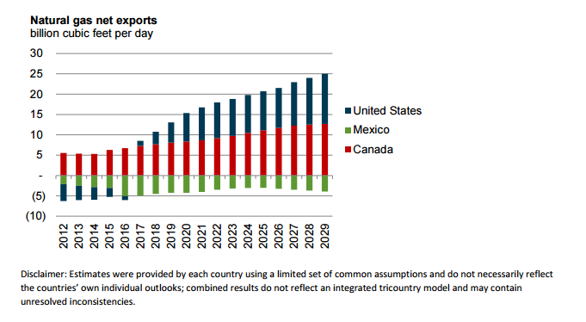
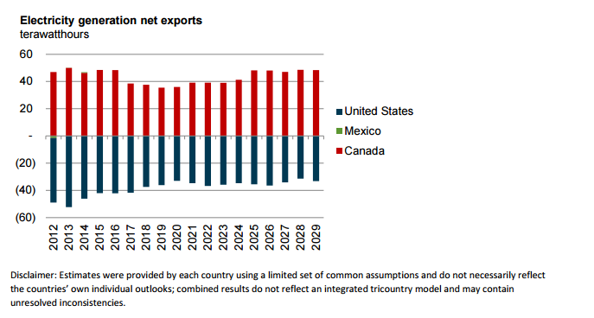
Trilateral Outlook for Energy Supply & Demand
A report from the Trilateral Energy Outlook Project focused on identifying areas where further coordination and understanding could yield the greatest mutual benefit
A comparison was developed of the respective modeling frameworks for each country's current official projections with a particular focus on understanding cross-border trade
The results of using a common set of assumptions across all three countries, while maintaining the same respective models and methods used by each, produced national outlooks displayed to the left
Note: Estimates were provided by each country using a limited set of common assumptions and do not necessarily reflect the countries’ own individual outlooks; combined results do not reflect an integrated tri-country model and may contain unresolved inconsistencies.

Slide 16
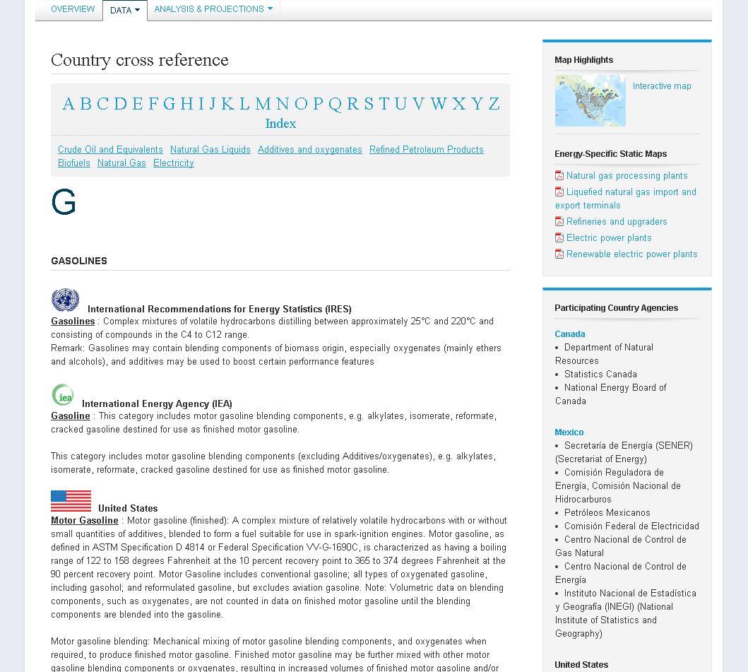
Cross reference for energy terminology

Slide 17
Lead Agencies and Partners

Slide 18
Lead Agencies
Canada | Mexico | United States
Department of Natural Resources | Secretariat of Energy | Department of Energy
Minister James Carr | Secretary Joaquín Caldwell | Secretary Ernest Moniz
Jay Khosla, Assistant Deputy Minister for the Energy Sector | Leonardo Beltrán Rodriguez, Deputy Secretary for Planning and Energy Transition | Adam Sieminski, Administrator of U.S. Energy Information Administration (EIA)
James Zeni, Chief of Economic Analysis & Statistical Information | Rafael Alexandri Rionda, General Director for Planning and Energy Information | Shirley Neff, Senior Adviser to the Administrator of EIA

Slide 19
Partners
United States
Department of Energy
Energy Information Administration
Office of Fossil Energy
U.S. Census Bureau
Canada
Natural Resources Canada
National Energy Board
Statistics Canada
Mexico
Secretariat of Energy
National Hydrocarbons Commission
National Statistics and Geography Institute
National Energy Control Center
Federal Electricity Commission
National Electricity Control Center
National Natural Gas Control Center
Energy Regulatory Commission
PEMEX

Slide 20
Supplemental Slides

Slide 21
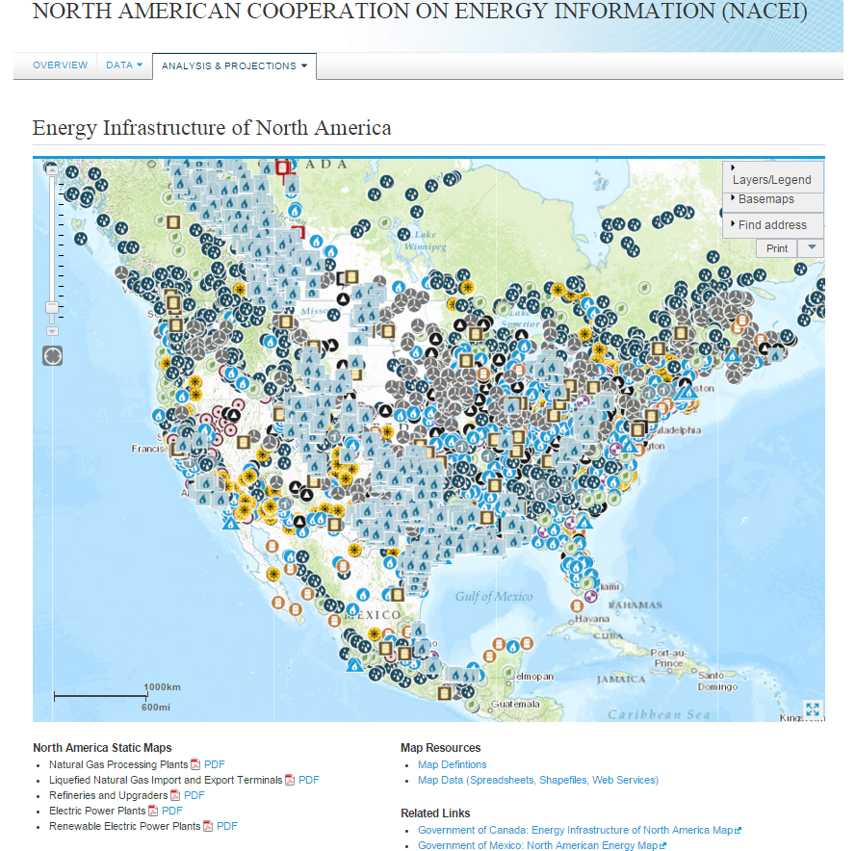
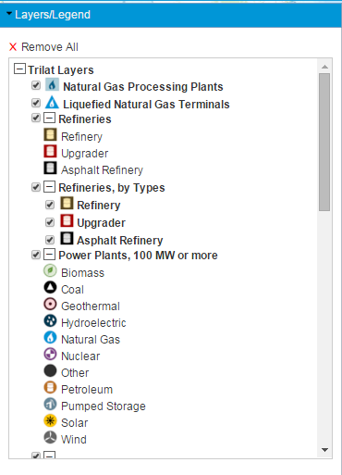
Geographic energy information: North American Energy Maps contain multiple elements of information

Slide 22
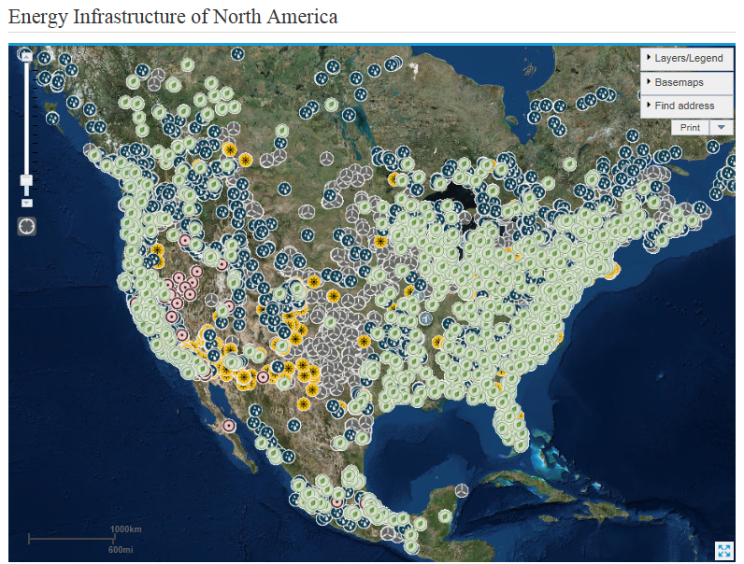
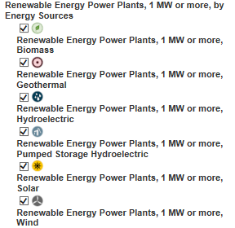
Geographic energy information: Renewable Power Plants, 1 MW or more

Slide 23
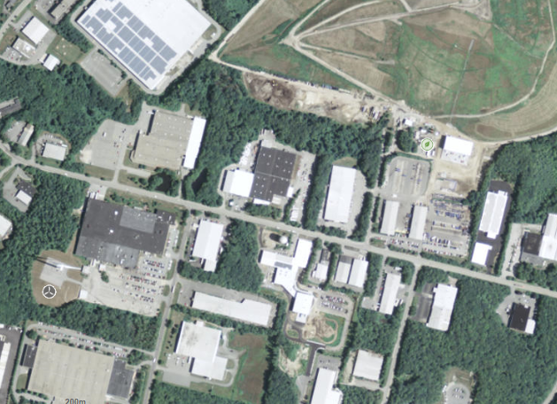
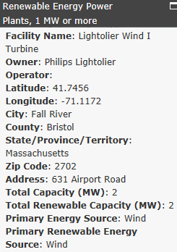
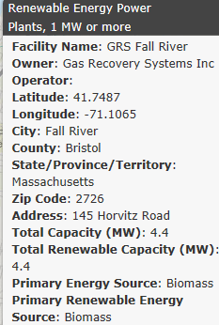
Geographic energy information: Tools to display detailed view and individual facility information

Slide 24
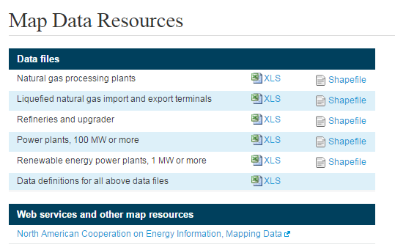
Map Data Files
Shapefiles and spreadsheet files available on the individual elements and by country
Provides flexibility to public users to select any or all datasets
Uniform table and file structure allows for easy merging and comparing
Updating country level data by element will be more frequent and easier for developers

Slide 25
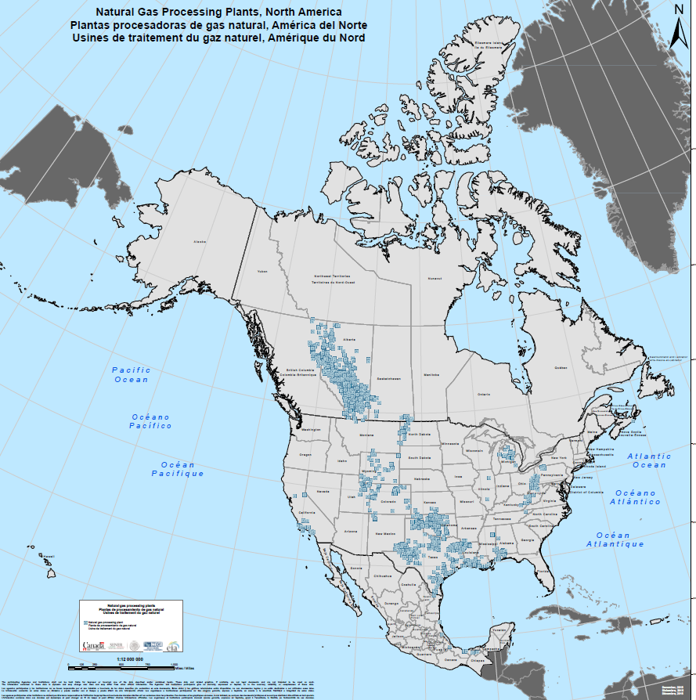
Static map of North American Natural gas processing plants

Slide 26
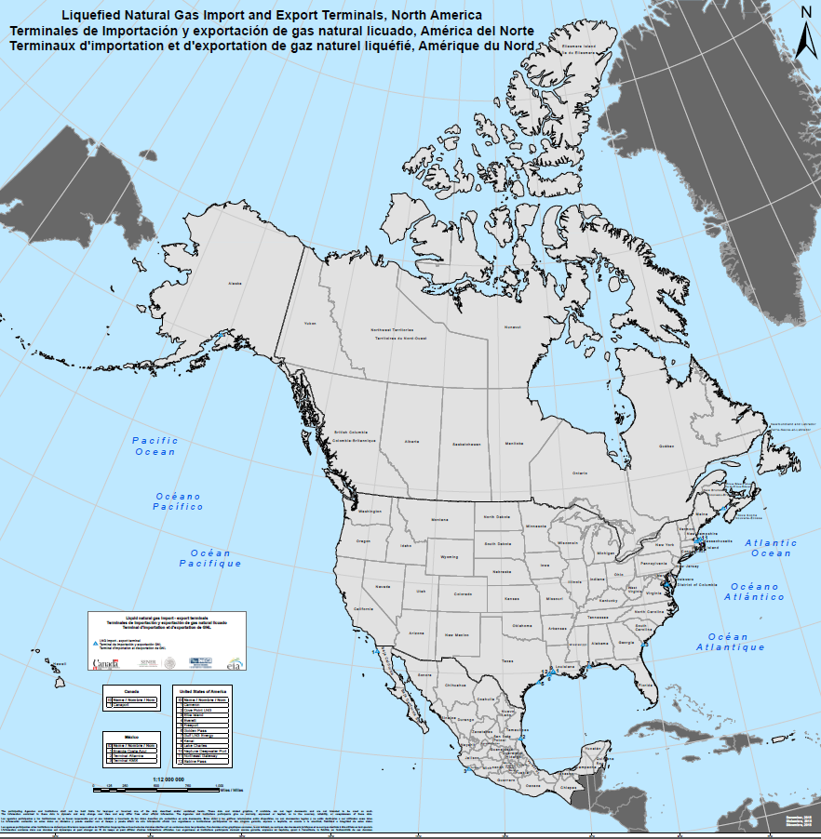
Static map of North American Liquefied natural gas import and export terminals

Slide 27
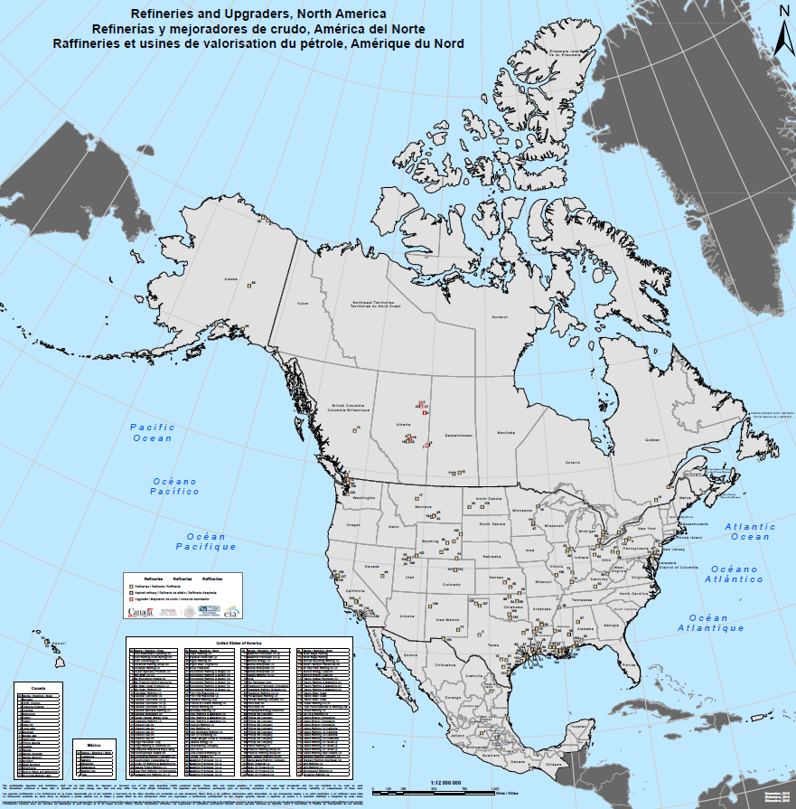
Static map of North American Refineries (including asphalt and upgrader facilities)

Slide 28
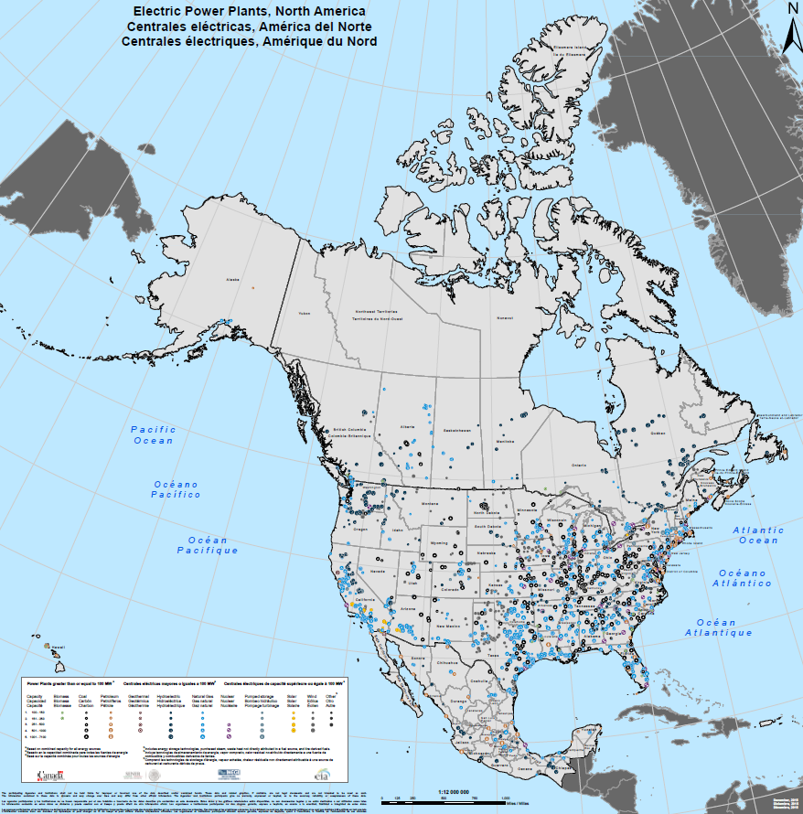
Static map of North American Electric Power Plants (100 MW or more)

Slide 29
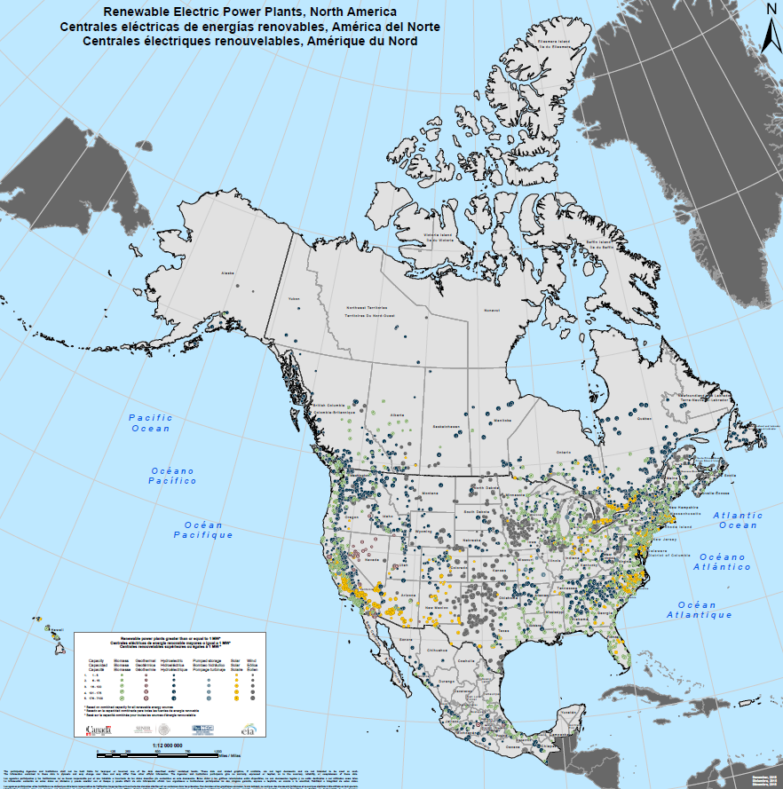
Static map of North American Renewable electric power plants (1 MW or more)

