Slide 1
Oslo Group’s new website and Unite Connections working platform
10th Oslo Group Meeting at Aguascalientes, Mexico
Ville Maljanen

Slide 2
Oslo Group’s new website
http://unstats.un.org/oslogroup/
opened in February 2016
Is now located in UNSD’s server
Contains relevant information about Oslo Group:
Background, Upcoming meeting, Mandate, List of Members of the Oslo Group, International Recommendations for Energy Statistics (IRES) etc.
Public for anyone

Slide 3
Oslo Group’s new website

Slide 4
Unite Connections - Working Platform
Unite connections is a modern social working platform
It provides platform for blogs, wikis and forums
Integrated with email, calendar, desktop, Office applications, instant messaging and document management
Login credentials are needed and may be asked from oslosecretariat@stat.fi

Slide 5
Login Page
Use your email
address to log in
Password has been sent you by email

Slide 6
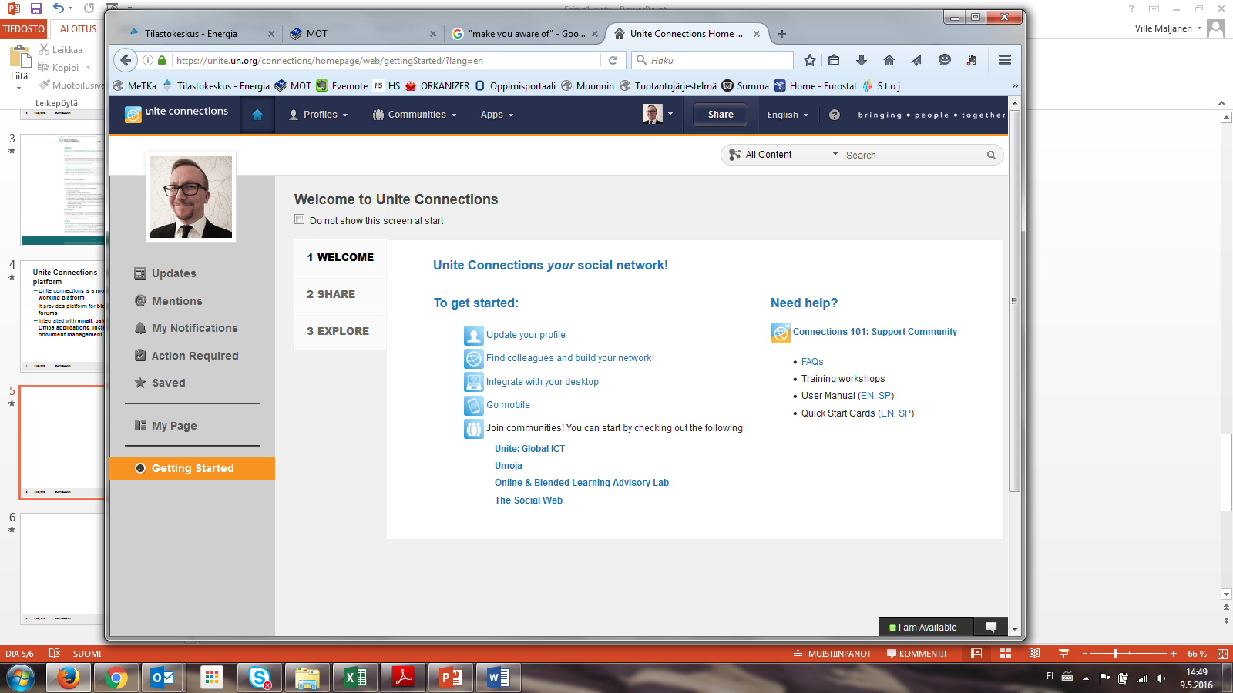
Getting Started
Select this option if you don’t want to see this page next time when you log in
If you need help, use these options
If you are new to Unite Connectios use these options to getting started

Slide 7
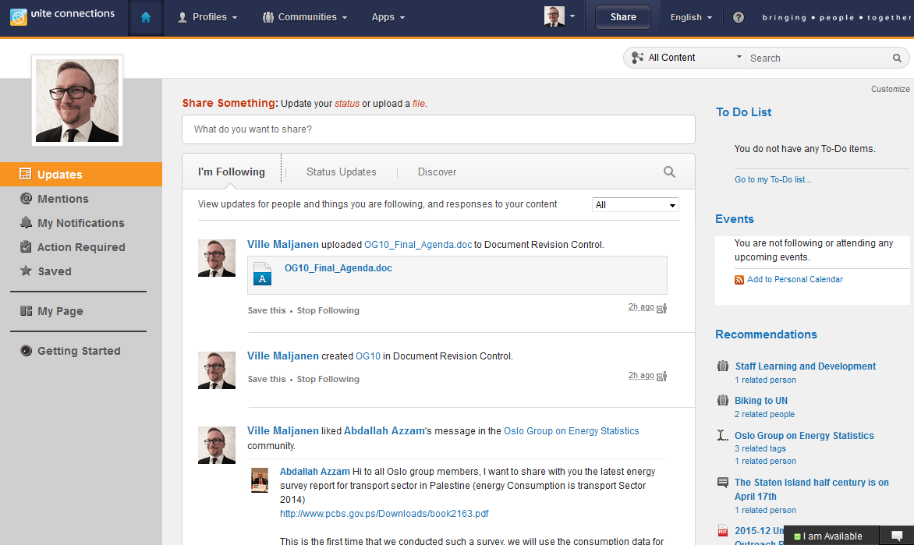
Updates & other personal sites
These options show you updates related to you and your Unite Connections network
These options show you messages that mentions you, your notifications, items requiring an action on your part and updates you saved for later

Slide 8
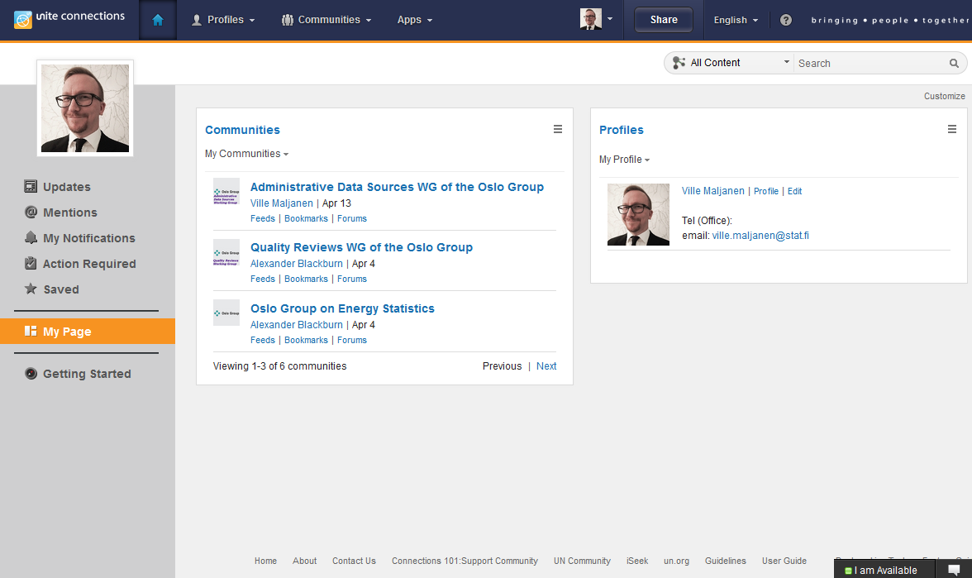
My Page
To customize your page choose this option
My Page is your customizable page where you can add and rearrange application widgets you like

Slide 9
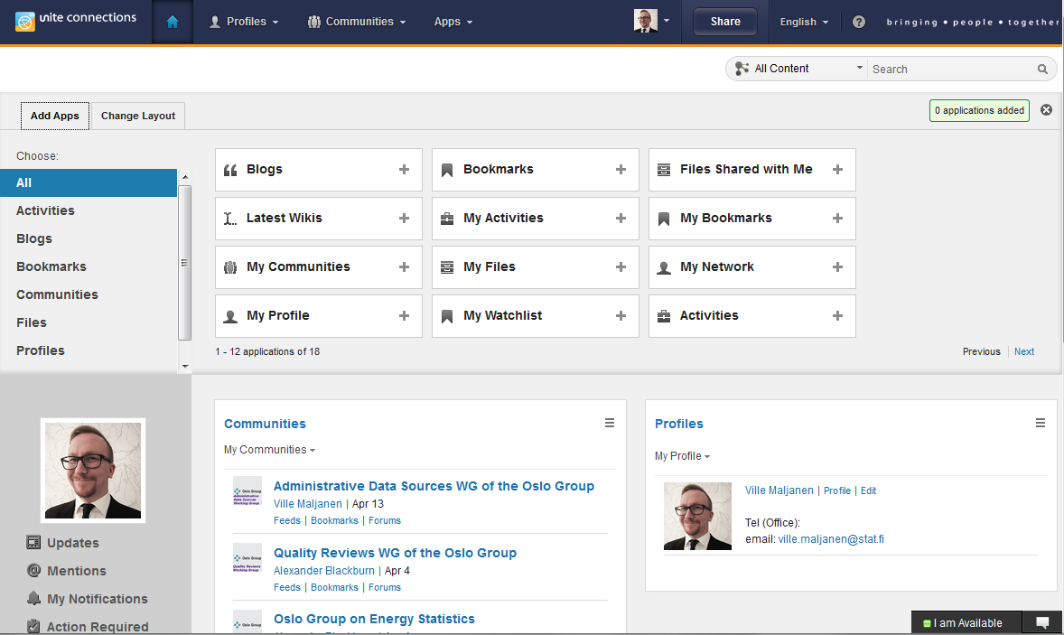
My Page - Customizing
There are multiple application widgets you may add to your page

Slide 10
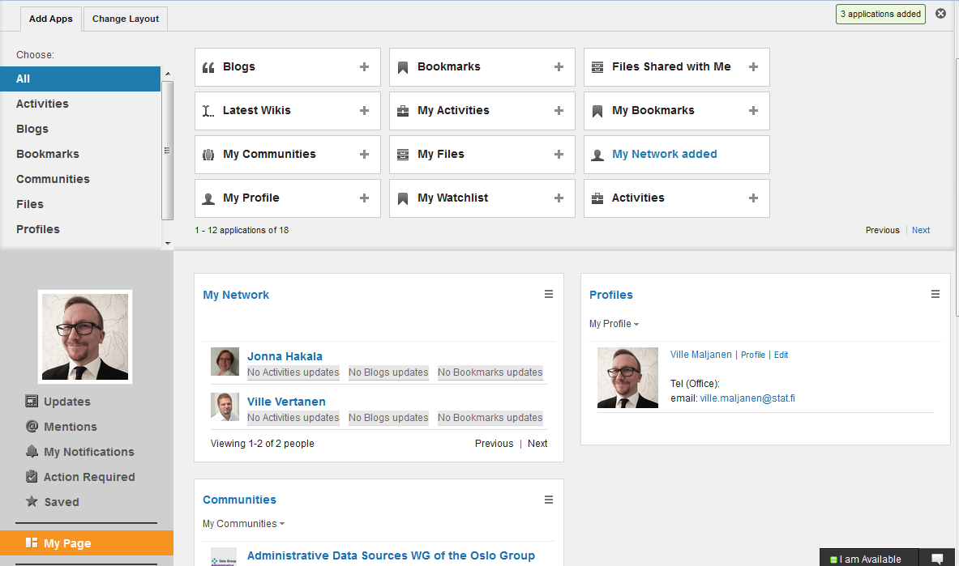
My Page - Customizing
I added My Network application widget…
…and it appeared here

Slide 11
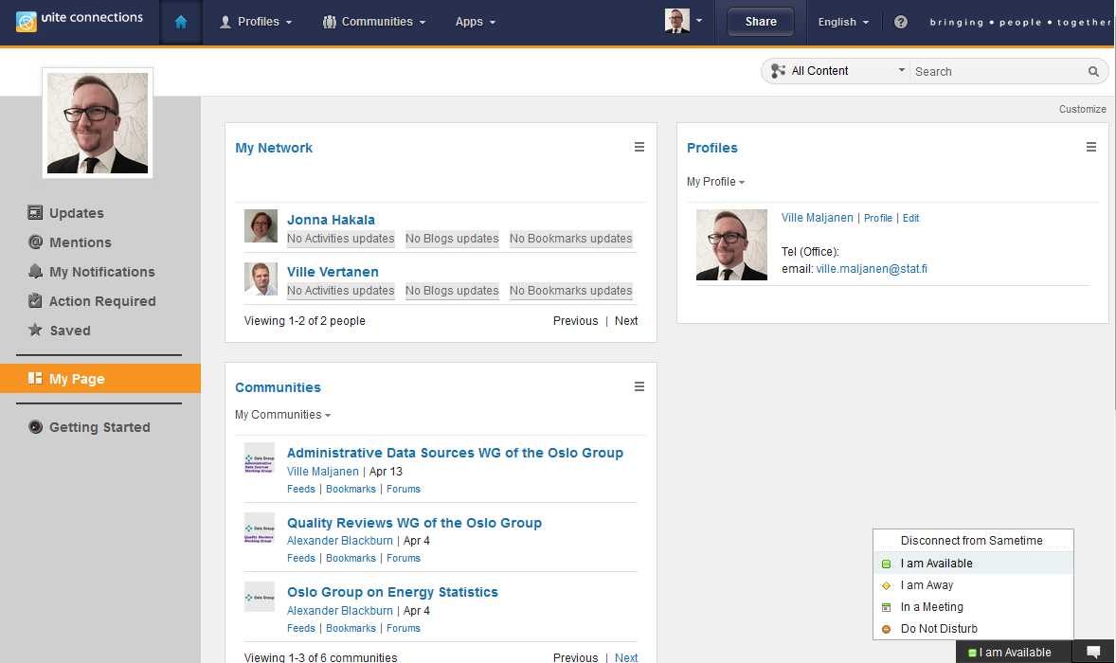
Instant Messaging
Instant Messanger opens in a separate window
You can change your status here

Slide 12
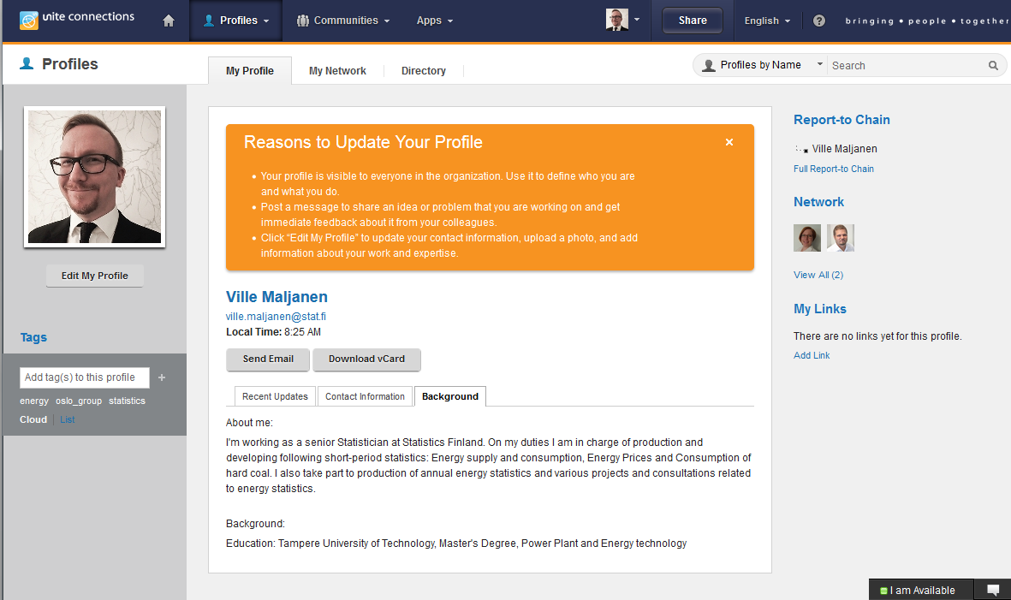
My Profile
To edit your profile choose this option
Add tags to your profile

Slide 13
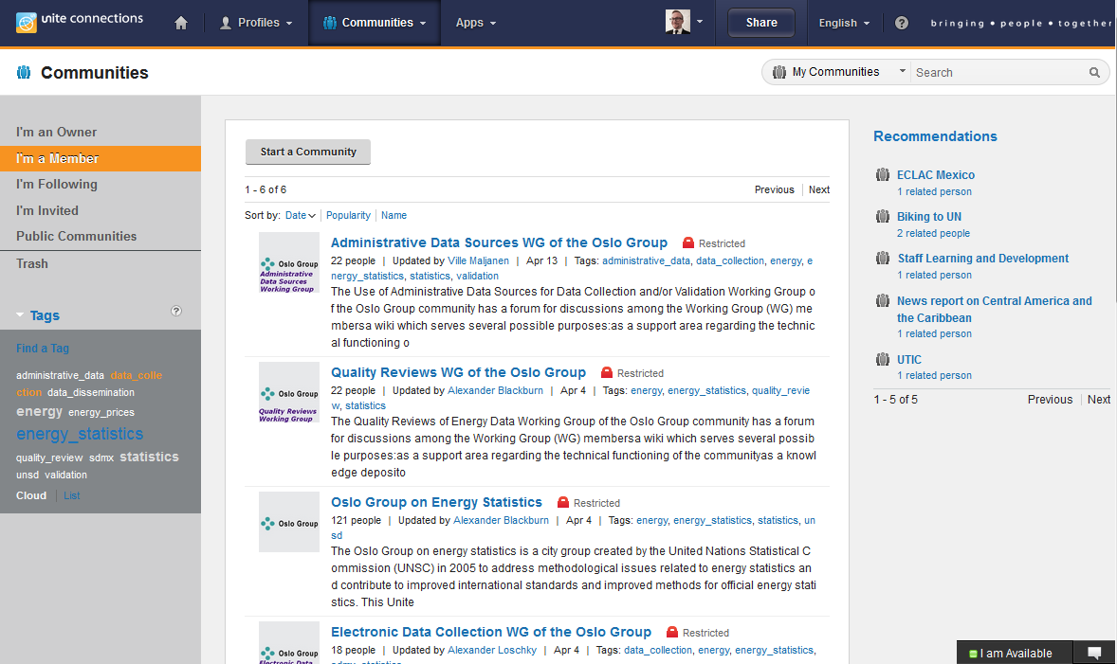
Communities
This option shows you the list of communities where you are a member
If you contribute to some working group’s acitivity you should be the member of the corresponding sub-community
You all should be at least the member of this community

Slide 14
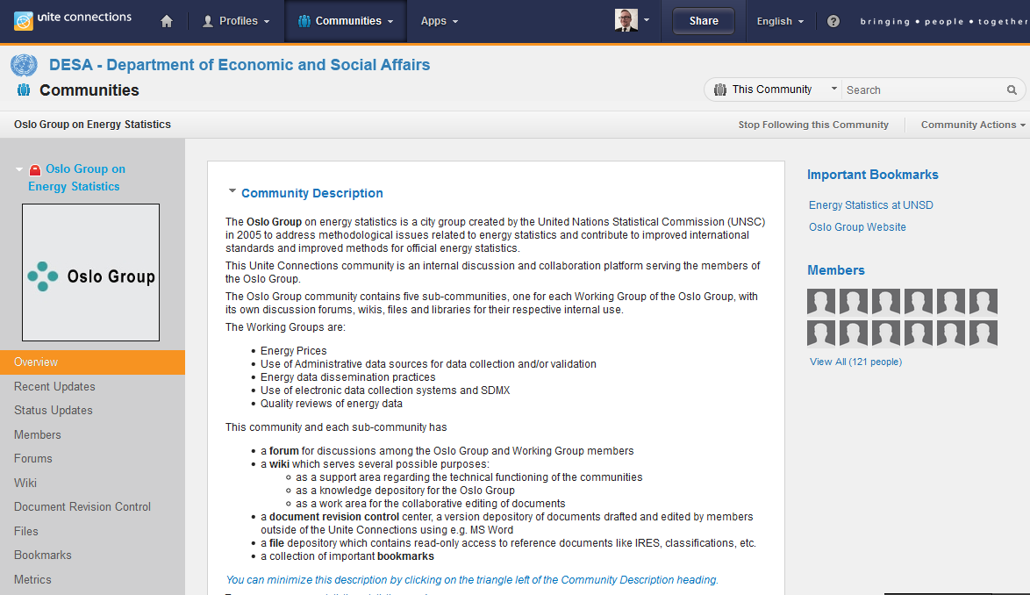
Communities - Overview
You can check who are the members of the community

Slide 15
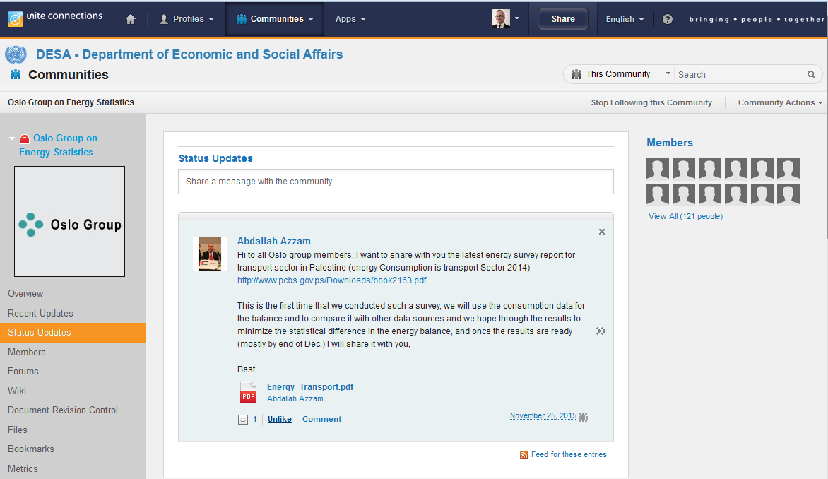
Communities - Status Updates
You can like and comment the updates

Slide 16
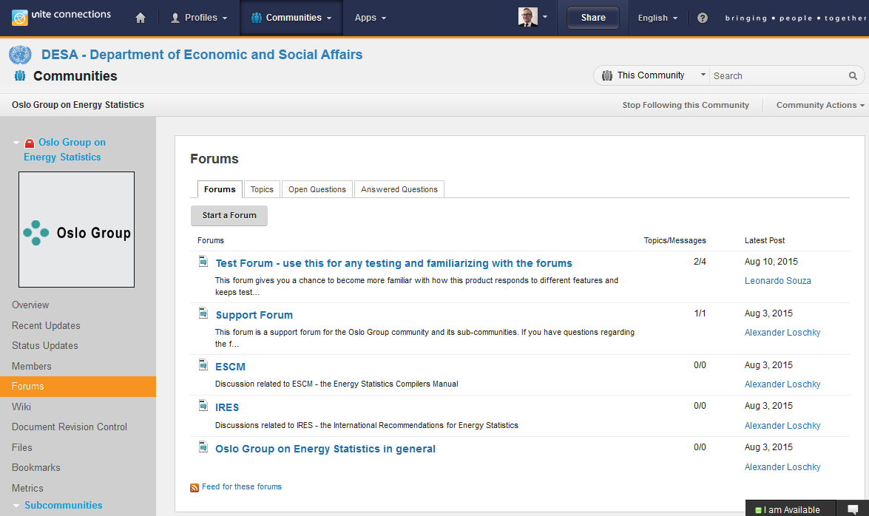
Communities - Forums

Slide 17
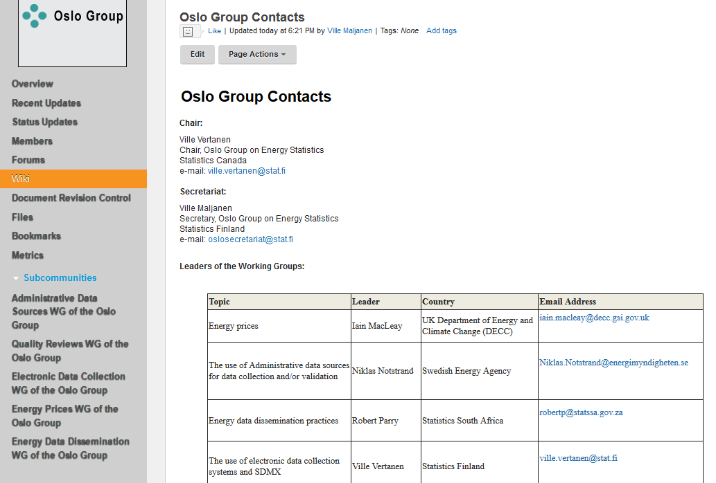
Communities - Wiki

Slide 18
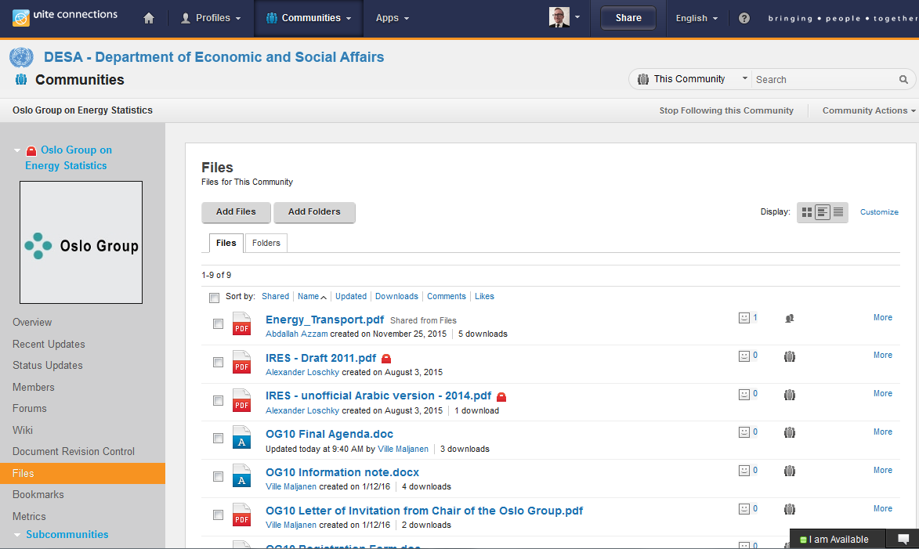
Communities - Files

Slide 19
Unite Connections - Working Platform
Contains many other nice features - no time to represent them all → go there and learn more
Purpose is to ease the work of the Oslo Group and it’s Working Groups
I hope to see you active in the Unite Connections!

Slide 20
Thank you!
10th Oslo Group Meeting at Aguascalientes, Mexico
Ville Maljanen, ville.maljanen@stat.fi

