Slide 1
Comparing the UNSD, IEA and Eurostat balances
6th meeting of the Oslo City Group
Canberra, Australia, 2-5 May 2011
Karen Tréanton
Section Head – Balances, Prices and Emissions
International Energy Agency

Slide 2
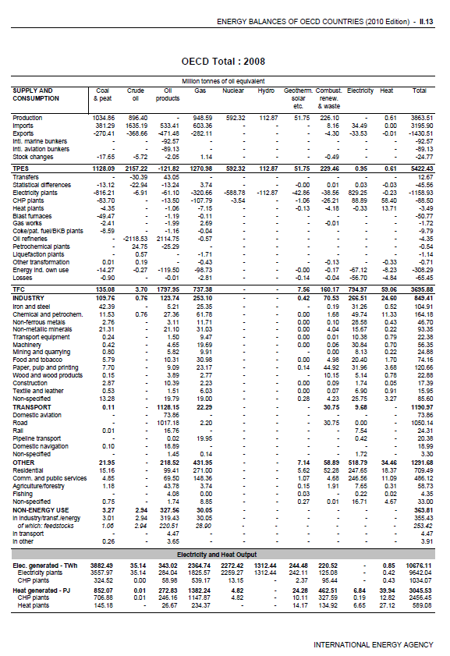

Energy balances
Why calculate an energy balance?
Message can differ
Reasons for confusion by users: comparison of UNSD, IEA and Eurostat balances
Note: other organisations such as APEC and OLADE also have energy balances, but these have not been included in this comparison

Slide 3
Why calculate an energy balance?
The energy balance is a way of reporting energy data in a common unit and with products aggregated by category: coal, oil, oil products, gas, biofuels, etc.
Advantages:
It allows comparison of the shares of each source in the energy supply of a country and in each sector of economic activity
Possible to analyse energy efficiency at a high level
A country can determine its dependence on energy imports/exports
Different countries can be compared when they are calculated with the same methodology
Good for quality control: can check inputs/outputs in the transformation processes and discrepancies can be queried

Slide 4
Message can differ
Which data to use/trust when assessing legally binding commitments?
What is the importance of renewables in the energy mix?
What is happening with CO₂ emissions (Kyoto targets)?
General confusion by users
- this could pave the way to speculation and misunderstandings

Slide 5
Reasons for confusion by users
Principles:
Methods:
Classifications / Definitions:
Presentational
  physical energy content vs. substitution method
  net vs. gross calorific values
  fiscal year vs. calendar year
  level of detail for conversion factors
  blast furnaces
  non-energy use
  treatment of electricity/heat in the transformation processes for non-combusted sources
  peat – fossil or renewable?
  fuel definitions differ
  units
  balance layout

Slide 6
Principle 1: Choice of method for calculating primary energy equivalent
TPES
nuclear, hydro,
geothermal, solar etc.
Partial substitution method
    represents the amount of energy necessary in conventional thermal plants
    difficult to choose efficiency
    not relevant for countries with a high share of hydro
Physical energy content method
    uses physical energy content of the primary energy source
    nuclear 33%
    geothermal 10%
    solar, wind, etc. 100%
IEA, Eurostat and UN opted for
Note: UNSD uses different efficiencies

Slide 7
Principle 1: Choice of method for calculating primary energy equivalent (cont)
2009 Energy Balance of Sweden
Using physical energy content method
Renewables = 35.2%
Nuclear
Hydro
Wind
Solar
TPES
13.04
5.60
0.21
0.01
Using partial substitution method
Renewables = 48.3%
Nuclear
Hydro
Wind
Solar
TPER
11.17
14.55
0.56
0.01

Slide 8
Principle 2: Net vs. gross calorific values?
Difference between NCV and GCV is the latent heat of vaporisation of the water produced during combustion
5%
5%
10%
IEA, Eurostat and UNSD all use net calorific values

Slide 9
Method 1: Level of detail for conversion factors
COAL
Physical units (tonnes) are converted to energy units using NCV [kJ/kg], reported in the questionnaires (varies over time)
Specific NCV for Production, Imports, Exports,
Inputs to Power Plants, Coal used in Coke Ovens, Blast Furnaces and Industry
Average NCV for all other flows
CRUDE OIL AND OIL PRODUCTS
Using NCV [kJ/kg]
Primary oil - Specific NCV for Production, Imports and Exports, reported in the questionnaires (varies over time)
Oil products - region specific default values

Slide 10

Method 1: Level of detail for conversion factors (cont)
NATURAL GAS
Figures collected in Mm³ and gross TJ (energy unit). They are converted to net TJ (0.9·gross TJ) and then to Mtoe (1 PJ = 0.02388 Mtoe)
OTHER GASES
Data collected in gross TJ, then converted to net TJ
(0.9·gross TJ) and then to Mtoe (1 PJ = 0.02388 Mtoe)
ELECTRICITY
Figures collected in TWh, then electricity production is converted to Mtoe (1 TWh = 0.086 Mtoe)
Level of detail for the IEA and probably close for Eurostat – UNSD is less detailed

Slide 11
Method 2: Blast furnaces
Eurostat considers that blast furnaces are transformers with 100% efficiency. The input of coke (only) is calculated on the basis of blast furnace gas output and the excess fuel input (including input of other fuels) reported as consumption of blast furnaces is added to the consumption of iron and steel industry
IEA assumes that the inputs to the blast furnace are equal to about 40% of the output of blast furnace gas (this can go higher depending on country reporting)
Gives different results for the blast furnace gas inputs as compared to industry, but doesn’t change the supply numbers

Slide 12
Method 3: Non-energy use
Eurostat and IEA have the same problem with the common questionnaires – there is not enough detail for the non-energy use of petroleum products.
  Both organisations estimate which sector the non-energy use should be deducted from to avoid double counting (may not make the same choice).
  This will no longer be the case starting in 2013 when the new common questionnaires are implemented.
  UNSD presents no detail on the sectoral breakdown of the non-energy use of oil products
not a major difference

Slide 13
Classification/Definition 1: treatment of electricity and heat in the transformation sector
transfer of nuclear, hydro and wind to the electricity column
Eurostat balances show nuclear heat as the input to transformation and electricity generation from nuclear as the transformation output. For hydro and wind, electricity generated is reported under primary energy production. It is then transferred as “interproduct transfers” to the electricity column.

Slide 14
Classification/Definition 1: treatment of electricity and heat in the transformation sector (cont)
IEA balances treat nuclear, hydro and wind in the same way as other transformation process, i.e. all are included in production and then in the transformation sector, the inputs to electricity generation are negative numbers and the outputs are positive numbers in the electricity column.
UNSD balances show the energy from these sources as gross production directly in the electricity column.
again, this is not a major difference

Slide 15
Classification/Definition 2: Peat
All 3 organisations have peat separately
in the detailed statistics
IEA (and Eurostat from this year) show “coal/peat”
UNSD shows “hard coal, lignite and peat”
This implies that all 3 organisations would consider peat as a non-renewable or “fossil” fuel

Slide 16
Classification/Definition 3: Fuel definitions differ
IEA and Eurostat have common questionnaires so the fuel definitions are the same
UNSD has some definitions that are slightly different (such as NGLs), but hopefully all the work done by InterEnerStat on harmonisation and the new IRES manual will improve the situation. We hope to have harmonised questionnaires within the next 2-3 years.
should improve over time

Slide 17
Presentational 1: What units?
kilowatt-hours
MBtu
IEA opted for Mtoe and ktoe
Eurostat opted for ktoe
Mtoe
ktoe
UNSD opted for TJ
Mtce
terajoules
not an ideal situation, but manageable

Slide 18
Presentational 2: Balance layout
supply
Eurostat balances subtract international marine bunkers from supply, but international aviation is included in transportation.
IEA and UNSD balances treat international marine and aviation bunkers the same and subtract from supply.
Could potentially cause a lot of problems because users do not understand why “supply” is different

Slide 19
Presentational 2: Balance layout (cont)
transformation sector
Eurostat balances show the transformation input separately from the transformation output and all numbers are positive.
IEA and UNSD balances show the inputs as negative numbers and the outputs as positive numbers on the same line.
not a major difference and should not cause any misinterpretation of the data, especially if the detailed energy balances are being used

Slide 20
Presentational 2: Balance layout (cont)
final consumption
Eurostat balances show “available for final consumption” and then “final energy consumption”. Statistical difference is after final energy consumption.
UNSD balances show non-energy uses above “final consumption”. Statistical difference is also above final consumption.
IEA balances show “total final consumption” and the non-energy is a sub-total at the same level as industry, transport and other. Statistical difference is after supply and before total final consumption.
minor details

Slide 21
Conclusions
In general, the energy balances of IEA, Eurostat and UNSD correspond fairly closely with each other.
Further harmonisation would:
help policy makers take informed decisions
reduce the workload on administrations collecting and supplying data
reduce the need for organizations to explain differences between different data sets to inexperienced users
help the general public understand the energy situation of their own country as well as other countries
However, this will not be easy since there are historical reasons why each of the formats evolved as they did

