Slide 1
SIDE EVEN OF THE UNITED NATIONS GENERAL ASSEMBLY
CAMEROON DELEGATION’S PRSENTATION
TOPIC:
IMPLEMENTATION OF THE « UNITED NATIONS LEGAL IDENTITY AGENDA» IN CAMEROON
New York, September 15th 2022

Slide 2
PRESENTATION OVERVIEW
I
INTRODUCTION
CIVIL REGISTRATION REFORM STRATEGY IN CAMEROON
II
MAIN MEASURES IMPLEMENTAED BY CAMEROOON TOWARDS THE IMPLEMENTATION OF THE UNITED NATIONS’ LEGAL IDENTITY AGENDA
III
CHALLENGES AND WAYS FORWARD
IV

Slide 3
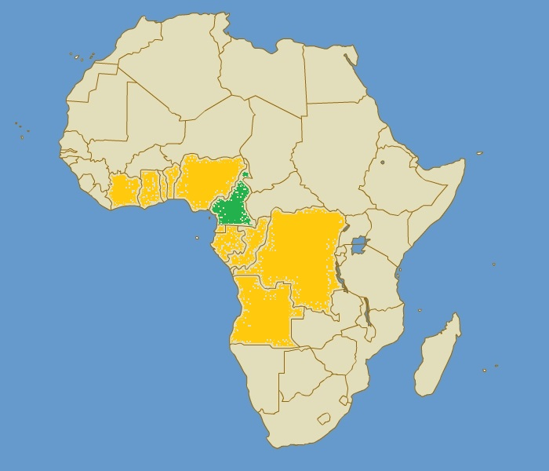
I- INTRODUCTION
Size: 4 75 650 Km²;
Population estimates in 2021 : 28 500 000 habitants ;
Administrative Organization of Cameroon: 10 regions, 54 departments, 360 arrondissements et communes ;
3154 Civil Registration centers;
374 principal Civil Registration centers within the national territory;
46 principal Civil Registration centers within diplomatic missions and consulates;
2734 secondary Civil Registration centers within the national territory;
Under 5 years old birth registration rate in 2018: 62 % ( Source: EDS 2018) ;
Under 5 years old birth registration rate in 2019 : 69 % ( Source: BUNEC) ;
Death registration rate: less than 10% (Estimations BUNEC 2019) ;
Cameroon

Slide 4
II
CIVIL REGISTRATION REFORM STRATEGY IN CAMEROON
SDGs 2030
Goal 16.9 : legal identity for all
African Union 2063 Agenda
APAI – CRVS Program
National Development Strategy ( SND 30)
Pilar 4 : development of human capital and wellbeing
Pilar : governance, decentralization and strategic
- Emergence of Cameroon in year 2035;

Slide 5
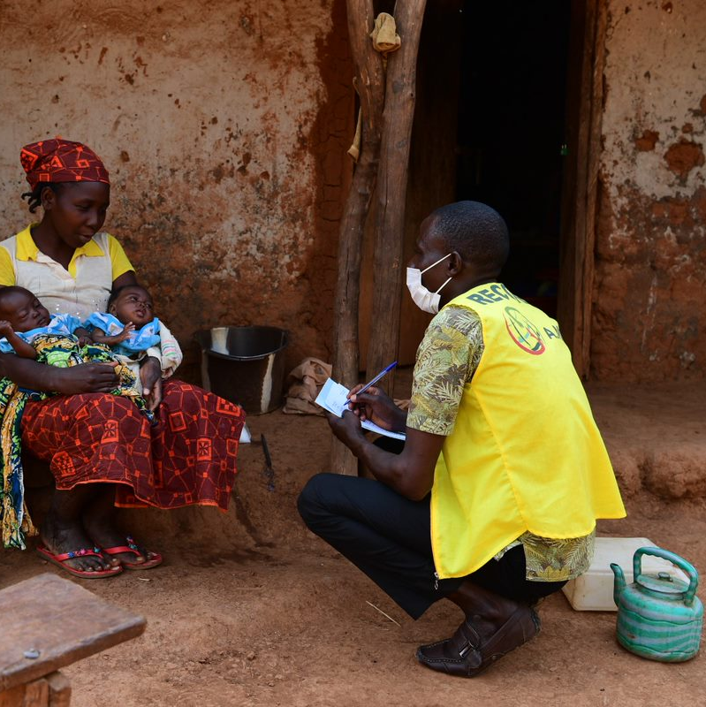
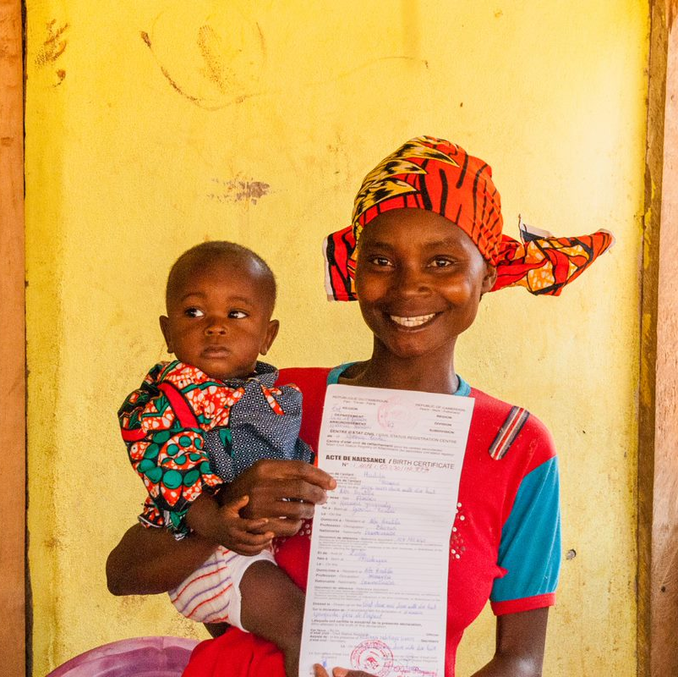
II. MAIN MEASURES IMPLEMENTAED BY CAMEROOON TOWARDS THE IMPLEMENTATION OF THE UNITED NATIONS LEGAL IDENTITY AGENDA
II.1. Improvement of vital events registration.
law N° 2011/011 modifying and completing certain articles of decree N° 81-02 from 29 June 1981 regarding the organization of the civil registry and various others regarding the state of physical person (extension of the allowed registration time for both birth and death from 30 to 90 days );
improvement of the functionality and efficiency of civil registration offices increasing from 60% in 2016 to 72,3% in 2021;
Implementation of the digitization road map of the civil registration system and processes through conducting two (02) pilots for numerization and digitization;
facilitation of the organization of campaigns settling judicial resolutions in order to establish birth certificates in cases of late registration;
Activities t ensure resilience of CRVS system conducted during the COVID – 19 pandemic.

Slide 6
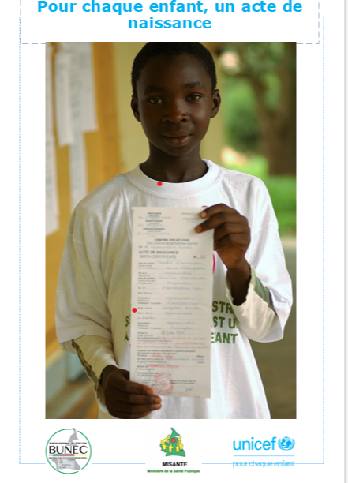
II-2 Sensitization and Mobilization of the various actors of Civil Registration.
Constant sensitization of the general public on the importance of civil registration, taking in consideration the minorities, particularly the Mbororos and the Pygmées, as well as various actors of the civil registration system (Parliamentarians, Jurors, Administrative Authorities, Municipals, Traditional and Civil Society Organizations);
Capacity Strengthening for Civil Registration staff (Officers and Secretaries of Civil Registration);

Slide 7
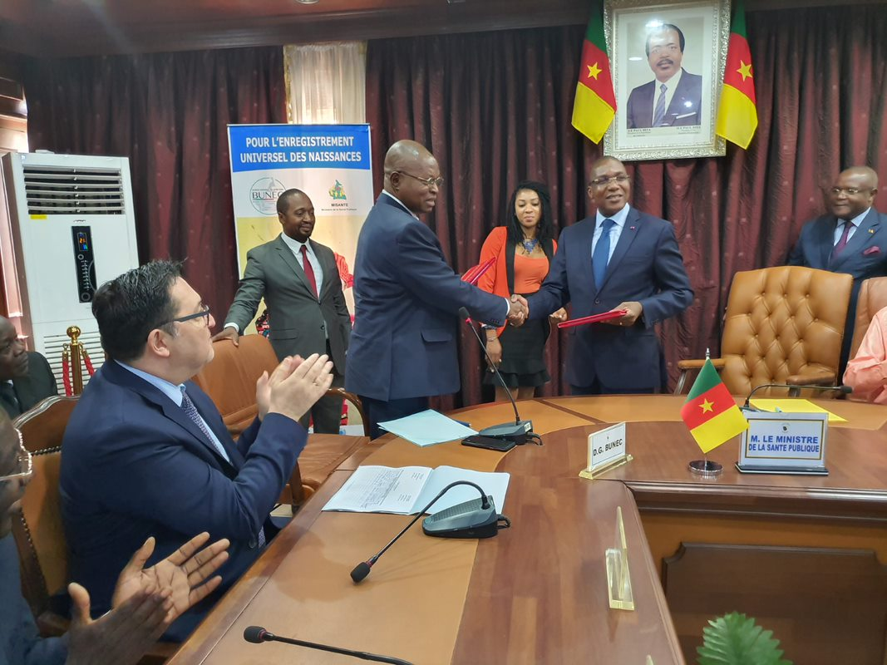
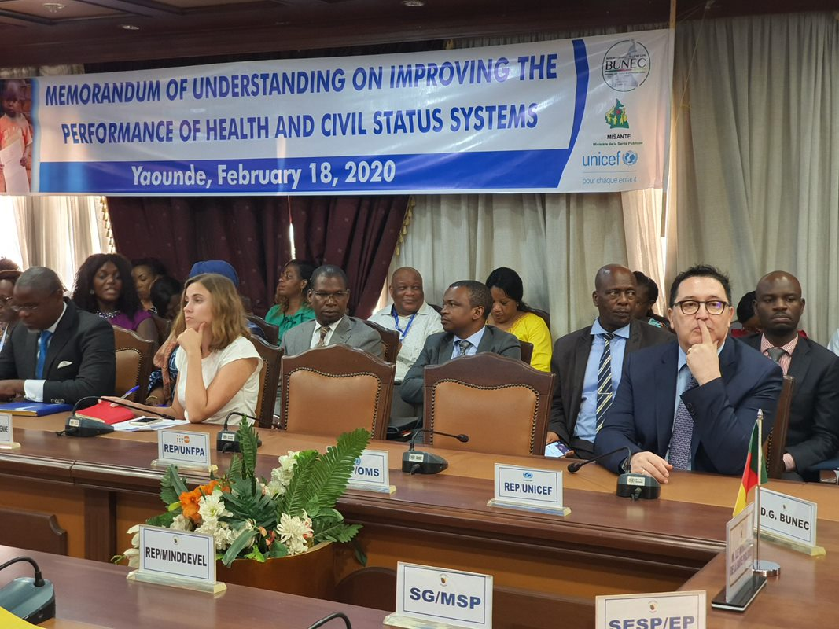
II. 3Interoperability of Civil Registration with other systems (Health, National Security, Justice)
Implementation of a Memorandum of Understanding between the National Bureau for Civil Registration and the Ministry of Public Health pertaining to the quality and efficacy improvement of health information and civil registration system;
Opening of civil registration offices in over 100 health facilities;
Development of connection / API between the District Health Information System (DHIS2) et le Integrated System for Civil Registration (SIGEC), in order to systematically notify births occurring in health facilities for the immediate registration by the civil registration centers.

Slide 8
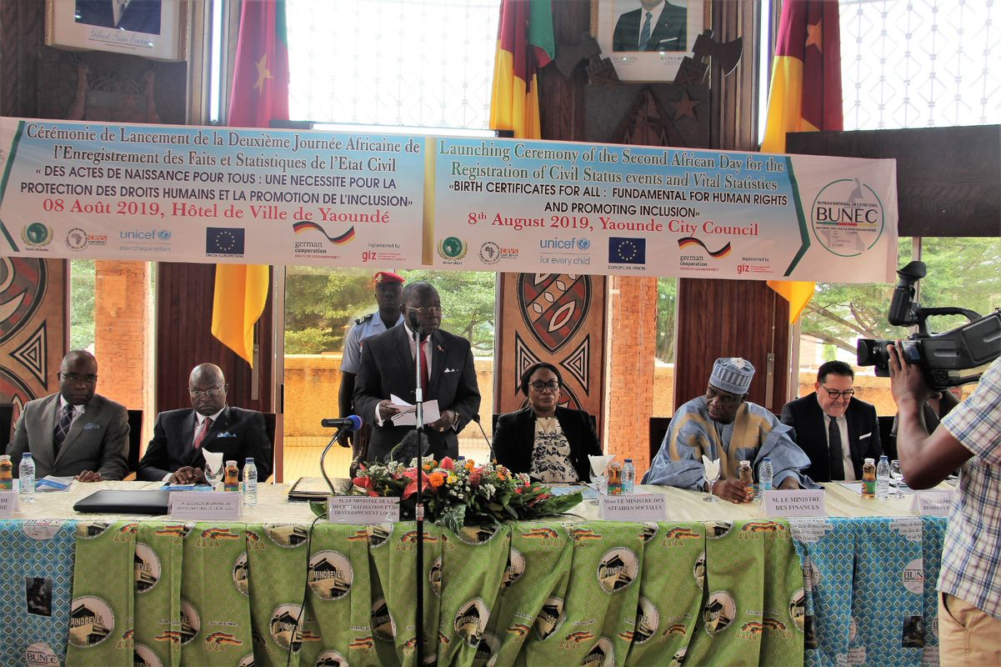
II-4
harmonization and implementation of birth notification and death declaration as well as cause of death information forms in health facilities in line with international best practices;
harmonization of judicial fees for civil registration.
sustained integration of birth registration during public health campaigns;
II.4. Coordination and leadership for the CRVS ID system in Cameroun :
- Implementation of a ministerial unit responsible for the enforcement of the civil registration laws and regulations;
Functioning of a Committee for Piloting of Civil Registration Program Rehabilitation in Cameroon (PRE2C);
Creation and implementation of the National Civil Registration Bureau (BUNEC);
Implementation of an administrations concertation cadre regarding unique personal identification number (NIPU), including services responsible for ID;
Implementation of coordination platforms for the CRVS stakeholders at central/national and regional levels.

Slide 9
IV. CHALLENGES AND WAYS FORWARD
IV.1. Challenges
Need for adequate mobilization of financial resources;
Comprehensive information towards the implementation of a dynamic, interoperable, resilient, proactive and agile system;
Creation and maintenance of a complete national civil registry / population registry.
IV.2. Ways Forward
- Finalization of the CRVS legal and regulatory review process which will ensure integration of IT requirements and necessary measures for personal data protection;
- Implementation of a robust Civil Registration System that will also allow a holistic, dynamic and integrated production of Vital Statistics, as illustrated in the following diagram:

Slide 10
IV.2 FUNCTIONAL DIAGRAM
MINDDEVEL
Application de la législation et de la règlementation sur l’état civil
MINISTRY OF DECENTRALISATION AND LOCAL DEVELOPMENT
Enforcement of Civil Registration Legislation and Regulations
MINISTRY OF FINANCES
Governance for stipends and pensions
HEALTH FACILITIES
Birth and Death Notification
MINISTRY OF EDUCATION
NATIONAL BUREAU OF CIVIL REGISTRATION
MINISTRY OF SECONDARY EDUCATION
COMMUNITIES
MINISTRY OF HIGHER EDUCATION
Governance of Schools and Universities
Traditional Birth, Deaths and Marriages Notification
MINISTRY OF SOCIAL AFFAIRS
Creation and Maintenance of National Population Registry
JAILS
Birth and Death Notification
Birth notifications for found and/or abandoned babies
PRIMARY CIVIL REGISTRATION CENTERS
City Halls,, Diplomatic Missions and Consulates…
Vital Events Registration
MINISTRY OF PUBLIC FUNCTION AND ADMINISTRATIVE REFORMS
SECONDARY CIVIL REGISTRATION CENTERS
Reception and Processing of Physical Files
Governance of administrative concours and government officials' careers
MINISTRY OF TRANSPORT
NATIONAL IINSTITUTE
OF STATISTICS
Delivery of Transport Permits
TRIBUNALS
GENERAL DELEGATION OF NATIONAL SECURITY
Divorces, separations, adoptions, recognitions, legitimations
Publication of Statistics
Delivery of ID documents and Passports
CENTRAL BUREAU OF CENSUSES AND POPULATION SURVEY
CAMEROON ELECTIONS
Electoral Governance
Population census and survey
SOCIAL SECURITY
POPULATION REGISTRY
Management of Social Security
Maintenance of registry for residents
BANKS AND INSURANCES
Clients Management

