Slide 1
Impact of Globalization on measuring economic growth
CIRET Workshop
Poznan 14 September 2021
Michael Connolly

Slide 2
Impact of Globalization on measuring economic growth - Presentation outline
Why does it have such an impact?
Where does it have an impact on economic data?
What can be done?

Slide 3
Why does Globalisation have such an impact?

Slide 4
Globalisation and Fragmentation of Production
Recording changes in economic ownership of goods and capital assets in particular
Both intangible and tangible capital assets
Fundamental question - Who owns what?
Basis for economic statistical compilation

Slide 5
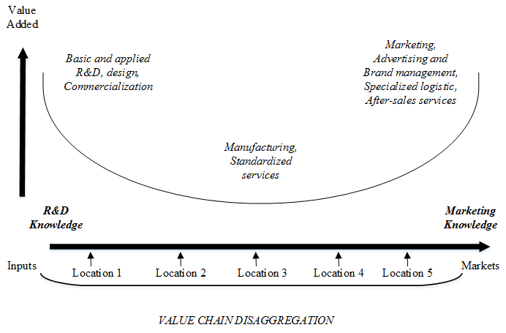
Why does fragmentation occur ?

Slide 6
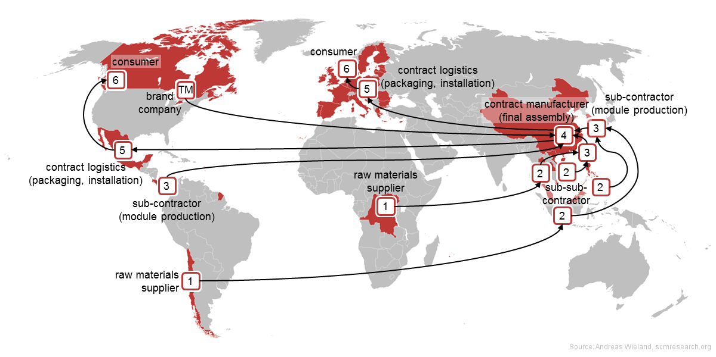

Slide 7
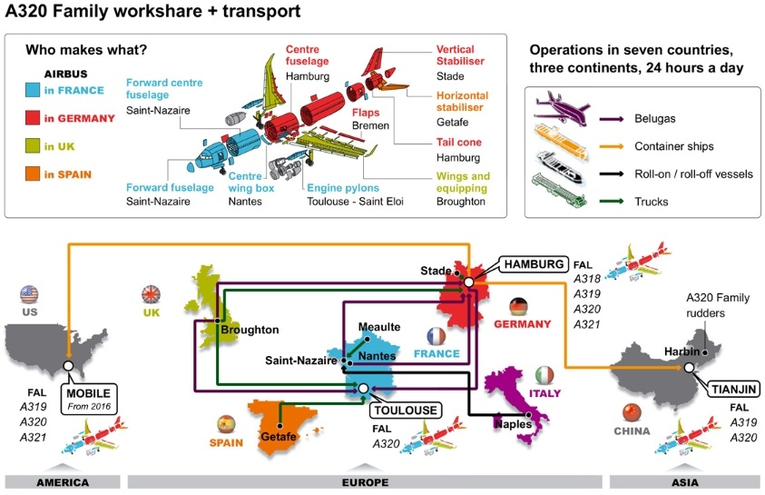

Slide 8
Features of Globalised Production
Contract Manufacturing - Factoryless production
Importance of Intangible assets – Intellectual Property in production
Location of intellectual property and changes in location

Slide 9
Changes in Accounting Standards and Regulatory Oversight
R&D assets only recognised as capital formation in SNA 2008
Coincided with OECD led developments in transfer pricing - BEPS etc.
Reduce the incidence of moving profits across jurisdictions to minimise taxes
Alignment of local legislation with BEPS recommendations

Slide 10
BEPS Recommendations
Companies encouraged to locate an IP asset where the value added arising from it is occurring
Against holding these assets in SPE type structures in tax friendly jurisdictions

Slide 11
How/Where does it impact the data

Slide 12
Case Study - Ireland 2015
Context - concentration of large MNEs in a small island economy

Slide 13
Corporate restructuring -
Relocation of entities from abroad
Large IP assets on the Balance Sheet
IP assets used in contract manufacturing abroad
Enormous addition to GVA /GDP for Ireland

Slide 14
Impact of Increases in Stock of Capital Assets
Increased Capital Assets
Increased Production of Goods and Services
Increased Depreciation
Increased Profits
Increased Exports

Slide 15
Notes:
- 748
- 1054

Slide 16
Balance Sheet Impact – Intl Accounts
Revisions to Ireland’s Net International
Investment Position
Notes:
Revised net International Investment Position:
Irelands net liabilities to non residents, has increased through the accumulation of Irish Capital Assets and non-resident financing.
Net IIP -530bn, see IIP release in pack for details.

Slide 18
Trend in Net Exports 2010 = 100 v's Total Exports and Imports
Notes:
EXPORTS 295 ( + 75)
IMPORTS 225 ( +40)

Slide 19
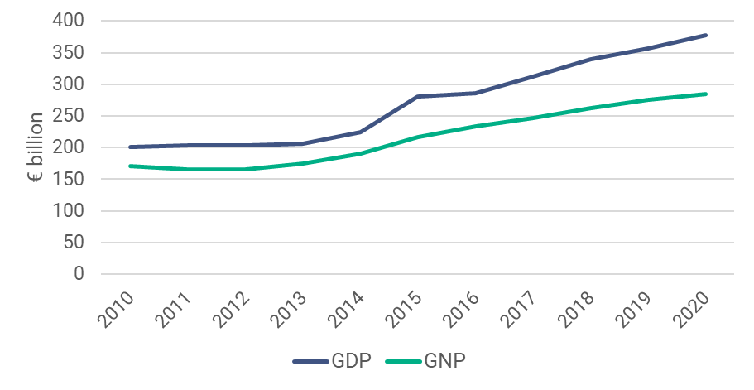
NIE 2020
Annual GDP and GNP (constant prices)
Year-on-Year
Growth Rates
GDP +5.9% (+3.4%)
GNP +3.4% (+0.6%)
Previous preliminary annual estimates in brackets

Slide 20
Notes:
GROSS DISPOSABLE INCOME

Slide 21
Reporting economic data in globalised economies - innovations

Slide 22
Changes to presentation of Economic data
Level indicator of economy – excl. globalisation GNI*
Structural indicator - Domestic and Foreign
Cyclical indicator - developments in underlying economy
Use SNA framework - more emphasis on Net measures
Not just GDP, Institutional Sector Accounts, Productivity Accounts , Extended SUTs etc.

Slide 23
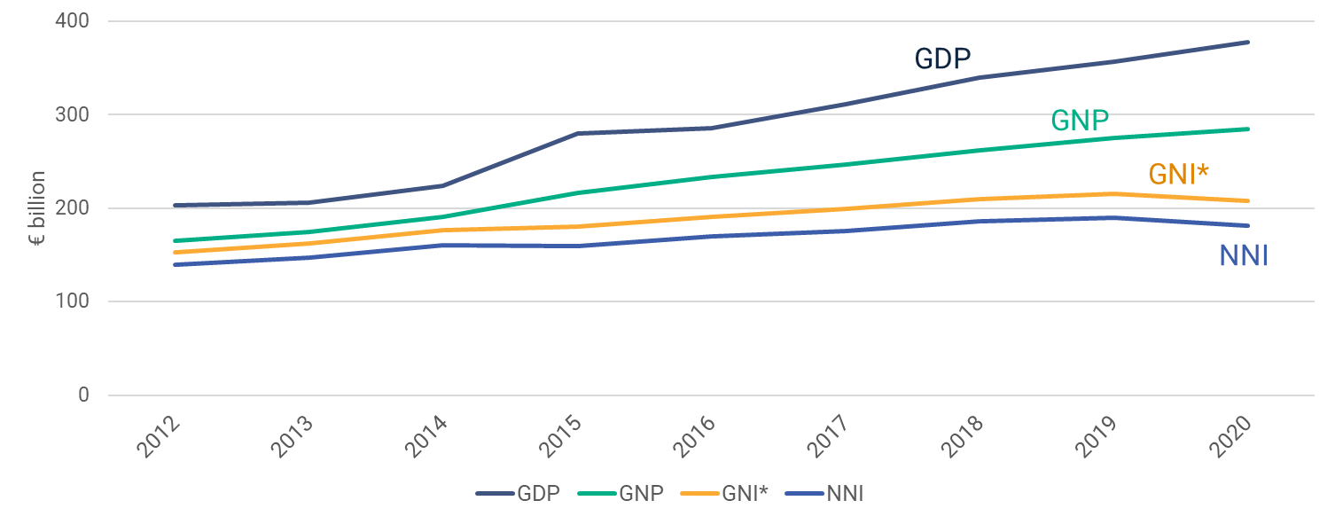
GDP, GNP, Modified GNI and NNI at constant prices
As we go from GDP
to NNI impact of
the corporate relocations and IPP is reducing

Slide 24
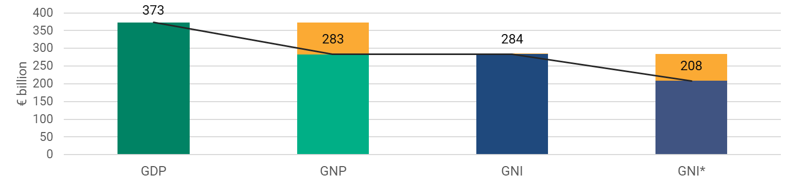
Modified GNI (GNI*) - 2020
GDP
€372.9bn
Net Factor Flows
-€90.2bn
GNP
€282.6bn
EU Taxes and Subsidies
+€1.1bn
GNI
€283.7bn
Adjustments
Depreciation IPP&Aircraft
Corp Inversions
-€75.6bn
GNI*
€208.2bn
+
=
+
=
+
=

Slide 25
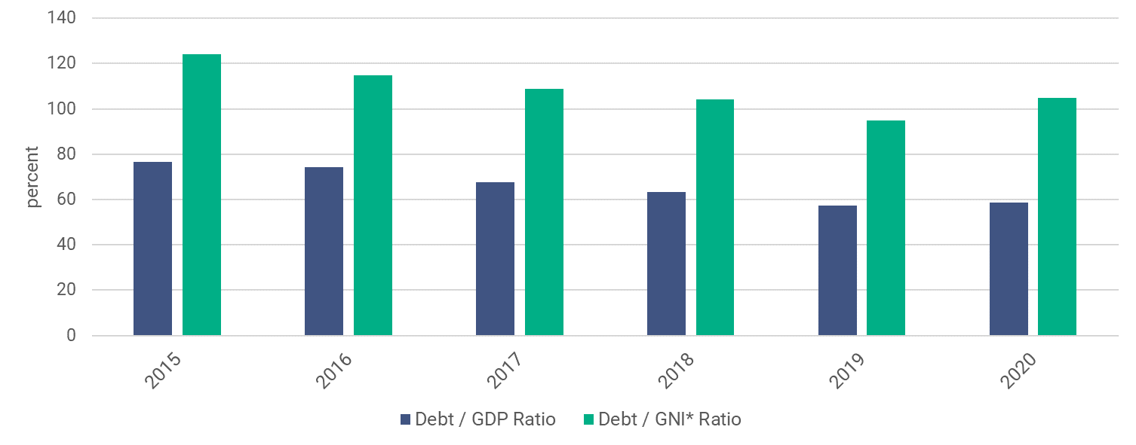
General Government Debt to GDP/GNI* Ratios

Slide 26
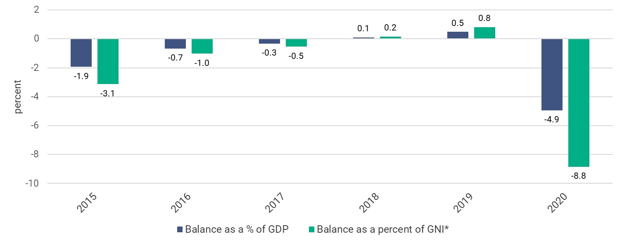
General Government Balance as a percentage of GDP and GNI*

Slide 27
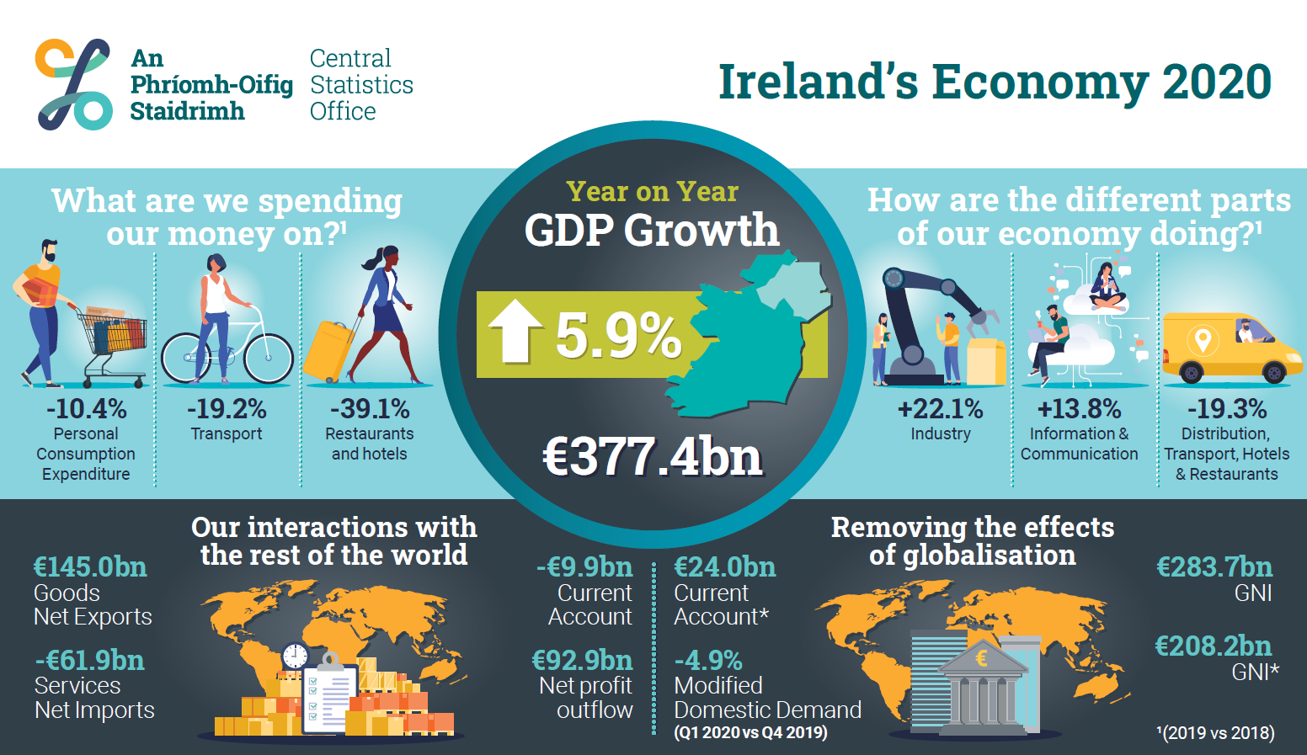

Slide 28
Institutional Sectors
Ireland
S1
Corporations
Government
S.13
Households and non-profits S.1M
Non-Financial Corporations
S.11
Rest of World
S2
Financial Corporations S.12
Foreign MNE S.12a
Domestic S.11b
Redomiciled PLC S.11c
Foreign MNE S.11a
Domestic S.12b
Households S.14
Non-profits S.15

Slide 31
In conclusion
Globalisation driven by fragmentation
Mobile intangible assets - Intellectual Property Products large impacts on economic accounts
For increasingly complex economies - a single indicator can no longer tell the full story
Work needed to provide insight on the domestic story – including work in domain of business statistics – Structural, Level and Cyclical indicators required.
International Statistical Standards being updated to provide more insight
Notes:
REGULATIONS AND STANDARDS
RELEVANT
SINGLE INDICATOR CAN NO LONGER TELL FULL STORY
NEED TO PROVIDE - INSIGHT INTO DOMESTIC STORY – PARTICULARLY BUSINESS STATISTICS
NATIONAL AND INYTERNATIONAL IMPLICATIONS
MORE GLOBALISATION EVENTS OF THIS NATURE POSSIBLE

Slide 32
Questions ? michael.connolly@cso.ie

