Slide 1

KOF Globalisation Index
Prof. Dr. Jan-Egbert Sturm
Director KOF Swiss Economic Institute
14 September 2021, Poznan, Poland

Slide 2
World Trade
% (Q
-
o
-
25
Q, annualised)
Index (2010=100)
140
20
120
6.5%
15
2.6%
100
10
80
5
60
0
40
-5
20
-10
0
71-75
76-80
81-85
86-90
91-95
96-00
01-05
06-10
11-15
16-20
21-25
Sources: OECD/CPB

Slide 3
Key determinants of long-term prosperity
Technological progress
Specialization
Political and institutional framework
Globalisation

Slide 4

Globalisation is a process of creating networks of connections among actors at multicontinental distances, mediated through a variety of flows

Slide 5
KOF Globalisation Index for the world
65
2.5
60
2.0
55
1.5
50
1.0
45
0.5
40
0.0
35
-0.5
1970-74
1975-79
1980-84
1985-89
1990-94
1995-99
2000-04
2005-09
2010-14
2015-19
Year-on-year change
Level
Source: KOF

Slide 6
flows of goods, capital and services & the presence of restrictions on trade across borders
Globalisation
Economic perspective
Social perspective
Political perspective
the spread of ideas, information, images, and people
diffusion of government policies

Slide 7
Globalisation
Economic perspective
Political perspective
Social perspective

Slide 8
Globalisation
Economic dimension
Social dimension
Political dimension
Trade
Interpersonal
International political cooperation
Financial
Informational
Cultural

Slide 9
Distinction between de jure and de facto
De facto globalization measures actual international flows and activities
De jure globalization measures policies and conditions that, in principle, enable, facilitate and foster flows and activities
Trade globalisation, de facto
  Trade in goods
  Trade in services
  Trade partner diversity
Trade globalisation, de jure
  Trade regulations
  Trade taxes
  Tariffs
  Trade agreements

Slide 10
Distinction between de jure and de facto
De facto globalization measures actual international flows and activities
De jure globalization measures policies and conditions that, in principle, enable, facilitate and foster flows and activities
For each dimension we have at least 3 indicators
and use principle component analysis to aggregate
(while allowing weights to slowly change over time)
Financial globalisation, de facto
  Foreign direct investment
  Portfolio investment
  International debt
  International reserves
  International income payments
Financial globalisation, de jure
  Investment restrictions
  Capital account openness
  International investment agreements

Slide 11
World Bank
International Monetary Fund (IMF)
United Nation Conference on Trade and Development (UNCTAD STAT)
…
Database: 43 Variables
    for 203 Countries
    from 1970 onward
KOF Globalisation Index

Slide 12
Panel normalisation…
… makes variables with different units comparable.
… accounts for outliers in the data.
… ranks the observations of each variables according to percentiles.
… ranks on a scale from 1 to 100.
… ensures comparability over time (within the same vintage!)

Slide 13
Panel normalisation…
Source: KOF

Slide 14
Weighting …
… determined by principal component analysis (PCA)
  Apply PCA on rolling windows of 10 years to calculate time-varying weights.
… assigns higher weight to variables with higher variation.
… applied for each level of the index.

Slide 15
Different components and weights over time using the 2018 vintage
Globalisation Index, de facto
1975
1985
1995
2005
2015
Globalisation Index, de jure
1975
1985
1995
2005
2015
Economic Globalisation, de facto
33.3
33.3
33.3
33.3
33.3
Economic Globalisation, de jure
33.3
33.3
33.3
33.3
33.3
Trade Globalisation, de facto
50.0
50.0
50.0
50.0
50.0
Trade Globalisation, de jure
50.0
50.0
50.0
50.0
50.0
Trade in goods
38.3
38.8
40.0
38.0
38.7
Trade regulations
29.6
25.0
19.5
21.7
26.8
Trade in services
41.9
42.1
42.3
43.8
44.9
Trade taxes
33.5
31.2
30.3
27.8
24.7
Trade partner diversity
19.8
19.1
17.7
18.2
16.4
Tariffs
20.1
22.7
25.1
26.7
25.3
Trade agreements
16.8
21.1
25.1
23.7
23.2
Financial Globalisation, de facto
50.0
50.0
50.0
50.0
50.0
Financial Globalisation, de jure
50.0
50.0
50.0
50.0
50.0
Foreign direct investment
16.5
17.2
22.9
29.6
26.9
Investment restrictions
33.0
38.9
33.9
35.2
32.9
Portfolio investment
8.1
9.0
7.2
14.1
16.5
Capital account openness
33.2
30.2
35.5
36.3
38.5
International debt
27.8
25.8
22.3
20.3
27.0
International Investment Agreements
33.8
30.9
30.5
28.5
28.7
International reserves
10.9
10.6
9.6
0.1
2.5
International income payments
36.7
37.4
38.0
35.8
27.2
Political Globalisation, de facto
33.3
33.3
33.3
33.3
33.3
Political Globalisation, de jure
33.3
33.3
33.3
33.3
33.3
Embassies
37.7
37.7
35.8
34.2
36.4
International organisations
39.5
40.0
36.6
36.1
36.1
UN peace keeping missions
23.0
22.5
26.9
28.9
25.9
International treaties
39.8
38.9
37.8
34.6
33.5
International NGOs
39.3
39.8
37.2
36.9
37.7
Treaty partner diversity
20.7
21.1
25.6
29.3
30.4

Slide 16
Different components and weights over time using the 2018 vintage
Globalisation Index, de facto
1975
1985
1995
2005
2015
Globalisation Index, de jure
1975
1985
1995
2005
2015
Social Globalisation, de facto
33.3
33.3
33.3
33.3
33.3
Social Globalisation, de jure
33.3
33.3
33.3
33.3
33.3
Interpersonal Globalisation, de facto
33.3
33.3
33.3
33.3
33.3
Interpersonal Globalisation, de jure
33.3
33.3
33.3
33.3
33.3
International voice traffic
24.7
23.8
22.4
21.2
20.8
Telephone subscriptions
37.9
39.8
41.7
41.6
40.2
Transfers
19.3
20.0
20.1
20.9
21.9
Freedom to visit
29.6
27.8
26.8
30.7
32.7
International tourism
20.3
19.9
20.3
20.2
21.1
International airports
32.5
32.4
31.6
27.7
27.1
International students
23.0
23.3
24.2
23.1
19.4
Migration
12.7
13.0
13.0
14.6
17.0
Informational Globalisation, de facto
33.3
33.3
33.3
33.3
33.3
Informational Globalisation, de jure
33.3
33.3
33.3
33.3
33.3
Used internet bandwidth
29.9
29.2
29.1
33.1
36.9
Television access
30.8
31.4
32.0
32.8
36.3
International patents
35.5
36.0
35.9
33.4
28.7
Internet access
38.3
37.5
37.0
39.9
42.4
High technology exports
34.6
34.8
35.0
33.5
34.4
Press freedom
31.0
31.1
31.0
27.2
21.2
Cultural Globalisation, de facto
33.3
33.3
33.3
33.3
33.3
Cultural Globalisation, de jure
33.3
33.3
33.3
33.3
33.3
Trade in cultural goods
35.4
30.8
27.7
27.0
27.9
Gender parity
34.7
33.7
32.6
32.6
25.5
Trade in personal services
25.6
22.1
21.7
22.9
24.4
Human capital
35.7
36.1
37.0
37.7
41.3
International trademarks
20.0
16.6
16.1
14.4
10.5
Civil liberties
29.5
30.2
30.4
29.8
33.2
McDonald's restaurant
8.8
15.2
17.9
21.1
21.4
IKEA stores
10.3
15.3
16.7
14.5
15.7

Slide 17
Missing data …

Slide 18
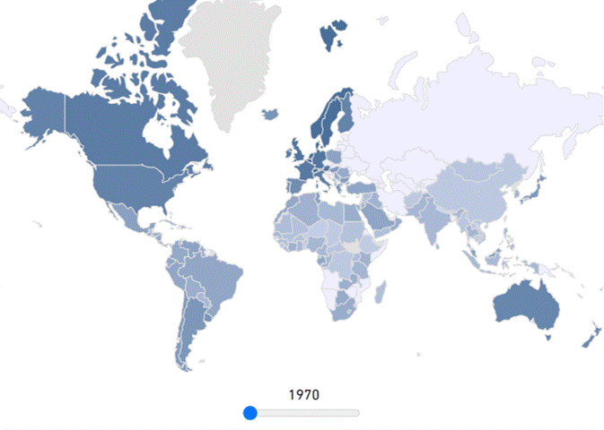
KOF Globalisation Index across the world and over time
Source: KOF

Slide 19
KOF Globalisation Index for the world
– de facto vs. de jure
65
60
55
50
45
40
35
1970-74
1975-79
1980-84
1985-89
1990-94
1995-99
2000-04
2005-09
2010-14
2015-19
Overall
De facto
De jure
Source: KOF

Slide 20
KOF Globalisation Index for the world
– economic vs. social vs. political
65
60
55
50
45
40
35
1970-74
1975-79
1980-84
1985-89
1990-94
1995-99
2000-04
2005-09
2010-14
2015-19
Overall
Economic
Social
Political
Source: KOF

Slide 21
Economic globalisation in the world: trade vs. financial globalisation
De facto
De jure
65
65
60
60
55
55
50
50
45
45
40
40
35
35
1970-
1975-
1980-
1985-
1990-
1995-
2000-
2005-
2010-
2015-
1970-
1975-
1980-
1985-
1990-
1995-
2000-
2005-
2010-
2015-
74
79
84
89
94
99
04
09
14
19
74
79
84
89
94
99
04
09
14
19
Trade, de facto
Financial, de facto
Trade, de jure
Financial, de jure
Source: KOF

Slide 22
Concluding remarks
The KOF Globalisation Index emerged as the most widely used and cited globalisation index in academia and beyond.
The KOF Globalisation Index is a composite index that annually measures globalisation along the economic, social and political dimension for almost every country in the world since 1970 on a scale of 1 (least) to 100 (most globalised), while distinguishing between de facto and de jure parts.
The KOF Globalisation Index and its underlying components allow us to
  consistently compare globalization across countries and years
  to identify driving forces behind the individual ranking positions
  and analyse what consequences of these processes have so far been.

Slide 23
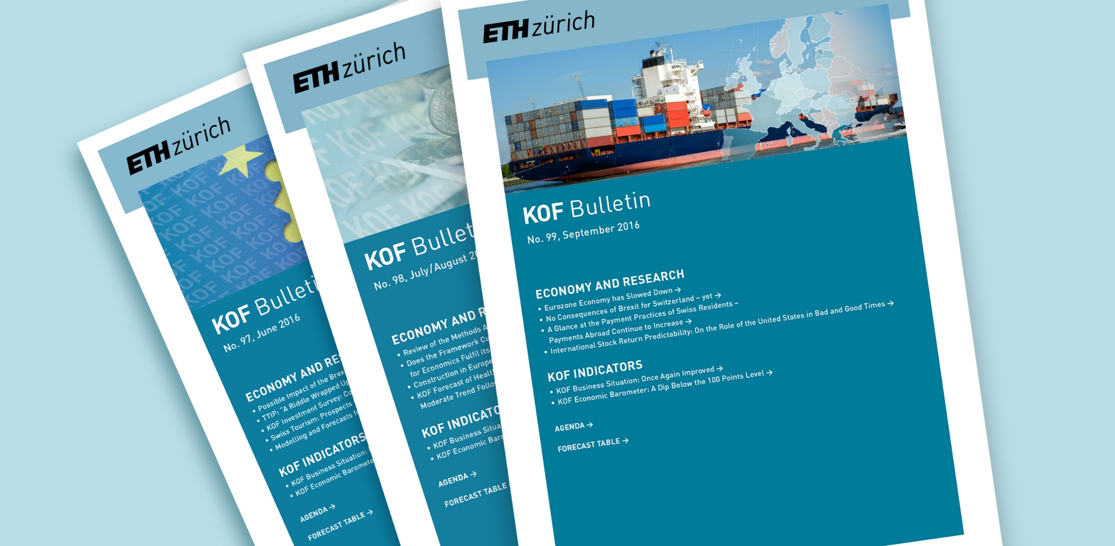
KOF Bulletin:
The free monthly newsletter of KOF
Registration: https://kof.ethz.ch/en/news-and-events/news/kof-bulletin/subscription.html

