Slide 1
China’s Statistics of Trade in Services
Statistics Division
Department of Trade in Services
Ministry of Commerce
The People’s Republic of China
February 2, 2011

Slide 2
Volume and Growth of China’s Imports and Exports of Services from 1997 through 2009

Slide 3
Table 8 Top 30 Importers and Exporters of Services in the World in 2009
In USD billion
Ranking | Exporter (country or region) | Amount | Percentage (%) | Growth rate (%) | Ranking | Importer (country or region) | Amount | Percentage (%) | Growth rate (%)
1 | US | 470 | 14.2 | -9 | 1 | US | 331 | 10.6 | -9.0
2 | UK | 240 | 7.2 | -16 | 2 | Germany | 255 | 8.2 | -10.0
3 | Germany | 215 | 6.5 | -11 | 3 | UK | 160 | 5.1 | -19.0
4 | France | 140 | 4.2 | -14 |  | P.R. China | 158 | 5.1 | 0.0
 | P.R. China | 129 | 3.9 | -12 | 5 | Japan | 146 | 4.7 | -11.0
6 | Japan | 124 | 3.8 | -15 | 6 | France | 124 | 4.0 | -12.0
7 | Spain | 122 | 3.7 | -14 | 7 | Italy | 114 | 3.6 | -11.0
8 | Italy | 101 | 3.0 | -15 | 8 | Ireland | 104 | 3.3 | -5.0
4
5

Slide 4
Overview
The Department of Trade in Services of the Ministry of Commerce is in Charge of the National Statistics of TIS
2007: The Statistics System of International Trade in Services of China( the symbol of the foundation of the Chinese statistics on trade in services )
2010: Revision of the Statistics System of International Trade in Services

Slide 5
Basic Framework of the Statistics of Trade in Services
Statistics Standards
1.The Manual on Statistics of International Trade in Services (Six Internatinal Organizations)
2.The Manual of Balance of Payment (BPM 5) (IMF)
3.General Agreement on Trade in Service(WTO)
4.System of National Accounts (SNA 1993)
5.The Classification of National Economy Industry (CHINA)

Slide 6
Framework of Statistics System
Two Main Lines
the Conventinal BOP + Enterprises Direct Survey
Statistics on Resident/Non-Resident Trade in Services
A Subordinate
Line
Foreign Affiliates Statistics(FATS）
Presence of Natural Persons Statistics
Notes:
6
DE

Slide 7
The Method of Data Collection
Administrative Records
Enterprises Survey
Scientific Estimation
Data Sources include: records of the Banks, Administration of Foreign Exchange, Ministry of Transport and other organizations
Set up the database of statistics on Trade in Services

Slide 8
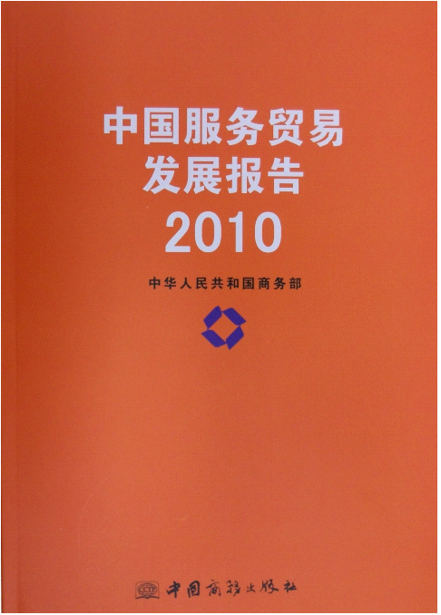
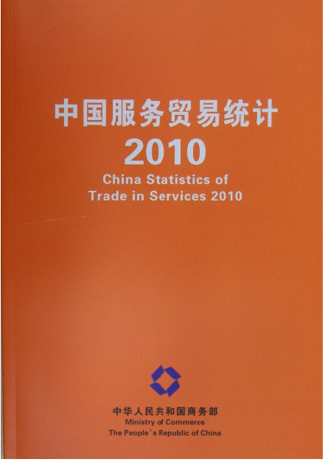
Data Publishment
Publish the data yearly on the import and export in services and on FATS, presence of natural persons statistics

Slide 9
Achievements
Website Building , Maintenance and Optimization
1.the Statistics Database and Reporting System
2.Information Release
3.Exchange Information
4.International Exchange and Cooperation

Slide 10
Channel of Information Release
Release statistical information and analysis articles on internet through the statistical column in the website of China Trade in Services
http://tradeinservices.mofcom.gov.cn

Slide 11
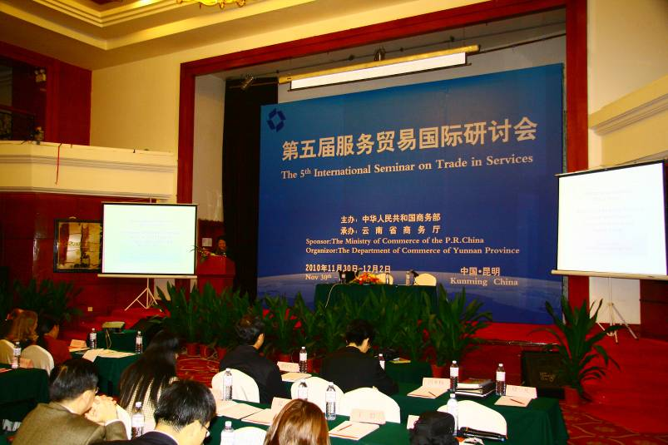
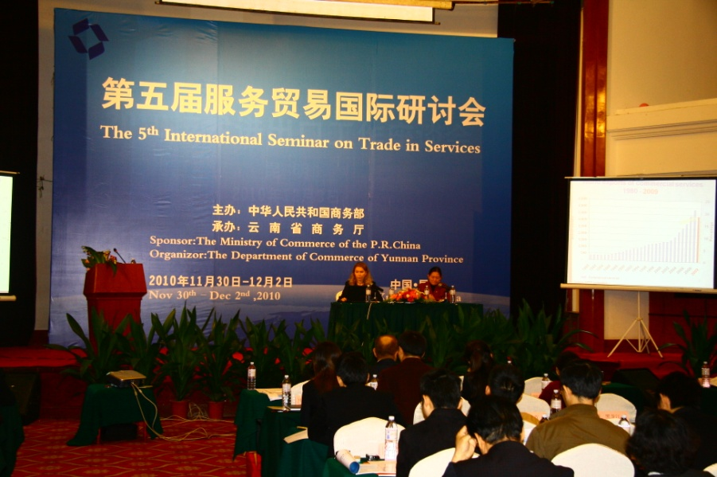
International Exchange and Cooperation
the Trade in Services Conference
the 5th International Seminar on Trade in Services

Slide 12
Difficulties and Problems
The Collection of Bilateral Data
Outward FATS
Value Statistics of the Presence of Natural Persons

Slide 13
Future Measures
Integrate the Statistics System
Enhance Training for Staff
●The basic theories of statistics ●The statistical methodology
Take an Active Part in the Revision of the Next Edition of MSITS
Strengthen the Exchange and Cooperation ●The Trade in Services Conference ●The International Seminar on Trade in Services

Slide 14
Contact Information
Zhang Yijin
Tel: 0086-10-65197038
Fax:0086-10-65197040
tongjichu@mofcom.gov.cn
zhangyijin@mofcom.gov.cn

Slide 15
Thank You

