Slide 1

Global Value Chain Analysis and
Its Implications for Measuring Global Trade
Gary Gereffi
Duke University
Durham, North Carolina (US)
ggere@soc.duke.edu
Global Forum on Trade Statistics
Measuring global trade - Do we have the right numbers?
Geneva, Switzerland
February 2, 2011

Slide 2
AGENDA
Global Value Chains -- an integrative approach
GVC Governance Structures & Trade
GVCs for Services as well as Goods
Policy Issues and Data Challenges

Slide 3
The Global Value Chain Approach
Global value chain framework developed over the past decade by a diverse interdisciplinary and international group of researchers who have tracked the global spread of industries and their implications for both corporations and countries
Global value chain analysis provides both conceptual and methodological tools for looking at the global economy
  Top down – a focus on lead firms and inter-firm networks, using varied typologies of industrial “governance”
  Bottom up – a focus on countries and regions, which are analyzed in terms of various trajectories of economic and social “upgrading” or “downgrading”
Notes:
3

Slide 4
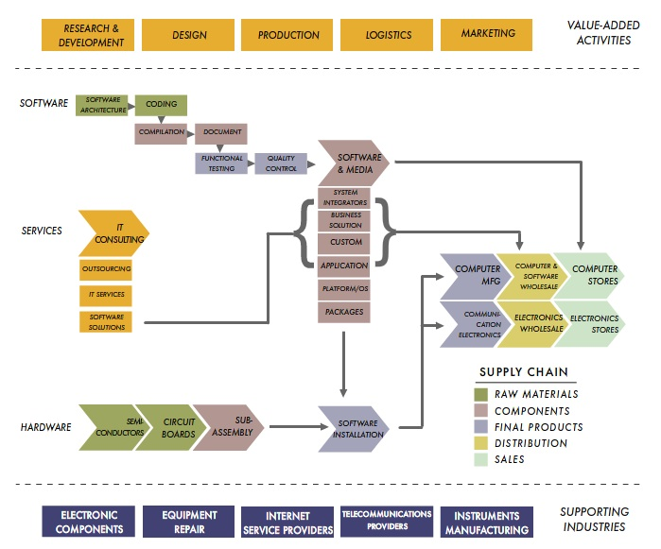
What is a value chain?
A value chain describes the full range of activities that firms and workers carry out to bring a product from its conception to its end use and beyond.
Source: CGGC (http://www.cggc.duke.edu), More Information: Global Value Chains (www.globalvaluechains.org )
Notes:
3 Value Chain Dimensions:
supply chain
value-added activities
supporting industries

Slide 5
Steps to build a data-driven value chain
National level:
Economic activity-based classification systems for establishments, enterprises, and industries
  E.g., NAICS in United States
Firm-specific sources linked to codes
  D&B, Reference USA
Firm structure & corporate “family trees”
  Corporate affiliations, D&B
International level:
Trade data (UN Comtrade, Eurostat, USITC)
Employment data (ILO + country sources)

Slide 6
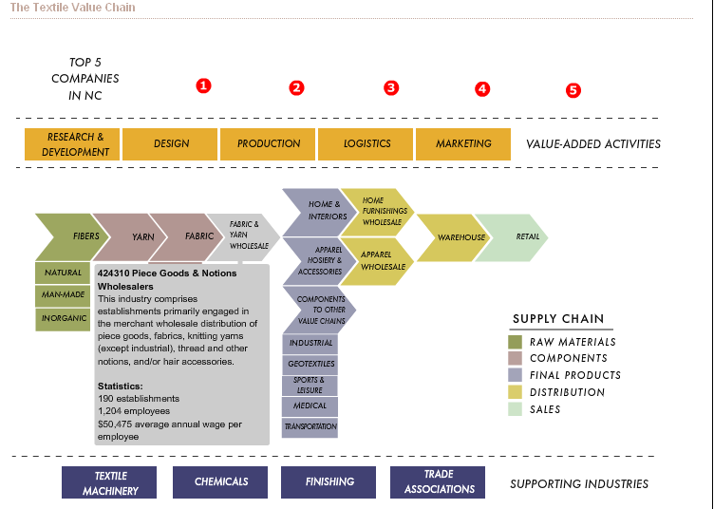
Textiles & Apparel: Interactive Value-Chain with Supporting Industries
Source: North Carolina in the Global Economy Project (http://www.soc.duke.edu/NC_GlobalEconomy/)

Slide 8
A typology of GVC governance structures
Based on an article by:
Gary Gereffi (Duke University), John Humphrey (Institute of Development Studies, Sussex), and Timothy Sturgeon (MIT),
“The governance of global value chains,”
Review of International Political Economy, 12(1) 2005: 78-104.
A summary of the GVC approach with related literature can be found at the
Global Value Chains Initiative website:
www.globalvaluechains.org

Slide 9
A Parsimonious Model: Three C’s
1. Complexity of information required for a transaction
2. Extent to which this information can be codified
3. Supplier capabilities in relation to a transaction’s requirements

Slide 10
Five GVC Governance Types
Low
High
Network org. forms

Slide 11
Five GVC Governance Types
Market
Modular
Relational
Captive
Hierarchy
End Use
Customers
Lead
Firm
Lead
Firm
Integrated
Firm
Lead
Firm
Value
Chain
Full-package
Supplier
Relational
Supplier
Price
Turn-key
Supplier
Component and Material Suppliers
Component and Material Suppliers
Suppliers
Captive Suppliers
Materials
Low
Degree of Explicit Coordination
High
Degree of Power Asymmetry

Slide 12
Dynamics in Global Value Chain Governance
① increasing complexity of transactions (harder to codify transactions; effective decrease in supplier competence)
② decreasing complexity of transactions (easier to codify transactions; effective increase in supplier competence)
③ better codification of transactions (open or de facto standards, computerization)
④ de-codification of transactions (technological change, new products, new processes)
⑤ increasing supplier competence (decreased complexity, better codification, learning)
⑥ decreasing supplier competence.(increased complexity, new technologies, new entrants)

Slide 13
Linking GVC governance to global trade
UNCTAD estimated the relevant proportion of global trade in each governance type:
Intra-firm trade by MNCs (hierarchies) -- 1/3
Inter-firm trade within GVCs -- 1/3
Open market trade -- 1/3
UNCTAD, World Investment Report 1999: Foreign Direct Investment and the Challenge of Development, New York & Geneva, 1999, p. xix.

Slide 14
Key research questions
Can existing data on global trade be used to track these 3 types of GVC governance in a more detailed fashion over time?
How can the GVC framework be applied to trade in services as well as goods?
How can we link multiple governance structures and economic upgrading in GVCs?
What are the policy issues and data challenges for each type of GVC governance (markets, networks, and hierarchies)?

Slide 17
Multiple Governance Structures Within the Offshore Services Value Chain

Slide 18

China assembles all iPods, but it only gets about $4 per unit – or just over 1% of the US retail price of $300
451 parts that go into the iPod
Hard Drive by Toshiba → Japanese company, most of its hard drives made in the Philippines and China; it costs about $73 - $54 in parts and labor -- so the value that Toshiba added to the hard drive was $19 plus its own direct labor costs
Video/multimedia processor chip by Broadcom→ American company with manufactures facilities in Taiwan. This component costs $8.
The retail value of the 30-gigabyte video iPod that the authors examined was $299 in
June, 2007
Controller chip by Portal Player→ American company with manufactures .This component costs $5 .
Final assembly→ done in China, costs only about $4 a unit
The unaccounted-for parts and labor costs involved in making the iPod came to about $110
The largest share of the value added in the iPod goes to enterprises in the United States→ $163 of the iPod’s $299 retail value in the United States was captured by American companies and workers, breaking it down to $75 for distribution and retail costs, $80 to Apple, and $8 to various domestic component makers.
The bulk of the iPod’s value is in the conception and design of the iPod. That is why Apple gets $80 for each of these video iPods it sells, which is by far the largest piece of value added in the entire supply chain. Apple figured out how to combine 451 mostly generic parts into a valuable product.
Source: Varian, Hal R. The New York Times, June 28, 2007. An iPod Has Global Value. Ask the (Many) Countries That Make It.

Slide 19
MNC intra-firm trade
POLICY ISSUE:
  Governments want to know which MNCs are operating in which markets, and which industries they are involved in
DATA ISSUES:
  Linking trade and production data to track where MNCs have national production facilities for different major industries and their national origins
  Currently, the data provided by the U.S. Census Bureau can't be disaggregated easily by industry or tracked over time.

Slide 20
GVC inter-firm trade
POLICY ISSUES:
  Problems in interpreting trade imbalances with current trade data based on a single country-of-origin
  Statistics in value-added terms can provide a more reliable way of seeing how trade affects employment
DATA ISSUES:
  Measuring value-added in “vertically specialized” supply chains,” particularly in (a) different phases of processing; (b) services involved in goods production
  Linking trade and production data (a) without using input-output tables; (b) at the same level of product specificity

Slide 21
Open market trade
POLICY ISSUES:
  The role of large international traders and 3rd-party logistics providers in controlling open trade
  Increased emphasis on the role of the private sector in
  “Aid for Trade” initiatives
  Policies needed to strengthen infrastructure for open market trade, esp. to get developing countries more involved in this market
DATA ISSUES:
  Separating “coordinated trade” from “open market” trade
  Measuring the size and flow of “spot market” trade (e.g., oil, grains, cut flowers)

Slide 22

Thank you
for your attention!
Gary Gereffi, Director, CGGC
Duke University
Center on Globalization, Governance & Competitiveness
ggere@soc.duke.edu

