Slide 1
Towards measuring trade in value-added and other indicators of global value chains: Current OECD work using I/O tables
Bo Meng (OECD and IDE-JETRO) & Sébastien Miroudot (OECD)
Global Forum on Trade Statistics, Geneva, 2-4 February 2011

Slide 2
Background
Reduction of transaction costs and changing global demand structures
↓
Increasing fragmentation of production, vertical specialisation (VS) trade and new firm strategies
“At least half of the observed increase in world trade can be explained by means of a model of world trade that incorporates vertical specialisation.”(Yi, 2003)

Slide 3
Fragmentation of production: the example of the Boeing 787 Dreamliner
Wing box: Mitsubishi Heavy Industries (Japan)
Wing ice protection: GKN Aerospace (UK)
Forward fuselage:
Kawasaki Heavy Industries (Japan)
Spirit Aerosystems (USA)
Centre fuselage: Alenia Aeronautica (Italy)
Rear fuselage:
Boeing South Carolina (USA)
Escape slides: Air Cruisers (USA)
Vertical Stabiliser: Boeing
Commercial Airplanes (USA)
Doors & windows:
Zodiac Aerospace (USA)
PPG Aerospace (USA)
Lavatories:
Jamco (Japan)
Flight deck seats:
Ipeco (UK)
Raked wing tips: Korean Airlines
Aerospace division (Korea)
Flight deck controls:
Esterline (USA),
Moog (USA)
Horizontal Stabiliser:
Alenia Aeronautica (Italy)
Engines: GE Engines (USA),
Rolls Royce (UK)
Aux. power unit: Hamilton
Sundstrand (USA)
Centre wing box:
Fuji Heavy Industries (Japan)
Engine nacelles: Goodrich (USA)
Passenger doors:
Latécoère Aéroservices (France)
Tools/Software: Dassault Systemes (France)
Navigation: Honeywell (USA)
Pilot control system: Rockwell Colins (USA)
Wiring: Safran (France)
Landing gear: Messier-Dowti (France)
Electric brakes: Messier-Bugatti (France)
Tires: Bridgestone Tires (Japan)
Cargo doors: Saab (Sweden)
Prepreg composites:
Toray (Japan)
Final assembly: Boeing
Commercial Airplanes (USA)
Source: www.newairplane.com

Slide 4
Policy concerns
Traditional international trade statistics do not adequately describe current trade flows nor allow full understanding of the nature and impact of economic globalisation whether in terms of income or employment.
When a good (or service) crosses borders several times at different stages of processing, conventional trade statistics record each time the full value of the good, including embodied (imported) intermediate inputs.
Leads to “multiple-counting”
Tends to hide actual patterns of trade among countries as the economy producing the final good seems to export the whole value when in reality it may have only marginally contributed to this value.
What can we do?
New indicators to assess the impact of vertical specialisation on trade and to understand international production networks.
Measuring the value-added content of trade and calculating the contribution of each economy to the global value chain.

Slide 5
Measuring trade in value-added: policy implications
A new perspective on trade can change the way we deal with the following issues:
Trade imbalances: reallocation of bilateral trade deficits and surplus across partner countries
Trade disputes: who are “them” and “us” once domestic value-added in foreign products has been accounted for?
Trade and macro-economic shocks: size of the 2008-2009 trade collapse and transmission of the crisis through trade channels.
Trade and employment: where are jobs created and lost in global value chains?
Trade and environment: impact of trade on greenhouse gas emissions.
Trade in gross and value-added terms: two complementary approaches.
Gross flows: global imbalances, expenditures (consumers’ perspective), link to monetary aspects.
Value-added flows: bilateral imbalances, global value chains (producers’ perspective), factor content of trade.

Slide 6
The iPhone example (Xing and Detert, 2010)
Components: $10.75
JPN
$60.6
$22.96
KOR
Apple sold 11.3 million iPhones in the US
in 2009
Retail price: $500.00
(Profit margin: 64%)
USA
CHN
$30.15
GER
$48.04
Assembly: $6.50
ROW
iPhone: $179.00
2009 US trade balance in iPhones (mio USD) | CHN | JPN | KOR | GER | ROW | World
Gross | -1,901.2 | 0 | 0 | 0 | 0 | -1,901.2
Value added | 48.1 | -684.8 | -259.4 | -340.7 | -542.9 | -1,901.2

Slide 7
How is OECD addressing the issue? Existing tools
OECD Input-output data
Symmetric industry by industry I/O tables (with separate tables for domestic flows and imports).
Data are available for OECD and major non-OECD economies (44 countries representing more than 95% of world GDP) and cover the years 1995, 2000 and 2005.
www.oecd.org/sti/inputoutput
Inter-country inter-industry model of 50 countries for 1995/2000/2005.
Bilateral trade by industry and end-use
Building ‘sustainable process’ for regular updates using ‘BEC method’ (BEC = Classification by Broad Economic Categories)
Conversions from all revisions of HS (88, 96, 02 , 07) to both BEC and ISIC have been developed.

Slide 8
Case studies
1) How does a country join GVCs? Looking at 3 factors.
Structural decomposition analysis of vertical specialisation
2) Is a single country-based framework effective?
International I-O based fragmentation indicator
3) Where and by which route value added is induced?
Spillover effect analysis using international I-O table

Slide 9
Case study 1: Vertical specialisation
Country 1
Intermediate goods
Capital
services
Country 2
Domestic intermediate goods
Domestic capital and labour
Intermediate and final goods
Domestic sales
Country 3
Exports of intermediate goods
Exports of final goods
VS share = induced intermediate imports / total exports
VSV share = induced value added / total exports

Slide 10
Case study 1: Vertical specialisation
Country 1
Intermediate goods
Capital
services
Country 2
Domestic intermediate goods
Domestic capital and labour
Intermediate and final goods
Domestic sales
Country 3
Exports of intermediate goods
Exports of final goods
VS share = induced intermediate imports / total exports
VSV share = induced value added / total exports

Slide 11
Case study 1: Vertical specialisation
Country 1
Intermediate goods
Capital
services
Country 2
Domestic intermediate goods
Domestic capital and labour
Intermediate and final goods
Domestic sales
Country 3
Exports of intermediate goods
Exports of final goods
VS share = induced intermediate imports / total exports
VSV share = induced value added / total exports

Slide 12
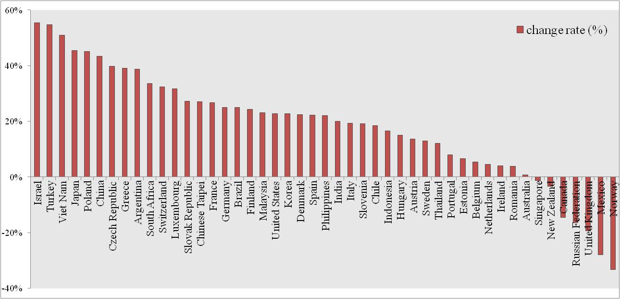
The change rate of VS share between 1995 and 2005

Slide 13
Structural decomposition analysis on vertical specialisation indicator
I-O based decomposition technique =>
∆VS share = f (∆m, ∆B, ∆e)
∆VSV share = f (∆v, ∆B, ∆e)
m: import dependency,
B: domestic inter-industrial production system,
e: export structure,
v: primary input dependency (value added ratio).

Slide 14
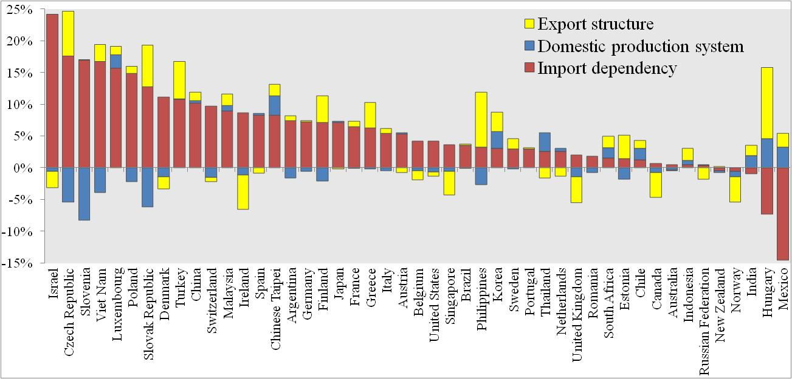
The decomposition result of the change in import contents of export (VS share)
Import dependency is the dominant factor for most countries

Slide 15
The decomposition result of the change in import contents of export (VS share)
Import dependency is the dominant factor for most countries

Slide 16
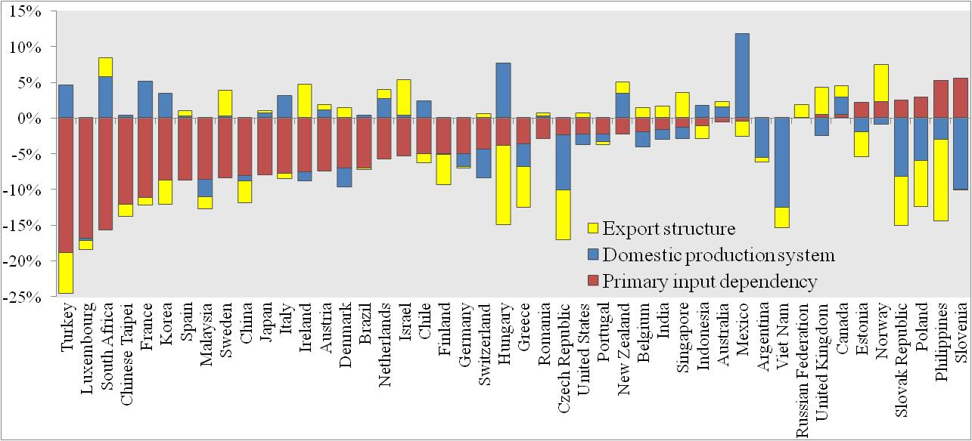
The decomposition result of the change in induced value added by export (VSV share)
Induced valued added of unit export has decreased for most countries

Slide 17
Value added induced by export grew much faster than value added itself, although value added induced by one unit export has decreased between 1995 and 2005.

Slide 18
Value added induced by export grew much faster than value added itself, although value added induced by one unit export has decreased between 1995 and 2005.

Slide 19
Case study 2: Fragmentation process in International I-O framework

Slide 20
Case study 2: Fragmentation process in International I-O framework

Slide 21
Case study 2: Fragmentation process in International I-O framework

Slide 22
Fragmentation process in International I-O framework

Slide 23
Decomposition of fragmentation process
Applying I-O based decomposition technique to the fragmentation measure:
Total Fragmentation degree = VS + IDF
VS: Conventional Vertical Specialisation indicator
IDF: Indirect Fragmentation Indicator (IDF)

Slide 24
Asian fragmentation index (1995/2005)

Slide 25
Case study 3: Where value added is induced and by what kind of production chain?
Based on international I-O model:
Induced value added by final demand (world GDP)
=V∙B∙F
=V∙(I+A¹+A²+A³+…+A^{n})∙F, n->∞
Supply chain crosses country’s border 3 times
Supply chain crosses country’s border 2 times
Supply chain crosses country’s border 1 time

Slide 26
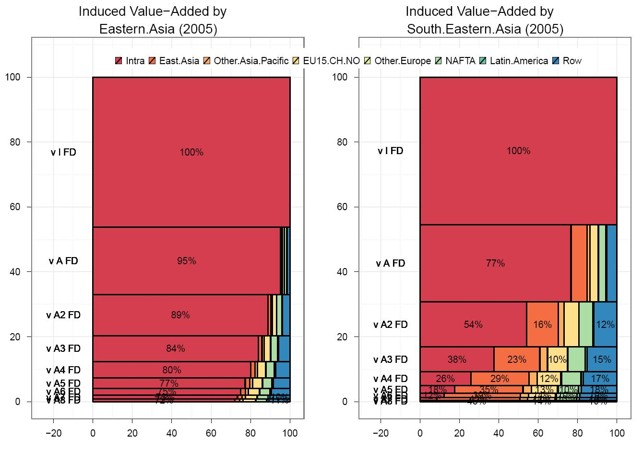
Production stages and VA spillover effects (2005)
Eastern Asia ASEAN6
ASEAN6: Indonesia, Malaysia, Philippines, Singapore, Thailand and Viet Nam
Eastern Asia: China, Chinese Taipei, Hong Kong, Korea and Japan

Slide 27
How is OECD addressing the issue? New work planned
2011-2012 project to measure trade in value-added:
1st step: Document on concepts, methodologies and challenges.
Major challenge is presenting results that can be easily understood and interpreted by non-practitioners of I/O modelling.
Co-operation with other organisations and projects – share ideas and compare results, minimise duplication of efforts.

Slide 28
Appendix1 IO based Factor decomposition technique
VS share = u∙m∙L∙EX/u∙EX = u∙m∙L∙e,
∆VS share=VS share¹ - VS share⁰=u(m¹∙L¹∙e¹ - m⁰∙L⁰∙e⁰)
= u∙∆m∙ (2L⁰∙e⁰ +2L¹∙e¹+ L⁰∙e¹+ L¹∙e⁰)/6
+ u∙ (2m⁰∙∆L∙e⁰ + 2m¹∙∆L∙e¹ + m⁰∙∆L∙e¹ + m¹∙∆L∙e⁰)/6
+ u∙ (2m⁰∙L⁰ + 2m¹∙L¹ + m⁰∙L¹ + m¹∙L⁰) ∙∆e /6.
∆m: the change in import dependency,
∆L: the change in domestic backward linkage,
∆e: the change in export structure.

Slide 29
Appendix 2 Decomposition of fragmentation process
Total intermediate trade (3-country international I-O model):
A X=A (I-A)⁻¹ F= A B F
Trade induced by country 1’s exports of final goods(EX¹_{fd}):
Ф1: VS based on single I-O table
Ф2: Indirect Fragmentation (IDF) index
Ф1 + Ф2: Total Fragmentation(TF) index
Ф3: induced intra-country transaction

