Slide 1
Physical Flow Accounting
UNSD SEEA Training of Trainers Seminar
July 7-10, 2014, New York
Joe St. Lawrence
Statistics Canada

Slide 2
“Beyond GDP”
“…we often draw inferences about what are good policies by looking at what policies have promoted economic growth; but if our metrics of performance are flawed, so too may be the inferences that we draw.”
Stiglitz, J.E., A. Sen, and J-P. Fitoussi, (2009), Report by the Commission on the Measurement of Economic Performance and Social Progress, p.7
www.stiglitz-sen-fitoussi.fr/documents/rapport_anglais.pdf
Notes:
Metrics of performance: not necessarily flawed, but at a different scope. Economy in isolation vs bigger picture.

Slide 3
The Economy
-Natural Resources
-Ecosystem Services
-Residuals
and The Environment
Stocks
The
Economy
Flows
Expenditures

Slide 4
System of Environmental-Economic Accounts (SEEA) view
Industries
Final demand
Assets
Sectors
Financial and produced assets, opening balance
Natural resource assets, opening balance
Natural resource assets, opening balance
Industrial output of goods and services
Industrial intermediate demand
Final demand
Gross fixed capital formation
Environmental protection expenditures
Environmental protection expenditures
Capital expenditures for environmental protection
Commodities
Resource production by industries
Resource production by households/gov’t
Resource use by industries
Resource use by households/gov’t
Waste consumption by industries
Waste consumption by households/gov’t
Wastes
Waste output by industries
Waste output by households/gov’t
Other changes in volume & holding gains/losses on financial & produced assets
Changes in and holding gains/losses on natural resource assets
Changes in natural resource assets
Sectors
Financial and produced assets, closing balance
Natural resource assets, closing balance
Natural resource assets, closing balance

Slide 5
Flow Accounting
United Nations, 2012, System of Environmental-Economic Accounting: Central Framework (white cover draft), New York. http://unstats.un.org/unsd/envaccounting/White_cover.pdf

Slide 6
Flow Accounting
United Nations, 2012, System of Environmental-Economic Accounting: Central Framework (white cover draft), New York. http://unstats.un.org/unsd/envaccounting/White_cover.pdf

Slide 7
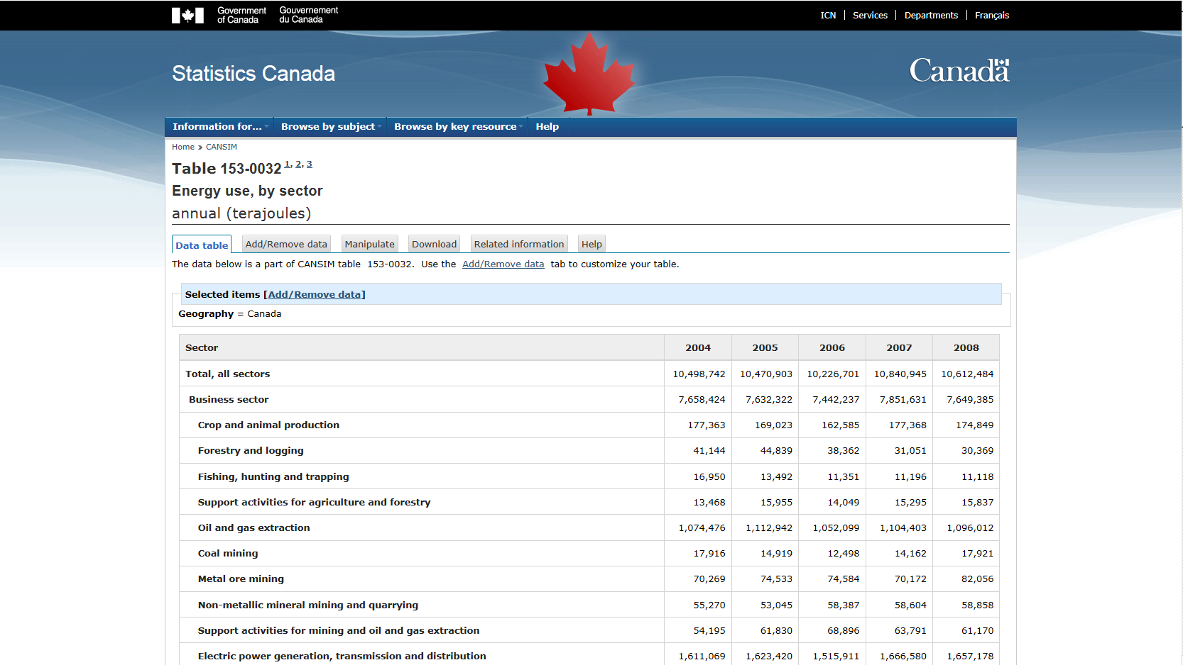
Energy Flow Accounting

Slide 8
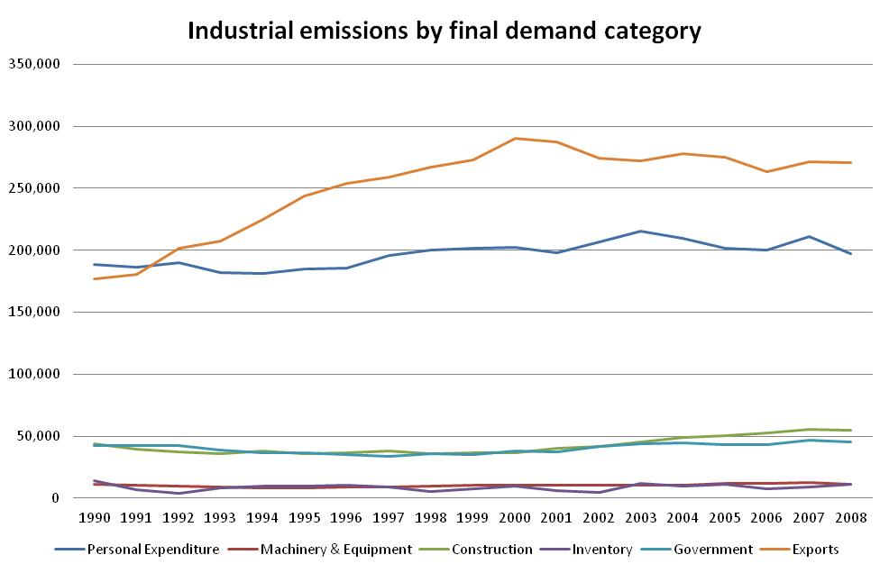
Residuals Flow Accounting

Slide 9
Demand-based perspectives

Slide 10
Questions?
Joe St. Lawrence
Environment Accounts and Statistics | Comptes et statistique de l'environnement
R.H. Coats Building | Immeuble R.-H.-Coats / Floor | Étage 25 M
Statistics Canada | 100 Tunney's Pasture Driveway, Ottawa ON K1A 0T6
Statistique Canada | 100, promenade Tunney's Pasture, Ottawa ON K1A 0T6
Joe.St.Lawrence@statcan.gc.ca
Telephone | Téléphone 613-951-7709
Facsimile | Télécopieur 613-951-0634
Government of Canada | Gouvernement du Canada

