Slide 1
Environmental activity accounts
Sjoerd Schenau

Slide 2
Content
What are environmental activity accounts ?
What is the EGSS ?
Application: the EGSS in the Netherlands
Exercise

Slide 3
Environmental activity accounts
Industries
Final demand
Assets
Sectors
Financial and produced assets, opening balance
Natural resource assets, opening balance
Natural resource assets, opening balance
Industrial output of goods and services
EGSS output
Industrial intermediate demand
Final demand
Gross fixed capital formation
Commodities
Environmental protection expenditures
Environmental protection expenditures
Capital expenditures for environmental protection
Resource production by industries
Resource production by households/gov’t
Resource use by industries
Resource use by households/gov’t
Wastes
Waste consumption by industries
Waste consumption by households/gov’t
Waste output by industries
Waste output by households/gov’t
Other changes in volume & holding gains/losses on financial & produced assets
Changes in and holding gains/losses on natural resource assets
Changes in natural resource assets
Sectors
Financial and produced assets, closing balance
Natural resource assets, closing balance
Natural resource assets, closing balance
Notes:
Highlight monetary transactions that may be considered environmental. These are already registered in core system of NA.
There can be organsied in separate acocunts with appropriate definitions and classifications

Slide 4
Scope and definition of environmental activities
The scope of environmental activities include those economic activities whose primary purpose is to reduce or eliminate pressures on the environment or to make more efficient use of natural resources.
Environmental protection
Resource management
Primary purpose criterion
Notes:
Usually, many activities are undertaken for a variety of purposes.
Only classified as environmentla activity as primary purpose is environmentla i.e. EP of RM.
Other ec activities that may be considered as related to the environment
Natural resource use activiities
Activities related with minimization of the impact of natural hazards on the economy (adaptation activities, flood protection etc).

Slide 5
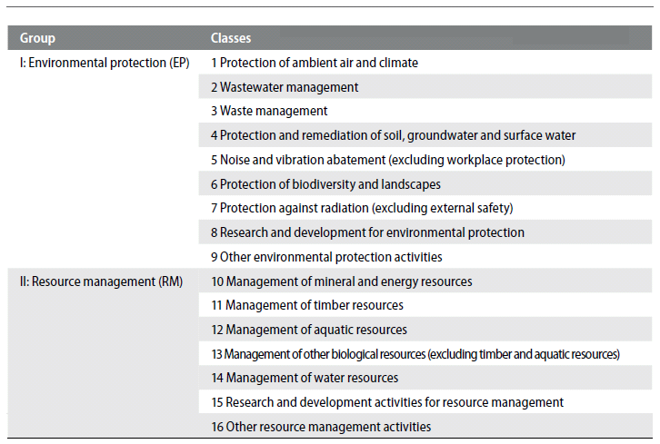
Classification of environmental activities
Notes:
CEA classification of environmental activities
Boundary issues

Slide 6
Environmental activity accounts in SEEA-CF
Environmental protection expenditure accounts (EPEA)
Environmental goods and service sector (EGSS)
Environmental taxes
Environmental subsidies and similar transfers
Environmental permits

Slide 7
Environmental goods and service sector: EGSS
Supply side of environmental activities → production of environmental goods and services
Aim: assessing the contribution of EGSS to the total economy and its employment potential
Key indicators:
Total production, total employment, total value added, total exports, total gross fixed capital
Europe: EGSS part legislation on Environmental accounts (Regulation No 691 )

Slide 8
Scope and definition
The EGSS consists of producers of all environmental goods and services →Thus, all products that are produced, designed and manufactured for purposes of environmental protection and resource management are within scope of the EGSS.
Environmental specific services, connected products, adapted goods and environmental technologies
‘Main purpose’ criterion (technical nature of product or activity / intension of the producer)
Notes:
Environmental protection (EP) includes all activities and actions which have as their main purpose the prevention, reduction and elimination of pollution and of any other degradation of the environment.
Resource management (RM) includes the preservation, maintenance and enhancement of the stock of natural resources and therefore the safeguarding of those resources against depletion.
In practice, the measurement of environmental sole-purpose products and adapted
goods relies on the development of lists of relevant goods and services. For sole-purpose
products, the purpose of goods or services is predominantly determined based on the technical
nature of the product and its technical suitability for use in environmental protection or
resource management. In certain boundary cases, where the technical nature of the product
does not provide a definitive guide, consideration may be given to the intent of the producer
of the product. For adapted goods, the lists are formed without reference to the primary purpose
of the good but are formed based on an assessment of whether, by virtue of its technical
nature, the good is environmentally friendly or cleaner.

Slide 9
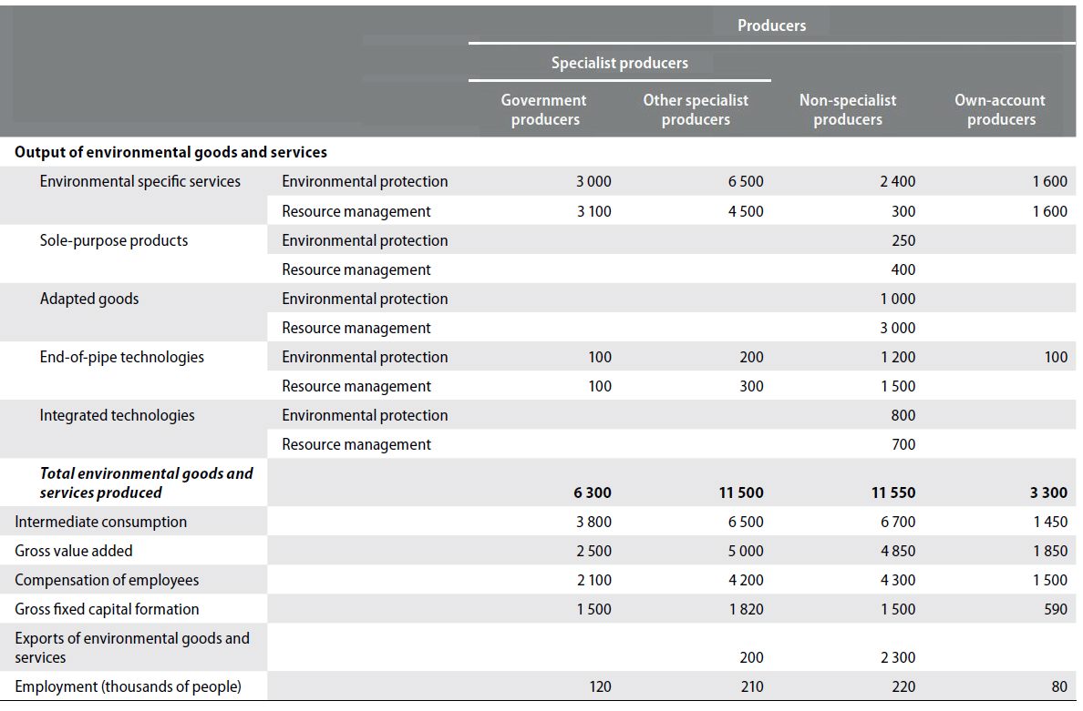
Table for the EGSS

Slide 10
EGSS in the Netherlands: Overview
Eight year experience in the field of EGSS
Work carried out in national accounts department, as part of environmental accounts work programme
Development in earlier years, statistic is since 2010 ‘in production’ (annual publication of data).
Work load: approximately 0,4 FTE every year.
Further development is still going on. Learning by doing aspect is very important. Every year methods are fine tuned and populations have been changed due to new insights.

Slide 11
Methodology: activity approach versus product approach
Product approach: → Identify environmental environmental goods and services in source data
Activity approach: → Identify environmental activities in source data
Data sources: surveys (new or already existing), statistics, SNA, external reports
Netherlands:
→Many different environmental activities have been identified by Statistics Netherlands as EGSS activities
→ For every activity a specific methodology has been developed in order to compile the data

Slide 12
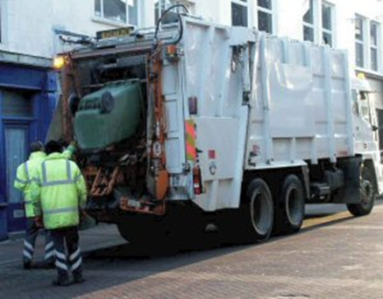
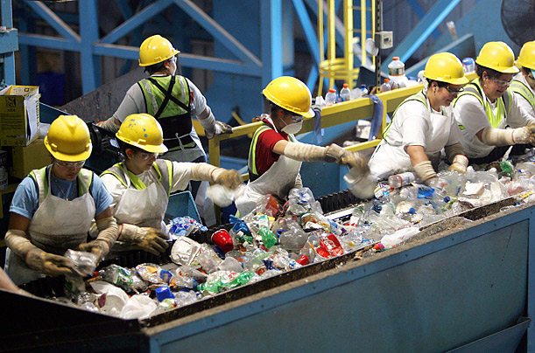
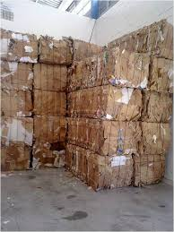
Overview: activites in EGSS (Netherlands)
Sewage and refuse disposal services (ISIC 37-39)
Recycling (ISIC 38.3)
Wholsale in waste and scrap

Slide 13
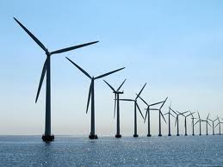
Overview: activites in EGSS (Netherlands)
Renewable energy production
Production of energy saving and sustainable energy systems
Insulation activities

Slide 14
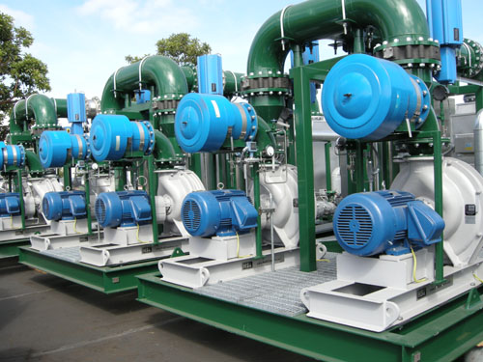
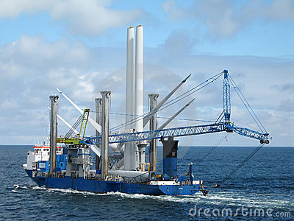
Overview: activites in EGSS (Netherlands)
Production of environmental equipment
Environmental advise, environmental engeneering
Environmental technical construcion

Slide 15
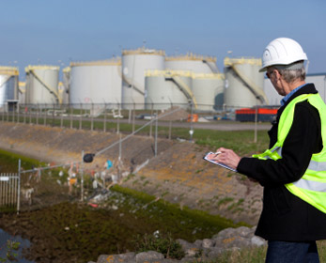
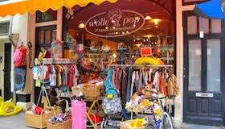
Overview: activites in EGSS (Netherlands)
Environmental related inspection
Second hand shops
Organic agriculture

Slide 16
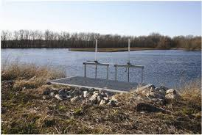
Overview: activites in EGSS (Netherlands)
Own account activities
Government governance related to the environment
Environmental non profit organisations
Environmental education

Slide 17
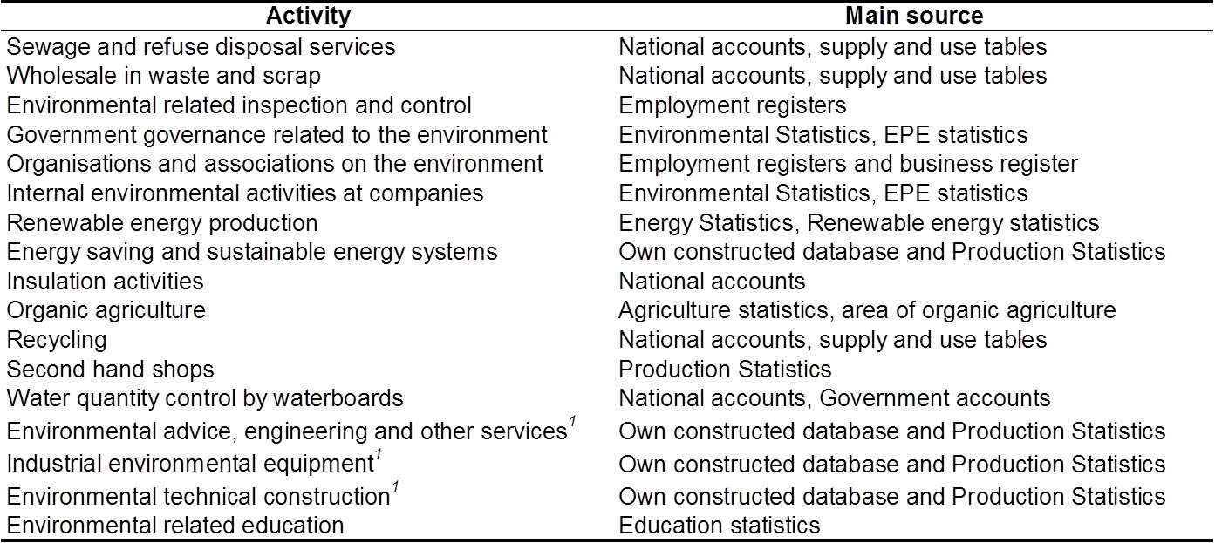
Many different data sources……..

Slide 18
Most important data sources
SNA data → environmental services
Own constructed data base of environmental companies plus production statistics (PRODCOM), international trade statsitics etc.
Government statistics
Agricultural statistics
Labour registers
EPEA

Slide 19
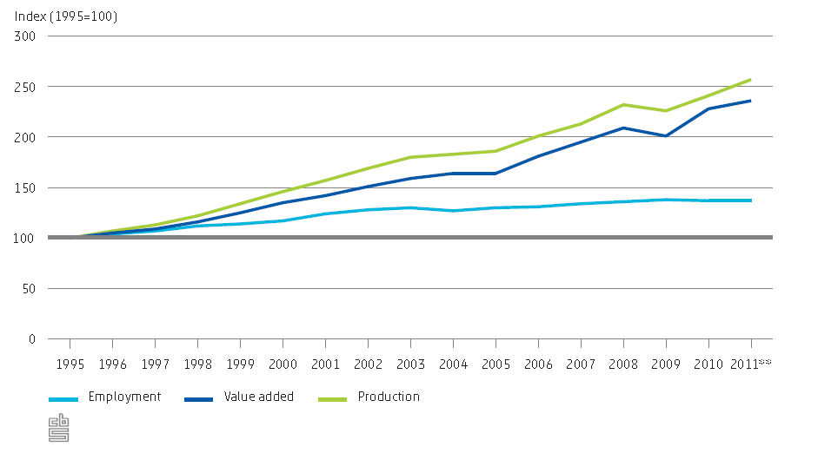
Employment, production and value added in the EGSS

Slide 20
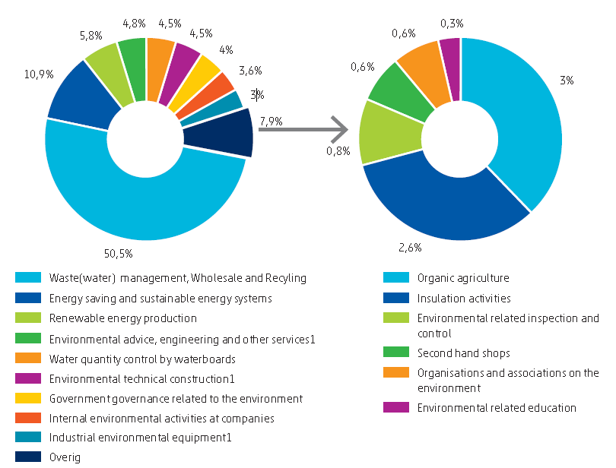
Distribution of value added EGSS over different activities, 2011
Notes:
In 2011 the EGSS, as share of the economy in terms of value added, constituted 2.4 percent
of the Dutch gross domestic product (GDP). This share hardly changed over 2010–2011. The
contribution to employment was 1.7 percent in 2010 and 2011. However, as Figure 6.4.6
shows, over the period 1995–2011 the employment share shows a pattern of sustained
growth, from 1.4 percent in 1995 to 1.7 percent in 2011. A similar increase holds for the
share of the EGSS in GDP, which has shown an upward trend from 2005 onwards. This
comes down to a contribution of 6 billion euros to Dutch GDP in 1995 and 82,000 fulltime
equivalents to total employment. In sixteen years this has risen to a contribution of
14.3 billion euros to GDP and 113,000 FTE to total employment in 2011.

Slide 21
Example: Monitor sustainable energy sector
The Ministry of Economic Affairs requested more detailed economic information on the sustainable energy sector
In spring 2011 Statistics Netherlands executed an in depth study on the sustainable energy sector.
Results will be updated every year and used for policy making and policy evaluation
2013: National energy agreement between government, industries, other stakeholders
2014: fist National energy report

Slide 22
Share of renewable energy (%)

Slide 23
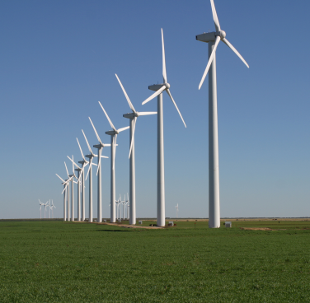
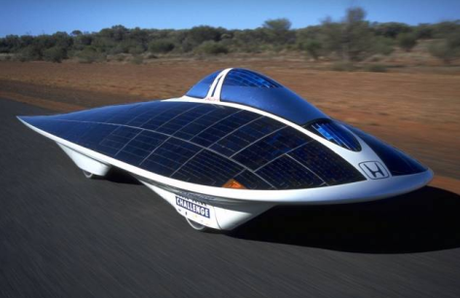
Scope: What is the sustainable energy sector ?
→ Energy related part part of the EGSS
The exploitation phase: The actual production
of renewable energy
The pre-exploitation phase: The companies that are active in the value chain that precedes the production of renewable energy
E.g.:
Production of solar panels
R&D aimed on sustainable energy technologies
Transport of wind turbines
Trade in solid biomass
Includes energy saving

Slide 24
Indicators
Employment (fte)
Monetary indicators (in current prices)
Gross value added = Production minus intermediate use
Production
Export and import
Investments
Innovation
Patent requests

Slide 25
Sustainable energy sector as part of the economy

Slide 26
Employment +13%
19100 fte
16900 fte

Slide 27
Employment per technology (pre-exploitation)

Slide 28
Some key issues…..
International comparison data
→ Scope
→ Methodology
→ Data sources
→ The more effort, the larger the EGSS ?
Cleaner goods / resource efficient goods
Integration in EPEA / ReMEA
Dissemination of the results

Slide 29
Questions ???

